Slide 1
Chapter 1: Introduction
Overview (pages 59--92):
what’s the Internet?
what’s a protocol?
network edge; hosts, access net, physical media
network core: packet/circuit switching, Internet structure
performance: loss, delay, throughput
protocol layers, service models
history
Introduction
1-<number>

Slide 2
Chapter 1: roadmap
  1.1 What is the Internet?
  1.2 Network edge
    end systems, access networks, links
  1.3 Network core
    circuit switching, packet switching, network structure
  1.4 Delay, loss and throughput in packet-switched networks
  1.5 Protocol layers, service models
  1.6 Networks under attack: security
  1.7 History
Introduction
1-<number>
Notes:
Then, we focus on packet-switched networks

Slide 3
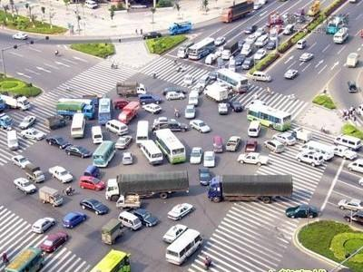
Why we need metrics?
To evaluate the performance of a system
Transportation system
  Cross-road traffic jam
  Delay, accident,
  vehicle traffic
Internet
  Congestion
  Delay, loss, throughput
Introduction
1-<number>

Slide 4

Delay and loss of a postal mail
Example of postal mail
Loss
Wrong address
Mistakes of postman and postal office
Delay
Time of processing the mail
Time of delivering the mail
Time of stopping at postal office
邮政网络：邮件，邮局，邮递员
上园村3号
北京交通大学
100044
Introduction
1-<number>
Notes:
Delay and loss can happen in any type of network.
Example of postal service network.
Loss
Delay

Slide 5

How do loss occur?
packets queue in router buffers
Loss when packet arrival rate to link exceeds output link capacity
Input = 2 arrivals > output = 1 left
  Analogy: # of mails > the max # that a postman can handle
A
One left
B
Two arrivals
Loss!
Introduction
1-<number>
Notes:
Queue = a line: sth or sb waiting in a line
Loss occurs when input > output

Slide 6
How do delay occur?
packets queue in router buffers
Every pkt has to wait for its turn
packet being transmitted (delay)
Time of transmitting the mail
A
B
Time before being sent
packets queueing (delay)
free (available) buffers
Introduction
1-<number>
Notes:
Every one has to wait for its turn to be served

Slide 7





Four types of packet delay (1/4)
北京
1. nodal processing:
  check bit errors
  determine output link
  ~processing time at postal office
A
上海
B
nodal
processing
Introduction
1-<number>
Notes:
Reading zip code of a mail

Slide 8
Four types of packet delay (2/4)
北京
2. queueing
  time waiting at output link for transmission
  depends on congestion level of router
  ~waiting time at postal office
A
上海
B
queueing
Introduction
1-<number>
Notes:
Reading zip code of a mail

Slide 9
Four types of packet delay (3/4)
北京
3. Transmission delay:
R=link bandwidth (bps)
L=packet length (bits)
time to send bits into link = L/R
~time of assigning mails to postman
transmission
A
上海
B
Introduction
1-<number>

Slide 10
Four types of packet delay (4/4)
北京
4. Propagation delay:
d = length of physical link
s = propagation speed in medium (~2x10⁸ m/sec)
propagation delay = d/s
~time of delivering a mail
A
propagation
上海
B
Note: s and R are very different quantities!
Introduction
1-<number>
Notes:
S is speed for distance, from A to B, 光速， fixed
R is speed for how fast you can draw pkts from queue on to the link, packet size， depends on router, it can change

Slide 11
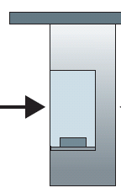

Caravan analogy
车队通过 Toll gate 收费站
100 km
100 km
ten-car
caravan
toll
booth
toll
booth
cars “propagate” at
100 km/hr
toll booth takes 12 sec to service car (transmission time)
car~bit; caravan ~ packet
Q: How long until caravan is lined up before 2nd toll booth?
Time to “push” entire caravan through toll booth onto highway = 12*10 = 120 sec
Time for last car to propagate from 1st to 2nd toll both: 100km/(100km/hr)= 1 hr
A: 62 minutes
Introduction
1-<number>
Notes:
1st car stops at the 2nd toll gate

Slide 12
Caravan analogy (more)
100 km
100 km
ten-car
caravan
toll
booth
toll
booth
Yes! After 7 min, 1st car at 2nd booth and 3 cars still at 1st booth.
1st bit of packet can arrive at 2nd router before packet is fully transmitted at 1st router!
Cars now “propagate” at
1000 km/hr
Toll booth now takes 1 min to service a car
Q: Will cars arrive to 2nd booth before all cars serviced at 1st booth?
Introduction
1-<number>

Slide 13
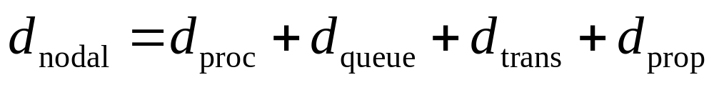
Nodal delay = delay at a node
d_{proc} = processing delay
  typically a few microsecs or less
d_{queue} = queuing delay
  depends on congestion
d_{trans} = transmission delay
  = L/R, significant for low-speed links
d_{prop} = propagation delay
  a few microsecs to hundreds of msecs
Introduction
1-<number>

Slide 14
Packet loss
丢包
aka = also known as
queue (aka buffer) preceding link in buffer has finite capacity
packet arriving to full queue dropped (aka lost)
lost packet may be retransmitted by previous node, by source end system, or not at all
buffer
(waiting area)
packet being transmitted
A
B
packet arriving to
full buffer is lost
Introduction
1-<number>
Notes:
Loss is much simpler

Slide 15
Throughput
吞吐量
throughput: rate (bits/time unit) at which bits transferred between sender/receiver
  instantaneous: rate at given point in time
  average: rate over longer period of time
  Inst. speed vs. avg. speed
link capacity
R_{s} bits/sec
link capacity
R_{c} bits/sec
server, with
file of F bits
to send to client
pipe that can carry
fluid at rate
R_{server} bits/sec)
pipe that can carry
fluid at rate
R_{client} bits/sec)
server sends bits
(fluid) into pipe
Introduction
1-<number>
Notes:
Then the 3rd metrics
Define rate and throughput，吞吐量

Slide 16
Throughput (more)
R_{server} < R_{client} What is average end-end throughput?
R_{s} bits/sec
R_{c} bits/sec
R_{s} > R_{c} What is average end-end throughput?
R_{s} bits/sec
R_{c} bits/sec
bottleneck link
link on end-end path that constrains end-end throughput
Introduction
1-<number>

Slide 17
Throughput: Internet scenario
R_{s}
per-connection end-end throughput: min(R_{c},R_{s},R/10)
in practice: R_{c} or R_{s} is often bottleneck
  Fiber >> cable
R_{s}
R_{s}
R
R_{c}
R_{c}
R_{c}
10 connections (fairly) share backbone bottleneck link R bits/sec
Introduction
1-<number>

Slide 18
Chapter 1: roadmap
  1.1 What is the Internet?
  1.2 Network edge
    end systems, access networks, links
  1.3 Network core
    circuit switching, packet switching, network structure
  1.4 Delay, loss and throughput in packet-switched networks
  1.5 Protocol layers, service models
  1.6 History
Introduction
1-<number>

Slide 19

What we like: organized
Introduction
1-<number>

Slide 20
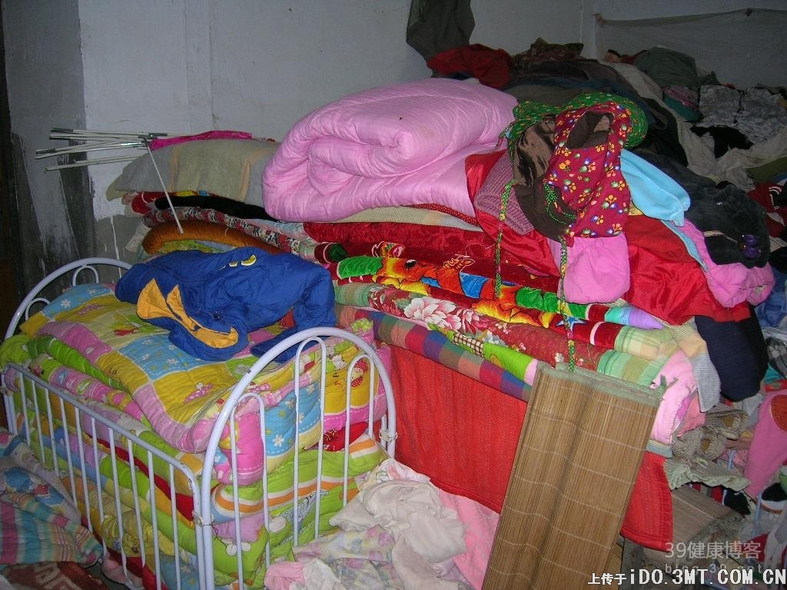
What we dislike: un-organized
Introduction
1-<number>
Notes:
A heap of clothes
disorder

Slide 21
Many pieces in memory
Networks are complex!
many “pieces”:
  hosts
  routers
  links of various media
  applications
  protocols
  hardware, software
  Delay, throughput
We’re
out of memory!
Introduction
1-<number>

Slide 22
Protocol “Layers”
Question:
Is that possible to organize the structure of network?
Introduction
1-<number>

Slide 23

Organization of air travel
ticket (purchase)
baggage (check)
gates (load)
runway takeoff
airplane routing
ticket (complain)
baggage (claim)
gates (unload)
runway landing
airplane routing
airplane routing
a series of steps
Introduction
1-<number>
Notes:
Tik at airline desk
Baggage
Gates
Takeoff by airline pilot
Routing by the on-ground controller center, to signal the plane via satellite.

Slide 24
Layering of airline functionality
ticket (purchase)
baggage (check)
gates (load)
runway (takeoff)
airplane routing
ticket (complain)
baggage (claim
gates (unload)
runway (land)
airplane routing
ticket
baggage
gate
takeoff/landing
airplane routing
airplane routing
airplane routing
departure
Airport
北京
intermediate air-traffic
control centers
arrival
Airport
底特律
东京
Layers: each layer implements a service
  via its own internal-layer actions
  relying on services provided by layer below
Introduction
1-<number>
Notes:
Boarding pass w/ a stamp of visa clear on it

Slide 25
Why layering?
Dealing with complex systems:
To clarify the relationship of complex system’s pieces
Easy maintenance of changes
  change to one layer does not affect rest of system
  e.g., change in gate procedure doesn’t affect rest of system
Introduction
1-<number>
Notes:
Easy for maintenance
Problem with ticket, wrong time, flight #
Problem with baggage, u lose ur baggage.
If u lose ur baggage, others can still fly.

Slide 26
Internet protocol stack
application: supporting network applications
  FTP, SMTP, HTTP
transport: process-process data transfer
  TCP, UDP
network: routing of datagrams from source to destination
  IP, routing protocols
link: data transfer between neighboring network elements
  PPP, Ethernet
physical: bits “on the wire”
传什么样数据？干什么事
application
transport
network
link
physical
从哪里到哪里？
需要确认吗？可靠传输？
途径哪些地方？
下一站是哪？
物理层具体怎么传数据？
（坐车还是坐船？）
Introduction
1-<number>

Slide 27
ISO/OSI reference model
presentation: allow applications to interpret meaning of data, e.g., encryption, compression, machine-specific conventions
session: synchronization, checkpointing, recovery of data exchange
Internet stack “missing” these layers!
  these services mostly are implemented in application layer
application
presentation
session
transport
network
link
physical
Introduction
1-<number>
Notes:
ISO - International Organization for Standardization
OSI是Open System Interconnect的缩写，意为开放式系统互联。国际标准组织（国际标准化组织）制定了OSI模型。
These two layers are integrated/included into the app layer.

Slide 28
Encapsulation
source
message
M
application
transport
network
link
physical
segment
H_{t}
M
H_{t}
datagram
H_{n}
H_{n}
H_{t}
M
frame
H_{l}
H_{n}
H_{t}
M
link
physical
switch
destination
H_{n}
H_{t}
M
network
link
physical
M
application
transport
network
link
physical
H_{l}
H_{n}
H_{t}
M
H_{n}
H_{t}
M
H_{t}
M
H_{n}
H_{t}
M
H_{l}
H_{n}
H_{t}
M
router
Introduction
1-<number>
Notes:
层层分解，越变越小
消息
数据段
数据包
数据帧
比特流

Slide 29
Chapter 1: roadmap
  1.1 What is the Internet?
  1.2 Network edge
    end systems, access networks, links
  1.3 Network core
    circuit switching, packet switching, network structure
  1.4 Delay, loss and throughput in packet-switched networks
  1.5 Protocol layers, service models
  1.6 History
Introduction
1-<number>

Slide 30
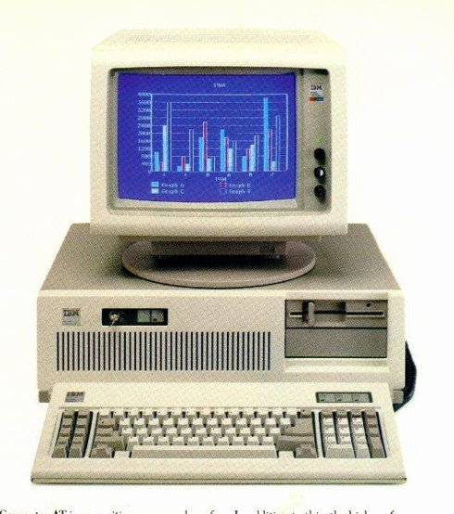
History of Internet in my life
Childhood
Unnamed computer
Unknown OS
Screen: green + black + gaming
No idea about computer science
Introduction
1-<number>

Slide 31
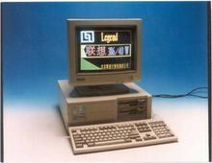
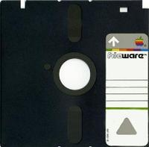
History of Internet in my life
Elementary school
386computer + DoS
  3 inche disk
  文字版三国志游戏
Computer science = install game on Dos
Introduction
1-<number>

Slide 32

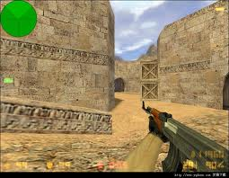
History of Internet in my life
Middle school
Internet bar + Windows
Computer science = CS = Play internet game
Introduction
1-<number>

Slide 33
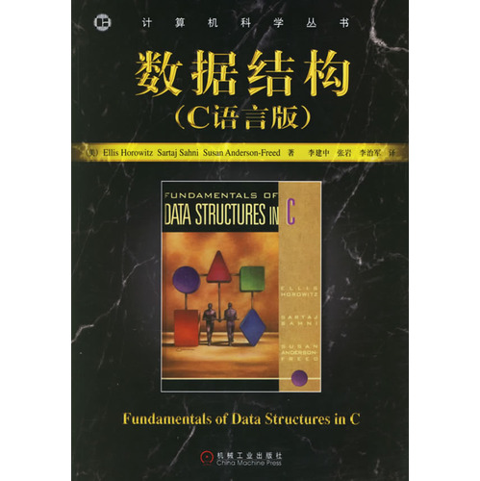
History of Internet in my life
Peking university
Computer science = = Internet + programming
Introduction
1-<number>

Slide 34



Internet and computer science in my life
Now
Computer science = Creative ideas + mathematics + programming
Internet?
Introduction
1-<number>

Slide 35

Internet History: pkt-switching
1961-1972: Early packet-switching principles
1961: Kleinrock - queueing theory shows effectiveness of packet-switching
1964: Baran - packet-switching in military nets
1967: ARPAnet conceived by Advanced Research Projects Agency
1969: first ARPAnet node operational
1972:
  ARPAnet public demonstration
  NCP (Network Control Protocol) first host-host protocol
  first e-mail program
  ARPAnet has 15 nodes
Introduction
1-<number>
Notes:
只能发包，发文件

Slide 36
Internet History: small networks
1972-1980: Internetworking, new and proprietary nets
1970: ALOHAnet satellite network in Hawaii
1974: Cerf and Kahn - architecture for interconnecting networks
1976: Ethernet at Xerox PARC
ate70’s: proprietary architectures: DECnet, SNA, XNA
late 70’s: switching fixed length packets (ATM precursor)
1979: ARPAnet has 200 nodes
Cerf and Kahn’s internetworking principles:
  minimalism, autonomy - no internal changes required to interconnect networks
  best effort service model
  stateless routers
  decentralized control
define today’s Internet architecture
Introduction
1-<number>
Notes:
小型联网，发包，发文件

Slide 37
Internet History: new protocols
1980-1990: new protocols, a proliferation of networks
1983: deployment of TCP/IP
1982: smtp e-mail protocol defined
1983: DNS defined for name-to-IP-address translation
1985: ftp protocol defined
1988: TCP congestion control
new national networks: Csnet, BITnet, NSFnet, Minitel
100,000 hosts connected to confederation of networks
Introduction
1-<number>
Notes:
定义不同类型的服务，发包，发文件

Slide 38
Internet History: web+apps
1990, 2000’s: commercialization, the Web, new apps
Early 1990’s: ARPAnet decommissioned
1991: NSF lifts restrictions on commercial use of NSFnet (decommissioned, 1995)
early 1990s: Web
  hypertext [Bush 1945, Nelson 1960’s]
  HTML, HTTP: Berners-Lee
  1994: Mosaic, later Netscape
  late 1990’s: commercialization of the Web
Late 1990’s – 2000’s:
more killer apps: instant messaging, P2P file sharing
network security to forefront
est. 50 million host, 100 million+ users
backbone links running at Gbps
Introduction
1-<number>
Notes:
互联网出现，是新的网络时代——应用极大丰富，用户数量急剧增长

Slide 39
Internet History: apps+wireless
2007:
~500 million hosts
Voice, Video over IP
P2P applications: BitTorrent (file sharing) Skype (VoIP), PPLive (video)
More novel applications: YouTube, gaming, facebook, twitter
wireless, mobility, apple store, android
2012:
# of sold mobile device > # of sold PC
10 Billion mobile devices
Introduction
1-<number>
Notes:
多媒体应用丰富，网页、无线、交互等技术促进互联网、物联网大发展

Slide 40
Introduction: Summary
Covered a “ton” of material!
Internet overview
what’s a protocol?
network edge, core, access network
  packet-switching versus circuit-switching
  Internet structure
performance: loss, delay, throughput
layering, service models
History: a new era has arrived
Introduction
1-<number>

