Slide 1

11.1HD – PIMA dataset
Hoang Long Tran (s223128143)

Slide 2
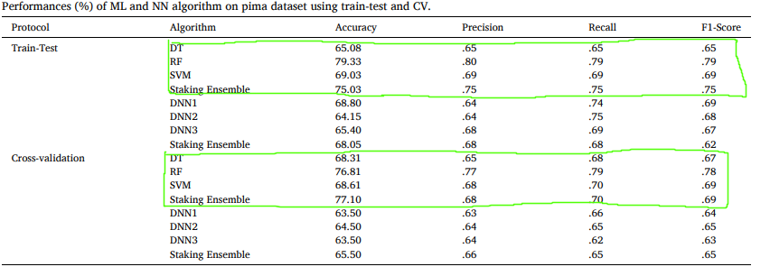
Article general information
Article on classify PIMA dataset (binary classification for type 2 diabetes disease patients) [2].
They preprocess data by using both z score and iqr to classify outliers. Then replace those outliers and missing values with median. Impute median to zero values for X. Use SMOTE for balancing labels.
Task sheet asks us to focus on ML and not DL.

Slide 3
My implementation of the article
Protocol | Algorithm | Accuracy | Precision | Recall | F1-Score
Train-Test | DT | 71.33% | 71.50% | 71.33% | 71.26%
 | RF | 78.33% | 78.54% | 78.33% | 78.29%
 | SVM | 79.33% | 79.66% | 79.33% | 79.27%
 | Stacking | 78.00% | 78.39% | 78.00% | 77.91%
Cross validation | DT | 71.67% | 71.67% | 71.67% | 71.66%
 | RF | 78.33% | 78.69% | 78.33% | 78.26%
 | SVM | 80.00% | 80.25% | 80.00% | 79.95%
 | Stacking | 78.00% | 78.39% | 78.00% | 77.91%
My implementation of the study has higher predictions on all of the models. This might be due to the combination of randomness and differences in outlier removal. The upper and lower boundary might bet different.

Slide 4
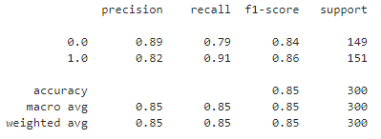
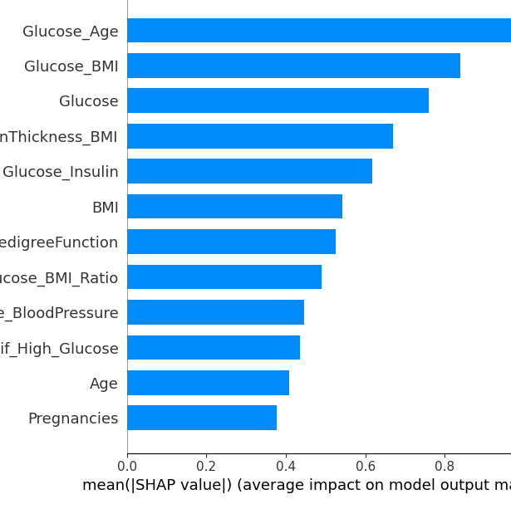
My solutions
Similar to the study, but don’t impute median values to ‘Pregnancies’ since 0 means they have not given birth.
Feature engineer based on “Glucose”
Gradient Boosted Tree has the highest predictions alongside Stacking.

Slide 5
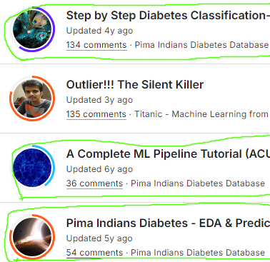
Compare with other notebooks on Kaggle [1]
The first notebook didn’t handle imbalanced dataset, and the highest model predicts 77% (model might be biased)
The second notebook has a sophisticated system to remove outliers, and the final model did 1% better than mine.
The third notebook has nice explanation for feature engineer but did not split the data into training and testing set, so models have high chance of overfit.

Slide 6
Conclusion
My solution is better than the study [2]
Compares to Kaggle [1] gold notebooks, mine did not bad.

Slide 7
References
[1] “Pima Indians Diabetes Database,” Kaggle. https://www.kaggle.com/datasets/uciml/pima-indians-diabetes-database
[2] Md Shamim Reza, R. Amin, R. Yasmin, Woomme Kulsum, and Sabba Ruhi, “Improving diabetes disease patients classification using stacking ensemble method with PIMA and local healthcare data,” Heliyon (Londen), vol. 10, no. 2, pp. e24536–e24536, Jan. 2024, doi: https://doi.org/10.1016/j.heliyon.2024.e24536.

