Slide 1
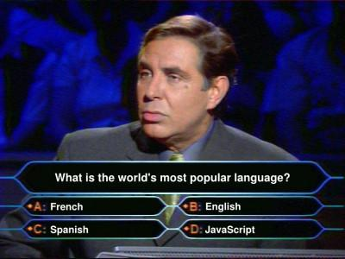

Advanced JavaScript

Slide 2
Agenda
Functions as a first class citizen in JavaScript
Understanding the apply/call methods
The context of this
Closures
Scopes
Object orientation with JavaScript
Debugging JavaScript

Slide 3
Functions are first-class objects in JS
In JavaScript, functions are first-class objects; that is, they coexist with, and can be treated like, any other JavaScript object.
created via literals
assigned to variables, array entries, and properties of other objects
passed as arguments to functions
returned as values from functions
contain functions with it
(source functions.js)

Slide 4
Closures/Functions are first-class objects in JS
And more than just being treated with the same respect as other objects types, functions have a special capability in that they can be invoked.
Invocation is frequently done in an asynchronous manner.

Slide 5
JavaScript Functions
What really happens when a function is called?
As it turns out, the manner in which a function is invoked has a huge impact the context of 'this'.

Slide 6
Functions (cont)
There are actually four different ways to invoke a function, each with their own nuances.
1. As a function, in which the function is invoked in a straightforward manner.
2. As a method, which ties the invocation to an object, enabling object-oriented programming.
3. As a constructor, in which a new object is brought into being.
4. Via their apply() or call() methods.
(include functions.js)

Slide 7
1. Invocation as a function
This type of invocation occurs when a function is invoked using the () operator.
Some simple examples:
  function ninja(){};
  ninja();
  var samurai = function(){};
  samurai();

Slide 8
2.) As a method, which ties the invocation to an object, enabling object-orientation
When a function is assigned to a property of an object and the invocation occurs by referencing the function using that property, then the function is invoked as a method of that object.
  var o = {};
  o.whatever = function(){};
  o.whatever();
NOTE: a function declared this way is considered anonymous..we are just assigning the annoymous function to a a member of the object o.

Slide 9
3. As a constructor, in which a new object is brought into being.
Invoking a function as a constructor is a powerful feature of JavaScript because when a constructor is invoked, the following special actions take place:
  A new empty object is created.
  This object is passed to the constructor as the this parameter, and thus becomes the constructor’s function context.
  In the absence of any explicit return value, the new object is returned as the constructor’s value.

Slide 10
A side note on constructors..
Functions and methods are generally named starting with a verb that describes what they do start with a lowercase letter.
  startCount();
Constructors on the other hand, are usually named as a noun that describes the object that’s being constructed, and start with an uppercase character;
  Ninja()

Slide 11
More on Instantiation
We’ve already noted that functions can serve a dual purpose: as “normal” functions, and as constructors. Because of this, it may not always be clear to users of our code which is which.
(source constructors.js)

Slide 12
4. Via their apply() or call() methods
So far, we've looked at the context of the 'this' parameter.
  For global functions, it is always window
  For methods, the method’s owning object
  For constructors, a newly created object instance.
But what if we wanted to make it whatever we wanted?
What if we wanted to set it explicitly?

Slide 13
Using the apply() and call() methods
JavaScript provides a means for us to invoke a function, and to explicitly specify any object we want as the function context. The way that we do this is through the use of one of two methods that exist for every function: apply() or call().
To invoke a function using its apply() method, we pass two parameters to apply():
  the object to be used as the function context, and an array of values to be used as the invocation arguments.
The call() method is used in a similar manner, except that the arguments are passed directly in the argument list rather than as an array.
(source apply-call.js)
(source apply-call2.js)

Slide 14
Arguments of a function
If there are a different number of arguments than there are parameters, no error is raised; JavaScript is perfectly fine with this situation, and deals with it as follows:
  If more arguments are supplied than there are parameters, the “excess” arguments are simply not assigned to parameter names.
  If there are more parameters than there are arguments, the parameters that have no corresponding argument are set to undefined.

Slide 15
Arguments of a function
And, very interestingly, all function invocations are also passed two implicit parameters:
  arguments and this.
All functions are implicitly passed this important parameter, which will give our functions the power to handle any number of passed arguments.
Even if we only define a certain number of parameters, we'll always be able to access all passed arguments through the arguments parameter.
(source apply-call.js)

Slide 16
This context of this
Whenever a function is invoked, 2 variables are always passed:
  arguments that were provided on the function call
  an implicit parameter named this
The this variable refers to an object that is implicitly associated with the function invocation and is termed the function context.

Slide 17
The context of this
The function context is a notion that those coming from OO languages such as Java will think that they understand – that this points to an instance of the class within which the method is defined. But beware!
Think of 'this' as the invocation context instead.
(source function-context.js)

Slide 18
Anonymous functions
Functions that are assigned to a variable and without a name is considered anonymous.
Functions can have a name when assigned to a variable
Name can be refereneced within the function (ie. for recursion).
(souce annoymous_functions.js)

Slide 19
Immediately Invoked Function Expressions
(function(){})()
The result of this code is an expression that creates, executes, and discards a function all in the same statement.
Additionally, since we're dealing with a function that can have a closure as any other, we also have access to all outside variables in the same scope as the statement. As it turns out, this simple construct, called an immediate function, ends up becoming immensely useful as we'll soon see.
(source iife.js)

Slide 20
IIFEs cont.
Let's see how IIFEs can solve a very common pitfall.
(source common-pitfalls.js)
This means that within the scope of each step of the for loop, the i variable is defined anew, giving the click handler closure the value that we expect.

Slide 21
Closures
A closure is the scope created when a function is declared that allows the function to access and manipulate variables that are external to that function.
Closures allow a function to access all the variables, as well as other functions, that are declared in the same scope within which the function itself is declared.

Slide 22
Uses of Closures
Private variables
A common use of closures is to encapsulate some information as a "private variable" of sorts – in other words, to limit their scope. Object-oriented code written in JavaScript is unable to use traditional private variables: properties of the object that are hidden from outside parties. However, using the concept of a closure, we can achieve an acceptable approximation.
(source closure.js)

Slide 23
JavaScript scoping
Scopes in JavaScript act somewhat differently than in most other languages whose syntax is influenced by C; namely, those that use braces ({ and }) as block delimiters. In most of such languages, each block creates its own scope; not so in JavaScript!
In JavaScript, scopes are declared by functions, and not by blocks.
(source scope.js)

Slide 24
JavaScript prototypes
All Javascript objects have an internal property called constructor.
The constructor property has a prototype property that points to the prototype object.
If you try to look up a key on an object and it is not found, JavaScript will look for it in the constructor's prototype. It will follow the “prototype chain” until it sees a null value. In that case, it returns undefined.
(source prototypes.js)

Slide 25
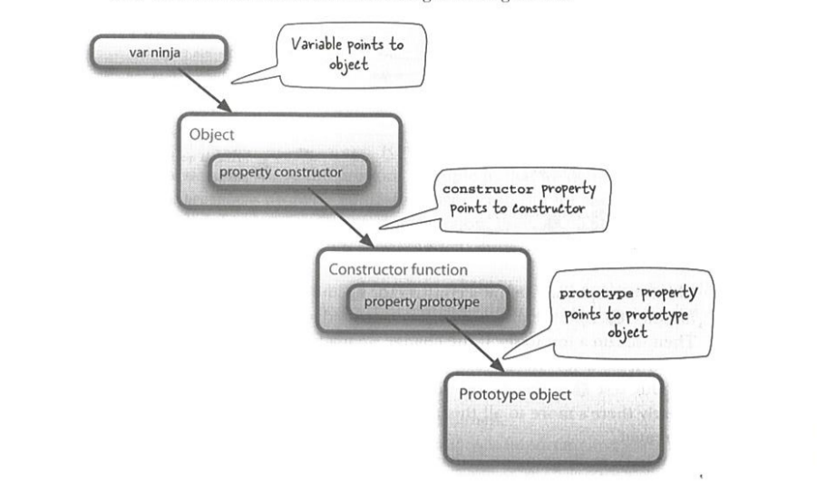
JavaScript Prototypes

Slide 26
Context for prototypes
Properties are bound to the object instance from the prototype.
This means the context of this defined in a function assigned to the protoype is bound to the object instance.

Slide 27
Inheritance with prototypes
Since every object has a prototype, you can actually change the pointer of the prototype property to point to something else, hence mimicking inhertiance.
(source prototypes2.js)

Slide 28
Advice: Try to use a library to help with object inhertiance
Mimicking object inhertiance yourself is clunky.
Have to set the prototype references yourself
Consider using a library such as prototypjs to help with object inhertiance.
http://prototypejs.org/

Slide 29
Finally, a note about semicolon insertion
JavaScript tries to be smart and inserts semicolons for you at the end of statements.
There are (complex-ish) rules where semi-colons are added for you.
My personal preference is to always insert semicolons yourself.
(semicolon-insertion.js)

Slide 30
Debugging JavaScript
For debugging JavaScript, I use the browser's web inspection tool to look at the execution.
  Can set breakpoints
  Unwrap minified code
  See ajax requests/responses
  Open the console to execute code

Slide 31
Unit Testing in JavaScript
Unit Testing is an integral part of software development
Our team uses the QUnit and Jasmine test frameworks for unit tests.
Let's take a look at how each works.
(unit-tests/qunit/qunit-unit-tests.html)
(unit-tests/jasmine/unit-tests.html)

Slide 32
Contact
Please contact me on email or IM if you have any questions: tochan@contractor.ea.com
Slides and notes are available:
  https://github.com/tommytcchan/presentations/tree/master/advanced-javascript

