Slide 1
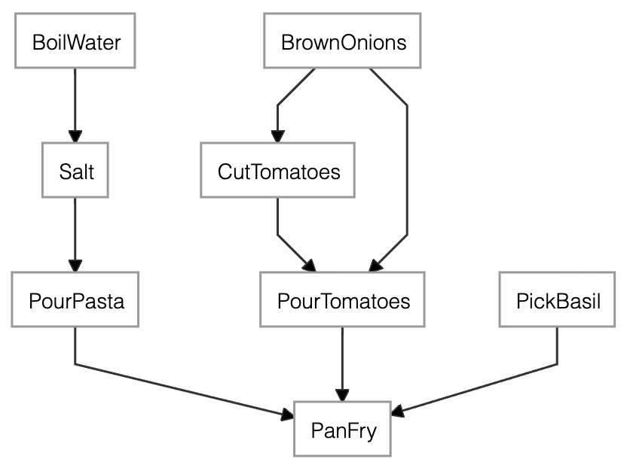
water = BoilWater()
brown_onions = BrownOnions()
cut_tomatoes = CutTomatoes(depends_on=brown_onions)
pour_tomatoes = PourTomatoes(depends_on=[cut_tomatoes, brown_onions])
salt_water = Salt(depends_on=water, name_alias="SaltWater")
salt_tomatoes = Salt(depends_on=pour_tomatoes, name_alias="SaltTomatoes")
pasta = PourPasta(depends_on=salt_water)
basil = PickBasil()
merge = PanFry(depends_on=[pasta, salt_tomatoes, basil])
head = merge
head.dependency_graph() # shows the image to the side
head.materialize() # run pipeline and return output

