Slide 1

CROP PRODUCTION ANALYSIS IN INDIA

Slide 2
BUSINESS PROBLEM :
Crop production is a common agricultural practice followed by worldwide farmers to grow and produce crops. On the other hand, agricultural business domain, as a vital part of the overall supply chain, is expected to highly evolve in the upcoming years via developments. This paper presents a business collaboration platform from agri-food sector perspective, which aims to facilitate the collaboration of numerous stakeholders belonging to associated business domains in an effective and flexible manner.
Based on the information the ultimate goal would be to analyze and predict crop production and find important insights highlighting key indicators and metrics that influence crop production.

Slide 3
KEY COMPONENTS OF THE PROJECT:
Through the presentation , we will explore-
Data Exploration : Understanding the structure and content of the dataset.
Analysis Techniques : Implementing various analysis techniques.
Visualization : Show the findings through charts, graphs, maps.
Interpretation : Interprete the result to have actionable insight.

Slide 4
OVERVIEW OF DATASET:
To check the data on crop production of India click here.
The data corresponds to the years 2000-2014.
State Name: Defines the name of states where the data of crop production is collected.
District Name: Shows the name of the district within the states from where the data if collected.
Crop Year: Defines the year of harvesting of crop.
Crop: The type of crop harvested for production.
Season: Season in which the crop grew and gave production.
Area: Total area of land used to harvest the crop.
Production: Total amount of production for the specific crop in the specific season and district.

Slide 5
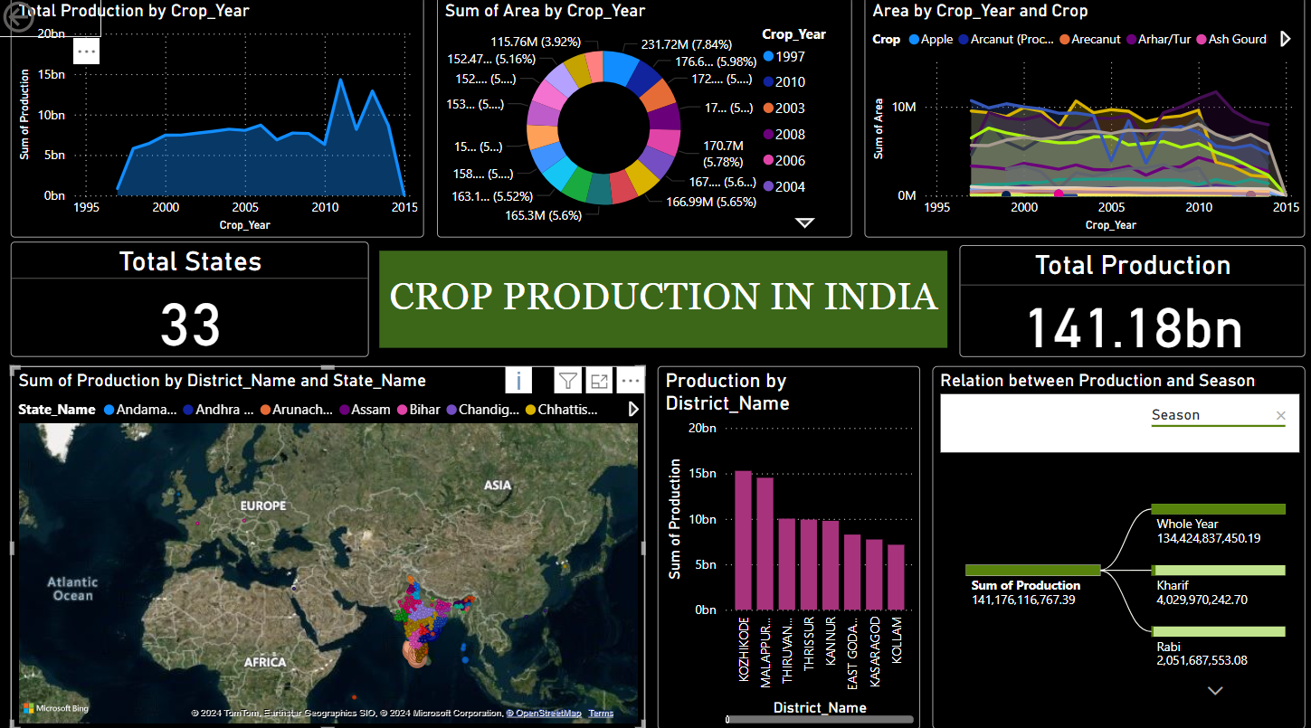
Power BI Dashboard

Slide 6
CONCLUSION:
Costal areas(Kerala, Tamil Nadu) have much more production than any other part of India.
33 states of India produces total of 141.18 bn of crops.
Production between 2010-2014 is highest.
Significant crops according to higher production: Rice, cotton.
Seasons with higher production: Kharif

Slide 7
THANK YOU

