Slide 1
Sign Alphabet Detection
CS 725 Project Presentation
Aastik(213050012)
Kashish Mittal(213050014)
Tushar Tomar(213050023)
Vatsal Dani(213050005)
Shivam Sangal(213050030)

Slide 2

Problem Description
Proposed Solution
It is a multi-class classification problem in which we have to classify the images containing alphabets in sign language.
To that end we built a CNN Model using tensorflow library, and used Tkinter for GUI to provide a clean interface to the user.

Slide 3

Motivation
The main motivation behind this project is to enable children with speaking disabilities to learn alphabets in sign language and help them better communicate with others.

Slide 4
Problems Faced
We used ASL Alphabet data (https://www.kaggle.com/grassknoted/asl-alphabet) to train our initial model.
Results obtained
95 percent train accuracy, 93 percent test accuracy
Poor performance in live environment
Reasons for poor live performance
Difference in image quality of train data and live data
Live images were of significantly lower quality

Slide 5
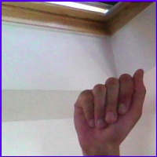
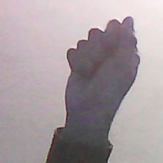
Difference in Live and Train Images
Sign for A in ASL Alphabet Dataset
Sign for A in Live Environment

Slide 6
Results for Custom Dataset
Custom data improved data set results
Train accuracy : 96 percentage
Test Accuracy : 93 percentage
Significantly higher live performance
Accuracies are different for different characters.

Slide 7

Characters with very little difference
Sign for A in ASL Alphabet Dataset
Sign for E in Live Environment

Slide 8
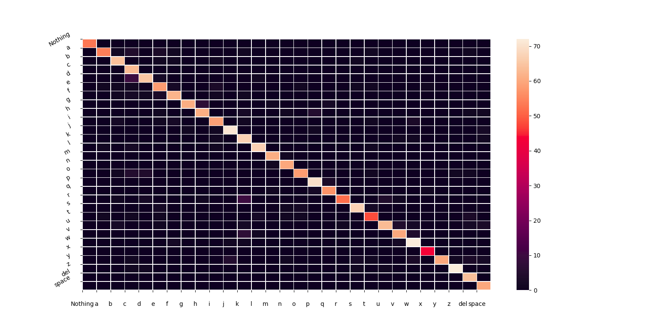
Confusion matrix Heatmap for Final model

Slide 9
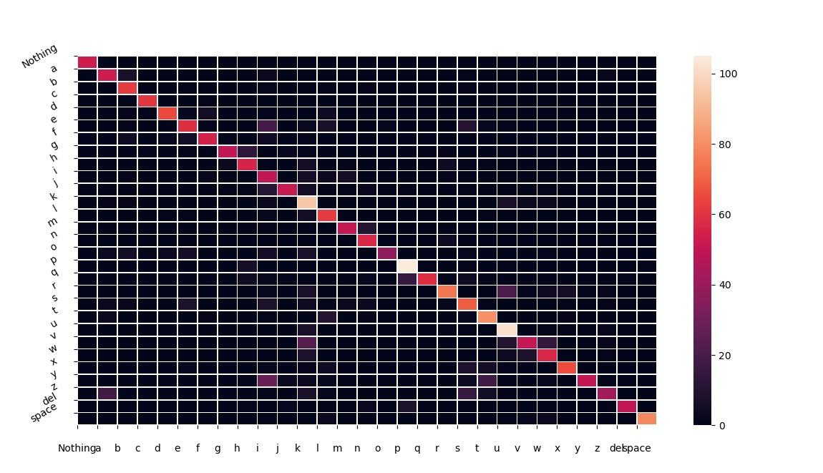
Confusion matrix Heatmap for Inferior model

Slide 10
Techniques Used in Experimentation
We experimented with different configurations of CNNs by changing hyperparameters like
Size of convolutional layers filters
Pooling layers (max-pooling / avg-pooling)
No. of hidden nodes
etc.

Slide 11
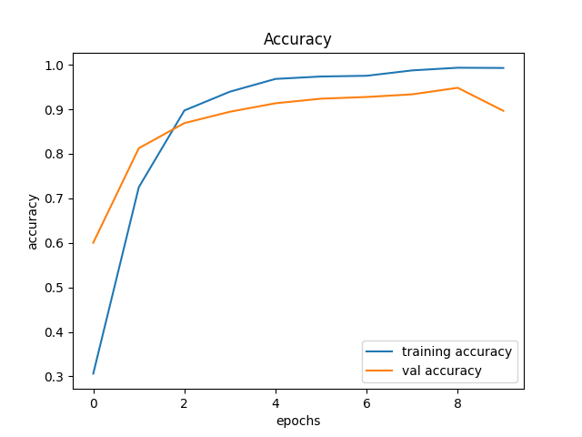
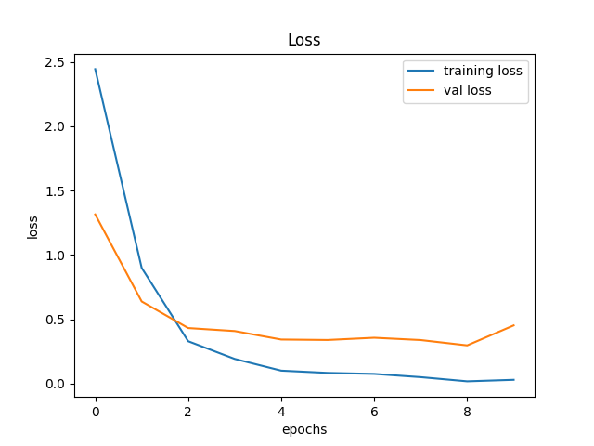
Training plots

Slide 12
Work distribution
Aastik’s Contribution:
Tkinter GUI
Custom Dataset Generation Tool
Kashish’s and Tushar’s Contribution
Result Analysis
Dataset preprocessing tool
Model experimentation
Vatsal’s and Shivam’s Contribution
Dataset generation
Plot generation
Dataset compiling
Team Efforts
PPT
Report
Final Testing of final tool

Slide 13
References
https://www.datacamp.com/community/tutorials/convolutional-neural-networks-python
Dataset: https://www.kaggle.com/grassknoted/asl-alphabet
https://stackoverflow.com/questions/42170411/tkinter-how-to-make-tkinter-text-widget-update
https://www.youtube.com/playlist?list=PLu0W_9lII9ajLcqRcj4PoEihkukF_OTzA
https://towardsdatascience.com/loading-custom-image-dataset-for-deep-learning-models-part-1-d64fa7aaeca6
https://stackoverflow.com/questions/33282368/plotting-a-2d-heatmap-with-matplotlib

Slide 14
Thank You!

