Slide 1
Lung Cancer Detection Using ML
Name- Vansh Tomar
Roll no- 2021517
Sec-E

Slide 2
Lung cancer is one of the leading causes of cancer-related deaths worldwide. Its detection and management are critical for improving survival rates. Here's an overview of its leading causes and the role of Machine Learning (ML) in early detection: Leading Causes of Lung Cancer *Smoking: Tobacco smoke contains carcinogens that damage lung cells. Smoking is responsible for approximately 80-90% of lung cancer cases. *Second-hand Smoke: Prolonged exposure to second-hand smoke increases lung cancer risk. Environmental Factors: Exposure to radon gas, air pollution, and industrial chemicals (e.g., asbestos) can contribute to lung cancer. *Genetics: Family history and genetic predisposition may play a role in some cases. *Occupational Hazards:

Slide 3
Machine Learning (ML) plays a transformative role in the early detection of lung cancer by leveraging data and advanced algorithms to identify patterns, predict outcomes, and improve diagnostic accuracy. Here's an in-depth look at how ML contributes to lung cancer detection: 1. Medical Imaging Analysis Medical imaging is a primary method for detecting lung abnormalities. ML enhances this process by improving accuracy and reducing diagnostic time. 2. Biomarker Identification Genetic and Molecular Data 3. Risk Prediction Models Personalized Risk Assessment Predictive Analytics

Slide 4
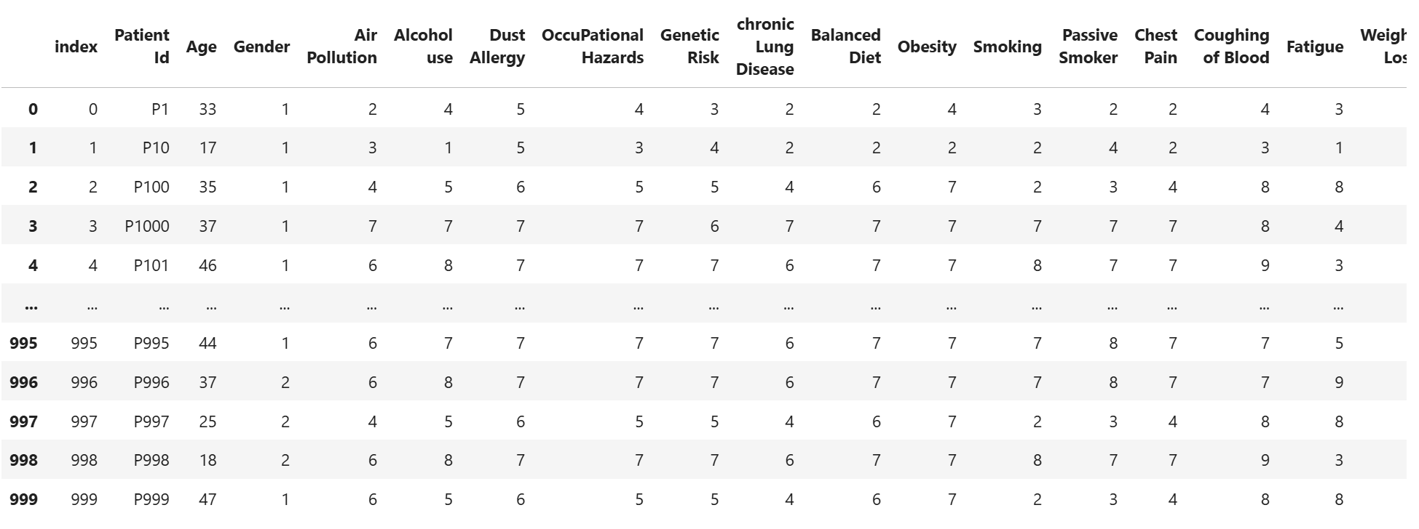
Dataset for model training- Collected from Kaggle

Slide 5
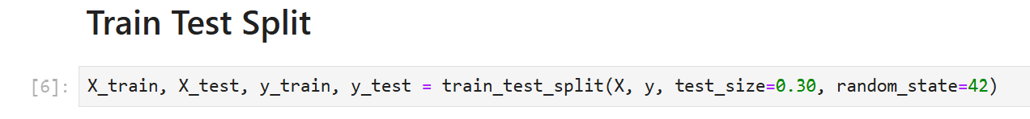
Technology Used The project is build using Python programming language, It provides an easy understanding and imported some Machine Learning libraries like sklearn (scikit-learn). For testing and building we have used jupyter notebook. Steps Involved 1. Collect Data – Obtain the dataset with feature (Age, Gender, Alcohol consumption, Smoking Habits, etc. 2. Data processing - Split Data -Divide the dataset into 3. Choose and Train a Machine Learning Model
Saturne possède plusieurs anneaux

Slide 6
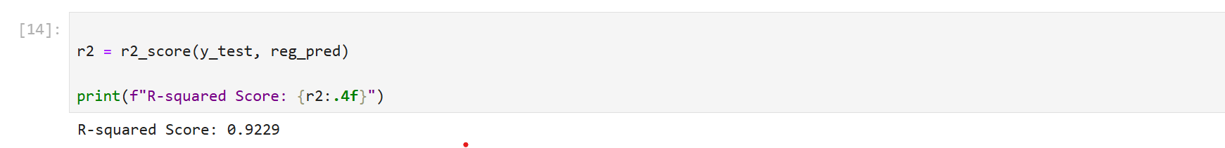
4. Evaluate the Model

Slide 7
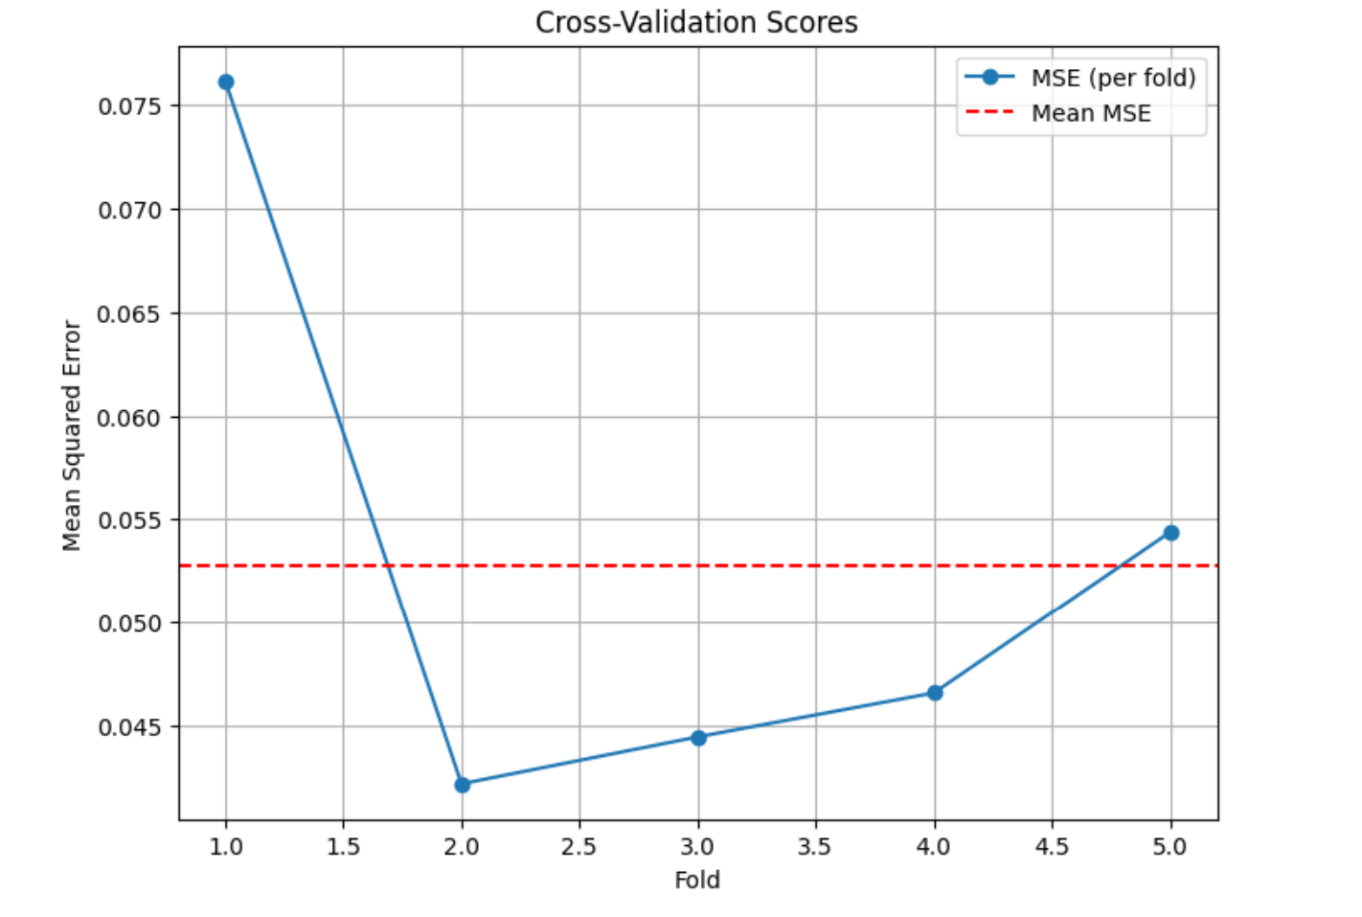
Result and Discussion

Slide 8
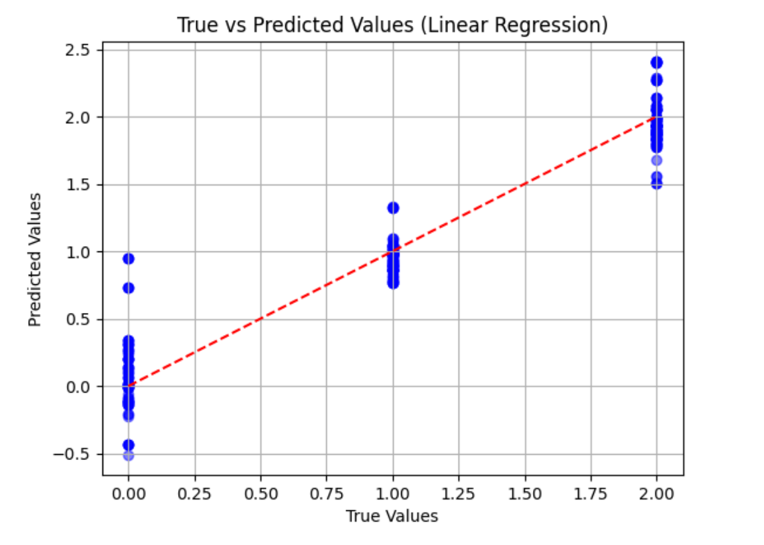
Linear Regression Graph

Slide 9
Conclusion
This project demonstrates that machine learning can be applied to predict lung cancer severity using clinical data. While the model performed well, further optimization and data enhancement could lead to better predictive power, especially in detecting high-severity cancer cases. The model could potentially assist healthcare professionals in prioritizing high-risk patients.

