Slide 1
TinyNet
Web
Browser
Internet
WindowsHost
Gateway
MailHost
WebServer
LDAPHost

Slide 2

TinyNet
Web
Browser
Internet
WindowsHost
Net A
Net C
Gateway
MailHost
Net A: 192.168.56.0 /24
Net B: 192.168.66.0 /24
Net C: 192.168.76.0 /24
Net B
We could label these
Net56, Net66, Net76
but what happens if we
change the subnetting?
WebServer
LDAPHost

Slide 3







TinyNet
Web
Browser
Internet
WindowsHost
Net A
Net C
Gateway
MailHost
Net A: 192.168.56.0 /24
Net B: 192.168.66.0 /24
Net C: 192.168.76.0 /24
Net B
We could label these
Net56, Net66, Net76
but what happens if we
change the subnetting?
WebServer
LDAPHost

Slide 4
With proper privileges, Windows Host could be configured to use DNSmasq for Name to IP
TinyNet
Web
Browser
Name To IP happens frequently
WindowsHost
Send Mail
URL
Deliver Mail
Gateway
MailHost
Person Lookup
Logical communication is direct, actual communication across subnets passes through the Gateway
WebServer
LDAPHost

Slide 5
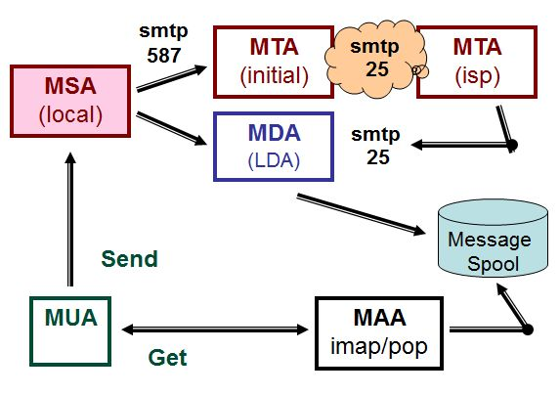
Mail - Abstract Architecture
in our setup, SquirrelMail is the MUA; Postfix on the Gateway is a MTA; Postfix on the Mailserver is the MSA when it receives mail from SquirrelMail and the MDA when it receives mail from Postfix on the Gateway; Dovecot on the MailServer is the LDA (called by Postfix for putting messages in mailboxes) and the MAA (imap server).
see 07-stunnel at www.my-tiny.net for more explanation

Slide 6
With proper privileges, Windows Host could be configured to use DNSmasq for Name to IP
TinyNet
Web
Browser
Name To IP happens frequently
Name
To IP
WindowsHost
Send Mail
Send
Mail
URL
Deliver Mail
Gateway
Access MailBox
MailHost
Person Lookup
Logical communication is direct, actual communication across subnets passes through the Gateway
WebServer
LDAPHost

Slide 7
With proper privileges, Windows Host could be configured to use DNSmasq for Name to IP
TinyNet
Web
Browser
Name To IP happens frequently
Name
To IP
WindowsHost
Send Mail
Send
Mail
URL
Deliver Mail
Gateway
Access MailBox
MailHost
Person Lookup
Logical communication is direct, actual communication across subnets passes through the Gateway
WebServer
LDAPHost

Slide 8

With proper privileges, Windows Host could be configured to use DNSmasq for Name to IP
TinyNet
Web
Browser
Name To IP happens frequently
Name
To IP
WindowsHost
Send Mail
Send
Mail
Deliver Mail
Gateway
Access MailBox
MailHost
Person Lookup
Logical communication is direct, actual communication across subnets passes through the Gateway
WebServer
LDAPHost

