Slide 1
Pizza di Noccatello
RequireJS meets MVVM

Slide 2

Problems with SP Applications:
Code complexity grows as the site gets bigger
Assembly gets harder
Dependency management gets harder
Developers want discrete JS files/modules
Deployment wants optimized code in just one or a few HTTP calls

Slide 3
There is a solution …

Slide 4

RequireJS
Manages your dependencies:
A module can be any text resource (JS, HTML, CSS ...)

Slide 5
RequireJS (Example)
KnockoutJS
(Module)
NavigationService
(Module)
HomeViewModel (Module)
define(["knockout", "navigationService"], function (ko, navService) {
var homeViewModel = {
...
};
return homeViewModel;
});

Slide 6

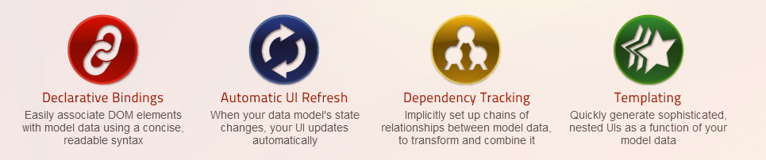
Managing UI with MVVM

Slide 7
Two-way data binding with Observables
Create:
var observable = ko.observable(optionalValue);
Get value:
var value = observable(); // call without arg
Set value:
observable(newValue); // call with arg

Slide 8
Three fundamental types
Single value: ko.observable()
var max = {
firstName: ko.observable(“Max”),
lastName: ko.observable(“Pecu”)
}
Collections: ko.observableArray()
max.likes = ko.observableArray([“Music”, “Hiking”, “Swimming”]);
Virtual values: ko.computed()
max.fullName = ko.computed(function() {
return max.firstName() + “ ” + max.lastName();
}); // re-evaluating when any referenced observable changes

Slide 9
Binding to the DOM
HTML:
<div id=“root”>
<input type=“text” data-bind=“value: firstName” />
<input type=“text” data-bind=“value: lastName” />
<ul data-bind=“foreach: likes”>
<li data-bind=“text: $data” />
</ul>
<p>Welcome, <span data-bind=“text: fullName” />!</p>
</div>
JavaScript:
var rootElement = document.querySelector(“#root”);
ko.applyBindings(rootElement, viewModel);

Slide 10
RequireJS: The JS Module Loader
Create and re-use modules without polluting the global namespace
Structure your code
Build for production
Load small resources on demand
Test with delight

Slide 11
Noccatello: The Big Picture
Views
(HTML)
ViewModels
(JS with KO)
Models
(Plain JS)
KnockoutJS
(+AMD)
Services
(Plain JS)
Server
RequireJS

Slide 12

View Composition
RequireJS
Knockout
(+AMD)
Knockout
(+AMD)
Load “basketViewModel.js”
Load “basketTemplate.html”
require „basket“
basket view

Slide 13
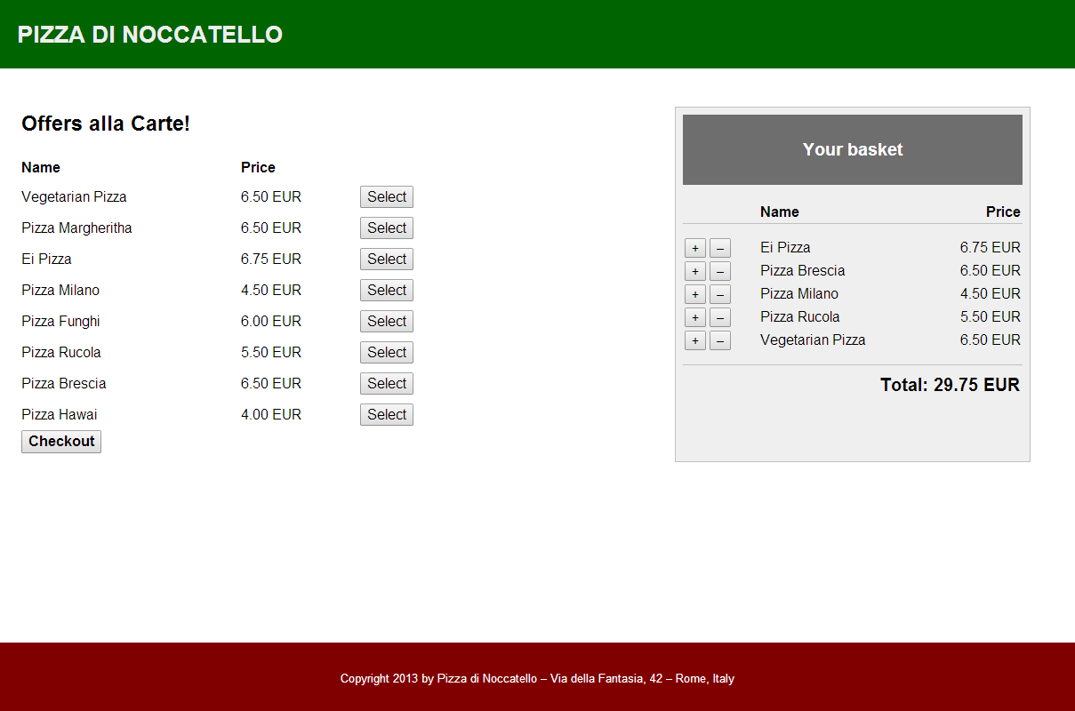
View Composition: Nested views

Slide 14
View Composition: Shell

Slide 15
View Composition: Shell (HTML)
<header>
<h1><a href="#/">Pizza di Noccatello</a></h1>
</header>
<section data-bind="module: currentModule, css: currentModule" />
<footer>
<p>
Copyright 2013 by Pizza di Noccatello &ndash;
Via della Fantasia, 42 &ndash;
Rome, Italy
</p>
</footer>

Slide 16
View Composition: Menu

Slide 17
View Composition: Menu (HTML)
<table data-bind="visible: !isEmpty()">
...
</table>
<button data-bind="enable: canGoToCheckout(), click: goToCheckout">
<b>Checkout</b>
</button>
<aside class="basketSection" data-bind="module: 'basketSection'" />

Slide 18
View Composition: Basket

Slide 19
View Composition: Basket (HTML)
<tbody data-bind="foreach: items">
<tr>
<td>
<button data-bind="click: $parent.cloneItem">+</button>
<button data-bind="click: $parent.removeItem">&ndash;</button>
</td>
<td>
<span data-bind="text: data.name"></span>
</td>
<td>
<span data-bind="text: data.price.toFixed(2)"></span>&nbsp;EUR
</td>
</tr>
</tbody>

Slide 20
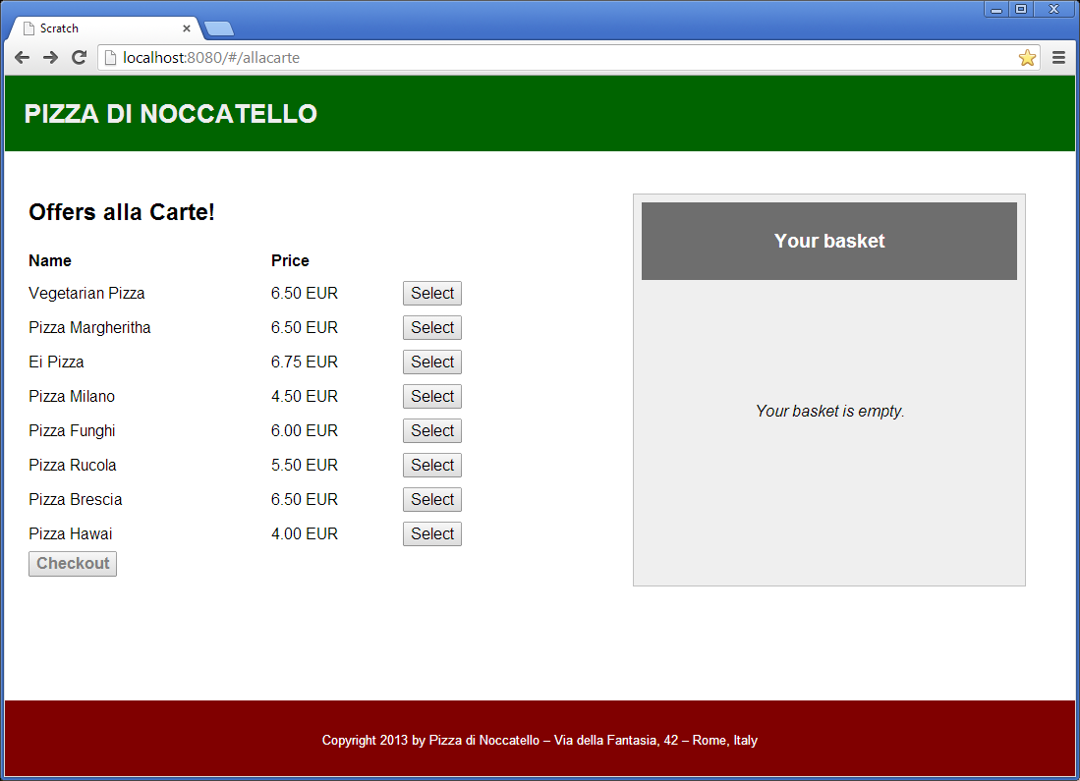
Declarative Navigation
Binding

Slide 21
Declarative Navigation (Code)
<section data-bind="module: currentModule, css: currentModule" />
// Mapping url path -> module:
var routes = {
"allacarte": "allaCartePage",
...
};
var shell = {
currentModule: ko.observable()
};
navigationService.addListener(function (path) {
shell.currentModule(routes[path.toLowerCase()]);
});

Slide 22
Managing Styles
shell.css
basket.css
allacarte.css
Build
Style “namespacing”:
.basket p {
// All paragraphs in basket …
}
main.css
(combined/minified)

Slide 23
Test: Easy module mocking
Module_D
Mock_D
Module_B
Module_C
Mock_B
Module_C
Squire
Module_A
Module_A
Module under test
Module under test
var squire = new Squire();
squire.mock("Module_B", { x: "Some mock value" });
squire.mock("Module_D", { y: "Some mock value" });
squire.require(["Module_A"], function (module_A) {
// Do something with module_A
});

Slide 24
Summary (1)
RequireJS Pros:
Favors revealing module pattern over classical prototype based development
Enforces modular software design
Mocking with Squire is pure delight
Choose between optimized bundles or lazy loading
Built-in versioning (over Querystring)
RequireJS Cons:
Modules do not reveal if they’re objects, functions or constructor functions
Build and test setup can be tricky when working with asynchrony

Slide 25
Summary (2)
KnockoutJS Pros:
Flat learning curve, very beginner-friendly
Good documentation
Active community providing many examples, plugins etc.
Does play very nicely with RequireJS
Automatic lazy loading of templates
Pure, static HTML5 (no custom elements/attributes)
Browser plugin for Chrome to inspect bindings/view models
KnockoutJS Cons:
No plain old JS objects (when 2-way binding is required)
View models can get relatively complex

Slide 26
Summary (3)
Other Pros:
RequireJS/KnockoutJS are specialized frameworks. They do not try to cover everything and get out of your way.
Free choice of other JS libraries (e.g. for AJAX)
Other Cons:
Not using an all-in-one-framework means you have to take care of the application structure for yourself.

