Slide 1


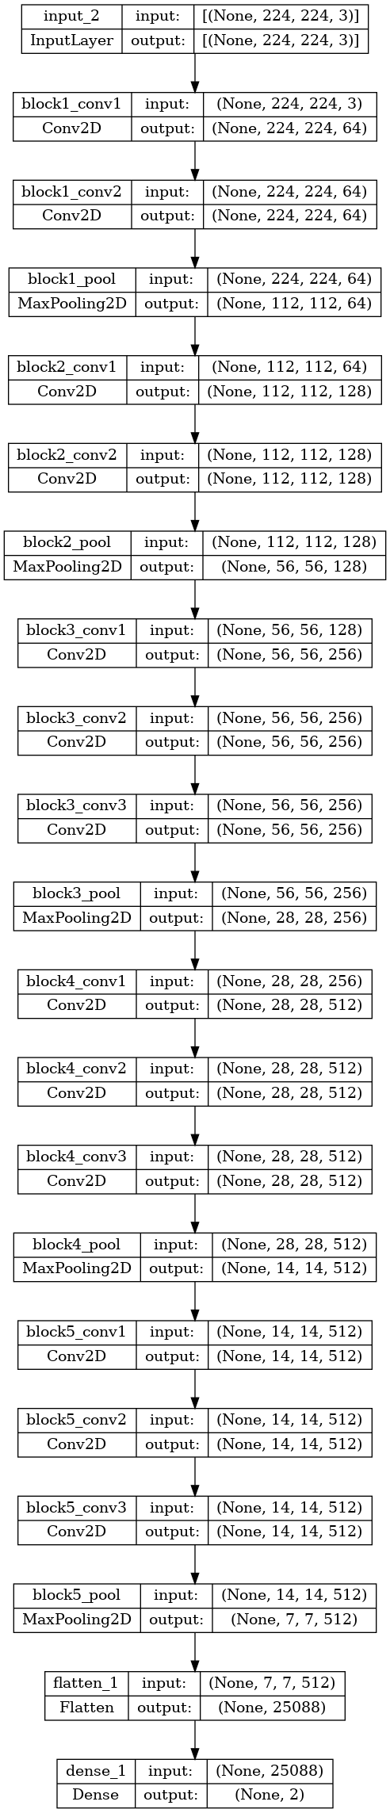

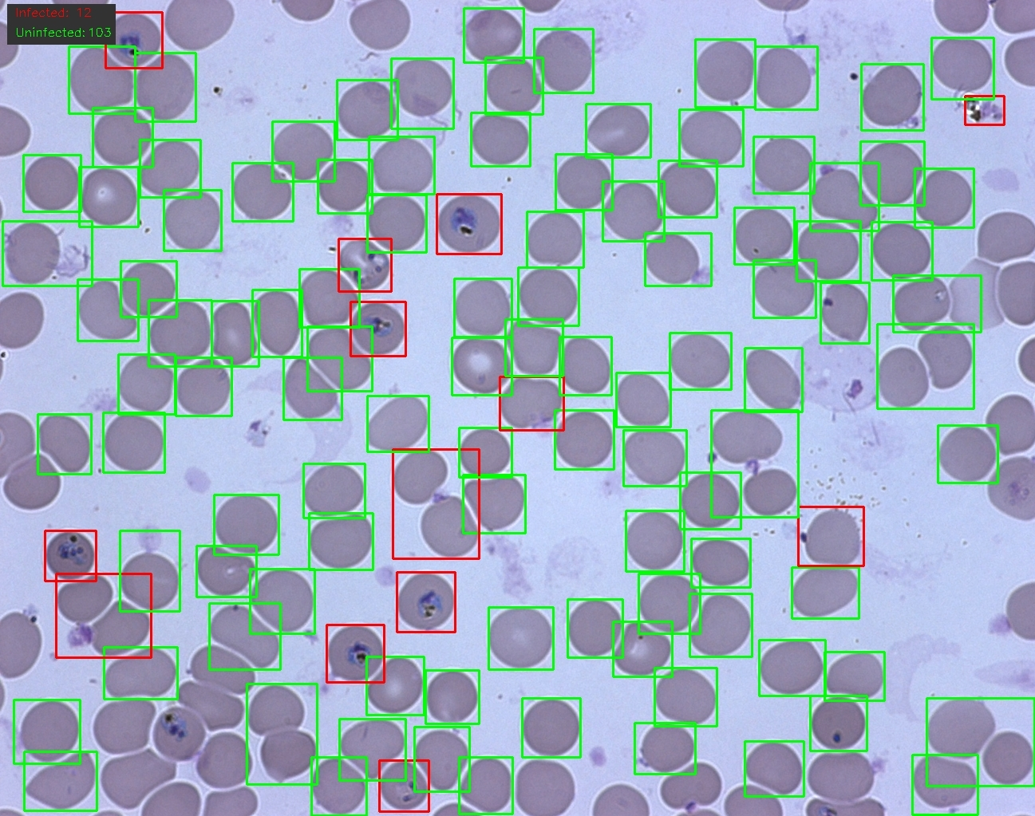
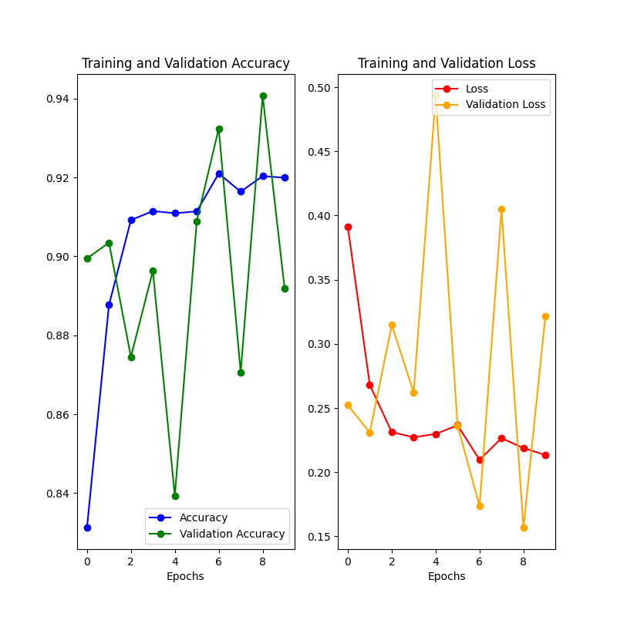
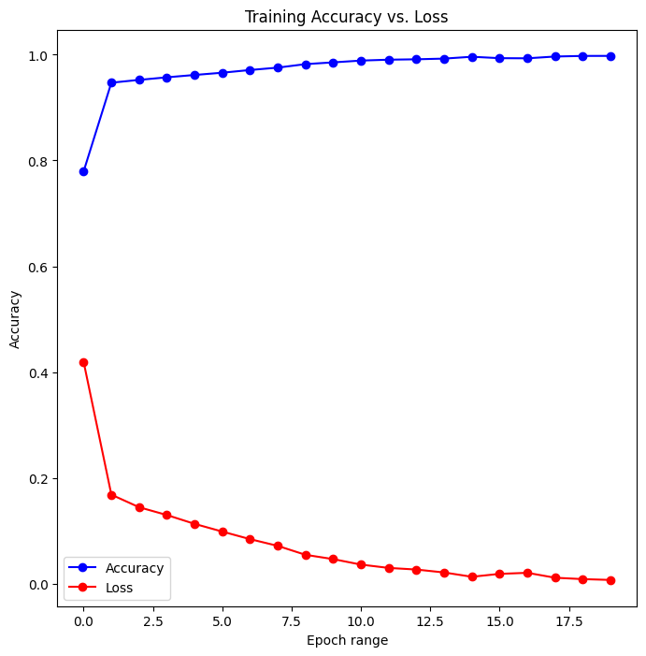




Assessing blood samples for malaria
Introduction
Tomas Tazar and Dr. Adrian Clark
Malaria – a life-threatening disease that is caused by parasites, remains pernicious around the world. In response to this, we present a software solution that leverages cutting-edge technology in order to accurately evaluate infected red blood cells within at-risk patients. Combining the power of machine learning classification and computer vision segmentation, we provide an end-to-end software solution able to combat malaria.
Image Input
Segmentation
Classification
Evaluated & Labelled Image
Figure 1. High-level model of the end-to-end system
Aims & Objectives
Develop classifiers that are trained on a database of malaria-infected & malaria uninfected blood cells that can accurately distinguish between the two.
Create a segmentation system that can isolate individual cells from blood smear images with low computational-complexity and high precision.
Integrate the classification and segmentation systems into a single end-to-end solution, that efficiently and accurately evaluates images and folders of malaria-infected blood smears with low-time complexity. (see Figure 1.)
Figure 2. Evaluated and labelled image output
Classification & Segmentation
We trained Sequential and state-of-the-art VGG16 (Large-Scale Image Recognition Convolutional Network) models on stained & labelled malaria cells.
Achieved 99% accuracy with Sequential & 92% accuracy with VGG.
Sequential model reached an F1 score of 0.95 & VGG achieved: 0.927.
We segmented and isolated individual cells from blood smears using Otsu’s thresholding and K-means clustering:
Gaussian blurring was carried out to de-noise the image before isolating.
Contours were identified, filtered for size & labelled with bounding rectangles marking our regions of interest.
These ROIs were then passed to the classifier for infection status prediction.
Figure 3. VGG Accuracy and Loss
Figure 4. Accuracy vs. Loss in Sequential model
Results
Tools
The final system can evaluate images and folders with a low time & computational complexity.
Users can choose to save the images to a directory or view them in an interactive window.
Otsu’s thresholding in combination with the Sequential model produced the most precise results.
As shown in Figure 2.
While the VGG model was effective, it struggled to accurately classify certain regions of interest.
Future Improvements
Porting the software to a mobile application to enable evaluation on the go.
Scaling the software to improve its adaptation to large-scale data processing.
Diversifying choice of segmentation and classification methods.
Adapting the classification to a wider range of light conditions.
Figure 5. Architecture of VGG model

