Slide 1
Java Continuous Integration
Vladimir Hlavacek
Juraj Toth

Slide 2
What you will get from this presentation
Not much about Java coding
Probably one of most important developer practice independent of any language
Showcase of open source continuous integration tools you can start using today
Notes:
Co chceme ukazat:
Maven
Git
Github
Travis
https://www.codacy.com/ - code quality
Heroku
… maybe some testing
My super library

Slide 3
Continuous Integration
development practice that requires developers to integrate code into a shared repository several times a day. Each check-in is then verified by an automated build, allowing teams to detect problems early.
Thoughtworks
Notes:
Co chceme ukazat:
Maven
Git
Github
Travis
https://www.codacy.com/ - code quality
Heroku
… maybe some testing
My super library

Slide 4



Why do you need a build tool?
You can use your IDE right?
But …
You may need some libraries
Other developers may use different IDE
You may need to build the software without IDE
You may need more than just compilation
And many more
Notes:
Co chceme ukazat:
Maven
Git
Github
Travis
https://www.codacy.com/ - code quality
Heroku
… maybe some testing
My super library

Slide 5
Most common Java build tool
Uses conventions over configuration
Build controlled by pom.xml
Conventions for project layout
Predefined build phases
Already integrated in all main IDEs
Notes:
Co chceme ukazat:
Maven
Git
Github
Travis
https://www.codacy.com/ - code quality
Heroku
… maybe some testing
My super library

Slide 6
Maven Project Layout
src - project sources
main - main project sources
java - .java sources
resources - other files present on the classpath
test - test project sources
java - .java test sources
resources - test files present on the classpath
target - compiled project sources
pom.xml - project build file
So where are the libraries?
~/.m2/repository
Notes:
Co chceme ukazat:
Maven
Git
Github
Travis
https://www.codacy.com/ - code quality
Heroku
… maybe some testing
My super library

Slide 7
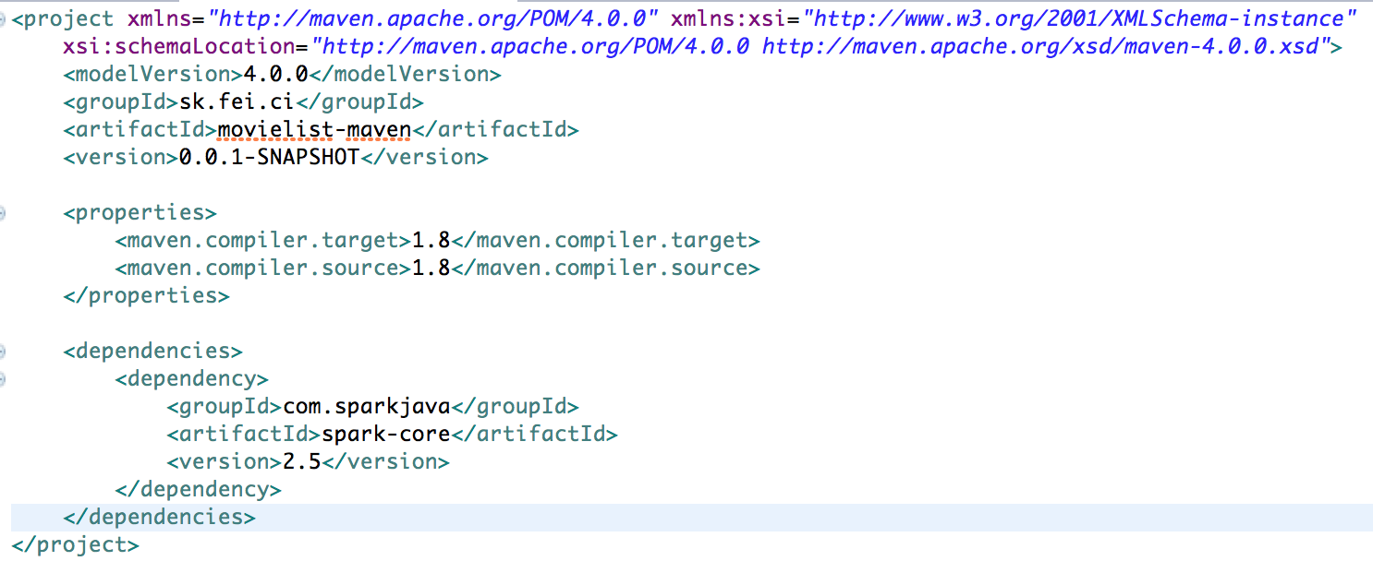
pom.xml
Notes:
Co chceme ukazat:
Maven
Git
Github
Travis
https://www.codacy.com/ - code quality
Heroku
… maybe some testing
My super library

Slide 8
Maven Build Lifecycles
clean
Delete target
default
Execute build for the sources
site
Execute build of the project site with reports
Notes:
Co chceme ukazat:
Maven
Git
Github
Travis
https://www.codacy.com/ - code quality
Heroku
… maybe some testing
My super library

Slide 9
Main build phases
compile - class compilation
test-compile - test class compilation
test - run test cases
package - create jar/war/ear/zip
integration-test - run integration tests
install - put archive to local repo
deploy - put archive to remote repo
Notes:
Co chceme ukazat:
Maven
Git
Github
Travis
https://www.codacy.com/ - code quality
Heroku
… maybe some testing
My super library

Slide 10



Version Control – System Configuration Management
Share your code with other developers
Track versions and see history
Revert back to other versions
Have multiple branches for development
Create tags
Notes:
Co chceme ukazat:
Maven
Git
Github
Travis
https://www.codacy.com/ - code quality
Heroku
… maybe some testing
My super library

Slide 11
Centralized Version Control
Centralized Server
v1
v2
v3
v4
v5
trunk
v6
v7
release1
checkout
update
branch
commit
Client 1
Client 1
Client 1
Client 1
Client 1
Notes:
Co chceme ukazat:
Maven
Git
Github
Travis
https://www.codacy.com/ - code quality
Heroku
… maybe some testing
My super library

Slide 12
Distributed Version Control
Repo1
add remote
pull
clone
push
Repo2
Repo3
clone
Notes:
Co chceme ukazat:
Maven
Git
Github
Travis
https://www.codacy.com/ - code quality
Heroku
… maybe some testing
My super library

Slide 13
Git – Basic commands
git init - initializes empty repository
git add - adds a file to version control
git commit - commits the current changes
git checkout - get commit / branch
git clone - get a copy of remote repo
git push - push local changes to remote
git pull - get remote changes to local
git merge - merge changes from branch
git log - show history

Slide 14
Git – Best practices
Push / Merge frequently
At least one push per day
Create useful commit messages
Use identification of the task
Use version control for source code only
.gitignore - classes, libraries, IDE configuration
Use feature branches
Create branch for every feature

Slide 15

Github
www.github.com
Free Git repository for open source projects
Social features
Fork - Join model
Fork original repository
Clone, make changes, commit, push
Create pull request
Review
Merge

Slide 16



Continuous Integration Server
Build server for automatic builds
Detect problems as soon as possible
Executes Continuous Integration Pipeline
Develop Code
Commit / Push
Start CI Build
Compile
Execute Tests
Deploy

Slide 17
Why Continuous Integration Server
Automatized checks of the quality
Makes sure that the code in the repository is runnable
Avoid disrupting other developers
Basic tool for continuous deployment and DevOps
Automatized deployment to different environments
Avoid deployment errors
Following a manual is hard, running a script is easy

Slide 18
Continuous Integration Server
Typical build configuration
Code repository
Type of the build
After each commit / scheduled
Commands to execute
E.g. mvn deploy
Pre / Post steps
Failure handling
E.g. notify developer
Tagging / branching

Slide 19
Continuous Integration - Stages
Development Environment
Commit
Build
Deploy
Test Environment
Test
Accept
Deploy
Production Environment
Test
Accept
Deploy

Slide 20
Continuous Integration Server – Best practices
Run the builds after each commit
Fast feedback
Nobody goes home if there is a failing build
Make fixing the build your first priority
Only thing required from the developer is commit
No manual build steps, automatic deployment
Deploy as often as possible - even to production
Build artifacts only once
Deploy same artifact to all environments

Slide 21
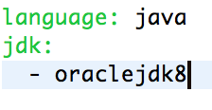
Travis CI
https://travis-ci.org
Free CI server for github projects
Allows building most common languages
Deployment to cloud platforms
Integration with other tools
Build controlled by .travis.yml
Part of the git repository

Slide 22
Automatized testing
JUnit
Framework for writing and executing tests
xUnit implementation
Alternatives available for other languages
Support for
Preconditions
Execute test
Verify results
Support in IDE and build tools

Slide 23
Code Coverage
Amount of code covered by test cases
Line coverage
Branch coverage
IDE plugins
EclEmma
Maven build plugin
Creates HTML report of the code coverage

Slide 24
Automatized Code Review
Automatically detect coding problems
Common bugs with using existing API
Security issues
Code formatting
Missing documentation
Test code coverage
Performance issues
Unused code
Violations of best practices
One of the best ways to learn good code practices

Slide 25





Automatized Code Review for Java
Offline tools
Executed from the build tool / IDE
Checkstyle
Findbugs
PMD
IDE checks (Intellij Idea)
Online tools
SonarQube
www.codacy.com

Slide 26





Continuous deployment
Automatically deploy every change
Even to production
Examples of target environments:
Artifact type | Example platform
.jar libraries | Artifactory, Sonatype Nexus
.war web applications | Apache Tomcat, Jetty
.ear enterprise applications | Wildfly, Weblogic, Websphere
Almost any | Cloud platforms AWS, Heroku, Cloud Foundry, Docker …

Slide 27
Continuous deployment
Deployment options:
Shell scripts
E.g. copy, upload via FTP
Build tool plugins
Maven tomcat plugin, maven heroku plugin
CI Server plugins
Jenkins, Travis
Cloud platform Git / Github integration
Heroku CI, AWS etc.
Build tool plugins are more universal
CI / Cloud platforms have better security and management
Notes:
https://fei-2016-movielist-maven.herokuapp.com/hello

Slide 28

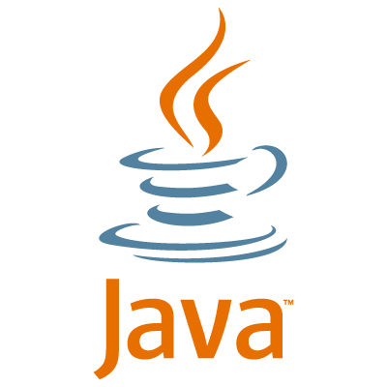
Continuous Integration - Summary
Our continuous Integration pipeline

Slide 29



Continuous Integration - Summary
Typical continuous integration pipeline
Task Management / Code review / Testing

