Slide 1
MACHINE LEARNING · POLITICAL SCIENCE · SURVEY DATA
Predicting Attitudes
Toward Democracy
A Machine Learning Case Study
World Values Survey · Wave 7 · Argentina

Slide 2
CORE QUESTION
What distinguishes people who strongly value democracy from those who don’t - and can we predict it from other survey responses?
DATASET
SAMPLE
TARGET
World Values Survey
Wave 7 — Argentina
1,003 respondents
~395 variables
Q250: Importance of
Democracy (1–10)

Slide 3
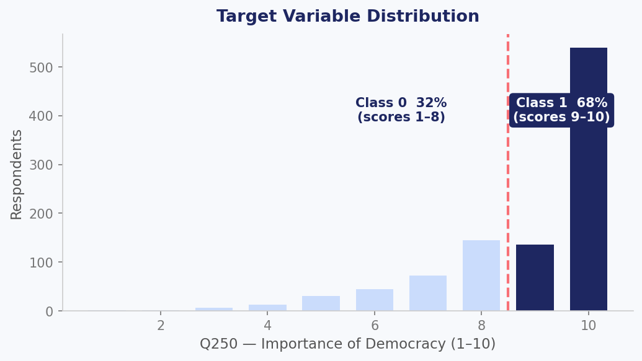
TARGET VARIABLE
Binarization Strategy
Q250 is highly skewed (most respondents cluster at 9-10).
Threshold applied at score > 8 to create a meaningful binary split
Class 0 (scores 1–8): 32% - lower democratic valuation -.
Class 1 (scores 9–10): 68% - higher democratic valuation -.
Class imbalance (~2:1) addressed by optimizing for F1-score, not accuracy

Slide 4
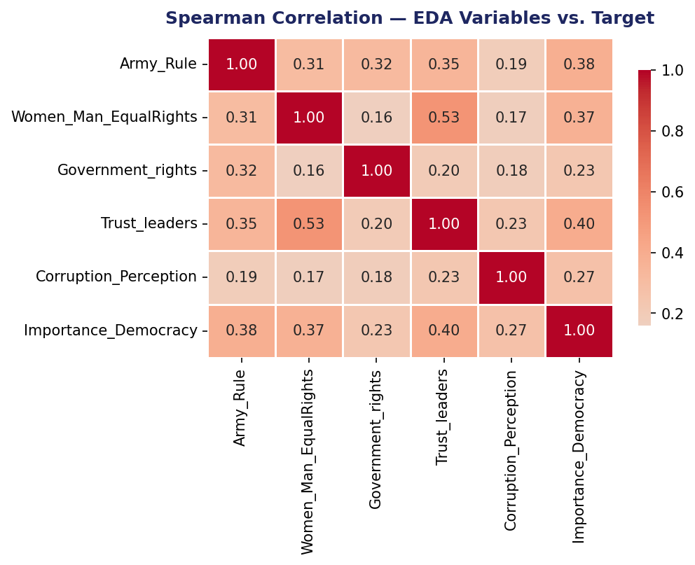
EXPLORATORY ANALYSIS
Key Patterns
Army_Rule (0.38)
Strongest EDA signal - rejecting military rule aligns with higher democratic valuation -.
Trust in Elections (0.40)
Institutional trust and democratic valuation move closely together
Gender Equality (0.37)
Egalitarian attitudes correlate with democratic values, and also with institutional trust (0.53)
Corruption (0.27)
Weak signal: people value democracy even when they perceive high corruption

Slide 5
MODELING PIPELINE
1
2
3
4
Preprocess
Select
Compare
Tune
Negative values → NaN
Mode imputation
Standard scaling
SelectKBest
F-test vs binary target
k = 6 features
Logistic Regression
Random Forest
XGBoost · CatBoost
GridSearchCV
Stratified 5-fold CV
Optimize F1-score
All preprocessing steps are performed inside the sklearn Pipeline — no data leakage across cross-validation folds.

Slide 6
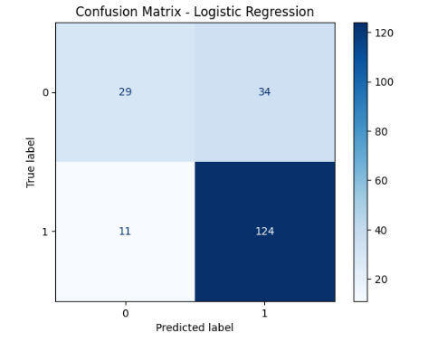
MODEL RESULTS
WINNER: LOGISTIC REGRESSION
RESULTS
77%
0.85
0.56
0.792
Logistic Regression with C=10 and k=6 features achieved the best cross-validated F1.
Expected: regularized linear models often outperform ensembles on small datasets with threshold-based targets.
F1 optimized over accuracy: deliberate choice given the 2:1 class imbalance.
ROC-AUC of 0.792 confirms meaningful discrimination above a naive baseline.
11 false negatives: respondents who genuinely scored 9-10 but were predicted as low-valuation.
Accuracy
F1 - Class 1
F1 - Class 0
ROC-AUC

Slide 7
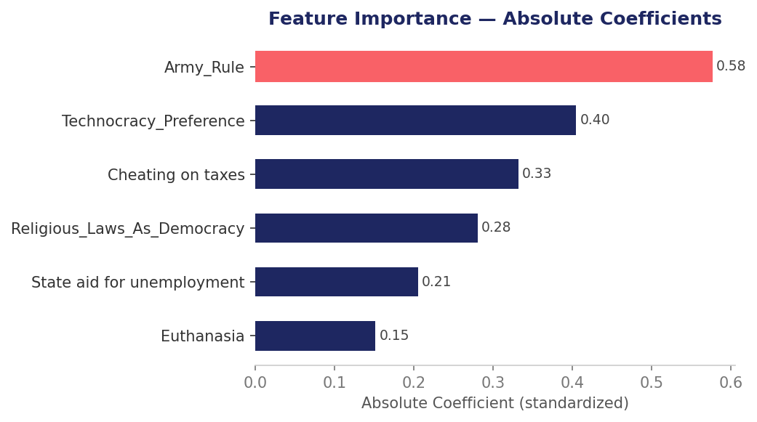
FEATURE IMPORTANCE
What the model uses
6 features selected
SelectKBest with F-test on binarized target (ranking differs from Spearman used in EDA).
Army_Rule dominates
Largest absolute coefficient (0.57), consistent with EDA findings.
Diverse domains
Political system attitudes + conceptions of democracy + moral attitudes
Coefficients ≠ causal
Magnitude shows importance; direction reflects multivariate partial effects (see next slide)

Slide 8
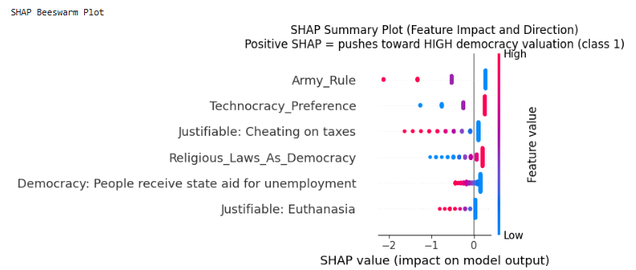
EXPLAINABILITY — SHAP DIRECTIONALITY
Each dot is one respondent in the test set
Position on X axis = magnitude and direction of impact on the prediction
Color = feature value (red = high, blue = low)
Positive SHAP = pushes toward Class 1 (high democratic valuation)
Note on suppression
Some directions differ from EDA correlations. When correlated features enter together, the model estimates partial effects. Individual signs can flip. This is statistical suppression, not a modeling error.

Slide 9
LIMITATIONS
01
No causal inference
02
Single-country sample
Cross-sectional observational data. The model identifies associations, not mechanisms.
Argentina only (WVS Wave 7, n ≈ 989). Findings may not generalize across cultural contexts
03
Self-report bias
04
Threshold sensitivity
Social desirability effects are plausible in items about democratic values.
Binarization at score > 8 is a modeling choice. A different threshold produces a different model.
05
Feature stability
06
Coefficient interpretability
Data-driven selection (SelectKBest) may retain variables correlated with the target for sample-specific reasons
Statistical suppression affects individual coefficient signs. SHAP reflects partial effects, not univariate relationships

Slide 10
DIVE DEEPER
Full analysis, code, and interpretation available in the notebook.
github.com/tomasallemand/wvs-democracy-attitudes-ml
World Values Survey · Wave 7 · Argentina
Haerpfer et al. (2022) · doi:10.14281/18241.20
Predicting Attitudes Toward Democracy · Machine Learning Case Study

