Slide 1

async programming in JS Part2
callbacks, Promises and async/await

Slide 2
History of async
RECAP
JS ako jazyk nemal žiadnu notáciu pre asynchronicitu
Callback bol fajn mechanizmus ako to zapísať syntakticky a čiastočne aj semanticky (všetko čo je odtabované je “LATER“)
Callback ako taký ale nič nevraví o asynchronicite
promises (ako nezávislý štandard) potom ako súčasť ES
generatory
async await
async iterators

Slide 3
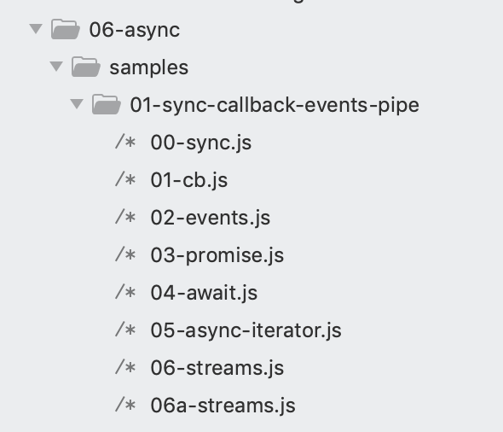
Async styles
RECAP
sync
async callback
async events
async promises
async async/await
async iterators/generators
streaming, pipe, pipeline
node.js core module fs is a good demo of all styles, it supports all of them, samples:
Notes:
core module “fs”, File System, je vyborny priklad, poskytuje vsecky api aby sme si to vedeli ukazat

Slide 4
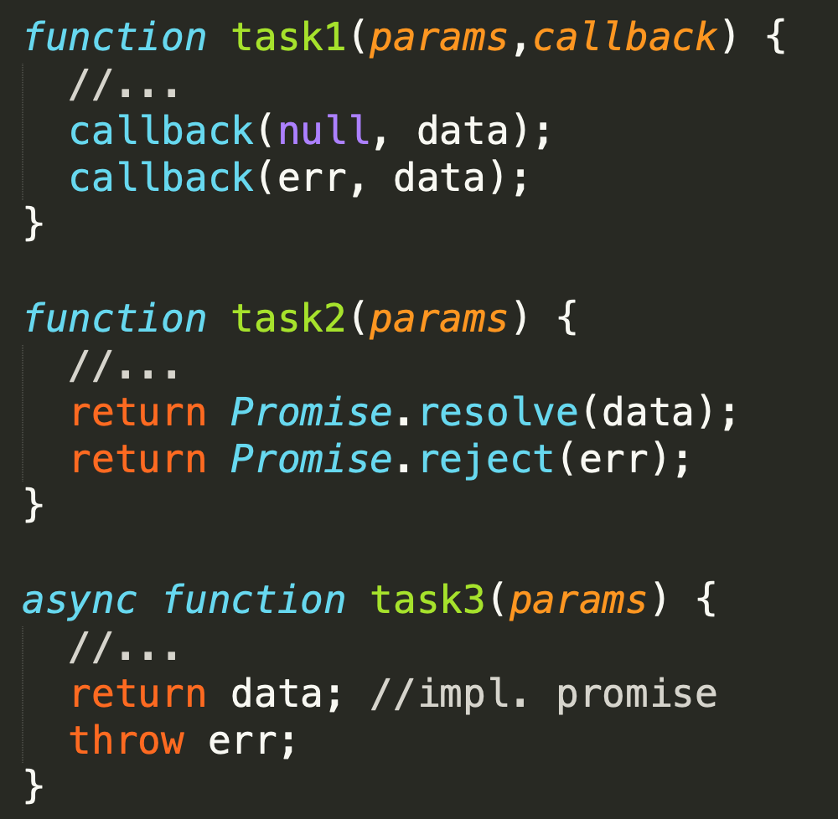


Async function - definitions
RECAP
now
later
V8 stack
Pod async funkciou budeme zjednodušenie rozumieť jednu z konštrukcií, ktorá nám umožní zapísať, že niečo sa deje NOW a potom LATER. V zásade existujú 3 možnosti ako je async funkcia implementovaná:
funkcia, ktorá v signatúre očakáva callback
funkcia, ktorá vracia Promise
ES2017 AsyncFunction

Slide 5
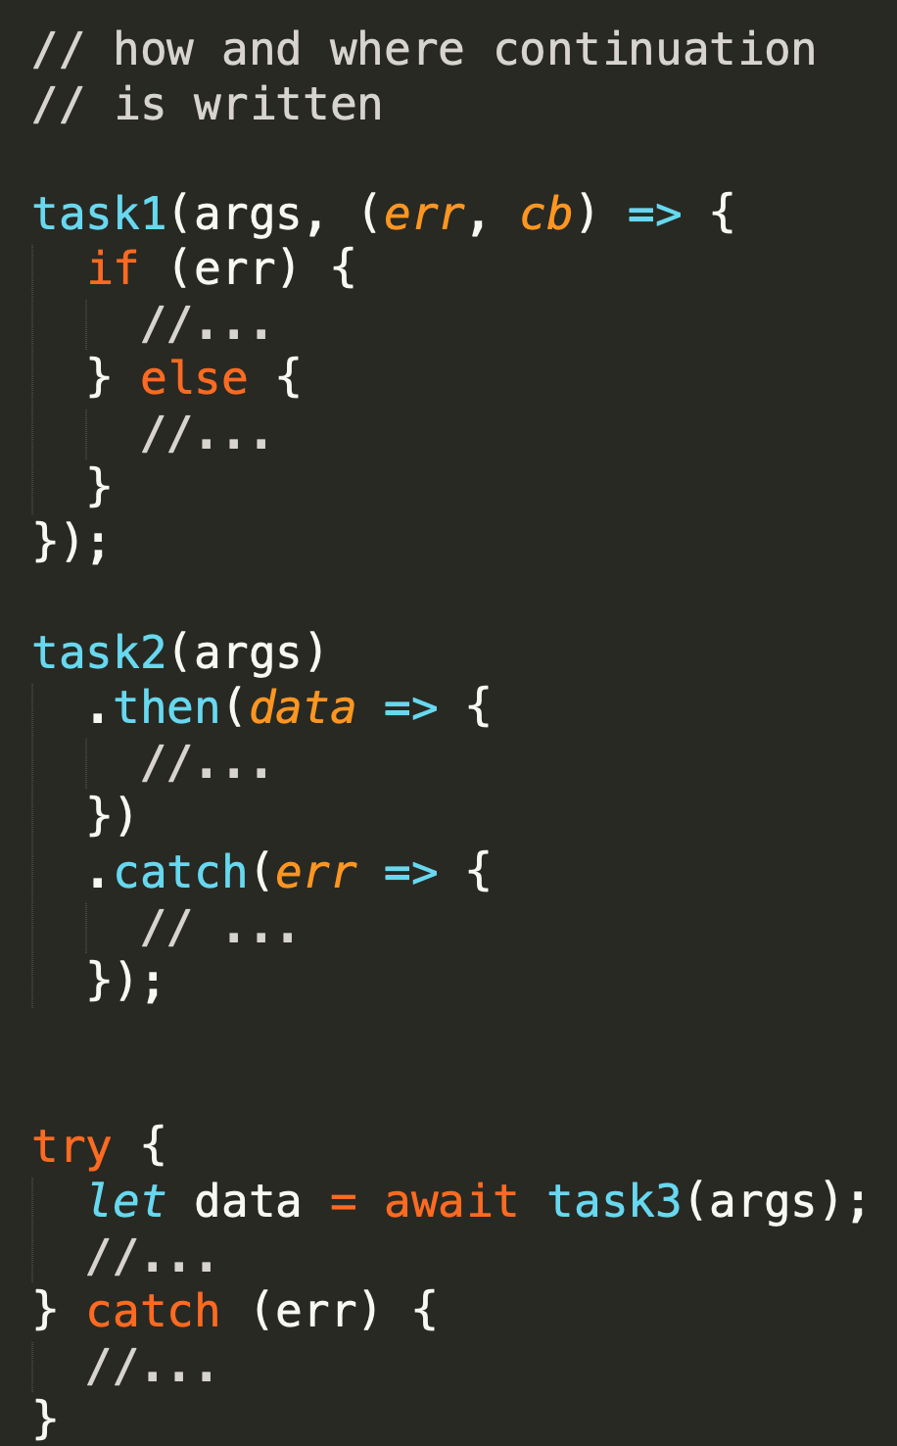

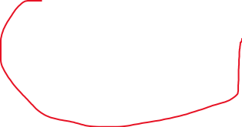
Async function - usage
RECAP
1995-2020
now
later
V8 stack
Podľa toho potom rôzne zapisujeme „later“
funkcia, ktorá v signatúre očakáva callback
funkcia, ktorá vracia Promise
ES2017 AsyncFunction
Niektoré knižnice sú napísané štýlom A) iné B) iné podporujú A/B/C ..... Niektoré runtimes podporujú len A, niektoré A,B,C
2010
2015-2020
2017-2020

Slide 6
Callbacks

Slide 7
Callbacks
RECAP
When your JS program makes async operation, you set up the "response" code in a function (commonly called a "callback"), and the JS engine tells the hosting environment, "Hey, I'm going to suspend execution for now, but whenever you finish with that request, and you have some data, please call this function back.“ (@getify)

Slide 8
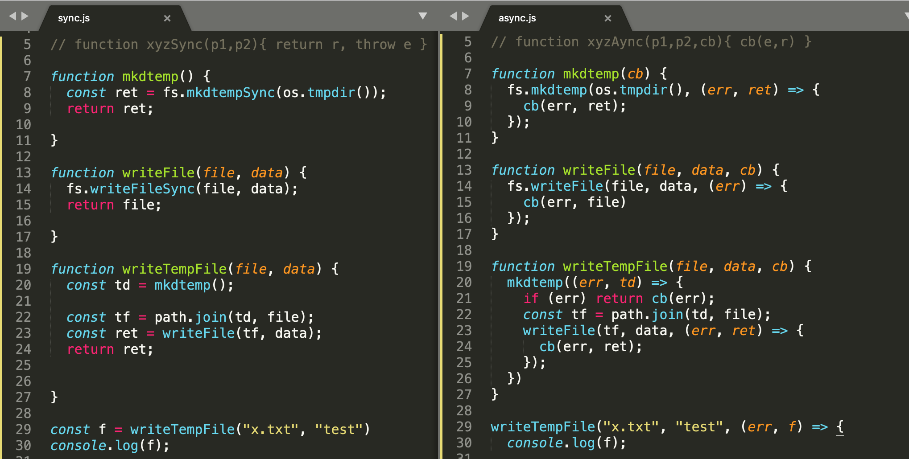
Sync / async code side by side
Notes:
porovnanie sync a async
v sync funkcii mate v signature parametre
v async funkcii mate parametre a posledny je callback
ked zavolate sync funkciu dostanete ret, alebo throwne error
ked zavolat async finkciu, dostanete zavolany vas callback bud z ret alebo z err
v sync robite return
v async funkcii volate callback
v sync komponujete funkcie ako sekcenciu volani a statementov
v async komponujete pomocou vnarania callbackov

Slide 9
Callbacks (+ pozitíva)
callbacks are by far the most common way that asynchronycity in JS programs is expressed and managed
Indeed, the callback is the most fundamental async pattern in the language
Countless JS programs, even very sophisticated and complex ones, have been written upon no other async foundation than the callback
The callback function is the async work horse for JavaScript, and it does its job respectably
https://github.com/getify/You-Dont-Know-JS/blob/master/async%20%26%20performance/ch2.md

Slide 10
Callbacks (- negatíva)
It turns out that how we express asynchrony (with callbacks) in our code doesn't map very well at all to that synchronous brain planning behavior
The reason it's difficult for us as developers to write async evented code, especially when all we have is the callback to do it, is that stream of consciousness thinking/planning is unnatural for most of us.
We think in step-by-step terms, but the tools (callbacks) available to us in code are not expressed in a step-by-step fashion once we move from synchronous to asynchronous.
And that is why it's so hard to accurately author and reason about async JS code with callbacks: because it's not how our brain planning works.
https://github.com/getify/You-Dont-Know-JS/blob/master/async%20%26%20performance/ch2.md

Slide 11
Callbacks – odpoveď na tému sekvencneho kodu
Getify: We think in step-by-step terms, but the tools (callbacks) available to us in code are not expressed in a step-by-step fashion once we move from synchronous to asynchronous.
Marcus: tak prestan premyslat step-by-step a zacni rozmyslat deklarativne, v zmysle co na com zavisi a mas po probleme, vid async patterns co sme si ukazovali, ale jasne ze nie na kazdy problem je toto vhodne riesenie

Slide 12
Callback hell (čo to znamená naozaj)
Toto sú podstatné problémy callbackov:
order of code is not sequential
with callback we trust the 3rd party (the one who calls our function) to
call us only once
but it can call us multiple times,
or not at all
call us in the async or sync fashion, but it can call us sync one time and async second time
hardcoded continuations (names of next functions)
error handling paths complicate the code
error handling of sync parts of async. functions (writeFile and encoding)
cluttered code hard to reason about
... indentation ... is just side effect not helping previous real problems
.....
Notes:
toto vsecko je callback hell,
niekedy sa stretnete z clankami ktore za callback hell povazuju hlavne bod 7,6, a 1,
ale podstata je uplne inde.
Zakladom callback hell je bod 2.
Na dalsich slajdoch si to rozobierieme po castiach….. preco a aky je to problem
Bod 1, je cisto dusevny problem a da sa to naucit pisat aj citat, samozrejme sa to ozaj spolieha na to ze nase assumptions v bode 2 sú správne a konzistentné
Bod 3,4,6,7 nie su podstatne problemy callbackov a daju sa eliminovat pomocou vhodnych zapisov a kniznic
Dokonca aj bod 2 sa da eliminovať,
takže ÁNO dá sa vyžiť cisto z callbackmi a vhodnou async knižniciou…..

Slide 13
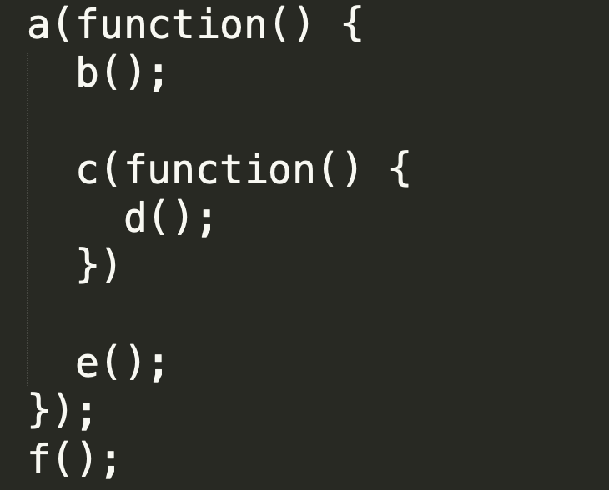
(1) Poradie kódu a poradie vykonávania
Zo syntaxe zápisu usudzujeme, že
a, c sú async funkcie
b,d,e sú sync funkcie
Poradie vykonania bude potom:
a, f, b, c, e, d
Čo nezodpovedá poradiu zápisu v kóde, čo komplikuje čítanie a analýzu kódu.

Slide 14
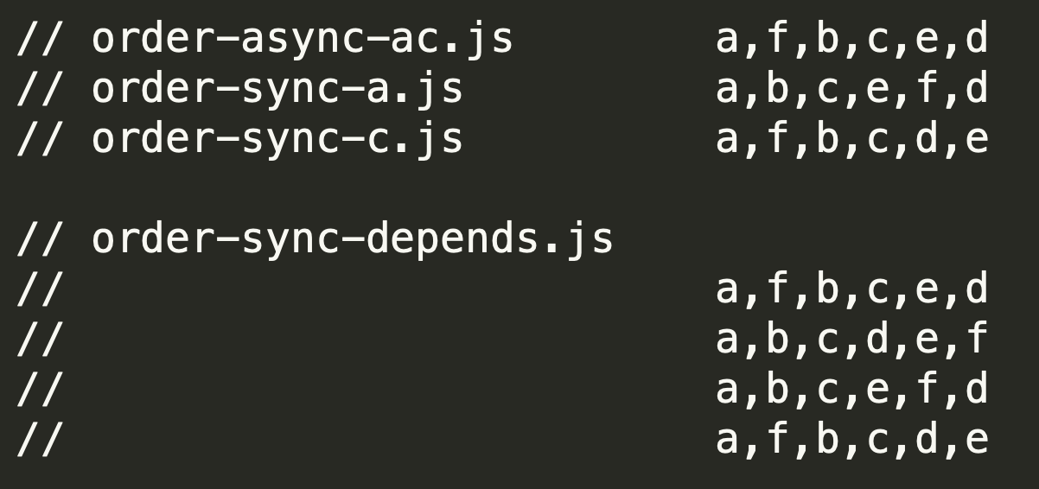
(1) Poradie kódu a poradie vykonávania
Zo synaxe zápisu len usudzujeme, že
a, c sú async funkcie
b,d,e sú sync funkcie
Čo ak to tak nie je ? čo aj je jedna z nich synchrónna , alebo obe ? dostaneme iné poradie:
prednasky/06-async/samples/02-callbacks/order-*.js

Slide 15
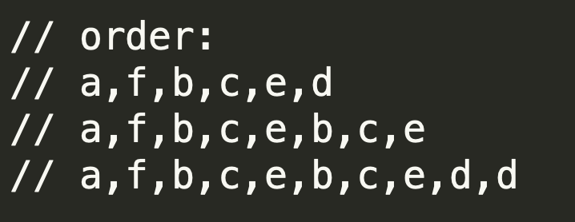
(2A) Počet zavolaní callback-u
Pri callbackoch sa spoliehame, na autora knižnice, že náš cb zavolá práve raz, ale to nemusí byť pravda, môže nás zavolať viackrát (by design alebo “lebo bug“),
a() - je implementovaná „zle“ a niekedy zavolá callback raz, inokedy dva razy
b() – zase niekedy nezavolá cb vôbec
prednasky/06-async/samples/02-callbacks/order-times.js

Slide 16
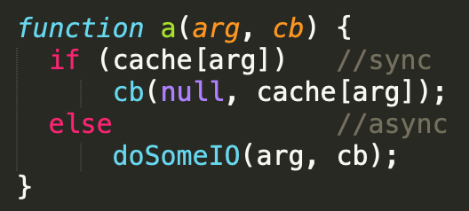
(2B) niekedy async, niekedy sync
Zo syntaxe zápisu len usudzujeme, že a(), c() sú async funkcie
Ale čo ak autor kódu implementoval volanie cb raz async a raz sync spôsobom ?
Prečo by to robil ?
napr: caching v nasledovnom príklade:
prednasky/06-async/samples/02-callbacks/order-times.js

Slide 17
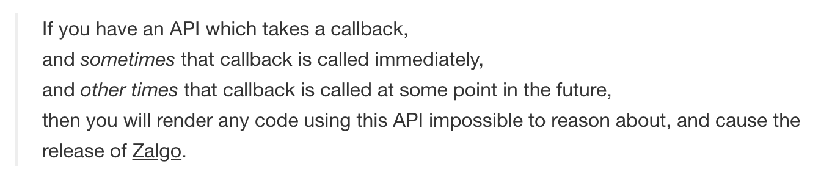
(2B) niekedy async, niekedy sync
prečo je “niekedy sync/async“ funkcia problém (ozaj v skratke):
nemôžte sa spoľahnúť na poradie (viď predošlý príklad)
b,c,e .... e vs.
b,c,d,e
Maximum call stack size exceeded
http://blog.izs.me/post/59142742143/designing-apis-for-asynchrony
https://blog.ometer.com/2011/07/24/callbacks-synchronous-and-asynchronous/
prednasky/06-async/samples/02-callbacks/sometimes-async.js

Slide 18
Riešenia:
(2AA) cb called multiple times
As authors: it is bug, do all callback paths coverage with your tests
As consumers: TODO: naštudovať, vymyslieť
(2AB) cb never called
As authors: it is bug, do all callback paths coverage with your tests
As consumers: wrap your functions with async.timeout(fn)
(3) cb called sometimes in sync sometimes in async fashion:
As authors: Do not produce sometimes sync, async functions
As consumers: When consuming sometimes async function wrap it with async.ensureAsync(fn)

Slide 19
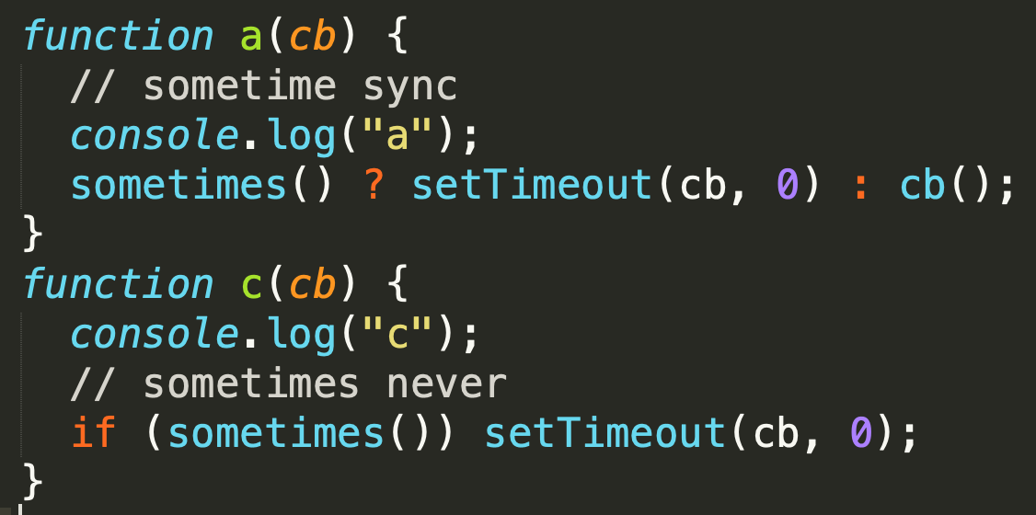

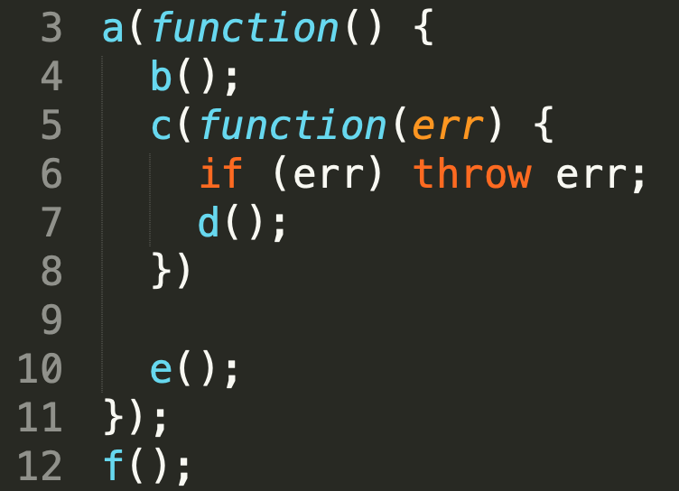
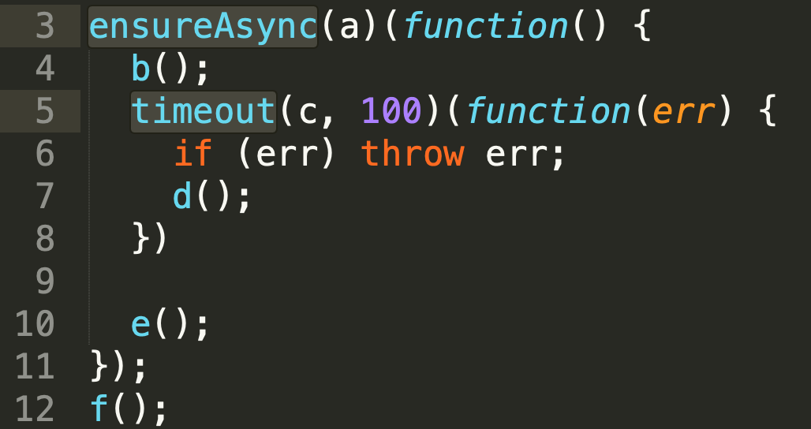
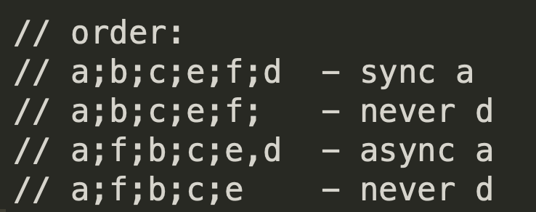
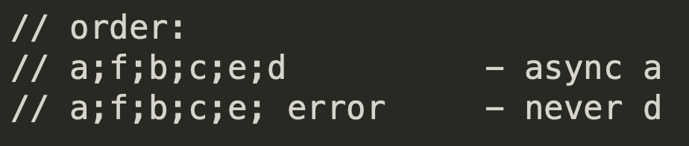
solutions async.ensureAsync and async.timeout once: TODO

