Slide 1
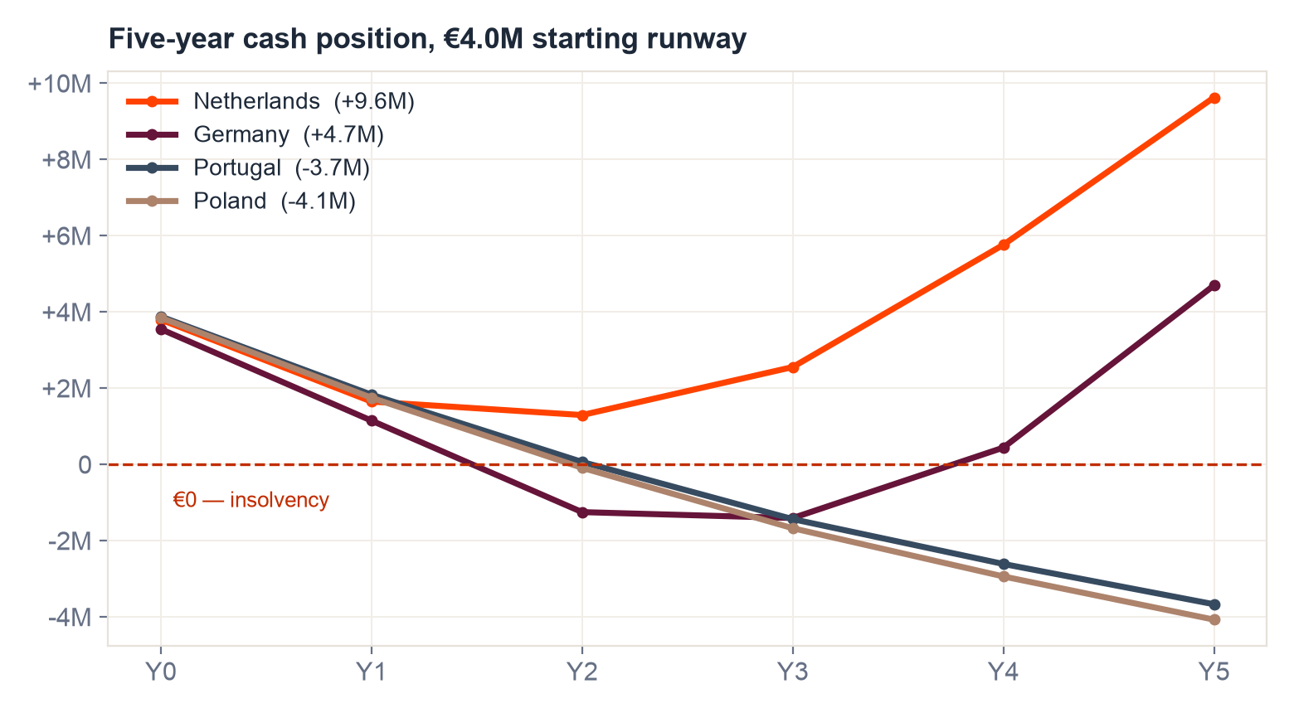
HELIX OPTICS · FIRST EUROPEAN MARKET · BOARD RECOMMENDATION
Enter the Netherlands first
Break-even Y3
company EBITDA positive in year 3, the second year of reimbursed sales
€1.30M
cash trough: the runway is never exhausted
159,910 / yr
addressable FIT-positives: 92% of Germany's volume, none of its barriers
€7,750 saved
per 100 patients triaged, at €650 per avoided colonoscopy. The payer wants this
The Netherlands is the only market of the four that survives on the €4.0M runway: 12 months to reimbursement, one national procurement route, no incumbent.
All figures computed by the data pipeline from the case pack; model replicated live in the Excel. Ramp anchored to the pack's benchmark (~20% of eligible volume within 3 years of reimbursement).

Slide 2
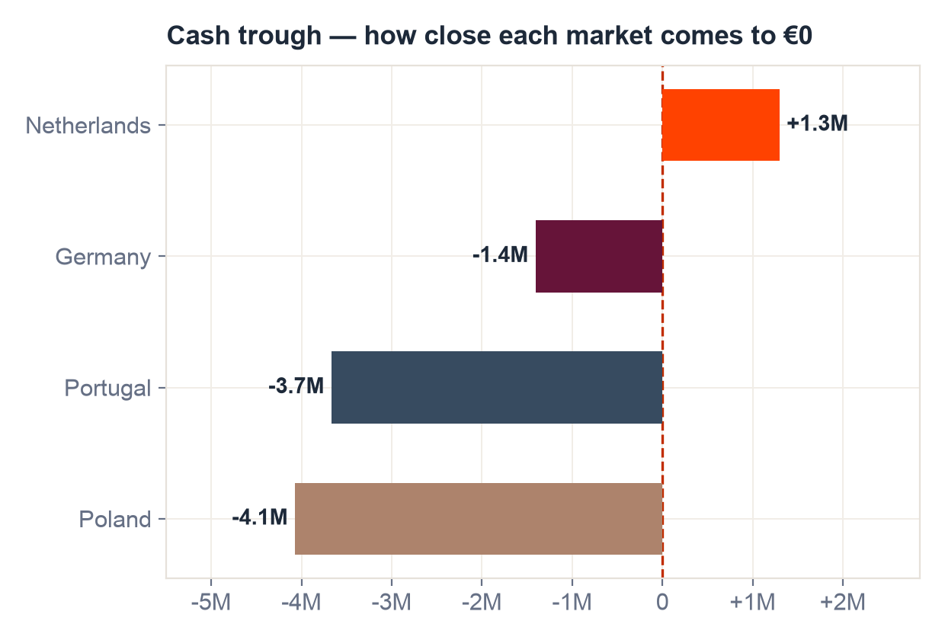
WHY NOT THE BIGGEST MARKET FIRST
Germany is the prize — and the certain death of the runway
▪ 24 months to reimbursed revenue. The pathway is procedural, and the national report is explicit that clinical investigators, lab partnerships and prior studies do NOT shorten it.
▪ Pre-reimbursement revenue ≈ €0. Selective contracts and self-pay have 'historically covered negligible volume'. Planning assumption: immaterial.
▪ The runway dies first. Burn reaches ~€2.85M in year 1; cash bottoms at -1.4M, insolvent before the first reimbursed euro.
▪ An incumbent owns the channel. OncoStream: ~3 years reimbursed, 35–40% of addressable volume, framework agreements with the largest endoscopy networks.
▪ Its 300k tests/yr claim is impossible. Germany's entire organised addressable volume is 174,240/yr; the company-reported figure is 1.7× the whole market. Pipeline check CHK-02 rejects it, and the independent 35–40% share (~61–70k tests) is used instead.
Right market later, unaffordable market now. File the German application early (the clock is procedural); enter when new capital or NL cash flow can fund the two-year wait.
Sources: Germany national report; Meridian competitor brief (company-reported figures cross-checked against primary screening statistics — see pipeline validation).

Slide 3
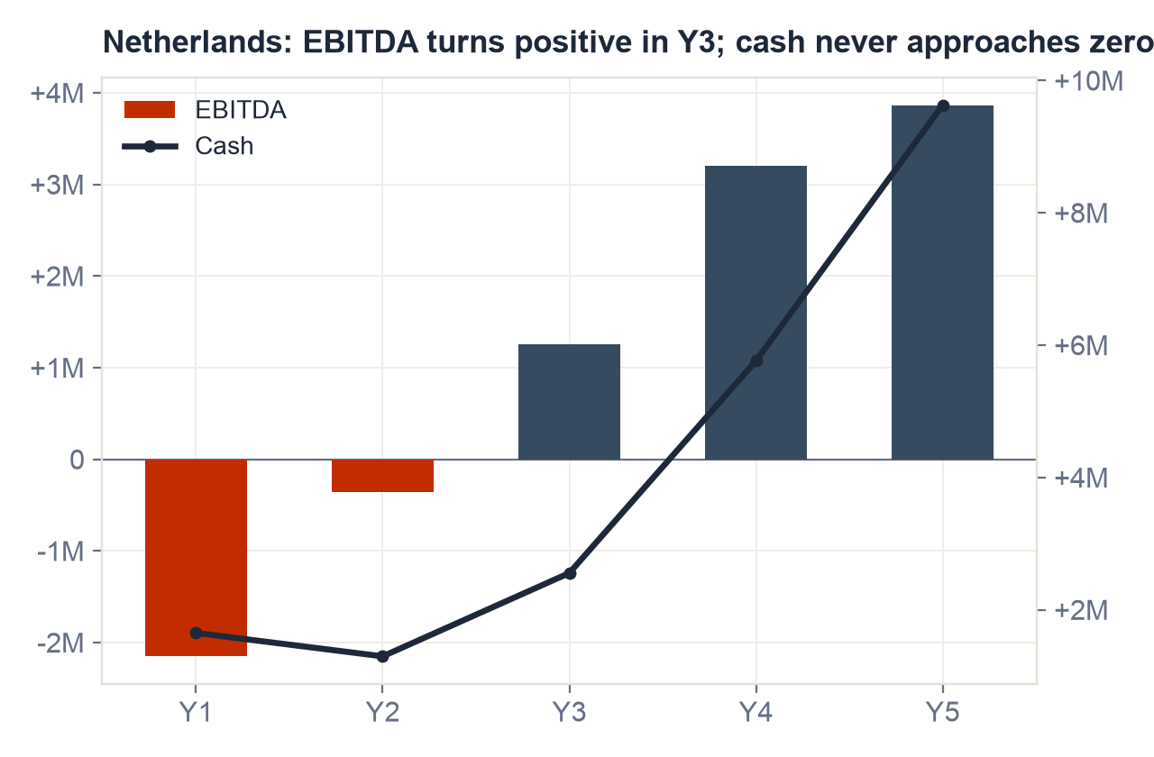
THE CASE FOR THE RECOMMENDATION
The Netherlands: fastest to revenue, and the payer is motivated
▪ Volume without the barriers. 71% participation × 9.1% positivity → 159,910 FIT-positives/yr from 4.95M eligible: 92% of Germany's volume.
▪ 12 months to reimbursement. Centralised programme, one national procurement decision. No region-by-region grind.
▪ Open field. No competitor active; second-highest price of the four (€215).
▪ Capacity pressure is policy. Reducing avoidable colonoscopies is an explicit programme priority; register data shows referrals at ~103% of national endoscopy capacity.
▪ The economics clear. €215 price vs €51 COGS (Y3) → 76% unit margin; company EBITDA positive Y3; 5-year end cash €9.6M.
What must be true: reimbursement lands ≈12 months; ramp reaches ~13% of addressable by the second reimbursed year; price holds near €215.
Utilisation computed from the deduplicated facility registers (3,236 raw records → 228 real units).

Slide 4
BREAK-EVEN AND THE RANGE AROUND IT
Where the case bends, and where it breaks
Break-even: Year 3
On the base case — reimbursement at month 12, ramp to 20% of addressable by year 3 (the pack's own benchmark), price €215.
▪ Ramp alone can sink it. At half the benchmark ramp the trough grazes €0 (−€0.0M): the case fails without help.
▪ Delay alone breaks it too. Any slip past month 12 puts the trough at −€0.8M on the base ramp (the annual model rounds delays up to whole years, deliberately conservative).
▪ Together, decisively fatal. Half-ramp AND a 24-month delay → trough −€2.1M.
▪ Price is the cushion; month 15 is the tripwire. Every €10 of price ≈ €0.2–0.3M of annual EBITDA at scale. No reimbursement signal by month 15 → cut in-market spend and bridge before the trough.
cash trough · ramp ↓ / delay → | 12 months | 18 months | 24 months
ramp ×50% | -0.0M | -2.1M | -2.1M
ramp ×75% | +0.8M | -1.3M | -1.3M
ramp ×100% | +1.3M | -0.8M | -0.8M
ramp ×125% | +1.6M | -0.5M | -0.5M
Green: comfortable. Amber: survives, thin. Red: insolvent.
Same grid lives as formulas in the Excel ('3 Sensitivity') — change any assumption in the live session and it recalculates.
Grid computed by the same engine as the Excel; delays round up to whole years (conservative).

Slide 5
QUESTIONS 3 — THE EXPANSION PLAN
After the Netherlands: sequence, triggers, and what we refuse to do
NOW → Y1
Netherlands entry
€200k entry · reimbursement application immediately · first revenue ~month 13
Y1
File Germany's clock
the 24-month pathway is procedural — start it while NL scales; commercial spend stays €0
Y2
Portugal
€120k entry, 12-month route, home turf; contribution-positive add-on (~€0.6M/yr at benchmark)
Y3+
Germany, funded
enter when NL cash flow / new capital covers the wait; IVDR done; Poland stays parked (€115 price ≈ COGS+ margin too thin)
Decision triggers, agreed with the board today:
▪ Accelerate: NL reimbursed-year-1 penetration ≥7% of addressable and price ≥€200 → pull Portugal forward; raise growth capital against proven uptake.
▪ Delay: reimbursement slips past month 15 or ramp <half of plan → freeze Portugal, cut NL in-market cost, extend runway before the trough.
▪ Abandon / pivot: no reimbursement by month 18 with pipeline dry → stop-loss NL commercial build; the Germany filing and the Portuguese R&D base (HealthTech Growth Call: €500k, 60% co-financing of Portugal-based R&D — not usable for any launch) keep two doors open.
▪ What we refuse to do: chase Germany's headline volume with a 24-month unfunded gap, or book the funding call as launch money. It is R&D co-financing only.
Pipeline run: 74 values extracted deterministically, 0 AI calls, eval 28/28, 0.9s end-to-end. The same assessment re-runs on markets 5–14 by adding a config entry.

