Slide 1
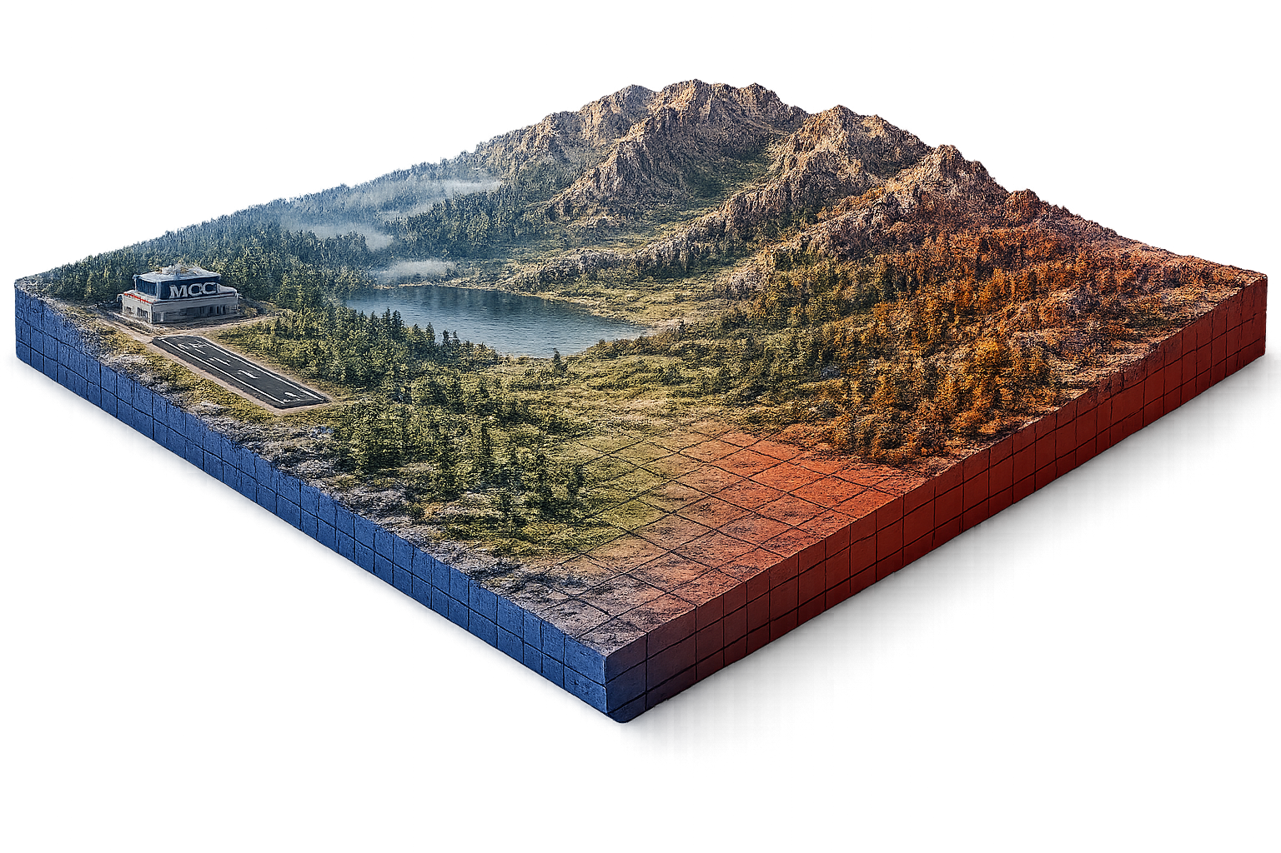
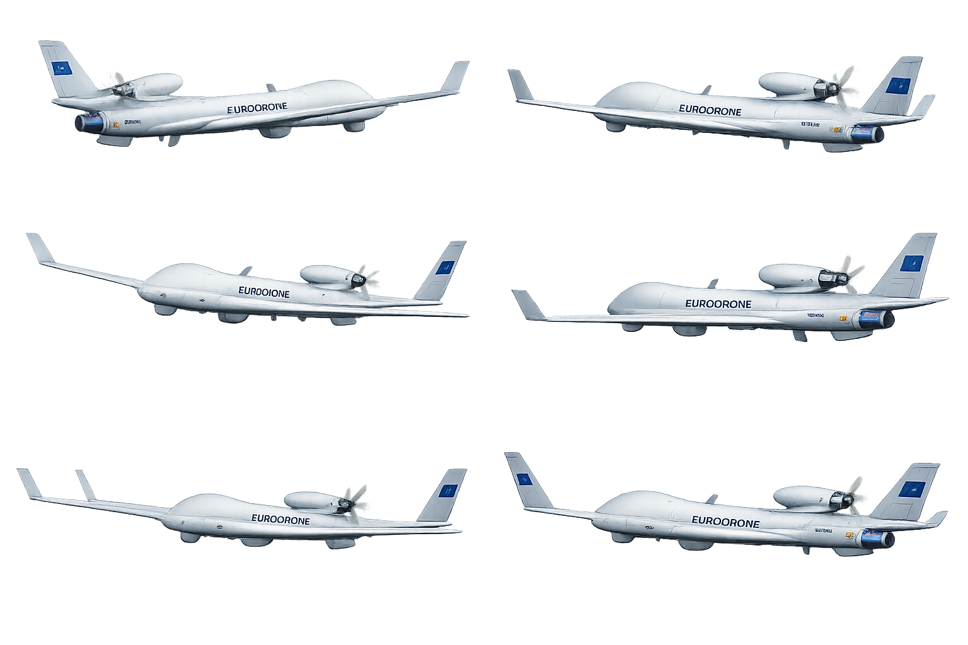


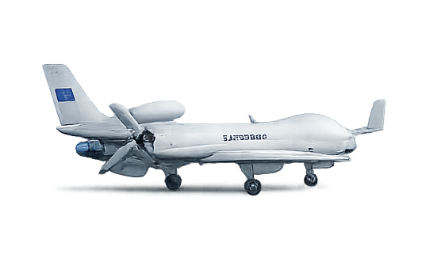
POST-MISSION ANALYSIS
LINK RECOVERY
4
7
DISCONNECTED MISSION
5
RETURN
6
1
MISSION PREPARATION
3
2
LINK LOSS
CONNECTED MISSION
Step | Title | Context | Objective | Objective
1 | Mission Preparation | Secure ground environment (full access to MCC & TSOC) Ground-based inspection possible | Start secure | Ensure platform integrity before mission Load latest threat intelligence & detection models
2 | Connected Mission | Airborne in permissive environment (stable low bandwidth communication with MCC & TSOC) | Full visibility | Maintain continuous situational awareness
3 | Link Loss | Airborne approaching a contested area (degraded / intermittent link) | Prepare for isolation | Detect transition to contested environment Prepare for autonomous operation
4 | Disconnected Mission | Operation in denied environment (disconnected from MCC & TSOC) | Monitor alone | Detect incidents locally, log and summarize
5 | Link Recovery | Airborne returning to controlled environment (stable communications restored) | Reconnect, report & restore situational awareness at C2 | Transfer critical cyber data Restore situational awareness at C2
6 | Return | Return to fully permissive environment (high bandwidth stable link) | In-depth verification | Validate no latent cyber compromise persists Prepare for secure post-mission data extraction
7 | Post-Mission Analysis | Landed in secure ground environment (full access to MCC & TSOC) Ground-based inspection possible | Learn & improve the fleet | Deep forensic analysis of the mission Improve models & intelligence Feed insights back into the fleet

