Slide 1
DeathNode
An anonymous reporting platform.
Network and Computer Security
Computer Science and Engineering
08/01/2026
Group: 53
Guilherme Pais Nº 116496
Pedro Duarte Nº 116390
Tomás Fernandes Nº 116122
Notes:
(Time: 0:00 - 0:20) -> Tomás
Good morning. We are Group 53, and we’ll present our implementation of DeathNode.
We selected Challenge B, focusing on monitoring to ensure availability against flooding attacks.

Slide 2
Table of Contents
01
02
03
04
05
06
07
Project Scope
Secure Document Format
Security Protocol
Infrastructure, Secure Channels & PKI
Security Challenge
Results & Conclusions
Demo

Slide 3

01
Project Scope

Slide 4
Project Scope
Main Assumptions
Static, fixed membership.
Preconfigured cryptographic trust.
Immutable report history.
No failures.
Fixed vigilant monitor server.
CA fully trusted.
Client & monitor server partially trusted.
Network, central server & database server untrusted.
Application-level anonymity.
Security Goals
SR1 Confidentiality
End-to-end encryption.
SR2 & SR3 Integrity
Individual (tamper-evident).
Batch (no missing/out of order/duplicated reports).
SR4 Consistency
Global history verification Prevent conflicting views.
Availability (Challenge B)
Resist flooding attacks.
Notes:
(Time: 0:20 - 1:00) -> Tomás
We designed the system to meet five core security goals: Confidentiality, Integrity of individual reports, Integrity of the history of reports, Consistency and Availability (related to Challenge B).
We operate under a specific threat model. Here are the main assumptions, namely:
1. The Network is Static
2. The certificates are pre-distributed.
3. The CA is fully trusted
4. The Client is partially trusted.
5. The Server and Database are completely Untrusted.

Slide 5
02
Secure Document Format

Slide 6
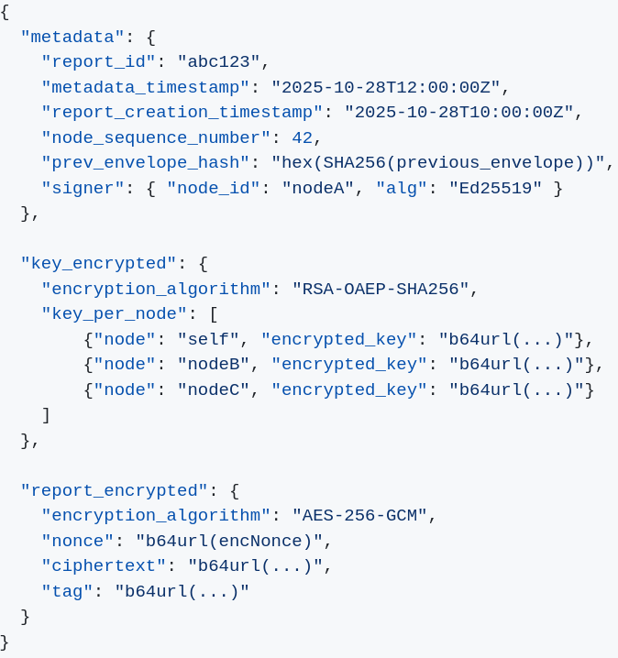
Secure Document Format
Envelope Design
Lightweight security library
protect · check · unprotect
Confidentiality
Report encrypted with AES-256-GCM with metadata as AAD;
DEK encrypted per recipient using RSA-OAEP-SHA256.
Integrity & Authenticity
Ed25519 signature over (report || metadata), stored encrypted.
Consistency & Ordering
Per-sender sequence number & previous hash - detects duplicate, reordered, forked or missing (partially) reports.
Design Choices
Standard, well-supported crypto (AES-GCM, RSA-OAEP, Ed25519);
Separate keys for encryption and signing (cross-protocol attacks).
Why It Works
AEAD binds content + metadata - tamper detection;
Encrypted signatures prevent impersonation and signature swapping;
Hash chaining gives strong integrity/consistency without heavy consensus.
Notes:
(Time: 1:00 - 1:45) -> Pais
To protect the reports, we implemented the required security library, which manages reports using this envelope structure.
This envelope is divided into three main parts: [point] metadata, [point] key_encrypted, and [point] report_encrypted.
First, let’s look at [point] report_encrypted.
This field contains the actual report payload. It is encrypted using AES-GCM, and we use the metadata as Associated Authenticated Data.
This ensures that any tampering with the metadata is detected during decryption.
Next, the key_encrypted field.
Here, the AES encryption key is encrypted separately for each Node using their public key.
This allows secure key distribution while ensuring that only well-Known Nodes can decrypt the report.
Finally, let’s look at the metadata itself.
Within the metadata, we use elliptic curve for digital signatures, chosen for its strong security and high efficiency.
We also include a per-sender sequence number and a hash chain to detect missing, reordered, or tampered reports.

Slide 7
03
Security Protocol

Slide 8
Security Protocol
Report Submission
1
Nodes store encrypted reports locally, maintaining an append-only sequence with cryptographic links.
Merkle Commitments
2
Nodes compute and sign Merkle roots over buffered, unsynced reports, committing to their exact set and order.
Synchronization
3
Server collects, performs a multi-stage verification (slide 9), and globally sorts all buffers, creating a new signed block linked to the previous one.
Client Verification
4
Multi-stage pipeline verifies (slide 10) server block, block chain, Merkle root, per-node signatures, and hash chains.
Notes:
(Time: 1:45 - 3:15) -> Tomás This is the most complex section. We should speak clearly and focus on the 'Blockchain' analogy.
To handle the Untrusted Server, we couldn't just trust it to store files. We implemented a lightweight Blockchain mechanism
Clients maintain a local hash chain. Every new report contains the hash of the previous one, creating an immutable local sequence
When syncing, clients don't just upload the unsynced files; they upload a signed Merkle Root of the buffer they are sending to the server for reordering.
This commits them to the exact set and order of reports, preventing the server from dropping or changing items.
On the other side, the server not only reorders all the reports, as it also computes a Merkle Root of the new ordered block, which it then signs and links this to the previous synced block to ensure continuity.

Slide 9
Server Verification Pipeline
For each buffer of envelopes (with encrypted reports and metadata) received from clients:
Client Buffer Root Signature
1
Verify each node’s signature on its Merkle root to verify its authenticity.
Buffer Merkle Root
2
Recompute the root from received envelopes to ensure the buffer is complete and untampered.
Client Envelope Chain Continuity
3
Ensure the first report links correctly to the last known synced report from the sender node to detect diverging histories.
Client Envelope Chain
4
Ensure all reports link correctly to their predecessors to detect missing, duplicated or out of order reports.
Notes:
Tomás
The server enforces this order. As shown here, it verifies the client's Merkle root and checks chain continuity. If any check fails, the entire client batch is rejected.

Slide 10
Client Verification Pipeline
For each block of ordered envelopes (with encrypted reports and metadata) received from the server:
Server Block Signature
1
Verifies server's identity and sync result authenticity.
Block Chain Continuity
2
Ensures history continuity with the previous block root and sequence number and detects server equivocation.
Block Merkle Root
3
Recompute Merkle root from received ordered envelopes to confirm server has not reordered or omitted envelopes.
Per-Node Buffer Signatures
4
Verifies each buffer signature, preventing the server from fabricating buffers on behalf of nodes.
Per-Sender Hash Chains & Continuity
5
Using the previous envelope hash and sequence number, detects missing, duplicated or reordered reports per sender.
Notes:
Tomás
Similarly, clients run a multi-stage pipeline. Most importantly, they verify the Block Chain Continuity and the per-sender buffer integrity to ensure the server or other entity hasn't forked or tampered with the history.

Slide 11
04
Infrastructure, Secure Channels & PKI

Slide 12
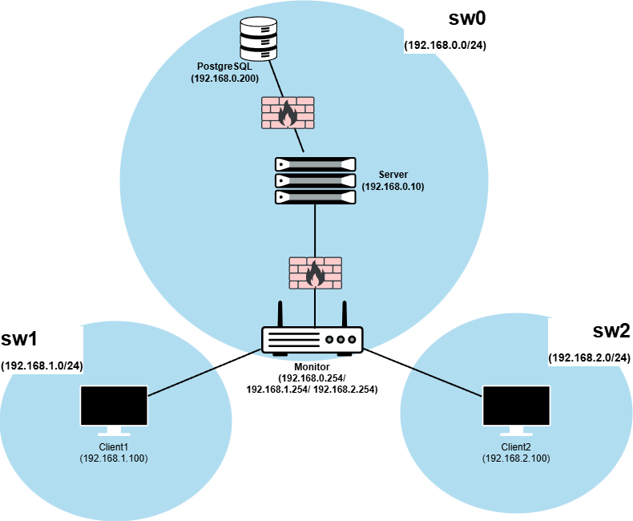
Infrastructure
Communication Flow
Client Nodes → Monitor (Gateway) → Server → Database
Database → Server → Monitor (Gateway) → Client Nodes
Clear separation of roles and network segments.
Monitor as gateway
All node traffic passes through the monitor, which performs
NAT and forwarding, while supervising the network and enforcing policies.
Minimal attack surface
Server exposes only port 9090, reachable only from the monitor.
Database reachable only from the server on 5432.
Strong isolation
Server, DB, monitor, and nodes are on separate subnets.
Nodes cannot talk to each other or the DB.
Strict firewalling (iptables)
Default DROP policies everywhere.
Explicit allow rules only for required flows.
Notes:
(Time: 3:15 - 4:00) -> Pais
Our infrastructure mirrors a high-security network topology. We isolated the system into distinct networks: Each client node have its own network; the server and the database are on the same network.
The Monitor, acts as a transparent Gateway between all the networks.
The Server is isolated and only accepts connections from the Monitor and the DB.
Database only accepts connections from the server.
We utilized restrict rules for the firewall using iptables with a default DROP policy, to minimize the attack surface.

Slide 13
Communication Security: TLS & PKI
Mutual TLS (mTLS)
All gRPC (Client ↔ Server) and JDBC (Server ↔ Database) communications are secured with mTLS.
Two-Level Key Architecture
User-level keys: RSA-2048 for report encryption, Ed25519 for digital signatures.
Transport-level keys: RSA-2048 key pairs for TLS server/client authentication, X.509 certificates.
Public Key Infrastructure (PKI)
CA: Manages trust relationships with a self-signed root certificate.
Entity Certificates: Unique certificates for each node, server and database, signed by the CA, with SANs.
Notes:
(Time: 4:00 - 4:45) -> Pais
For transport security, we enforce TLS with Mutual Authentication on all channels, including the connection between Server and Database.
We separate Transport Keys (TLS) from User Keys (signing/encryption).
For Public Key Infrastructure, we followed our assumptions and simulated creating a CA with a self-signed root certificate, which signs the certificates of each node, server and database.

Slide 14
05
Security Challenge

Slide 15



Security Challenge: B
Monitor Server Role
A dedicated Python-based monitor server observes network activity to detect flooding attacks from misbehaving nodes.
Positioned as a gateway between clients and the central server, it intercepts all client-server communications.
IP | # Sync | Status
192.168.1.10 | 3 | [-] Blocked (22s)
192.168.2.2 | 1 | [!] Warning
Monitor
Flooding Detection
Monitors client synchronisation requests. If a client sends too many requests within a 30-second window, the monitor inserts a dynamic iptables rule to drop that client's packets temporarily.
Blocking timeout doubles with each subsequent infraction.
Server
Database Server
Notes:
(Time: 4:45 - 5:30) -> Pedro
For Challenge B, we needed to ensure availability against flooding. We implemented a Vigilant Monitor using Python.
Because the monitor acts as the gateway, it can passively sniff traffic without needing to decrypt it. It knows the exact size of Sync requests from the clients to the server
and uses it to track the number of Sync requests per client within a 30-second window.
If a client exceeds the threshold, the Monitor inserts a dynamic iptables rule to drop that client's packets at the network layer
This protects the application server from ever having to process the spam traffic.

Slide 16
06
Results & Conclusions

Slide 17
Results & Conclusions
Requirement | Mechanism | Enforcement Point
SR1: Confidentiality | End-to-end AES-GCM encryption | Only authorized nodes can decrypt
SR2: Integrity (individual) | End-to-end AES-GCM and Ed25519 signatures inside ciphertext | Client verification upon decryption
SR3: Integrity (batch) | Per-sender hash chains + Merkle trees | Server and client verification
SR4: Consistency | Signed block roots + block chaining | Client multi-stage verification pipeline
Availability | Gateway Monitor Server that supervises client-server traffic | Detects and blocks clients that exceed the sync requests threshold
Communications | mTLS and network isolation | gRPC & JDBC are implemented using mTLS
We believe our system meets all project requirements under the defined threat model and assumptions.
Notes:
(Time: 5:30 - 6:00) -> Pedro
In conclusion, we believe we have fully satisfied all the project security requirements, as it is shown by this table summary of what we have just explained.
Thank you.
We are now ready for the demo.
—
<Confidentiality and Individual Integrity are secured via our Hybrid Envelope.
Batch Integrity and Consistency are guaranteed by our Hash and Merkle Chains protocol.
Availability is protected by the Monitor.
All infrastructure communications are secured with mutual TLS.
While the system is robust under our current assumptions, future work would focus on improvements such as Dynamic Membership, allowing nodes to join and leave the network without redeployment.>

Slide 18
07
Demo

Slide 19
Thank you!

