Slide 1
Clean Architecture
Tomáš Jurásek

Slide 2
Motivation
If you think good architecture is expensive, try bad architecture.
-Brian Foote and Joseph Yoder
The only way to go fast, is to go well.
-Robert C. Martin

Slide 3
SOLID
Single Responsibility Principe (SRP)
Open-Closed-Principle (OCP)
Liskov Substitution Principle (LSP)
Interface Segregation Principle (ISP)
Dependency Inversion Principle (DIP)
KISS (Keep It Simple, Stupid!)
Short method and class
Single responsibility
Refactoring
Split your problems to smaler

Slide 4
Clean Architecture
Core
Domain Entities != Database Entities
UseCases (request, response)
Domain Services and Interfaces
Infrastructure
Third party library services (EF, Redis, SendGrid,IoC,..)
API
Controllers
Models
Web services (Context handler, web IoC installers,…)

Slide 5
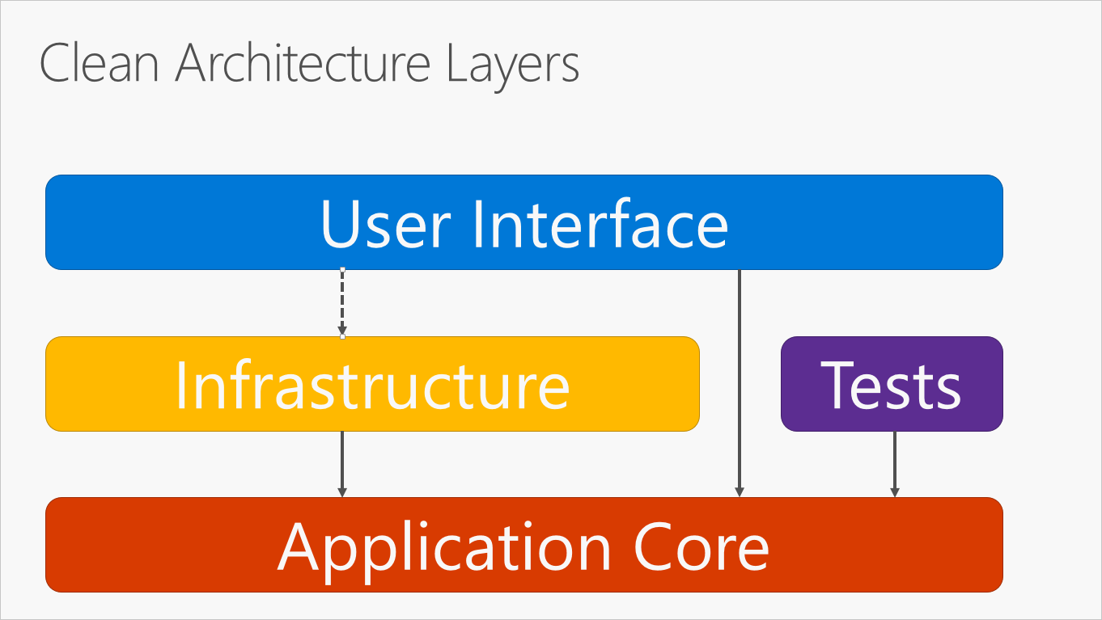

Slide 6
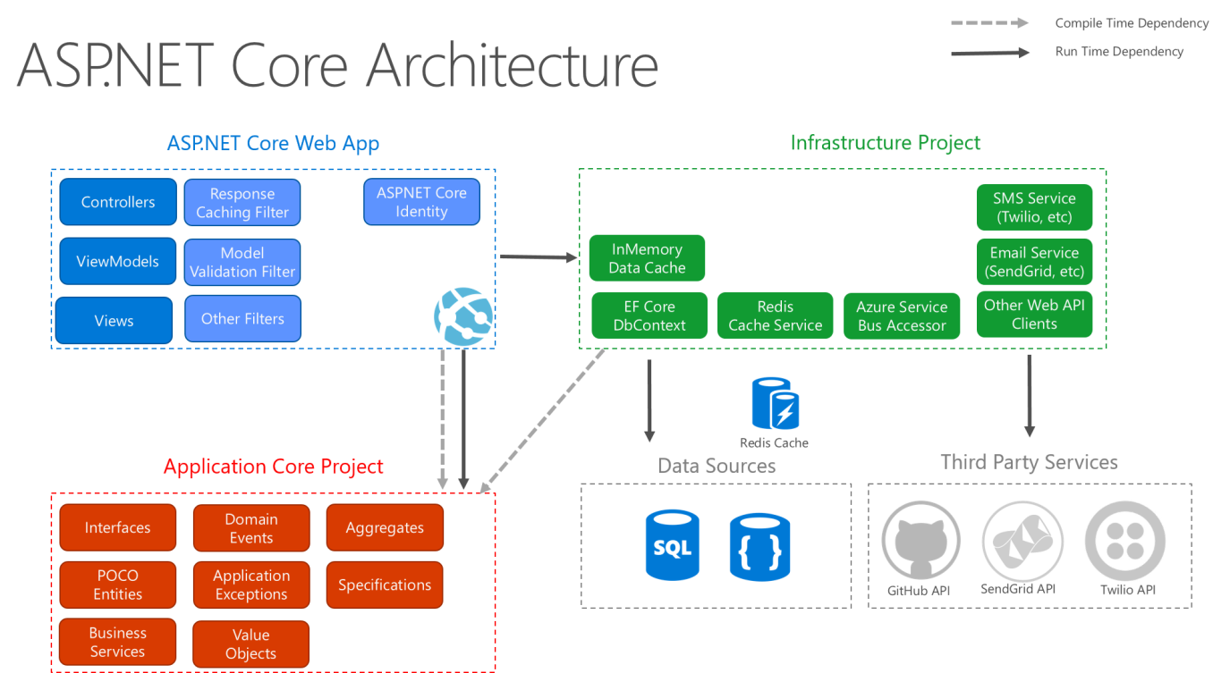

Slide 7
Demo

Slide 8
Links and Books
https://www.amazon.com/Clean-Architecture-Craftsmans-Software-Structure/dp/0134494164
http://voho.eu/wiki/princip-solid/
http://www.robertdresler.cz/2016/10/jednoducha-slozitost-nebo-slozita.html
https://www.augi.cz/programovani/moderni-programovani-v-c/
https://github.com/tomasjurasek/CleanArchitecture

