Slide 1

Writing Sound Asynchronous Code with Coroutines
Tomas Kulich
ReactiveConf 2016

Slide 2
Old school: Callbacks
fetchData(url, (err, data) => {…})

Slide 3
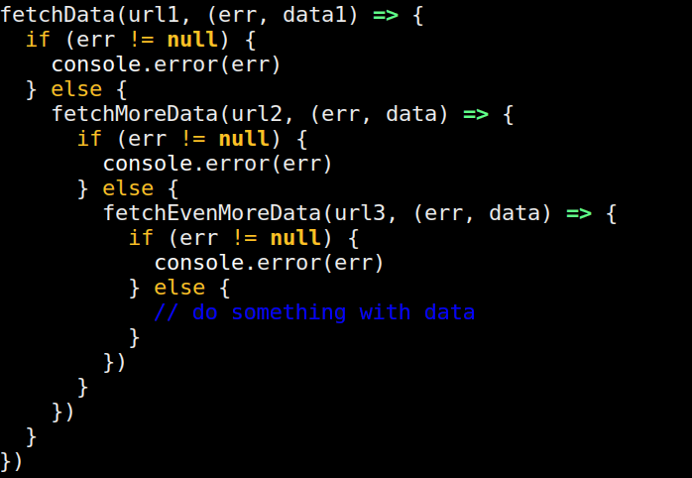

Slide 4
Promises: Great Leap Forward
fetchData(url).then((data) => …)

Slide 5
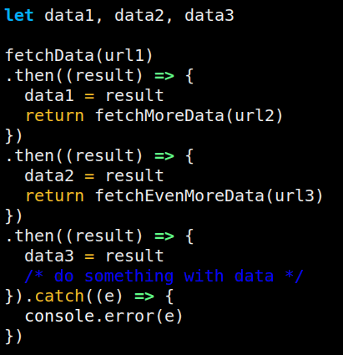

Slide 6
Super Great Leap Forward: Promises + async / await

Slide 7
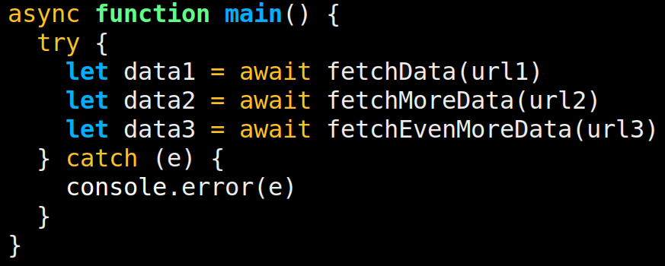

Slide 8


Slide 9
Alternative approaches
Communicating Sequential Processes
aka CSP
js-csp, core.async in Clojure
koa webserver
co
task.js
redux-saga

Slide 10
yacol
Yet Another COroutine Library
https://github.com/vacuumlabs/yacol
npm: yacol

Slide 11
doBusiness
invoice
pay

Slide 12
.catch
doBusiness
invoice
pay
Error

Slide 13
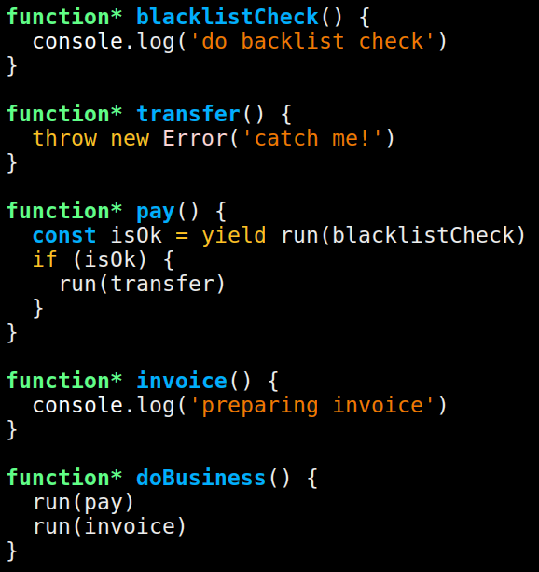
doBusiness
pay
invoice
blackl.
transfer

Slide 14
.catch
doBusiness
pay
invoice
blackl.
transfer
Error

Slide 15
Explicit parent-child relationship, yay!
Context (Dart zones, thanks Dart)
Messaging (very simple, thanks js-csp)
Plays nice with promises
--- TBI ---
Terminate
Awesome stacktraces
Inspect

Slide 16
Explicit parent-child relationship, yay!
Context (Dart zones, thanks Dart)

Slide 17
{}
context.set(
‘hello’,
‘world’
)
{}
{}
{}
context.get(‘hello’) === ‘world’

Slide 18
Explicit parent-child relationship, yay!
Context (Dart zones, thanks Dart)
Messaging (very simple, thanks js-csp)

Slide 19
Explicit parent-child relationship, yay!
Context (Dart zones, thanks Dart)
Messaging (very simple, thanks js-csp)
Plays nice with promises

Slide 20
Explicit parent-child relationship, yay!
Context (Dart zones, thanks Dart)
Messaging (very simple, thanks js-csp)
Plays nice with promises
--- TBI ---
Terminate
Awesome stacktraces
Inspect

Slide 21


Slide 24
https://github.com/vacuumlabs/yacol
npm: yacol
Questions please?

