Slide 2
Screen
Data
New screen

Slide 3

Display always fresh data
Do only little extra work

Slide 4

Not everything is awesome.
- Rich Hickey

Slide 5

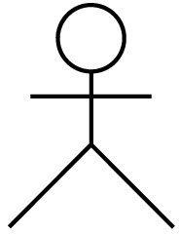

Slide 6
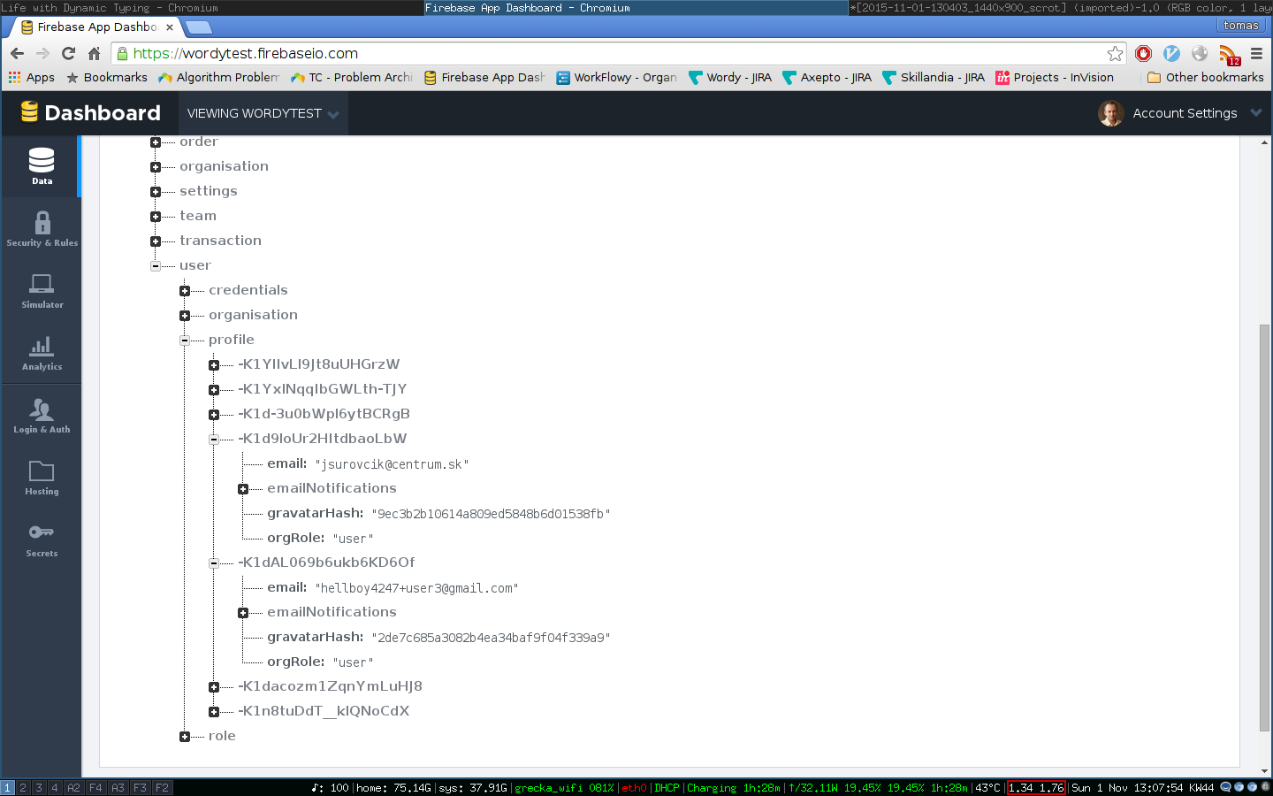

Slide 7

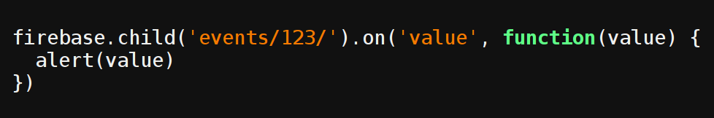

Slide 9



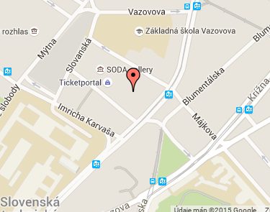


Emily | Jogging @ Petrzalka
John | Beer @ Bratislava
Eve | Cinema @ Vienna
Ford | Wild party @ Saffron
Arthur | Tea @ Teahouse
Initiator: Ford Prefect
Description: Party
Place: Hotel Saffron, Earth
Remarks: Bring your own towel

Slide 10
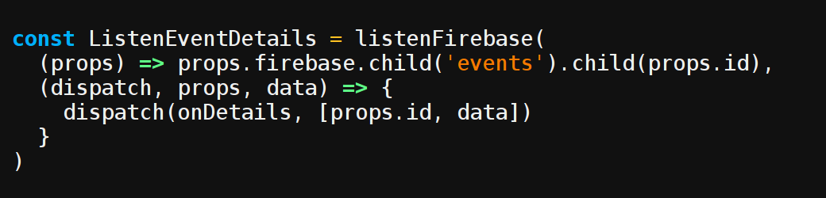

Slide 11
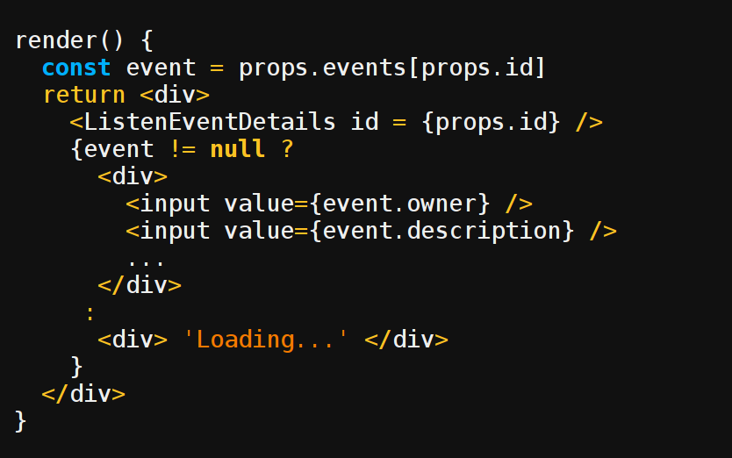

Slide 12
Eliminating read API endpoints

Slide 13
GET api.mycoolapp.com/event/{id}
GET api.mycoolapp.com/sql/"select * from users join events on users.id = events.id where users.id = 123“
GET api.mycoolapp.com/sql/"delete * from users"

Slide 14
Let
user/$id
be guarded by
function(who, what, DB) {
if who == $id and only 'name' changes
}

Slide 15
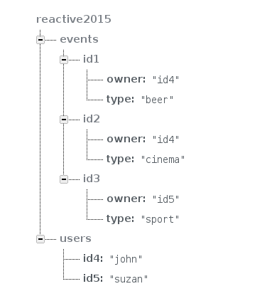



Slide 16
???
Firebase
SQL
2.
1.
3.

Slide 17
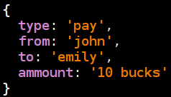
Transactions? Nope.
firebase-transactions
https://github.com/vacuumlabs/firebase-transactions

Slide 18
Not everything is JSON document
-- old Chinese proverb --

Slide 19

User
name | String
attends
friends
Event
type | String
people
place | String
food_served
etc

Slide 20
(d/q '[ :find ?name
:where [?name :name ?person]
[?person :attends ?event]
[?event :food_served ?food]
[?food :contains ?ingredient]
[?ingredient :name "chocolate"] ]

Slide 21
Reversibility: What subscriptions (and how) are affected by a given change?
change:
sub1: firebase.child('events/234').on(…)
sub2: firebase.child('events/123').on(…)
sub3: firebase.child('users/567/name').on(…)
sub4: firebase.child('events').on(…)
firebase.child('events/123/place').set(…)

Slide 22
Summary
Reactivity is great, especially when cheap
Probably quite doable with right tools
HARD
Several subproblems must be tackled at once
Firebase, GraphQL, Relay, Falcor, Datomic, …
Let’s get to work

