Slide 1
Type inference for dynamic languages
Tomáš Kulich, Ľubo Žák, Dominik Kapišinský
Seminár teoretickej informatiky, 10.5.2013

Slide 2
Outline
Short introduction to Python, overview of its (scary?) dynamic features
Why dynamic languages? Why Python?
Problem definition
Overview of existing solutions

Slide 3

Python

Slide 4
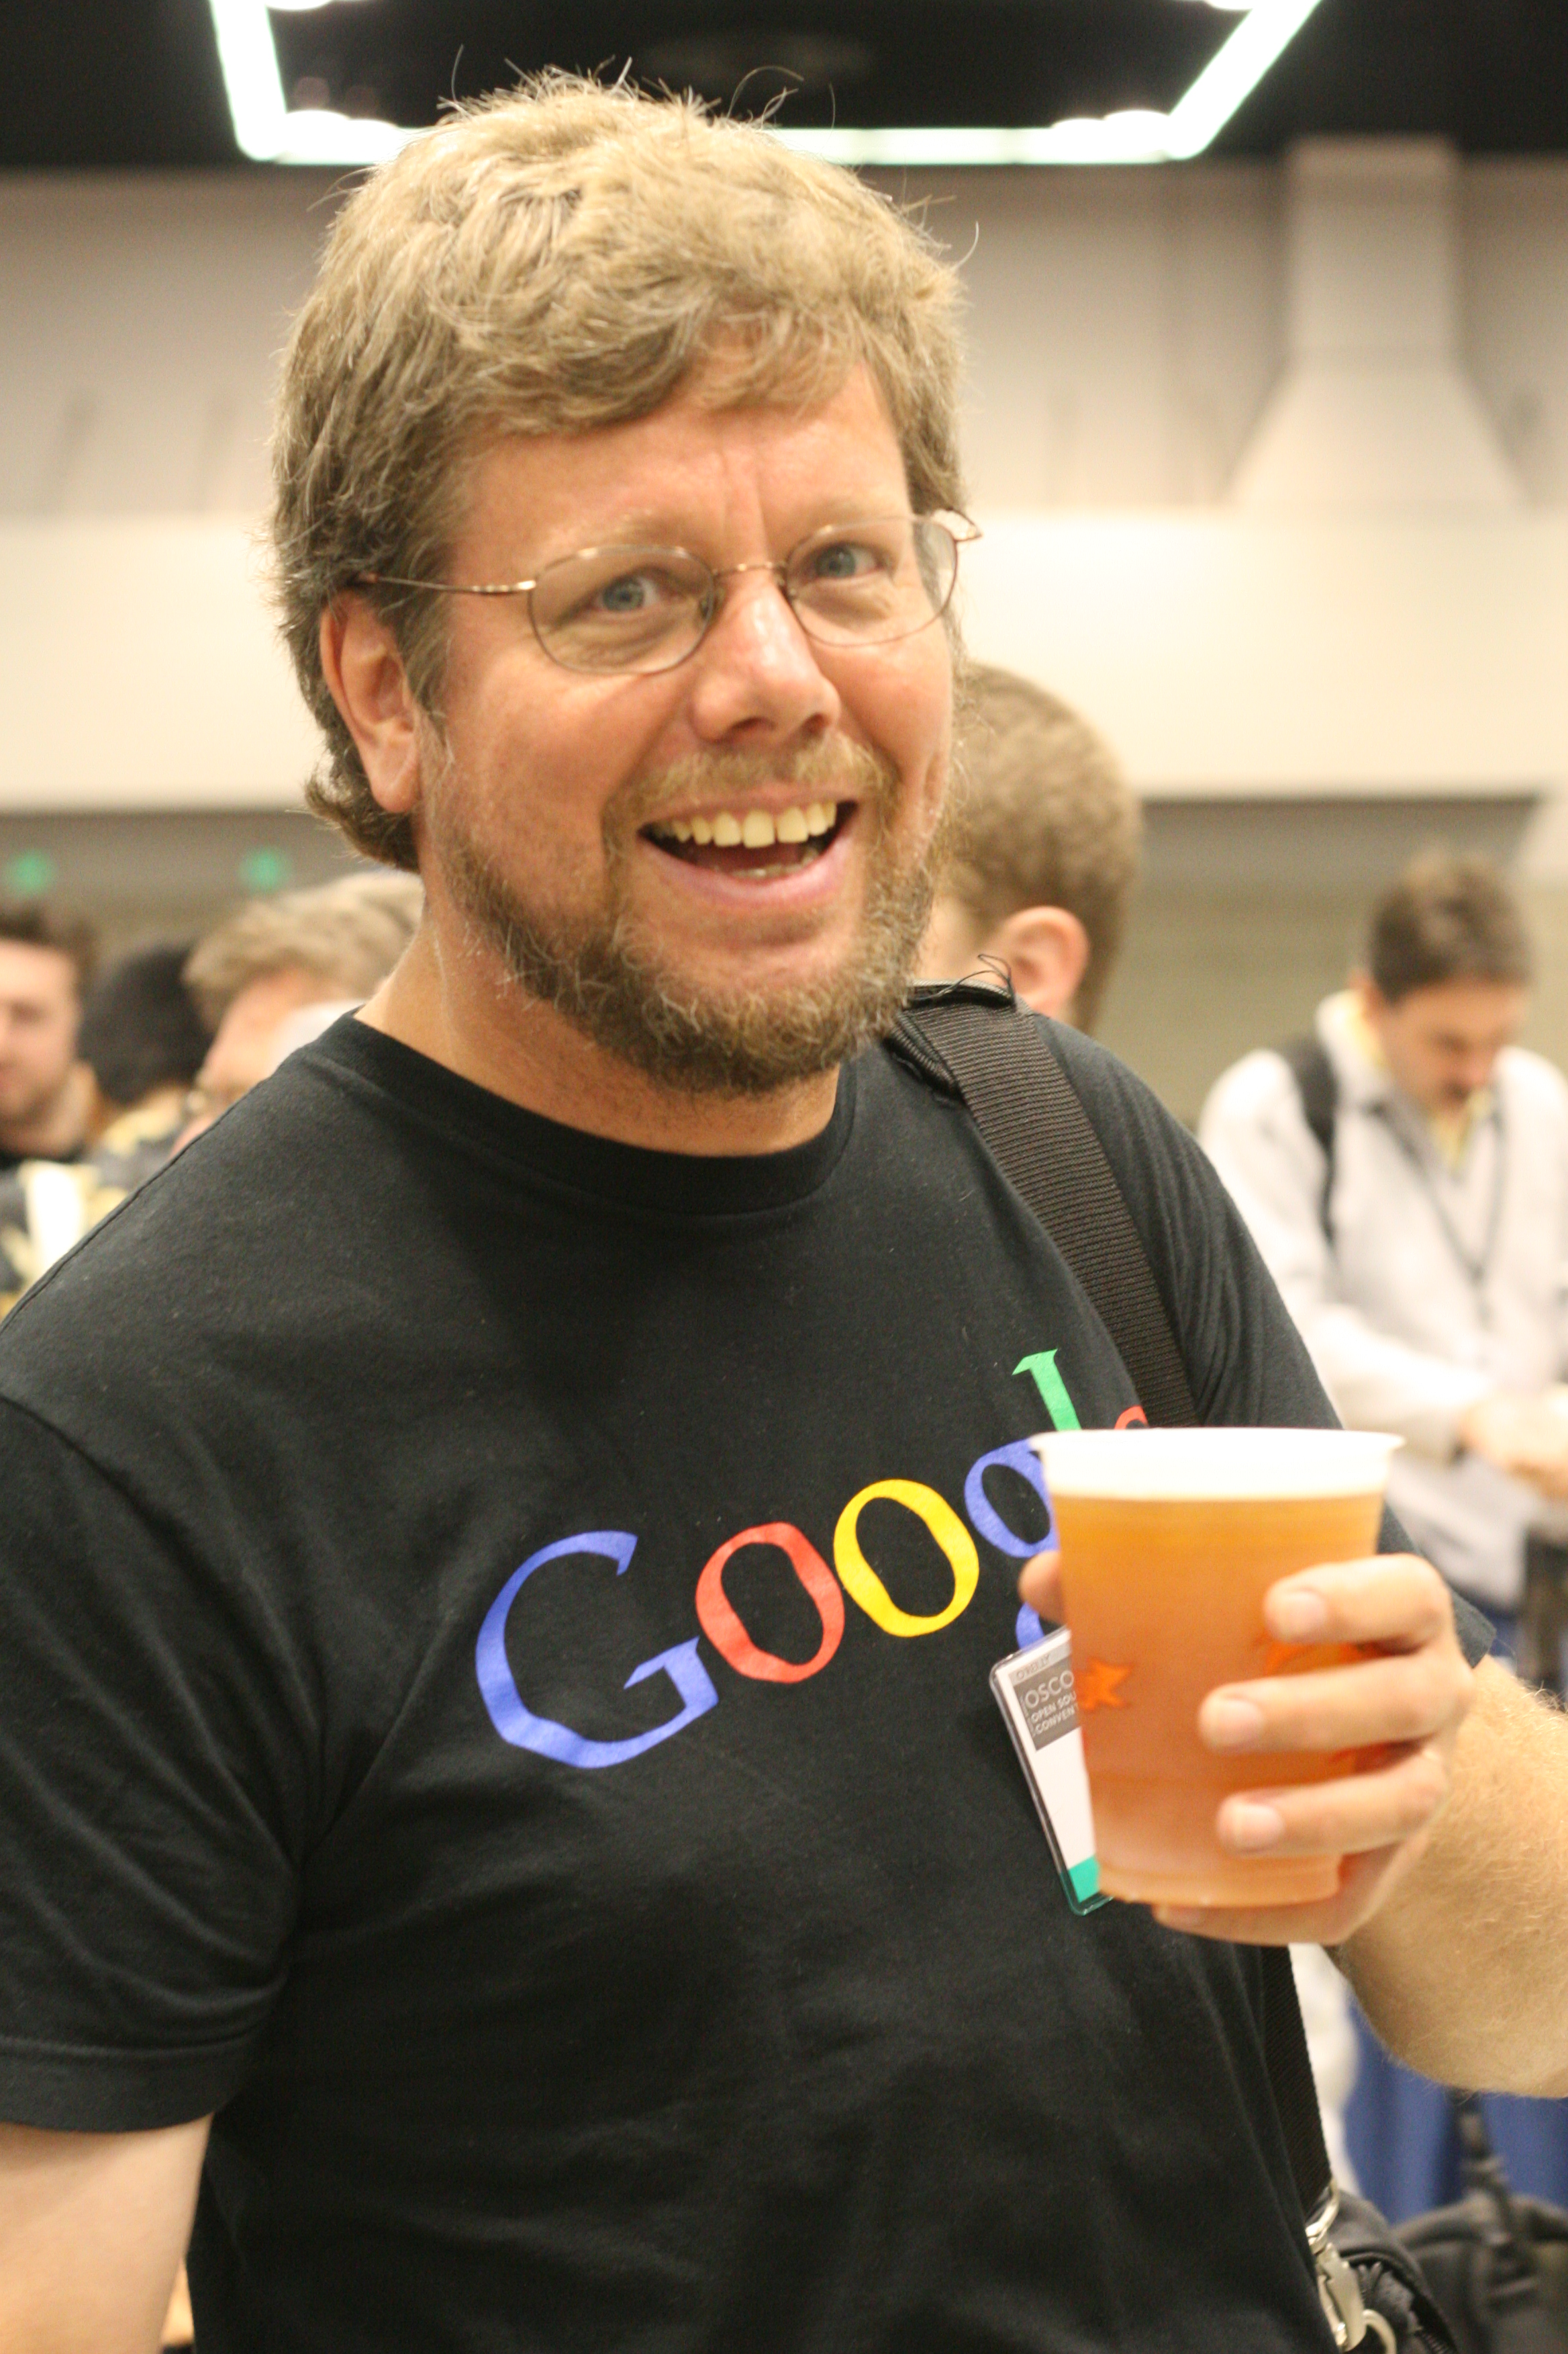
Python
not a snake!
written by Guido van Rossum (BDFL)
as a Christmas passtime in '89
Just one representant of wider family of languages (Python, Ruby, Groovy, Clojure, Javascript, etc..) (not Scala!)
Chosen for its maturity
Scripting language, but not only scripting language

Slide 5
What does it mean to be dynamic?
Object is just 'sack' full of objects and functions bound to their names
Attributes can be dynamically added
Functions are first-class objects, e.g. attributes
Methods are just functions
Class is just 'template' for creating objects, it has no deeper meaning

Slide 6
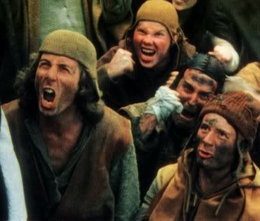
Common Python outcries

Slide 7
I know JavaScript and it sucks
JavaScript is connected to DOM, it is DOM that is broken
No proper IDE
JS community is full of lousy coders and lousy code
If error, 'fail as late as possible' strategy (this is bad!)
“Python is Javascript done right” (one young CTO)

Slide 8
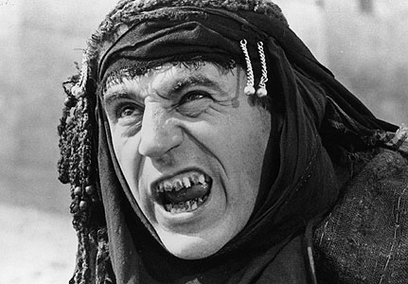
Broken ==
"" == 0 //true
0 == "0" //true
"" == "0" //false
Casting like mad
[]+[] === "" //true
{}+[] === 0 //true
isNaN({}+{}) //true
[1,2,3]+4 === '1,2,34' //true
(from Gary Bernhardt's WAT)

Slide 9
Indentation for specifying code blocks? You must be joking!
Just try it!

Slide 10
Code must be type safe
(or: if you do not have compile time type safety, the code must broke all the time)
“What kind of type safety checks if you convert inches to centimeters correctly?” (paraphrased from GvR's speech)
If you do not test, it'll get nasty in any language

Slide 11
Access modifiers are esential
(Access modifiers = private, public, protected, ..)
Does Java really respect access modifiers?
  reflection model
  bytecode manipulation
“We don't lock the door, we take our tie and put it on the door and say that the room is occupied. If you come in, what you see and how you react is your own problem.”
(Raymond Hettinger, author of the itertools library)

Slide 12
Java evolution (skeptic version)
  1. Restrict everything
  2. Oops, those feature WERE usefull, let's get them back using bytecode manipulation!
  3. Gazilion of frameworks / libraries are coded for this sole purpose
  4. Almost every one is full of dark magic, almost none of these is compatible with any other one
  Java EE is not solution, at least for now.

Slide 13
Python is SO slow
WAY faster than PHP and who cares?
PYPY
Great C extensions (numpy, scipy,...)
“Premature optimization is root of all evil” (common knowledge)

Slide 14
You can do dynamic.. So what?
You can prototype faster
Modularity, better code reuse
Nicer architecture?
You can unit test properly
  Mocking is amazingly easy
There is no DI framework in Python (ZOPE?)

Slide 15
Most serious outcry: Where is some fine IDE?
You may not like Java, but Eclipse is great, IDEA is even better (?)
Eclipse is great for Java but plugins for other languages are quite poor
VIM is a great editor, but it is not fine IDE

Slide 16
What do we need from fine IDE
Highlight syntax (done)
Show as much errors and warnings during typing the code as possible
Code completion
Easier refactoring
Quick navigation in the project (show definition of variable, function, object, class)
Management of user's project (needed?)
Managing running configurations (needed?)
Support for testing (definitly not needed)
Quality of code meassures (Pylint)

Slide 17
Pylint, Pyflakes

Slide 18

Can we do better?

Slide 19
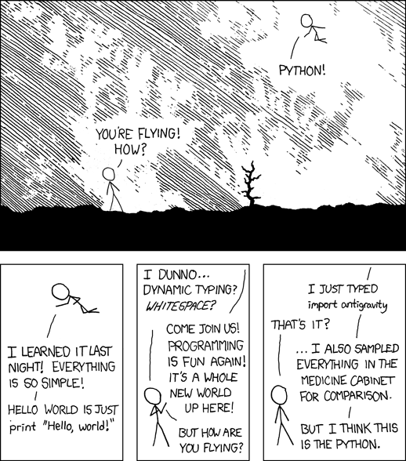

Slide 20
How can we infer the type?
static-type approach: ignore most of the dynamic features, make some inference rules
another approach: run the code and see
(does the object 'o' have the attribute 'www' on the line 42 ? Well let's see)
Can we do something in between?

Slide 21
Symbolic execution
Do exactly the same as interpreter, but:
  Instead of variables' values use their types
  Substitute std library and native code by mock implementation
    Mock implemntation must have no side-effects and mus return correct type
  If you are not sure, what would interpreter do, guess
  We are trying to give valuable advice, but we are not proving anything

Slide 22
Typez
a=1+2 is just Typez(int)
o=Empty()
o.a=5
o.b='ahoj'
o=Typez(
  'a': Typez(int),
  'b': Typez(str),
  '__class__':Typez(...),
)

Slide 23
Problematic?
EASY | DOABLE | HARD
function, classes | if | Inversion of controll
closures | try/catch | eval, exec?
inheritance
in-time semi-accuracy
builtins, std. library
for, while
list comprehension

Slide 24
for, while
Ostrich algorithm

Slide 25
builtins
class Num_(inf_object):
def __add__(self,x):
return 0
def __div__(self,x):
return 0
def __mul__(self,x):
return 0

Slide 26
try/catch
trivialy reduceable to if

Slide 27
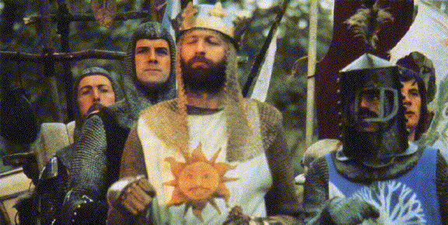
if
Former strategy: if-else-merge
New strategy: shoot and relax

Slide 28
collections
class list():
def __init__(self):
self.val=None
def append(self, item):
if undecidable:
self.val=item
def __setitem__(self, attr, item):
if undecidable:
self.val=item
def __getitem__(self, attr):
return self.val

Slide 29
Future work

Slide 30
Thank you for your attention

Slide 31
If Python is so great, why it is used so infrequently?
“There is a lot of friction in the system” (Andy Tanenbaum)
Speed (very important point for e.g. Google)
Can I trust BDFL? Can I believe they are not going to screw it up?
Great with POSIX systems, sharp edges on Windows

