Slide 1
User-Centered Design and Evaluation
First Assessment
Team 17

Slide 2

Hunt Statement
Are young adults already thinking about future expenses or still living day by day?

Slide 3
RESEARCH PLAN
Survey:
Open Answer Questions
Multiple Choice Questions
Goals:
Financial Literacy Level
Budget Management Strategy
Future Goals?
Already thinking about the future?

Slide 4
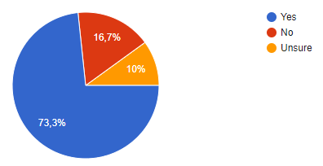
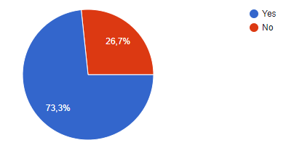
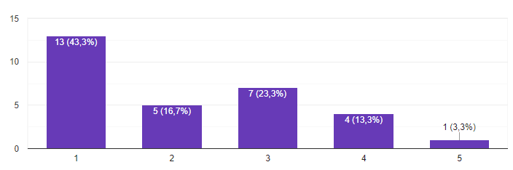
Data analysis
Concerns about not having enough money to rent/buy a house:
Do you live with your parents/share a house?
Reasons for not using a budget management app:
Didn’t find a good one
Already careful with spendings
Don’t have much expenses yet
Not useful
Financial Literacy Level:

Slide 5

Persona
Profile:
Has a bachelor and/or a master’s degree.
Recently started his first job.
Lives with his parents.
Doesn’t make enough money to move out
To be addressed:
Improve own’s financial literacy.
Generate passive income.
Get better at managing his wage
Technology:
Proficient in social media and the internet.
Has a high-end smartphone and a good laptop.
Personal Goals:
Move out from his parent’s house.
Progress professionally
Live comfortably
João
23 Years
Fresh Graduate

Slide 6
SCenario
João, 23, just started working on a big company and needs some sort of way to improve his financially literacy, especially when he travels to work/home or on breaks to better manage his income and finance and also generate passive income.
Since it’s his first job out of college, his income isn’t enough to move out and be financially independent. He wants to learn more about finance however, doesn’t know where to start and on the weekends or at the end of the day he is too tired to try.

Slide 7
SCENARIO
Offer an app where he can read small lessons (each one shouldn’t take more than 5 minutes to read), these lessons are organized in modules, in this app he can also simulate investments, he can also track his expenses to get a better understanding of where he spends his money and how he can save up.
First Assesment

Slide 8
IDEATION
A landing page where he can input his income and it gives him his best options regarding investments/passive income
A virtual reality application where the user can visualize stats about his spendings
An app (duolingo style) where he can have classes about financial literacy
4. A landing page that, after inputting your monthly income, gives you information on what percentage of it should be spent in which area (rent, groceries, etc)

Slide 9
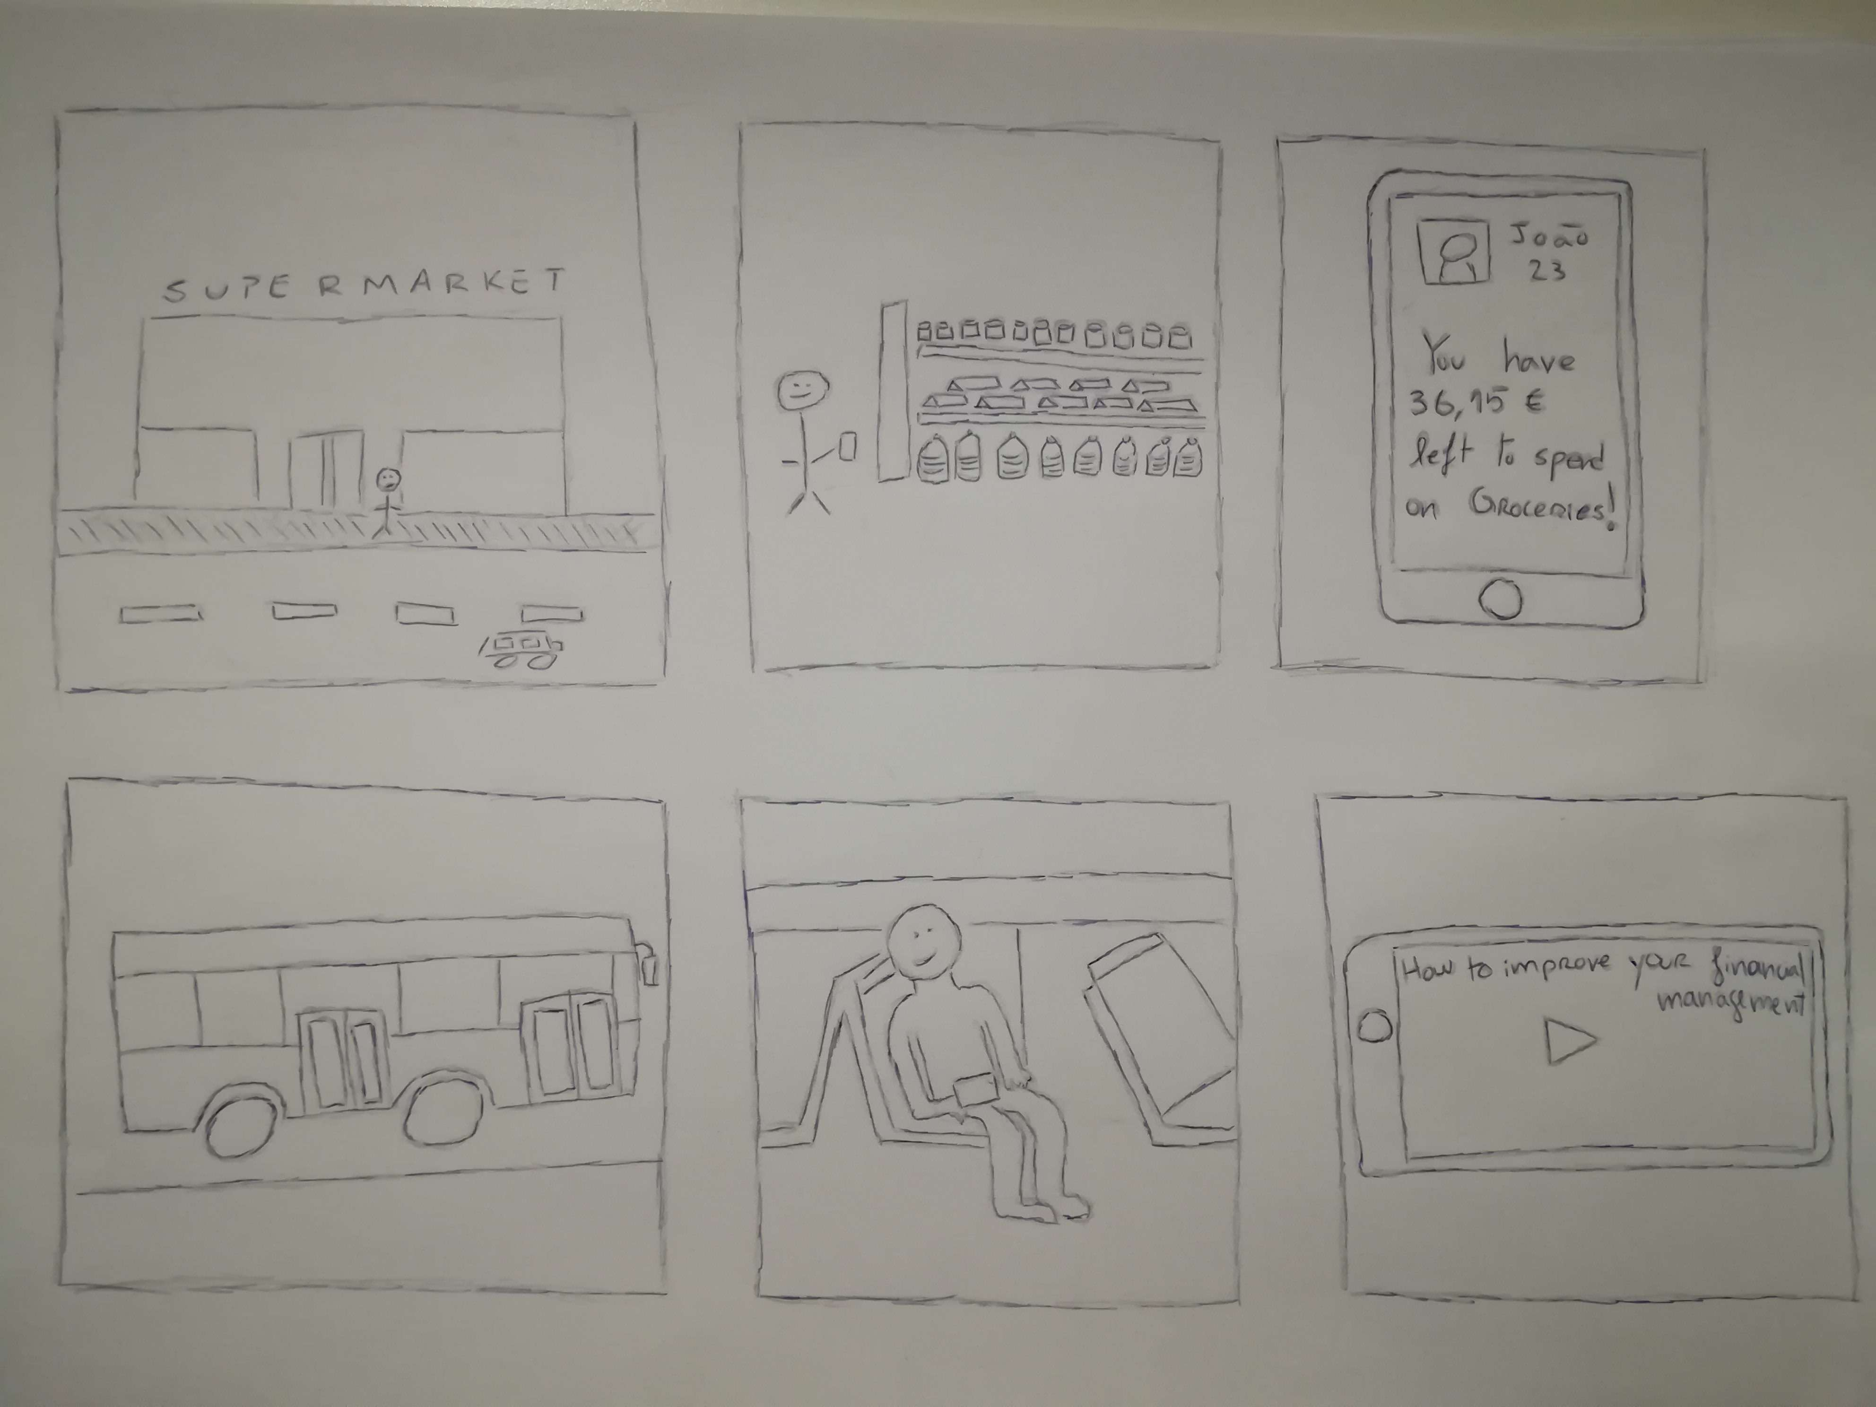
Storyboard

