Slide 1
✈
DST Airlines
Flight Delay Analytics Platform
Data Engineering Project | DataScientest | Feb 2026
PostgreSQL + MongoDB + Neo4j
Dash + FastAPI + Docker
560,352 Real Flights
Ali Doghan | Adam Bonwitt | Timo | Fabian K · Mentor: Antoine F

Slide 2
The Problem
Why do we need this platform?
$33B
28%
47 min
Lost every year
due to delays
of US flights
are delayed
average delay
per flight
Our platform answers:
Which airlines delay the most — and why?
Which routes are most likely to be delayed?
Will THIS flight be delayed, and by how many minutes?
What is the shortest path between any two US airports?

Slide 3
System Architecture
4 layers · 7 Docker containers · one command to start everything
DATA
STORAGE
API
DASHBOARD
560K Flights
Kaggle CSV
PostgreSQL
MongoDB · Neo4j
FastAPI
13 Endpoints
Dash + Plotly
7 Pages
▶
▶
▶
ML Models
Live Weather
Neo4j Graph
Docker
Logistic + Linear
Regression
Open-Meteo API
346 airports
shortestPath
algorithm
7 containers
1 command

Slide 4
Key Numbers
560,352
28%
346
5,167
Real Flights
Delay Rate
Airports
in Neo4j
Routes
in Neo4j
7
16
7
3
Dashboard
Pages
API
Endpoints
Docker
Containers
Databases

Slide 5
Three Specialized Databases
Each database is built for a different type of data
PostgreSQL
MongoDB
Neo4j
Structured Historical Data
Flexible Live Data
Airport Route Graph
560,352 real flights
Real-time flight positions
346 airport nodes
Medallion: Bronze → Silver → Gold
OpenSky Network API
5,167 route relationships
SQL queries & joins
ML prediction log
shortestPath algorithm
Delay stats aggregation
Flexible JSON documents
Impossible with SQL alone

Slide 6
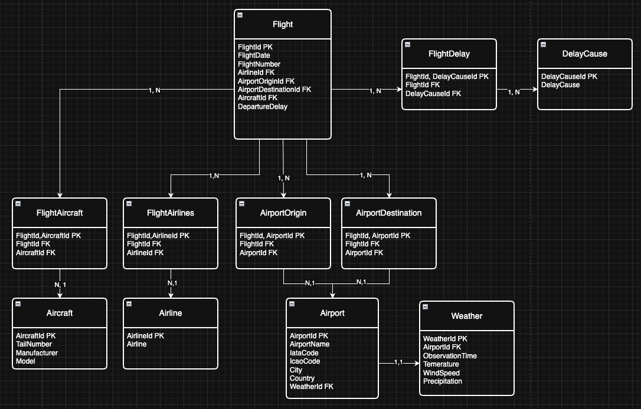
Step 1: Database Infrastructure + System Setup
Setting up the foundation — LDM, Docker, and PostgreSQL schema
First Steps:
Draw LDM for the database
Init docker-compose.yml for PostgreSQL
Implement SQL dump file as database blueprint
Providing a README.md
Start Up Guide
1. Clone the GitHub Repo
2. Start the docker container
docker compose up -d
3. Initialize the database
docker exec -i pg_airlines_container psql -U airlines \
-d airlines_db < ./airlines.sql

Slide 7
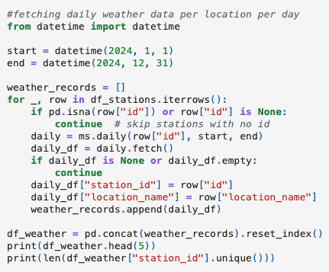
Step 2: ETL — Data Collection
Extracting data from Kaggle and Meteostat, cleaning, and loading into bronze layer
Data Sources:
#fetching daily weather data per location per day
from datetime import datetime
start = datetime(2024, 1, 1)
end = datetime(2024, 12, 31)
weather_records = []
for _, row in df_stations.iterrows():
if pd.isna(row["id"]) or row["id"] is None:
continue # skip stations with no id
daily = ms.daily(row["id"], start, end)
daily_df = daily.fetch()
if daily_df is None or daily_df.empty:
continue
daily_df["station_id"] = row["id"]
daily_df["location_name"] = row["location_name"]
weather_records.append(daily_df)
df_weather = pd.concat(weather_records).reset_index()
print(df_weather.head(5))
print(len(df_weather["station_id"].unique()))
• Flight delay dataset from Kaggle
• Weather data from meteostat
Cleaned up data loaded into bronze layer
via sqlalchemy

Slide 8
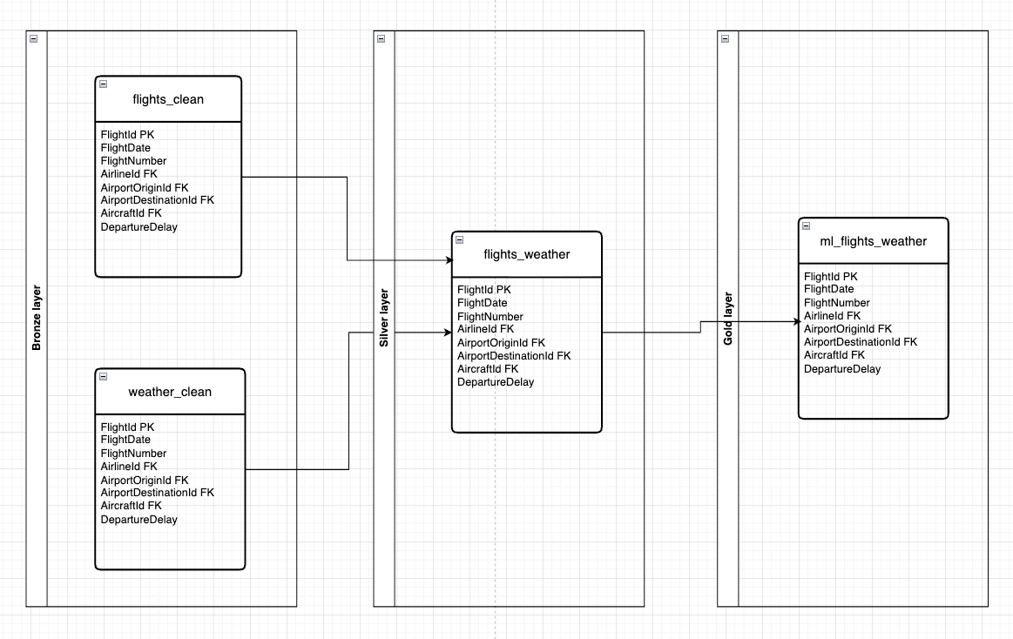
Step 2: Database Design
PostgreSQL — Medallion Architecture · Main use case: ML
Why Medallion? Main use case: ML
Layer | Table / View | Description
Bronze | bronze.flights | Raw flight data — 560,352 rows exactly as from CSV
Bronze | bronze.weather | Raw weather data per city
Silver | silver.flights_weather | Flights joined with weather — ready for analysis
Gold | gold.delay_summary | Aggregated stats per airline/route — ready for ML

Slide 9
Step 3: Machine Learning Models
Trained on 100,000 real flights from PostgreSQL · saved as models.pkl
Classifier
Regressor
Logistic Regression
Linear Regression
Question: Will the flight be delayed?
Question: How many minutes delayed?
Output: YES / NO + probability %
Output: Expected delay in minutes
Read 100K flights from PostgreSQL
Same 100K flights from PostgreSQL
LabelEncode: airline, origin, dest
Same LabelEncoded features
Train on DepDel15 column (0 or 1)
Train only on delayed flights
Predict: probability 0.0 → 1.0
Predict: minutes (e.g. ~43 min)

Slide 10
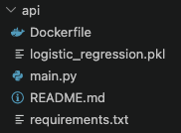
Step 4: FastAPI Implementation
Docker Container Setup to request predictions · Utilizing pre-trained .pkl file
📁 api/
🐳 Dockerfile
≡ logistic_regression.pkl
🐍 main.py
ℹ README.md
≡ requirements.txt
Own Container Setup
Utilizing pre-trained .pkl file
Returning prediction for the UI

Slide 11
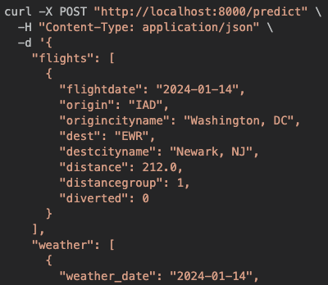
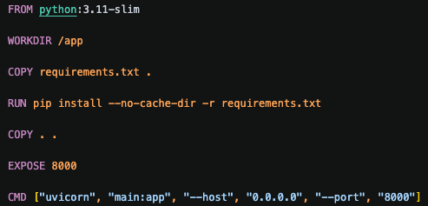
Step 4: FastAPI Flow
requirements.txt
installs
Docker
Container
runs
main.py
POST request
.pkl-file
provides
response

Slide 12
Step 5: Dashboard — 7 Pages
Built with Dash + Plotly · OOP architecture · Sidebar filters update all charts instantly
▣ Overview
✈ Airlines
⬡ Routes
▲ Trends
6 KPI cards · monthly trend · day analysis · top routes
Delay rate per airline · 5 causes stacked chart
Heatmap top 20 airports · bubble chart (3 metrics)
Monthly trend · worst routes with exact minutes
⚡ Risk Analyzer
🗺 Airport Map
🕸 Route Graph
ML + live weather + risk gauge — flagship page
Interactive US map · size=volume · color=delay rate
Neo4j shortestPath between any 2 airports

Slide 13
⚡ Flight Risk Analyzer
The flagship page — combines ML + live weather + historical data in one workflow
1
Select Airline → origin airports filter automatically
✅ LOW RISK
20.4% delay probability · ~43 min expected
2
Select Origin → destinations filter automatically (Cascading)
3
Select Day of Week
🌍 ATL — Atlanta
🌍 LAX — Los Angeles
16.8°C · 6.1 km/h · 0.0 mm
19.7°C · 11.6 km/h · 0.0 mm
4
Live weather fetched from Open-Meteo API — automatically
20.6%
26.5%
20.2%
7.7 min
5
Click Analyze → ML model predicts delay probability + minutes
Route
Delay Rate
Day
Delay Rate
Airline
Delay Rate
Avg Delay
on Route

Slide 14
Live Demo
Walk-through of the 7-page dashboard — presenter shares screen
1
Overview Page
2
Airlines Page
3
Routes Page
Show KPI cards + monthly trend + Tuesday worst day
Compare delay rates + show Late Aircraft as main cause
Heatmap + bubble chart — hover to show details
4
Risk Analyzer
5
Airport Map
6
Route Graph
Select airline → airport → day → show live weather → click Analyze
Hover over airports — show size vs color difference
Type JFK → LAX — show Neo4j shortest path result

Slide 15
Future Perspectives
What we would do next to make this production-ready
📡 Live Flight API
🔄 Auto ML Retraining
🌍 International Flights
Replace Kaggle CSV with a live API (OpenSky / AviationStack) to collect real-time flights automatically into MongoDB
Use Apache Airflow to retrain the model monthly with new data — keeping predictions accurate over time
Expand beyond US domestic flights to include European and Middle East airlines using Eurocontrol data
🚨 Alert System
☁️ Cloud Deployment
📊 Advanced ML
Send email or Slack alerts automatically when a route's delay rate exceeds a defined threshold
Deploy on AWS or GCP with auto-scaling so the platform handles real traffic from many users
Try XGBoost or neural networks for better accuracy, and add more features like historical weather patterns

Slide 16
Technical Decisions — Dashboard
Why we chose each technology for the dashboard
Why Dash, not Streamlit?
Why OOP architecture?
Full control over design and layout. Custom dark theme and complex callbacks not possible in Streamlit.
Two classes: LayoutBuilder + App. ChartFactory with 10 methods. Clean, readable, easy to extend.
Why API Layer?
Why Open-Meteo for weather?
Free — no API key needed. 346 airports with GPS coordinates. Real-time data fetched automatically.
Dashboard uses FastAPI endpoints instead of direct PostgreSQL:
Separation of concerns
Reusable by other apps
Production-ready (auth, rate limiting)
Automatic fallback to mock data
Why Cascading Dropdowns?
Why ORDER BY RANDOM()?
User does not need to know airport codes. Airline → Origin → Destination filters automatically step by step.
Prevents loading only January data. Gets a balanced sample from all months for better analysis and ML.

Slide 17
Our Team
Data Engineer Program · DataScientest · February 2026 Cohort
AD
AB
T
FK
Ali Doghan
Adam Bonwitt
Timo
Fabian K
Dashboard + ML + Neo4j
+ Weather + Map + Docker
+ Documentation
Data Collection
Database Design
Bronze Layer
Docker Compose
PostgreSQL Schema
FastAPI Base
ML Pipeline
/predict Endpoint
Model Evaluation
Mentor: Antoine F

Slide 18
Thank You!
DST Airlines — Flight Delay Analytics Platform
📊 Dashboard
⚡ API Docs
🗄 pgAdmin
🕸 Neo4j
http://localhost:8050
http://localhost:8000/docs
http://localhost:5050
http://localhost:7474
DataScientest · Data Engineer Program · February 2026

