Slide 1
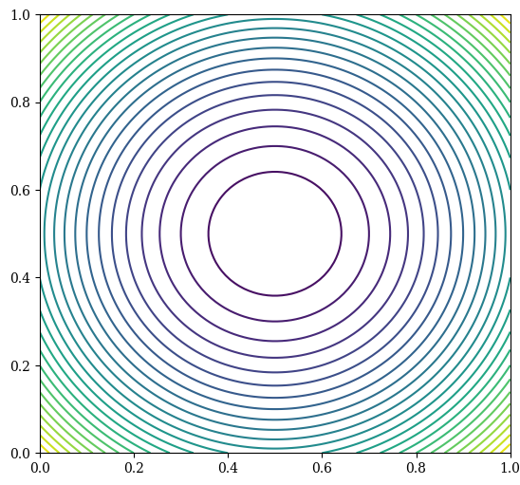
Initial Population

Slide 2
Evolved Population

Slide 3
Next Generation

