Slide 1

Android Introduction
LEIM – DAM

Slide 2

What is Android?
A Open source platform for touchscreen mobile devices
A Linux-kernel based operating system
Created by Andy Rubin (Android Inc.) in 2003
Developed by the Open Handset Alliance, led by Google
“Android is a mobile operating system based on a modified version of the Linux kernel and other open source software, designed primarily for touchscreen mobile devices such as smartphones and tablets. Android is developed by a consortium of developers known as the Open Handset Alliance, with the main contributor and commercial marketer being Google.” Wikipedia

Slide 3


Android history
2003, Android Inc. founded by Andy Rubin, Rich Miner, Nick Sears and Chris White
2005, Google acquires Android Inc.
2007, Open Handset Alliance (OHA) is formed
2007, Beta version of the Android SDK
2008, Android 1.1 version in a mobile device HTC DREAM (T-Mobile G1)
2010, Android is the mobile platform with the largest number of active devices
2014, Android Lollipop (version 5) - Android Runtime (ART) and support for 64-bit architectures
2015, Android Marshmallow (version 6) – USB-C, Fingerprint authentication, Android Pay
2016, Android Nougat (version 7) – Improved multitasking, multi-window mode, support for virtual reality
2017, Android Oreo (version 8) – Picture-in-Picture, APIs for Artificial Intelligence and shared memory
2018, Android Pie (version 9) – updated user interface, richer notifications, biometric authentication
2019, Android Q (version 10) – more audio codecs, MIDI API, WPA 3 WiFi support, gesture navigation
2020?, Android R (version 11) – rumors: improved app storage management, airplane with Bluetooth activated, extended screen shots
Android logo 2007–2014
Android logo 2014–2019

Slide 4

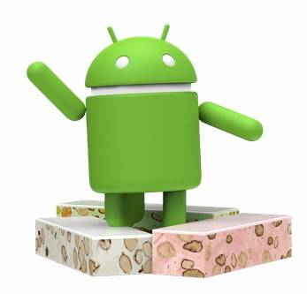
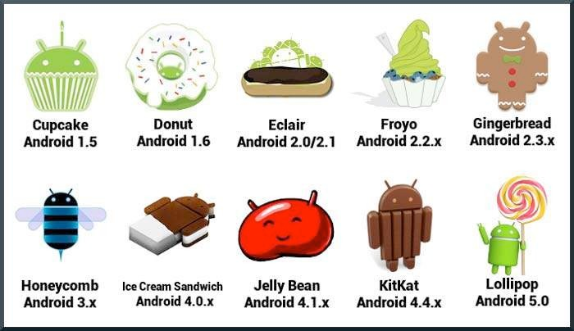




Logos and Names of Android Versions
Marshmallow Android 6
Nougat Android 7
Oreo Android 8
Pie
Android 9
Q
Android 10
R
Android 11

Slide 5

Android version
Platform Version | API Level | Version Code
Android 11.0 | R | R
Android 10.0 | 29 | Q
Android 9.0 | 28 | Pie
Android 8.0 / 8.1 | 26 / 27 | Oreo
Android 7.0 / 7.1.1 | 24 / 25 | Nougat
Android 6.0 | 23 | Marshmallow
Android 5.1 | 22 | Lollipop_MR1
Android 5.0 | 21 | Lollipop
Android 4.4W | 20 | KitKat_Watch
Android 4.4 | 19 | KitKat
Android 4.3 | 18 | Jelly_Bean_MR2
Android 4.2, 4.2.2 | 17 | Jelly_Bean_MR1
Android 4.1, 4.1.1 | 16 | Jelly_Bean
Android 4.0.3, 4.0.4 | 15 | Ice_Cream_Sandwich_MR1
Android 4.0, 4.0.1, 4.0.2 | 14 | Ice_Cream_Sandwich
… | … | …
Versions increment name first letter

Slide 6
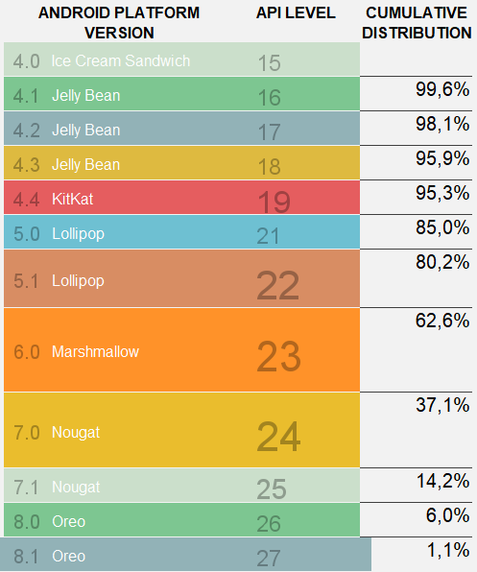
Market use
Target platform – best practice
An app should target at least 90% of devices
Extract from Android Studio on March, 2020

Slide 7
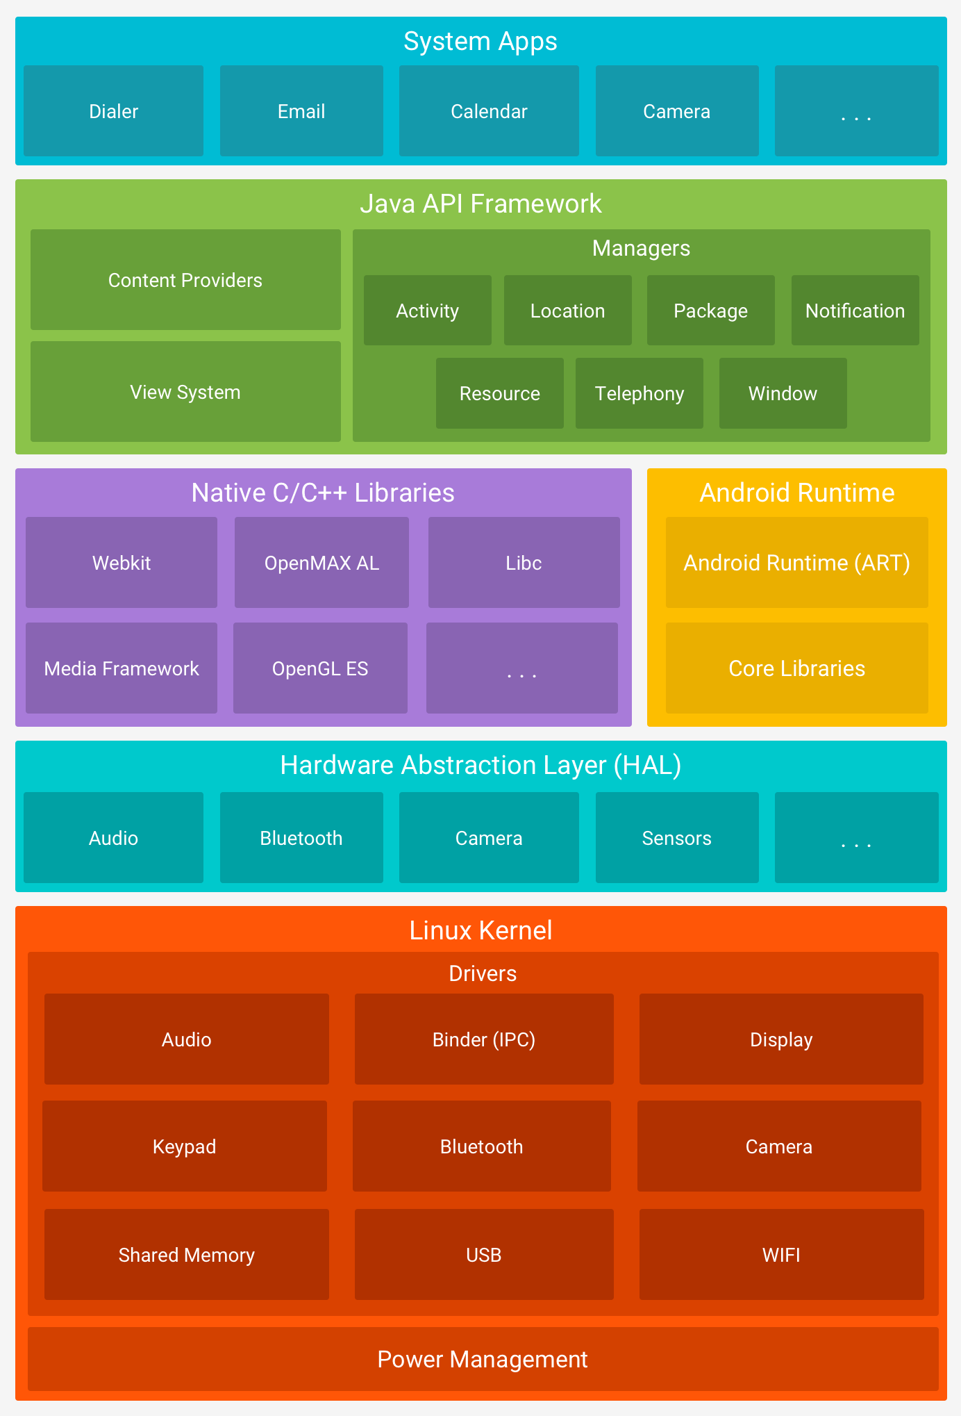
Android architecture
User apps
Facebook
WhatsApp
…
User apps
System apps providing base services for user and other apps.
This layer makes the connection between the application developed and the layers below: Libraries, Android runtime and Linux kernel.
Composed by components such as, Window Manager, Search Service or Notification Manager.
Java API providing the environment and resources to Android App development.
Environment to access and develop to/of native code (C/C++).
Runtime to execute Android apps.
Abstraction layer providing a uniform way to access to device hardware capabilities (Bluetooth, camera, …)
Linux Kernel providing base OS services

Slide 8
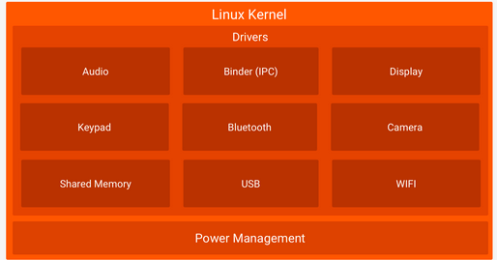
Architecture: Linux Kernel
Linux Kernel provides the base OS services
(processes, threads, memory, file system, …).
Changed with:
wakeLocks,
aggressive memory management,
Inter-Process Communication (Binder) that minimizes memory use.
Allows manufacturers to develop hardware drivers for Linux.
https://developer.android.com/guide/platform

Slide 9
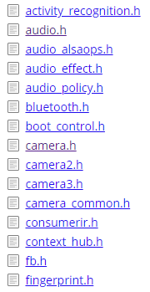

Architecture: abstraction layer
Abstraction layer provides a uniform way (API) to access to device hardware capabilities
Bluetooth
Camera
Sensors
https://android.googlesource.com/platform/hardware/libhardware/+/master/include/hardware

Slide 10
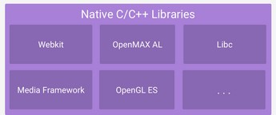
Architecture: Native Libraries
Exposes native libraries in C/C++
In Java framework APIs
To access: 2D and 3D graphic libraries
Native Development Kit (NDK) to code in C/C++

Slide 11
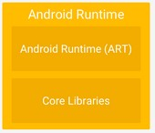
Architecture: Android Runtime
Android Runtime (ART) (Dalvik Virtual Machine for Android < 5.0)
Runtime to execute .dex files
similar to a JVM, but optimized for Android
.dex files are more compact and efficient than class files
Suitable for limited memory and battery systems
An app runs on a process in a dedicated instance of the Android Runtime (ART).
ART platform may run multiple ART instances.
Core Libraries
Java core Libraries

Slide 12
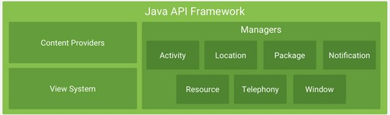
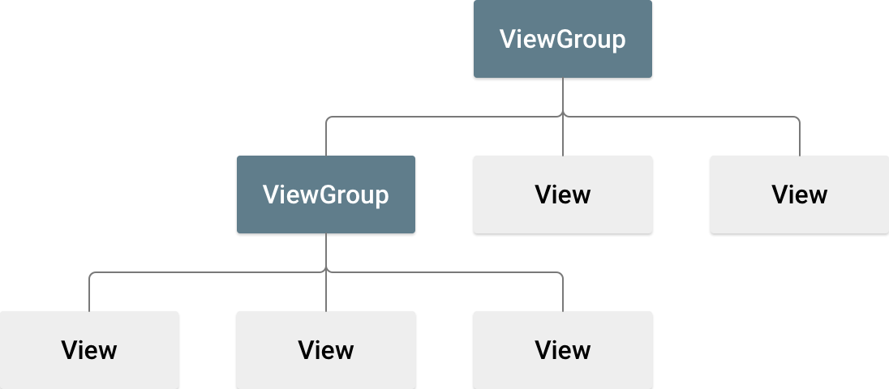
Architecture: Java API Framework
Java API to all Android OS
Provides the environment for Android App development
Activity manager: manages activities life cycle
Resource manager: access to embedded resources (Strings, colors, images, interfaces screens, …)
Content providers: to publish data and access data from other apps
View System: a system and a set of resources to develop User Interfaces

Slide 13

Architecture: System Applications
System apps
Have access to all platform APIs
Built-in (Android or manufacturer) applications
Provide base services (services and content providers) for user and other apps
Ex: Camera, Messages, Bluetooth, Calendar, Phone, Music, …
Placed on: /system/app (/app)
To see these apps: adb shell pm list packages -s
https://android.jlelse.eu/system-app-in-android-f003d418b4cc

Slide 14
Architecture: User Applications
User apps
Apps installed by Google PlayStore and by user direct actions
Placed on: /data/app
To see these apps: adb shell pm list packages -3
User apps
Facebook
WhatsApp
…

Slide 15
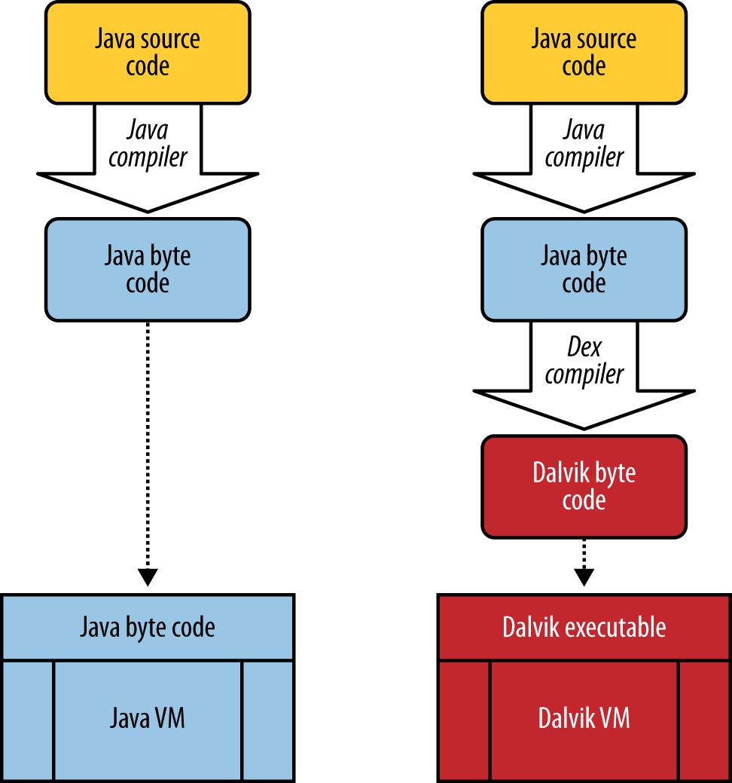
Runtime: Java and Android
Java
Compile .java to .class files
Java bytecode
Group .class in .jar files
JVM excutes .class files
Android
Compile .java to .class files
Compile .class to .dex files
Dex/Dalvik bytecode
Dex – Dalvik executable
Grouped in an .apk file
Dalvik/ART executes dex code

Slide 16
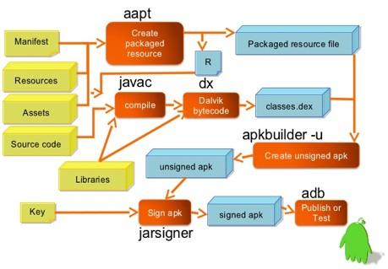
Android application development and deployment flow

Slide 17
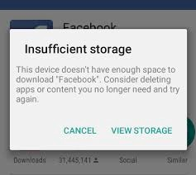
Dalvik bytecode
"Dalvik" bytecode – Dalvik Executalbe format - .dex files
Dalvik and ART platforms run .dex files
Programs are written in Java compiled for Java bytecode and converted to "Dalvik" bytecode
Or written in Kotlin
Multiple classes are included in a single .dex file.
An app is packed in an .apk file (Android Package Kit file)
Strings in all used classes are included only once in .dex file to conserve space
No duplication

Slide 18
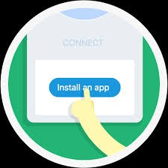


Android Runtime (ART)
ART: Android Runtime environment
replaces Dalvik virtual machine from Android 5.0
ART uses Dalvik byte code
Art uses ahead-of-time (AOT) compilation
It compiles the app bytecode to native code once at app installation
Dalvik uses Just-in-Time compilation, compiling the app bytecode every time that is used
Better application performance, less processor and battery use
But with greater installation time and ART files need some more space
ART improves (over Dalvik) memory allocation, Garbage Collection and allows better debugging and profiling
https://source.android.com/devices/tech/dalvik/index.html

Slide 19
Android Application Package (APK)
An .APK file is a zip file containing
Android Manisfest file
defines app componentes and settings, like permissions, Android version needed, ...
Dalvik executable (.dex )
Java/Kotlin code compiled for .dex executable
Resources
everything that is not code
Native libraries
C / C ++ libraries
Digital signature
META-INF directory

Slide 20
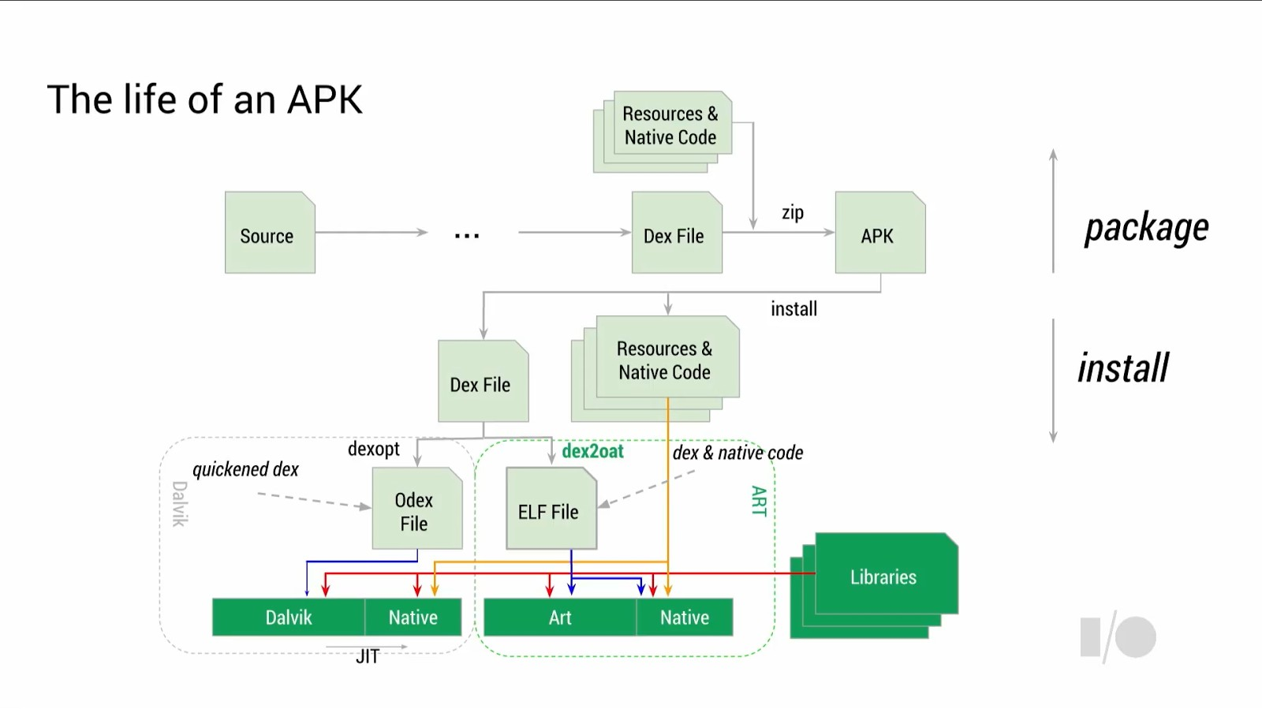
ART and Dalvik: artifacts
.odex – Optimized Dex file
.elf – Executable and Linkable Format

Slide 21
Summary
Android - an open source platform for mobile devices that is a Linux kernel-based operating system
Layers of the Android environment - Linux Kernel, Hardware abstraction layer, Natice C/C++ Libraries, Android Runtime, Java API Framework, System Apps
Android Application Package (APK) – an APK containing all the files of one app
Android Execution Runtime: ART and Dalvik, Ahead-of-Time (AOT) and Just-in-Time (JIT) compilation, ART versus Dalvik

