Slide 1
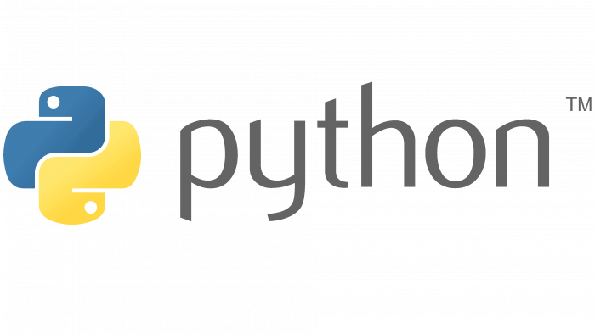
Introduction
No programming experience assumed.
Study technique: Experiment with the code.
This course will learn you everything you need to get started with Python.
After finishing the course, dive deeper into the applications (Data Analysis, AI, Web Development, …) of your interest.

Slide 2
Accessing Jupyter Notebook Through the Anaconda Distribution
In this course, the Python code will be written in Jupyter Notebooks which I personally access through the Anaconda Distribution (there are other alternatives).
You can follow the course either through a Jupyter Notebook or an IDE (Spyder, PyCharm, …) of your choice.
Anaconda can be installed at:
https://www.anaconda.com/

Slide 3
Next Steps
https://www.python.org/
Docs > Tutorials
Documentation > Python Books
https://www.w3resource.com/python-exercises/
- Python exercises.
All feedback is appreciated. Subscribe for more content in the future.
Thank you for following the course!

