Slide 1

Back into the reallife
By：Tomason lee
Electronic and Communication Engineering

Slide 2
Content
1
Phenomenon
2
Problems
3
Suggestions

Slide 3

Hometown

Slide 4

Parents

Slide 5
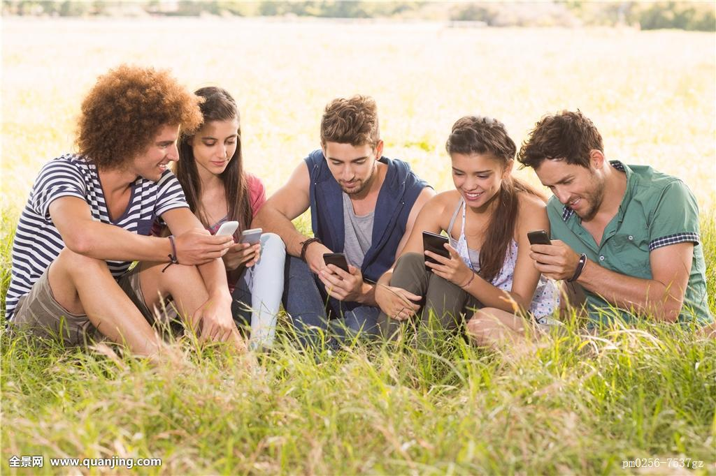
Friends

Slide 6

So on ...
Pets

Slide 7
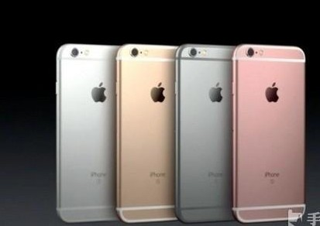
Smart Phone

Slide 8

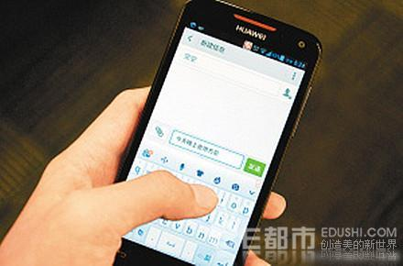

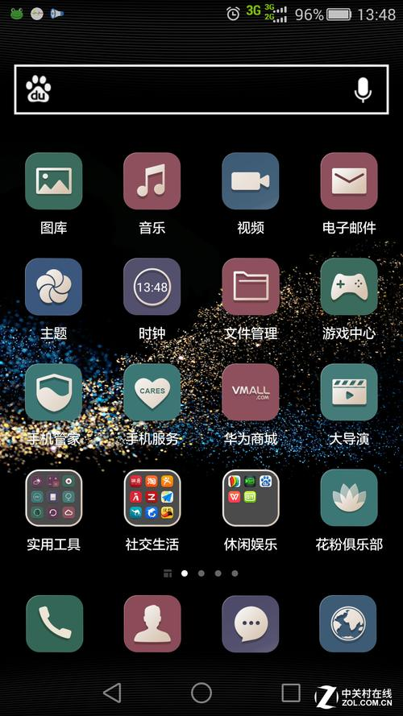
Basic Functions

Slide 9
With the development of technology,
People seem to can’t live without computer and smart phone.
Once We don’t have smart phone at hand for a while.
we seem to be lost and feel something miss in our life.

Slide 10

The farthest distance in the world is when i stand
in front of you,
while you are playing with your dam* cellphone!

Slide 11
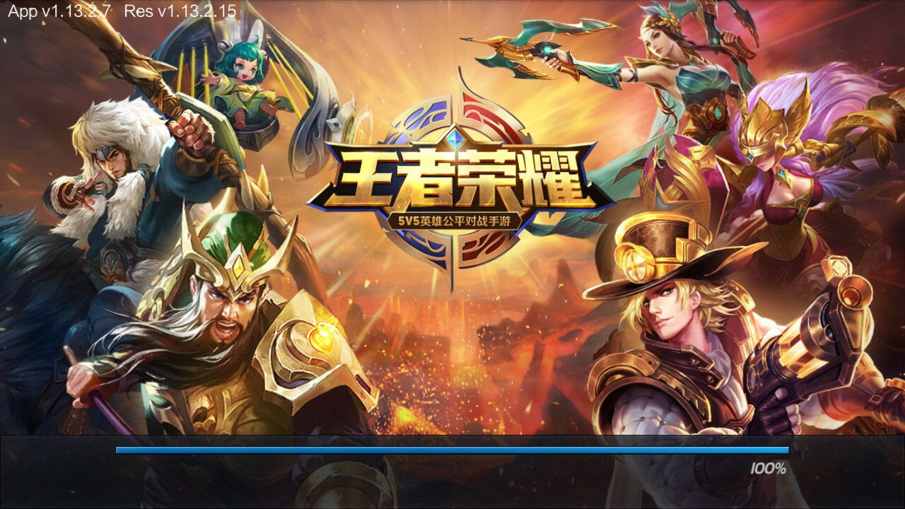
Glory of kings

Slide 12


Slide 13
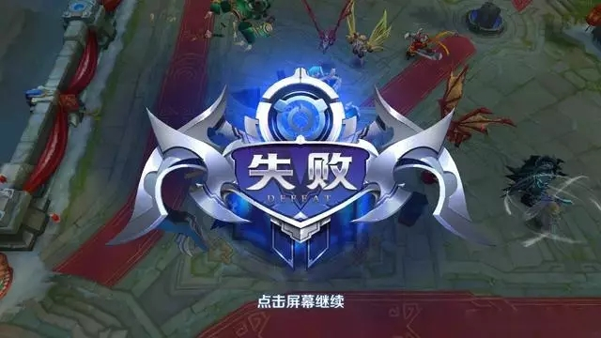

Sometimes, we don't fear the god same opponents,
but the pig same teammates.

Slide 14
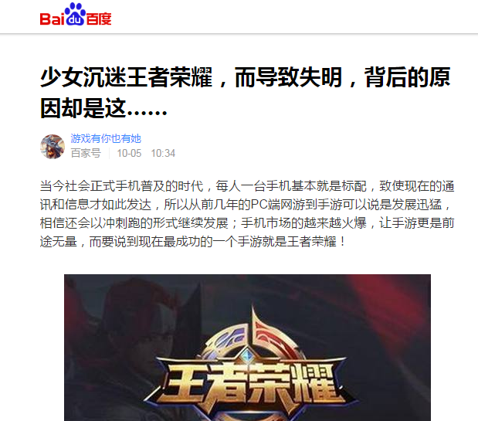
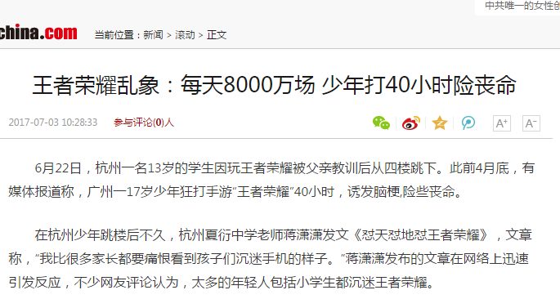

Slide 15
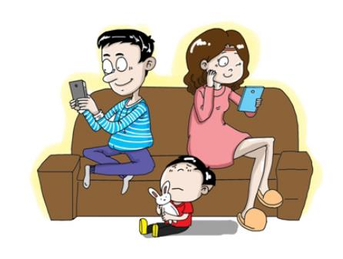
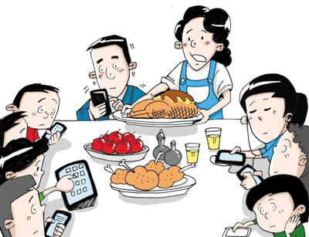

Slide 16
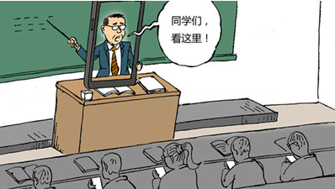

Slide 17
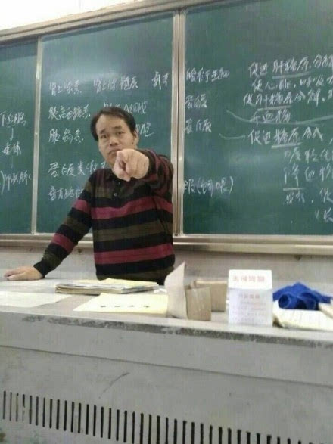

You don't let your teacher get ino your world,
your teacher will let you go out !

Slide 18
Change our bad lifestyle;
Don't put too much time on it;
Get back of our intresting times.
Go back to old times.

Slide 19

Keep your head up !

Slide 20

Bai le ge bai!

