Slide 1

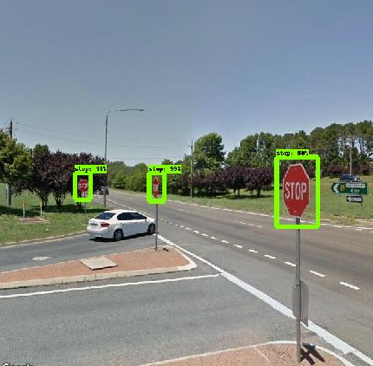
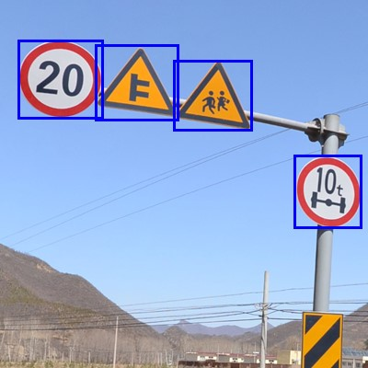
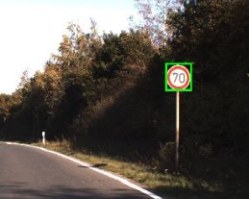
Project Proposal
Traffic Signal Image Classification with different ML Models
Dataset: GTSRB - German Traffic Sign Recognition Benchmark
João Faia, nº 47051, Tomás Oom, nº 59447

Slide 2

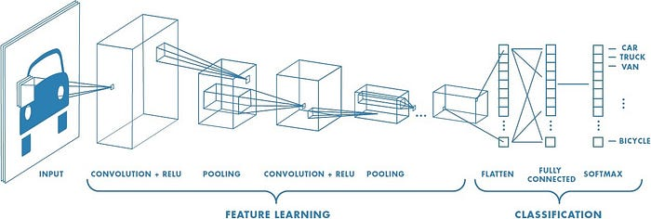
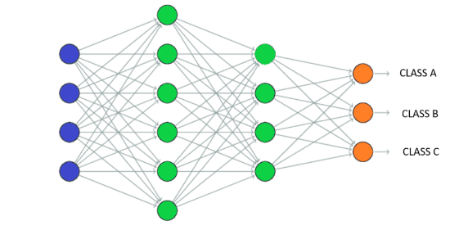
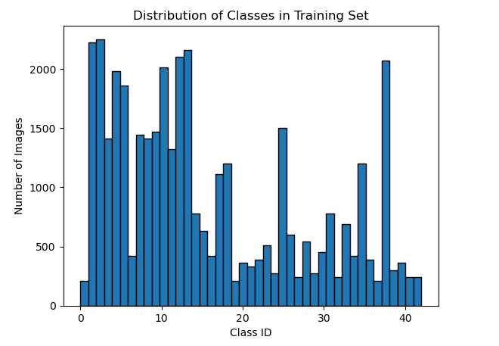
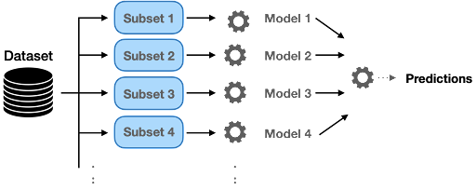
How?
Pre-processing: reshape, normalizing and data augmentation.
51839 images split into 39209 for the training set with 43 classes.
Limited computational power: Transfer Learning and Fine-tuning
Real-time classification with video as final test

