Slide 1




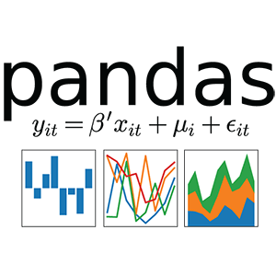

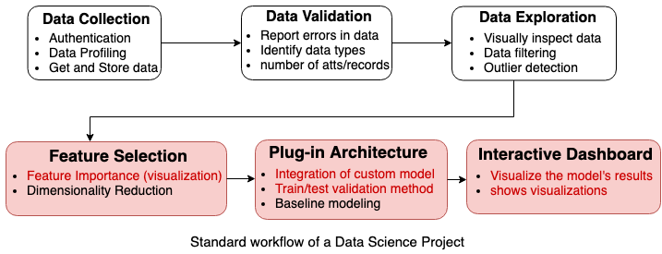
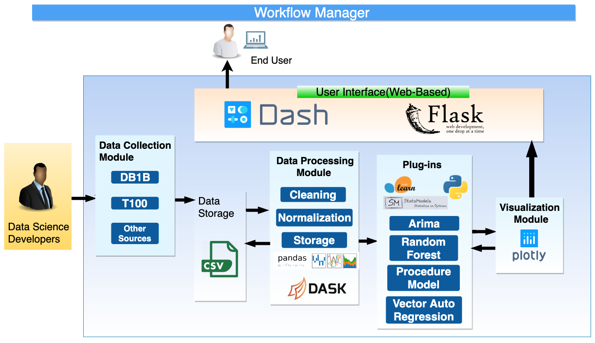
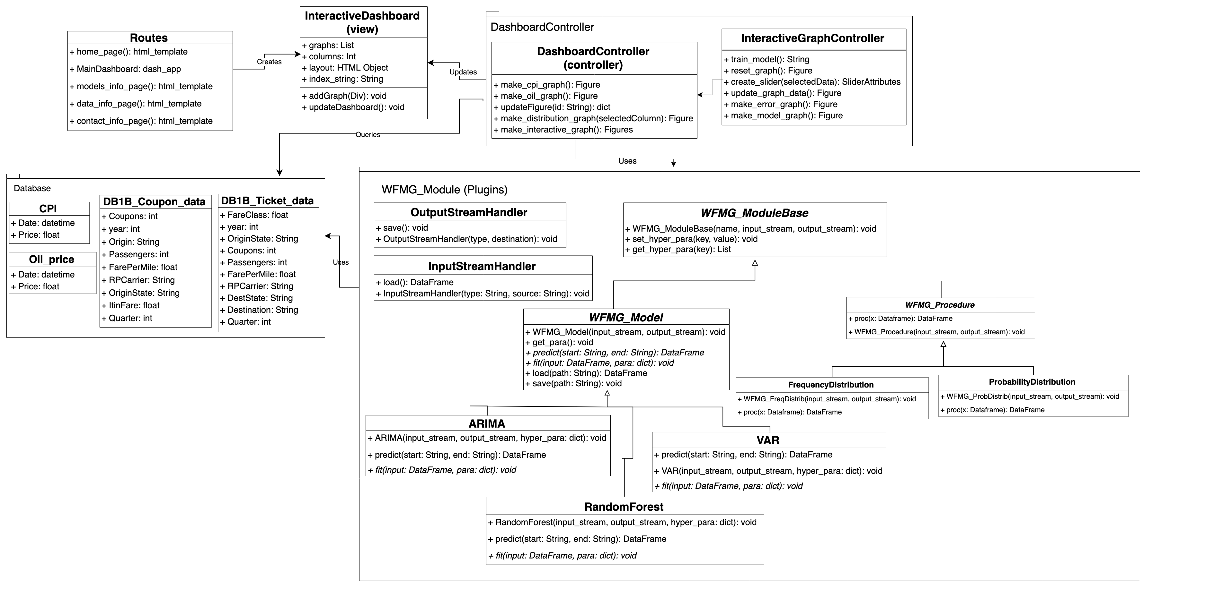
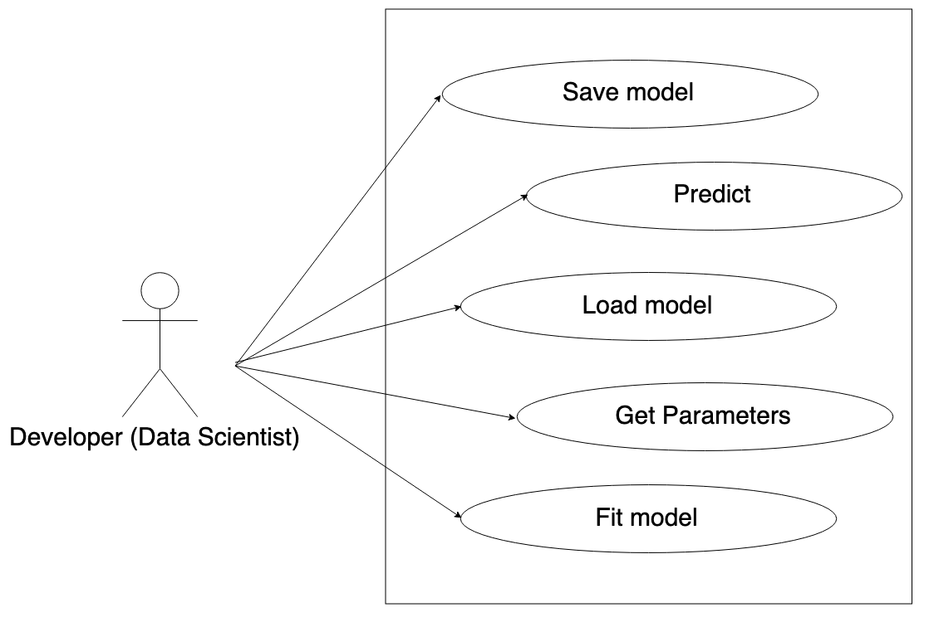
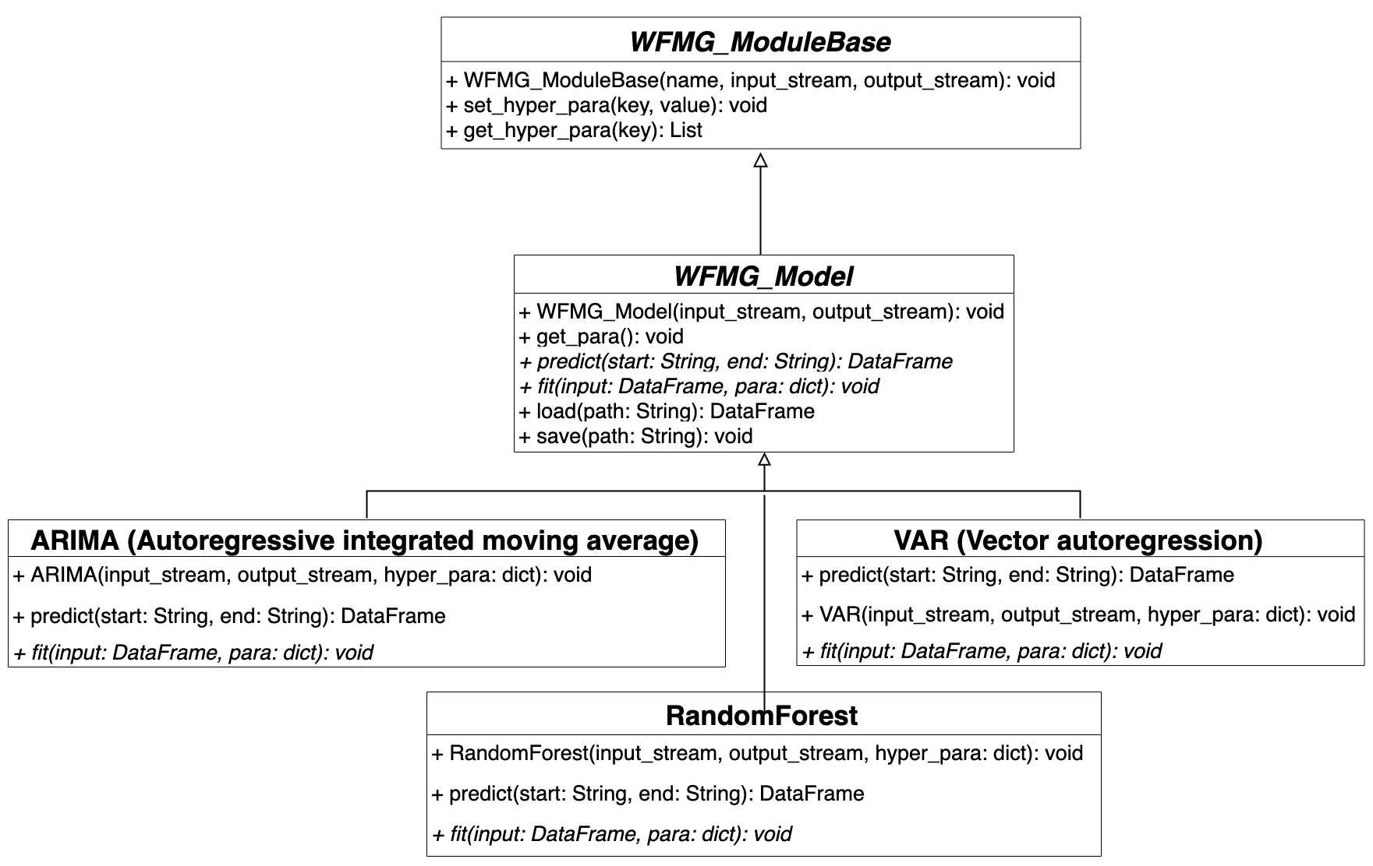
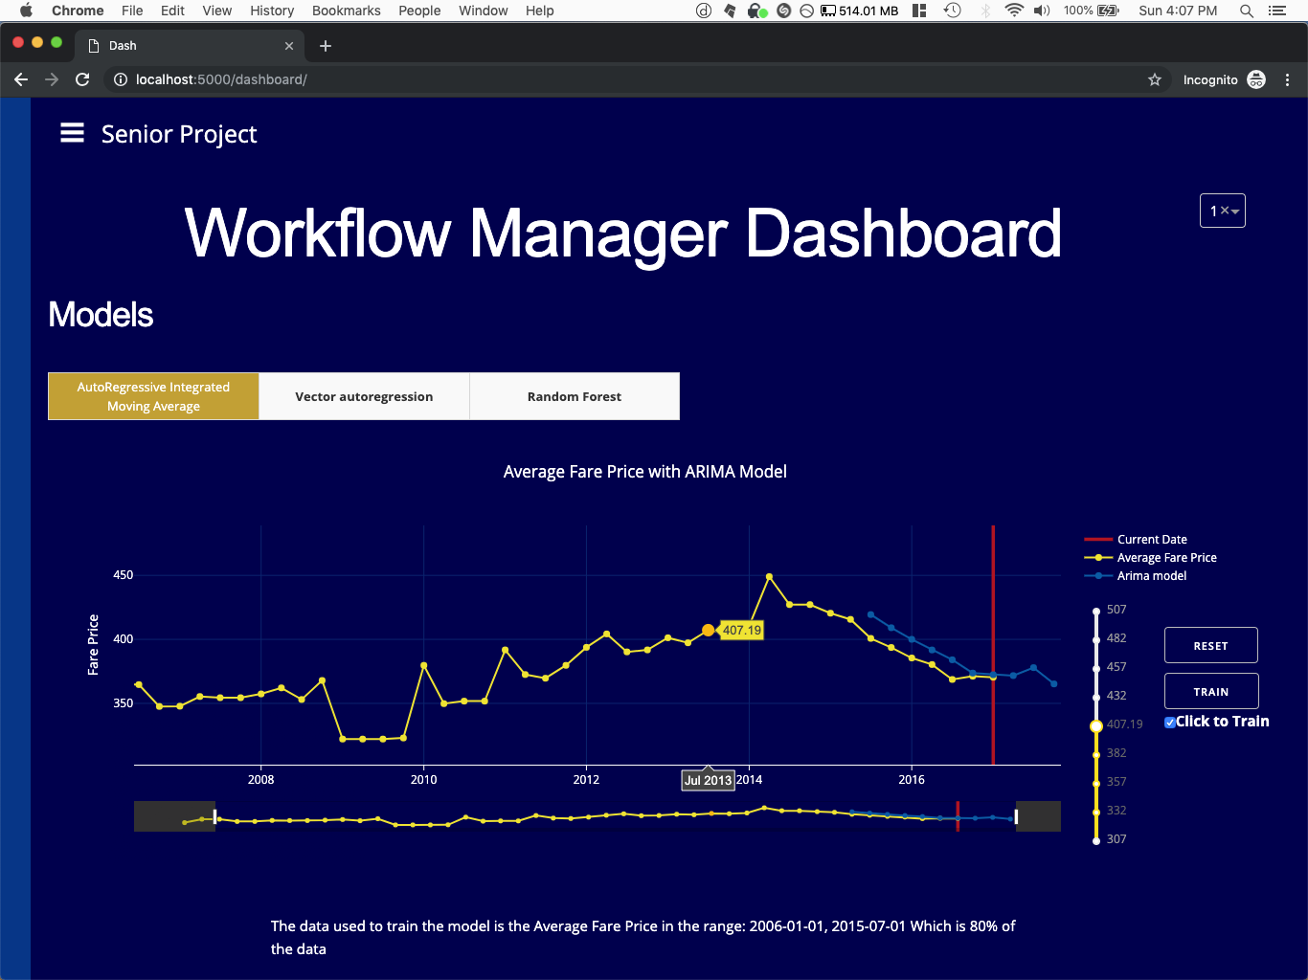
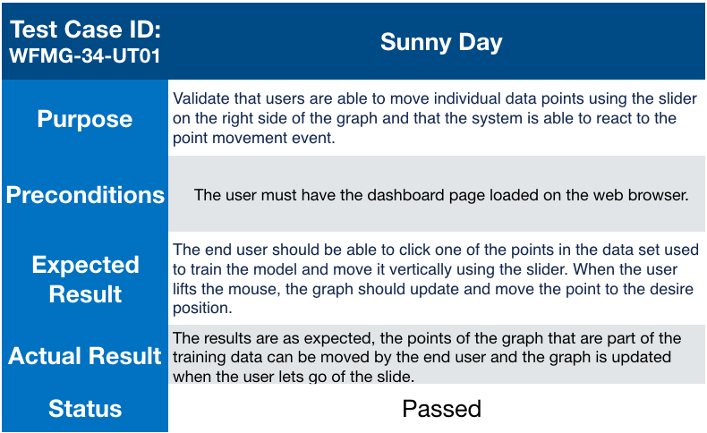
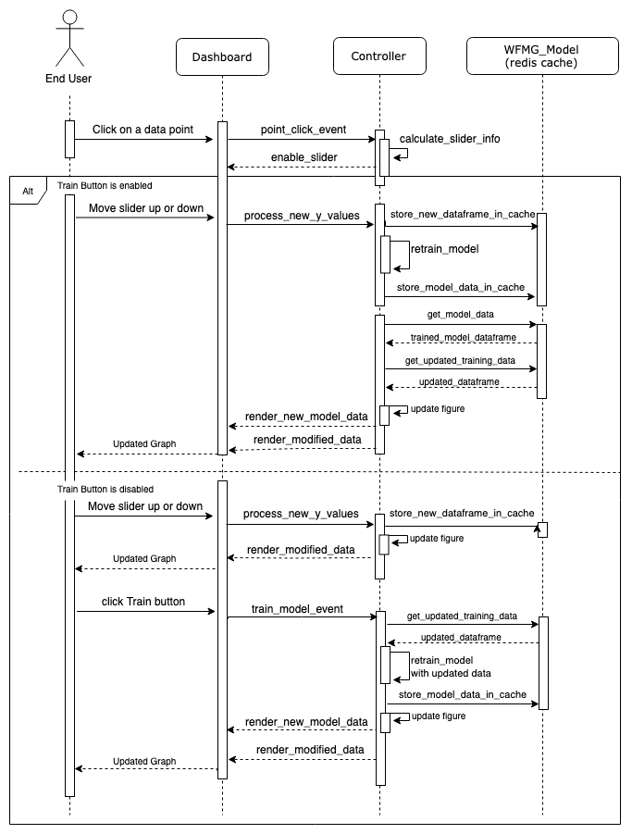
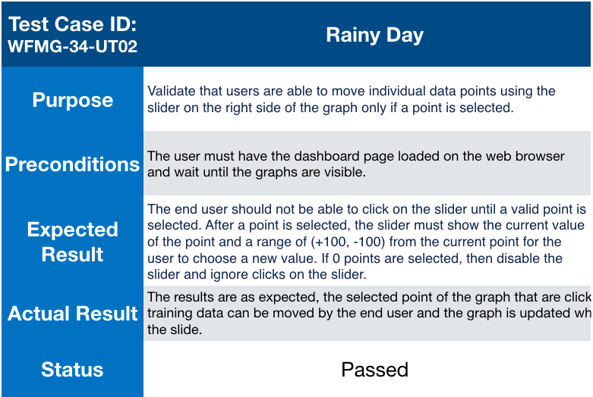
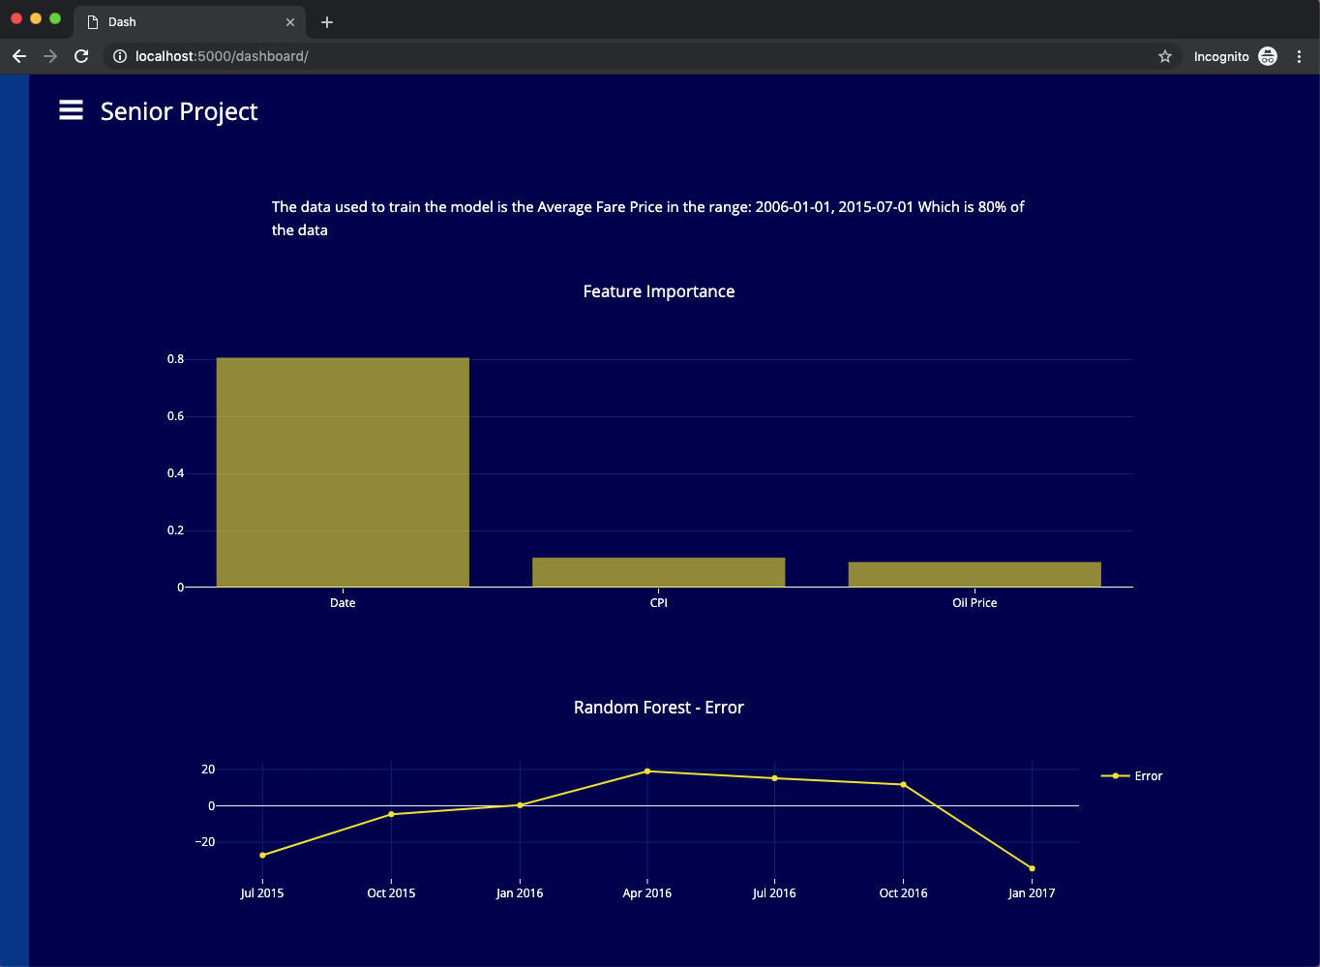
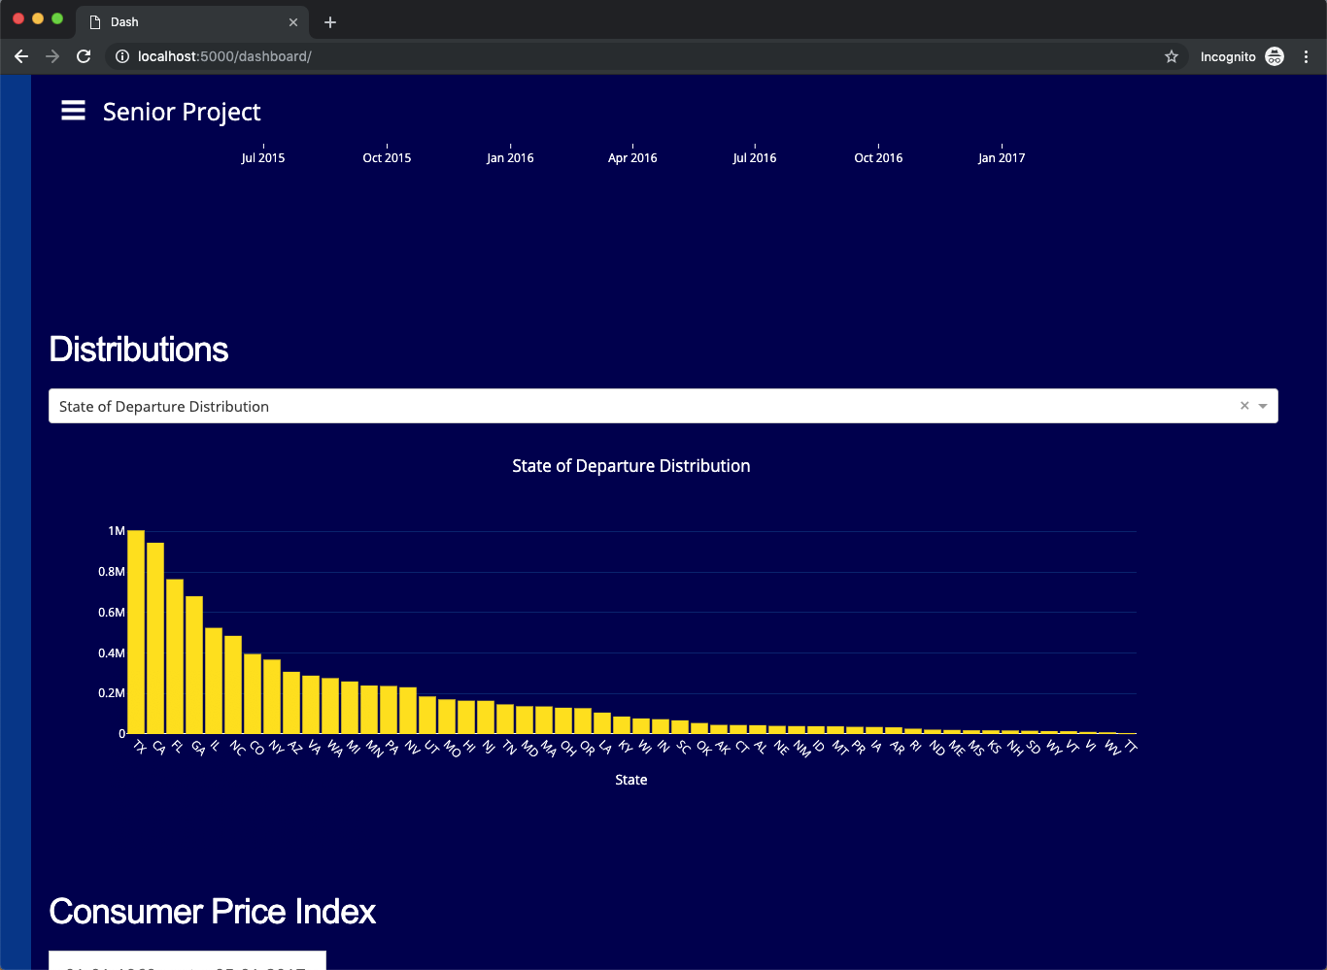
School of Computing & Information Sciences
Spring 2019 Senior Design Project
Data Science Workflow Management System
Student: Tomas Ortega
Mentor: Dr Miguel Alonso, Steven Luis, Florida International University
Instructor: Dr. Masoud Sadjadi, Florida International University
Problem
Current System
Requirements
The airline industry does not currently have the capabilities to fully take advantage of the huge amounts of data generated every day to enhance customer experience, increase the efficiency of operations or make sounder data-driven decisions because they lack the tools to implement the solutions. We believe that following the latest data science tools and techniques, we can leverage valuable insights from airline data and increase revenue.
Version 1.0 System:
The WFMG project requires the development of
A web front-end that displays an interactive dashboard containing graphs with predictions and relevant information for the users to explore and interact with.
A back end that uses the Plug-in system to create and train models, process data and manage user interactions.
Users of the web application are able to see and interact with graphs that contain predictions from machine learning models and move single or groups of points to change the training data. Then they can click on the train button to train the models. The user can also visualize frequency distributions involving attributes such as state of departure, market share and coupon distributions.
A WFMG Module (implemented in python) intended for providing the functionalities of custom machine learning models. This module should implement functions to load, fit, train, and save the models.
System Design
Object Design
Architecture diagram
Class Diagram for the workflow management system
Design of the wfmg_model python module for the plug-in architecture
This module provides functions for loading, fitting and saving machine learning models. It also provides a function to generate new predictions from the visualiation module..
The WFMG module contains interfaces that other plug-ins can implement to be accepted by the visualization module.
The Workflow Manager web application utilizes the Model View Controller (MVC) design pattern to provide different levels of abstraction to the developers working on new plugins or working on the view components. We used plotly for the visualizations because it provides interactive components in a web environment.
We created a system for Plug-ins using OOP concepts so that developers working on a data Science project can add new plugins into the pipeline so that they can be used in the visualizations or for data processing. The wfmg_model class and all its subclasses are currently being used to create the prediction data and to retrain the models.
Implementation
Screenshots
Verification
Sequence diagram for retraining the model when points are moved. It also includes the steps for updating the data used in the visualizations.
We used selenium to automate part of the testing process and performed unit and integration tests
Visualizations from the dashboard page:
Sample unit tests.
This particular test description is for the user story “movable data points” with ID “WFMG-34”
Fare Price Visualization and Model Prediction
These tests are used to verify the performance of the feature under different conditions.
Summary
Random Forest Feature Importance graph and Model Error
The WFMG project version 1.0 is now able to display the visualizations for the prediction data from several multivariate and univariate machine learning models. The Plug-in architecture enables developers to include new models or swap the current models for new ones.
The end user can interact with the machine learning models by modifying the training data and visualizing the results immediately
We used methods provided by the dash framework to dynamically update the components of the UI to allow the user to smoothly interact with the dashboard visualizations
The error graph is also updated every time the user makes a change to the graph.
Frequency and Probability distributions plots
Acknowledgement
The material presented in this poster is based upon the work supported by the FIU AIRLab Team and the Farelogix Team. I am thankful for the help that I received from my group member Serge Metellus.

