Slide 1
Spectrum Etiquettes for Short Range Wireless Devices Operating in the Unlicensed
Band - A Proposal
Victor Bahl
Joint work with
Amer Hassan and Pierre de Vries
Microsoft Corporation
Spectrum Policy: Property or Commons
Stanford Law School
March 2, 2003

Slide 2
Introduction
Why etiquettes?
  ‘Unlicensed’ is growing up
  Experience in existing bands
  Broader use requires better reliability
  Coexistence of smart devices
Goals
  Establish common ground
  Joint proposal to regulators
Objectives today
  Reality test our thinking so far
  Improve the proposal
  Build consensus

Slide 3
The Outlook
Over time the number of wireless data devices will increase dramatically (e.g. sensors)
Over time the demand and expectation from wireless connectivity will increase
Current allocation of unlicensed bandwidth is not sufficient to meet these demands
Need regulations to enable robust wireless data networks

Slide 4
Design Criteria
Enable continued innovation
Minimize mutual interference between transmitters
Allow all devices to contend and gain some access
Maximize spectrum utility
Global solution

Slide 5
State of Art –
WiFi performance data…

Slide 6
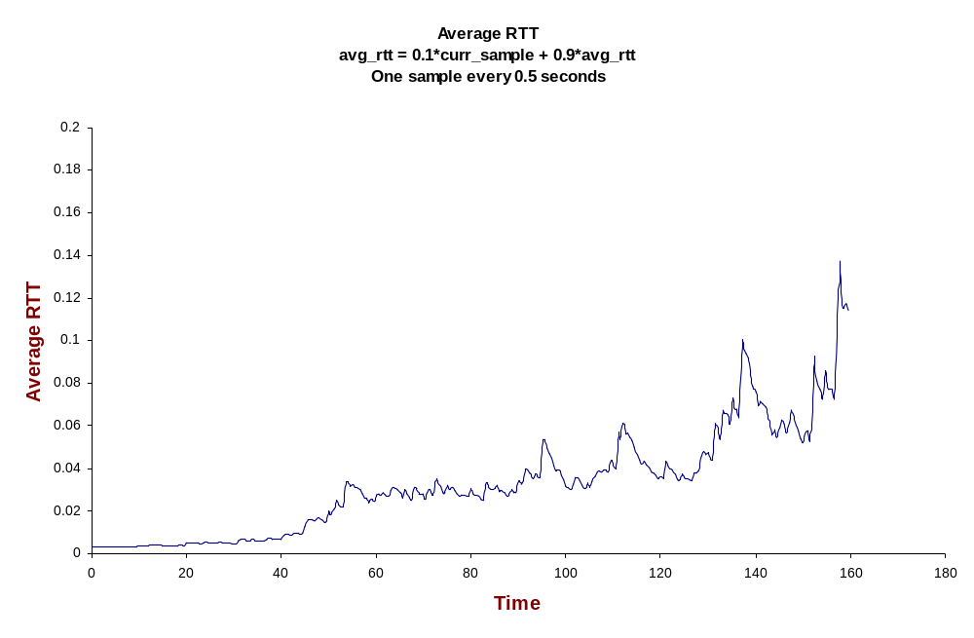
Round Trip Delay versus Node Density
A new 100Kbps CBR connection starts every 10 seconds,
between a new pair of nodes. All nodes hear each other.

Slide 7
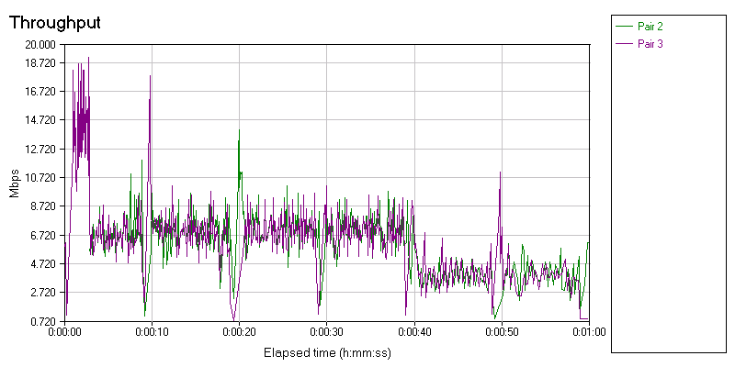
Throughput versus number of flows
Courtesy, MS eHome Team
11B Station
associated
2nd flow added
IEEE 802.11g (draft) in mixed configuration 2 flows with 11b node associated

Slide 8
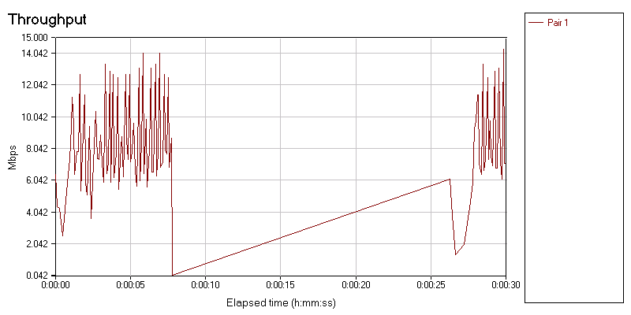
In the presence of other 2.4 GHz devices
Courtesy, MS eHome Team
Phone on
Panasonic 2.4GHz Spread Spectrum Phone 5m and 1 Wall from receiver

Slide 9
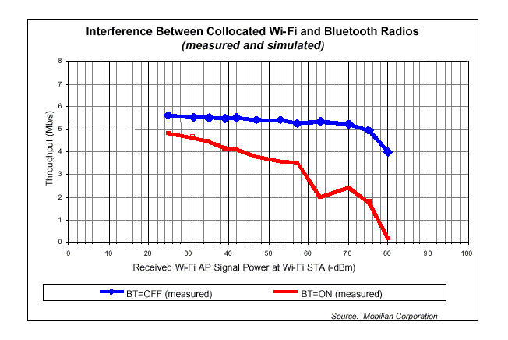
Colliding standards: performance degrades
Courtesy: Mobilian Corp.
Performance worsens when there are large number of
short-range radios in the vicinity

Slide 10
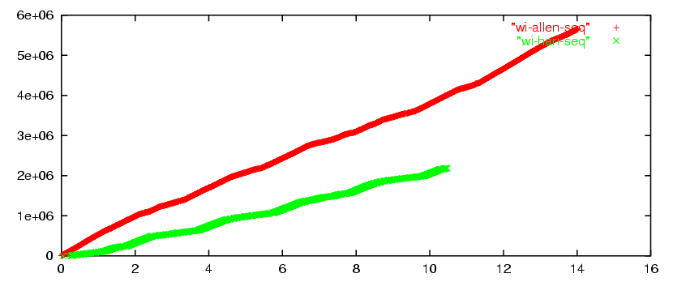
Following rules and regulations but….
Adding BT to
the mix
TCP Sequence Number
Time(second)
Two TCP Downloads From a 802.11 Access Point

Slide 11
Etiquette Proposal….

Slide 12
Design Criteria (repeat)
Enable continued innovation
Minimize mutual interference between transmitters
Allow all devices to contend and gain some access
Maximize spectrum utility
Global solution

Slide 13
Design Goals
Allow continued innovation in the Physical (PHY) and Medium Access Control (MAC) layers
Minimize mutual interference between transmitters
Allow all devices to contend and gain access to the channel
Maximize spectrum utilization and capacity
    Note: goals 2 & 4 are related.
Promote harmonization of rules and regulations for spectrum management around the world

Slide 14
Constraints (self imposed)
– to facilitate operation of diverse wireless devices
Make no assumptions about receivers or their existence
    Consider transmitters only
Make no assumptions about the channel
    Channel may be symmetric or asymmetric
Make no assumptions about formats
    Do not think in terms of bits, bytes, or frames – this is for higher layer protocols (e.g. TCP/IP)
    Work with time, frequency, and power

Slide 15
Constraints → Limitations
Etiquettes do not completely eliminate device interference
Etiquettes do not address the inevitable reduction of throughput with increase in node density

Slide 16
Etiquette Proposal
Transmit Power Control (TPC)
  Reduce interference between neighbors, increase capacity through increased spatial reuse
Dynamic Frequency Selection (DFS)
  Reduce destructive interference resulting from simultaneous transmissions
Listen Before Talk with Channel Wait Time (LBT-CWT)
  Eliminate the possibility of devices being shut out from using the spectrum
In addition….

Slide 17
Etiquette Proposal (cont.)
TPC is applied to the entire unlicensed band
DFS is applied to x % of the unlicensed band
LBT-CWT is applied to (100-x) % of the unlicsensed band
For example,
5 GHz Unlicensed
5.0
5.1
5.2
5.3
5.4
5.5
5.6
5.7
5.8
5.9
6.0
US
TPC, DFS
TPC, LBT-CWT

Slide 18
Strengths and Rationale
Simplicity
  Easy to understand and enforce. Complicated regulations help neither the adopters nor the enforcers.
Existence Proof (true and tried technologies)
  TPC and DFS are already mandated in Europe and Japan (e.g. ETSI HIPERLAN/2)
  LBT-CWT is an abstraction of widely successful CSMA/CA
Easy to Implement
  TPC, DFS, LBT-CWT are based on RSSI measurement that can be obtained from a variety of modulation schemes

Slide 19
Mapping Proposal to Goals
Goal 1: Allow innovations in PHY and MAC
  DFS, TPC allow CDMA, TDMA, FDMA, CSMA etc. protocols over most of the band
Goal 2: Prevent mutual interference between transmitters
  DFS and LBT-CWT
Goal 3: Last one in can still use the spectrum
  LBT-CWT provides probabilistic fairness. Greedy transmitters are not allowed to monopolize channel
Goal 4: Maximize overall spectrum utilization and capacity
  DFS provides 100% utilization,
  LBT-CWT provides approximately 95% utilization
  Allow transmitters to transmit in the presence of existing signals

Slide 20
Notable Points
Interference redefined
In case a signal is detected, the device may still begin using the channel if its transmissions do not cause harmful interference to the current transmitting system.
Parameter values
  Chosen to make it easy for hardware vendors to incorporate and adopt rules
  For LBT-CWT, utilization goes over 95% when more than one device is on the network
  Provided in the paper…..
Open Questions
  All three rules can suffer from the hidden terminal problem
    When receivers can transmit, hidden terminal problem can be removed
  Developing an algorithm for TPC without receivers in the loop is difficult

Slide 21
Conclusions
Additional unlicensed band is needed to meet future demands on wireless data networks
Regulation of this unlicensed band is necessary
We have proposed an etiquette that includes TPC, DFS, and LBT-CWT
Strengths
  Simple for adopters and enforcers
  Built on proven technology
  Allows continued innovation in PHY and MAC
  Does not dictate any particular network architecture
  Improves definition of what constitutes interference
Weakness
  Does not solve hidden terminal problems
  LBT-CWT does not get us 100% utilization
  TPC needs to be defined b

Slide 22
Thanks !
For additional details, contact
Pierre de Vries (pierred@microsoft.com)
Victor Bahl (bahl@microsoft.com)

