Slide 1
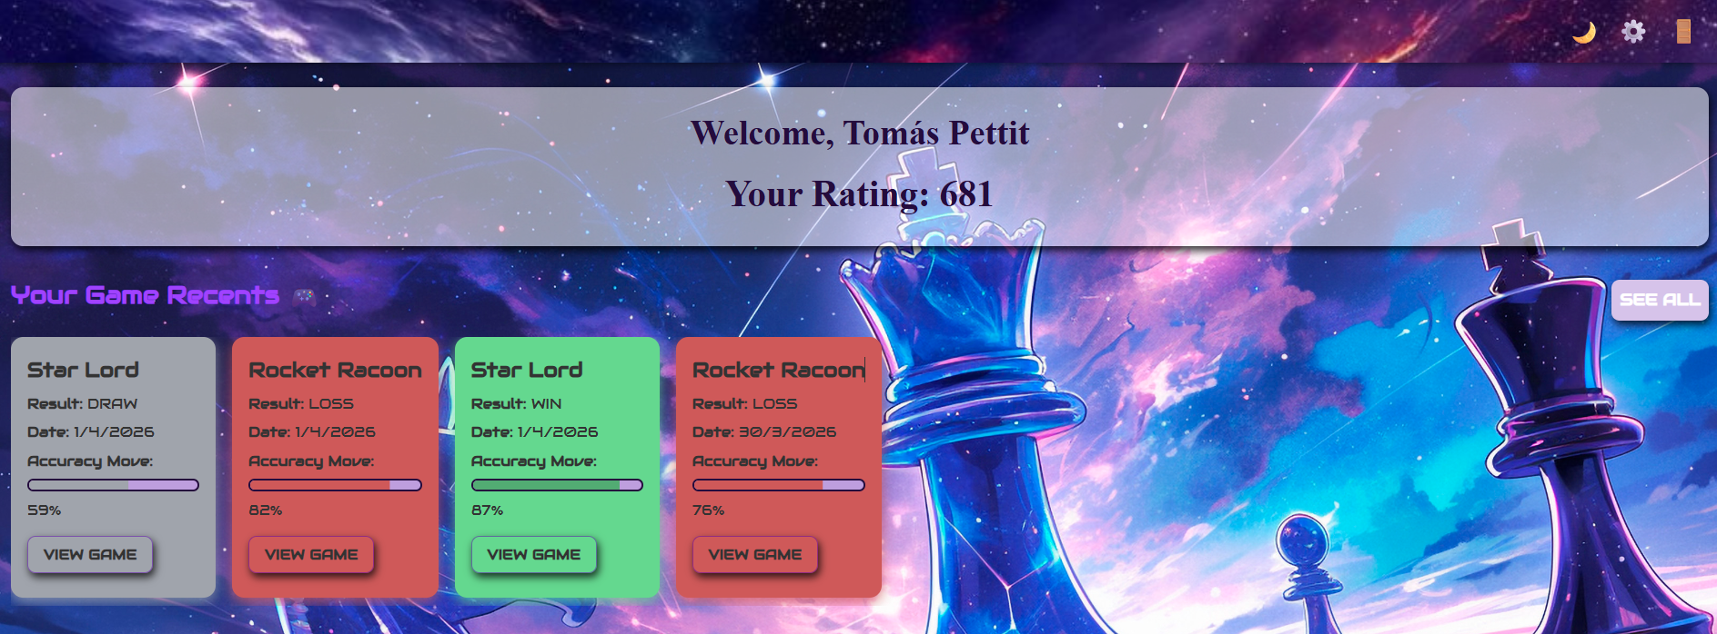
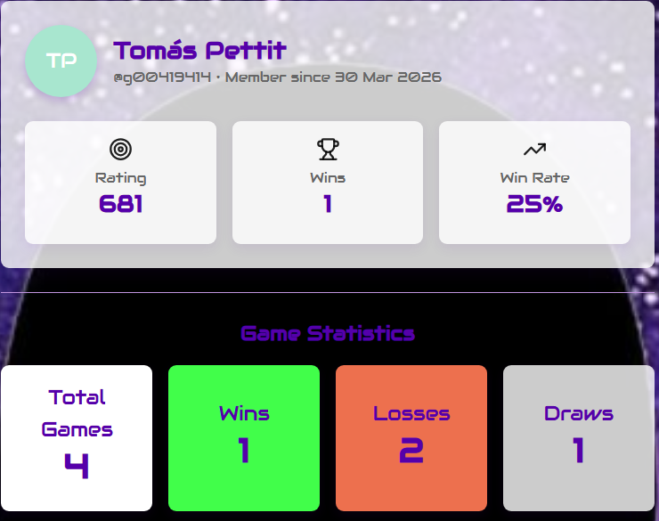
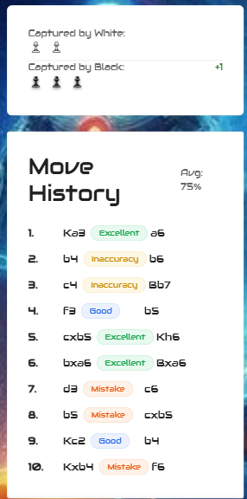
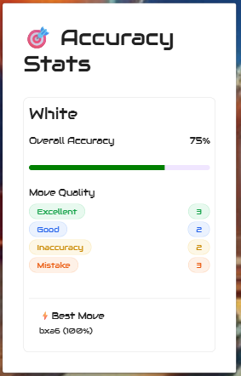
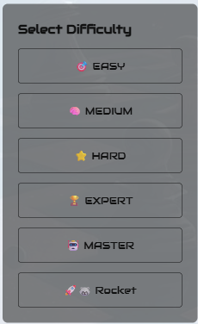
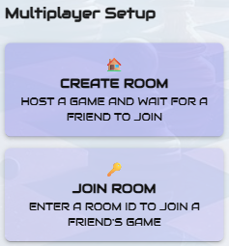
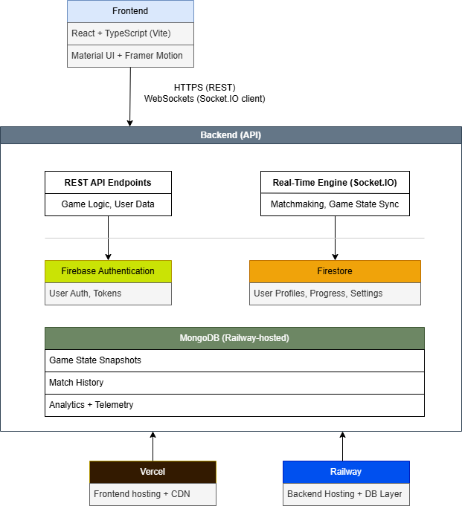

Guardians of the Chess Grandmaster
Learn Chess Like a Grandmaster
| Tomás Pettit – G00419414 |
| BSc Software Development - ATU Galway |
| https://github.com/tomaspettit2506/final-year-project |
Introduction
Dashboard
Testing involved simulated matches across multiple skill levels to validate the stability of the multiplayer system and the reliability of the chess‑engine API. Results show that the API provides strong, high‑quality move recommendations, while the multiplayer engine maintains smooth, low‑latency interactions.
User feedback highlighted the platform’s intuitive interface and effective learning support. Suggestions for future improvements included deeper, more personalized feedback and expanded training features.
Overall, the evaluation demonstrates that GOTCG successfully combines API‑powered guidance with engaging multiplayer gameplay, while identifying clear opportunities for continued enhancement.
Guardians of the Chess Grandmaster (GOTCG) is an interactive chess‑learning platform that helps players think and improve like a grandmaster. It combines guided tutorials, real‑time gameplay, automated game analysis, and progress tracking to create a structured learning experience for beginners and intermediate players.
The platform is built using a modern web stack - React, TypeScript, Node.js, Firebase, MongoDB, and Socket.IO - to deliver a responsive, mobile‑friendly Progressive Web App (PWA). The project demonstrates full‑stack engineering, real‑time communication, cloud deployment, and user-centred design.
The dashboard serves as the central hub for users to access their learning progress, upcoming challenges, and personalized recommendations. It features an intuitive interface displaying real-time game statistics, recent match history, and tutorial completion status.
Figure 2: Home page with a list of game recent
The figures show an overview of all information coming through from MongoDB. Every time a user plays a Multiplayer game, their rating is updated and the game data is added to the database, reflecting real-time progress and performance tracking.
System Architecture
The architecture of Guardians of the Chess Grandmaster (GOTCG) supports a scalable, responsive, and real‑time multiplayer learning environment. It consists of five core components:
Frontend: React + TypeScript PWA providing tutorials, gameplay, and progress tracking.
Backend: Node.js server managing game logic, authentication, and real‑time events via Socket.IO.
Databases: Firebase Authentication for secure sign‑in; Firestore for user progress; MongoDB Atlas for game states, match history, and analytics.
Real‑Time Engine: Socket.IO ensures low‑latency, synchronized multiplayer gameplay.
Deployment: Vercel, Railway, and MongoDB Atlas deliver scalable hosting and reliable cloud infrastructure.
This modular design enables smooth gameplay, fast updates, and efficient data management across the platform.
AI vs Multiplayer
The AI vs Multiplayer section highlights the platform's dual gameplay modes, where users can challenge an AI opponent or compete against other players in real-time multiplayer matches. The AI mode uses a sophisticated chess engine to provide strategic feedback and move suggestions, helping players improve their skills through guided practice. Meanwhile, the multiplayer mode updates player ratings and game data in the database in real time, reflecting real-time progress and competitive performance.
This dual approach balances personalized AI-driven learning with the excitement and unpredictability of human competition, fostering a comprehensive chess improvement experience.
Figure 5: Profile stats
Figure 6: Captured Pieces, Move History
Figure 7: Accuracy Stats
Conclusion
A
B
Guardians of the Chess Grandmaster (GOTCG) delivers a modern, scalable, and user‑friendly chess learning platform that showcases full‑stack engineering, real‑time communication, cloud deployment, and thoughtful UX design.
Future development will focus on advanced non‑ML analysis tools, personalized training plans, and adaptive difficulty to further enhance learning outcomes. Balancing real‑time responsiveness with complex AI computation remains central to the platform’s evolution.
With millions of players worldwide seeking structured improvement tools, GOTCG is positioned to serve a significant and growing audience. This highlights its potential not only as an academic project but as a scalable, real‑world learning platform.
Figure 3: AI Difficulty Level
Figure 4: MP Create and Join Room
Integration
Guardians of the Chess Grandmaster (GOTCG) integrates its frontend and backend components to deliver real‑time multiplayer gameplay and AI‑assisted training. The React frontend communicates with the Node.js backend through REST APIs and Socket.IO, ensuring fast updates and synchronized game states.
User authentication is handled through Firebase Authentication, while Firestore and MongoDB Atlas store user progress, match history, and gameplay analytics. The AI mode uses a chess‑engine API to generate move suggestions and strategic feedback. The backend processes these API responses and integrates them seamlessly into the gameplay loop, providing consistent and reliable guidance without requiring local model training.
Cloud deployment on Railway, Vercel, and MongoDB Atlas ensures scalability, low latency, and a smooth user experience across devices.
Acknowledgements
Supervisor: Kevin O’Brien, for guidance, support and expertise throughout the project.
Material UI: For UI components and design consistency.
Chess.com: Used as a platform for playing chess and benchmarking player ratings.
Evaluation
The evaluation of GOTCG focused on multiplayer responsiveness, API‑driven AI performance, and overall user experience. Key metrics included latency during real‑time gameplay, consistency of AI move suggestions, and user feedback collected through surveys and usage analytics.
Scan to Access the Live Application
Figure 1 : My System Architecture

