Slide 1

ZZ ILab Midterm Presentation
03.12.2025
Giulio Iepure, Caterina Piacentini, Farkas Tallos, Tomas Samaj

Slide 2
1
Strategy Overview & Methodology
2
Replication Results
Agenda
3
Portfolio View
4
Factor Selection & Clustering
5
Robustness of the Strategy
6
Conclusion & Investment Verdict
Notes:
Tags: divider, simple, no image, left aligned header

Slide 3
Papers and Context
Literature Review & Methodology
Literature Review - Arnott, Kalesnik & Linnainmaa (2023):
Extends momentum research to factor portfolios – showing that factor returns themselves exhibit momentum.
Finds that factor momentum subsumes industry momentum.
Uses principal component analysis to identify systematic sources of momentum.
Literature Review - Ehsani & Linnainmaa (2022):
Shows that momentum in stock returns stems from momentum in factor returns
Factors show strong autocorrelation: winners stay winners, losers stay losers.
Momentum reflects timing of factor exposures, not a separate risk factor.
Data Description:
Fama-French 17 Industry Portfolios: Monthly excess returns (July 1963 - Dec 2024).
JKP Factors: Cross-sectional factor returns (value, profitability, investment, quality, risk).
Thematic Factors: Growth, leverage, volatility, and other economic themes.
Final Sample: July 1963 - December 2024 (U.S. market).
Replication Methodology:
Replicate Arnott et al. (2023) Appendix figure comparing Factor vs. Industry Momentum.
For each month:
Rank all assets by previous month's return.
Go long the top half (winners), short the bottom half (losers).
Apply to Fama-French 17 industries and selected JKP factors.
Equal-weight portfolios; rebalance monthly.
Compute 1-month long-short return.

Slide 4
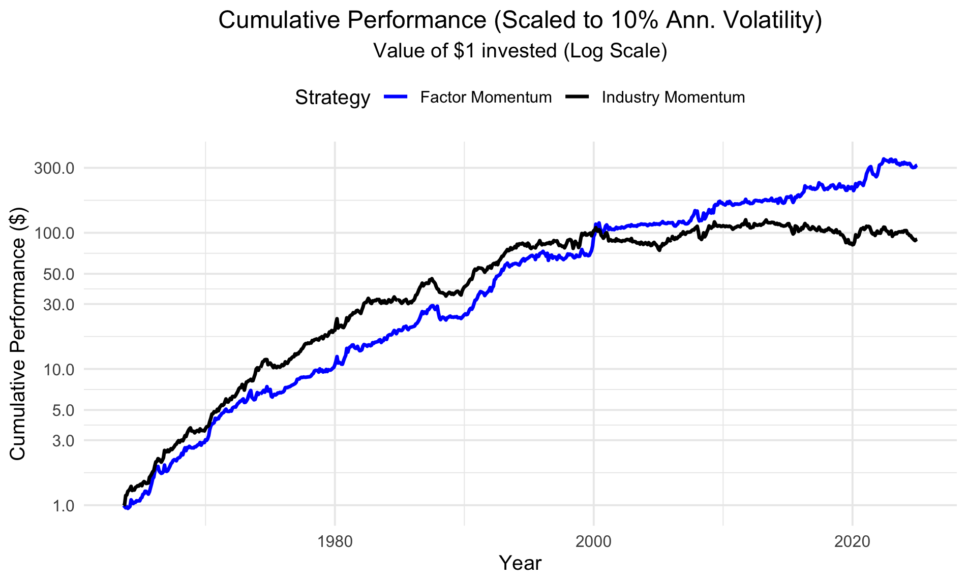
Replication Results
Replication Results
To match the paper’s methodology, the strategies are scaled to a target volatility of 10% per year.
Before 2000, industry momentum consistently outperforms factor momentum, showing stronger cumulative returns.
After 2000, industry momentum stops growing, while factor momentum accelerates and becomes the clear winner.
This trend is even more pronounced in the unscaled strategy.

Slide 5
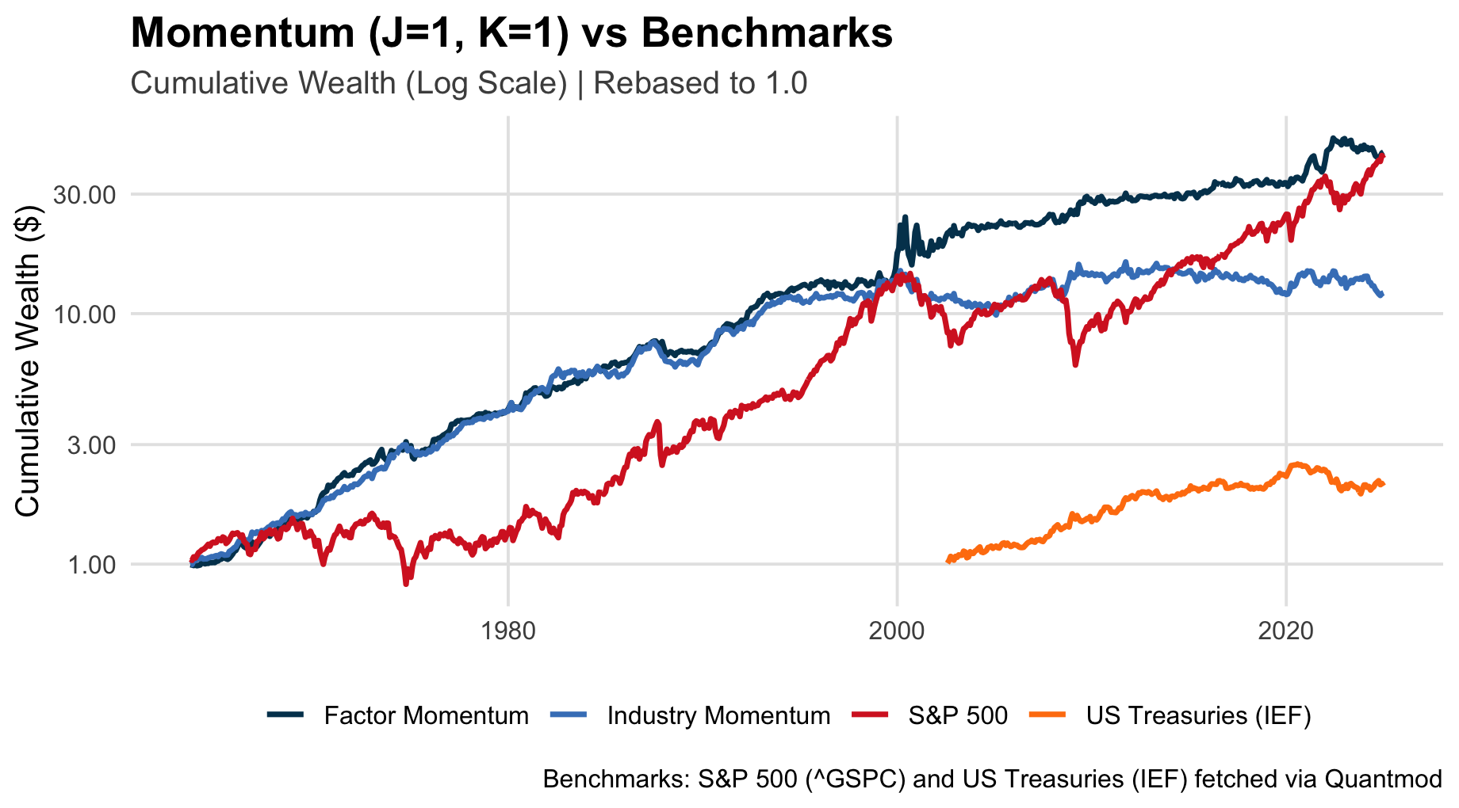
Replication Results
Replication Results
We benchmark the factor momentum and industry momentum strategies against two major asset classes: U.S. equities (S&P 500) and U.S. Treasury bonds (IEF ETF).
Over the full sample, factor momentum delivers total returns comparable to the S&P 500, despite lower volatility.
Industry momentum underperforms the S&P 500, with substantially lower cumulative returns.
US Treasuries (IEF) provide much lower long-run returns but remain the lowest-volatility asset in the comparison.
Overall, factor momentum stands out as the strongest alternative to equities, while industry momentum behaves more defensively but with limited upside.

Slide 6
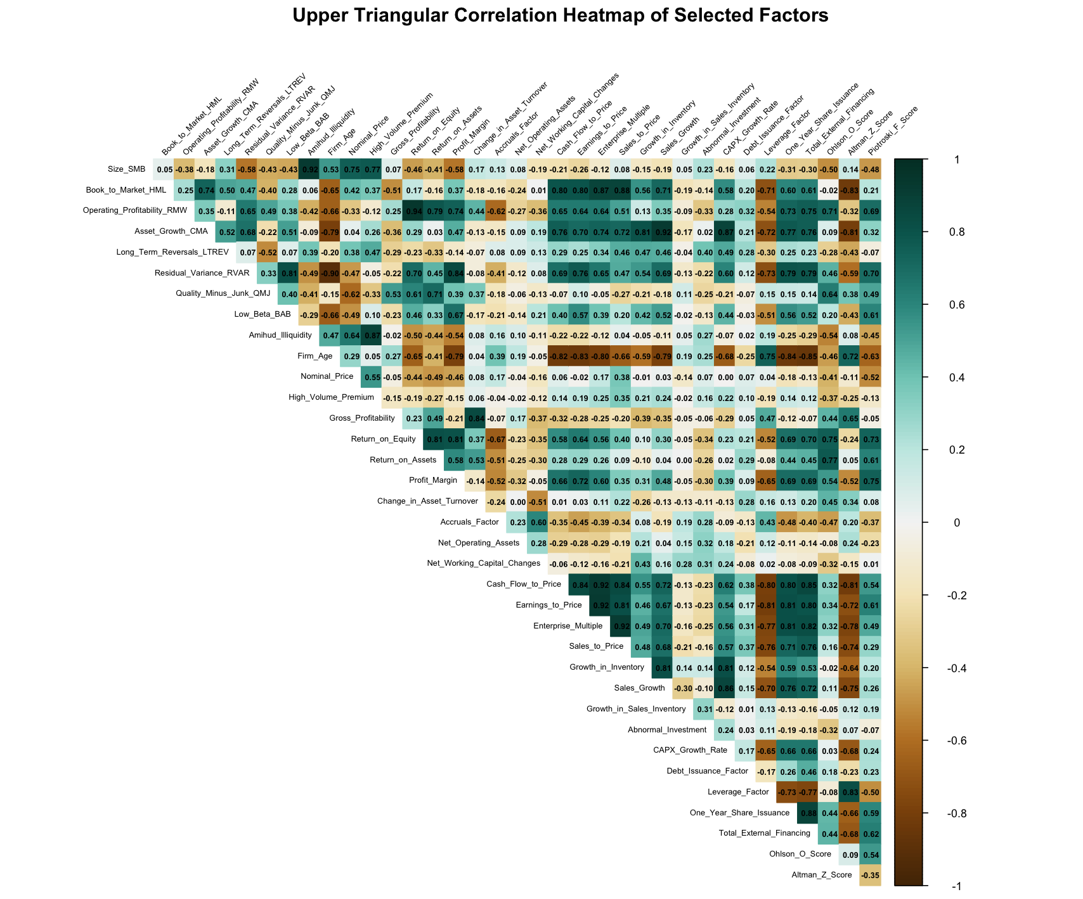
Factor Correlation & Regression Analysis
Factor Correlation Heatmap
Correlation calculated across selected JKP factors.
We observe clusters of highly correlated factors (dark green), such as profitability and investment factors, as well as groups with low or negative correlation (brown). For example, distress and volatility proxies show weak or inverse correlation with profitability/value.
Size (SMB) and momentum-related factors remain largely orthogonal, reflecting their distinct economic drivers.
Fundamental factors move together, reinforcing systematic momentum.
We then regress each factor on FF5 + MOM to isolate the subset of statistically significant, non-redundant factors used in the subsequent analysis.

Slide 7
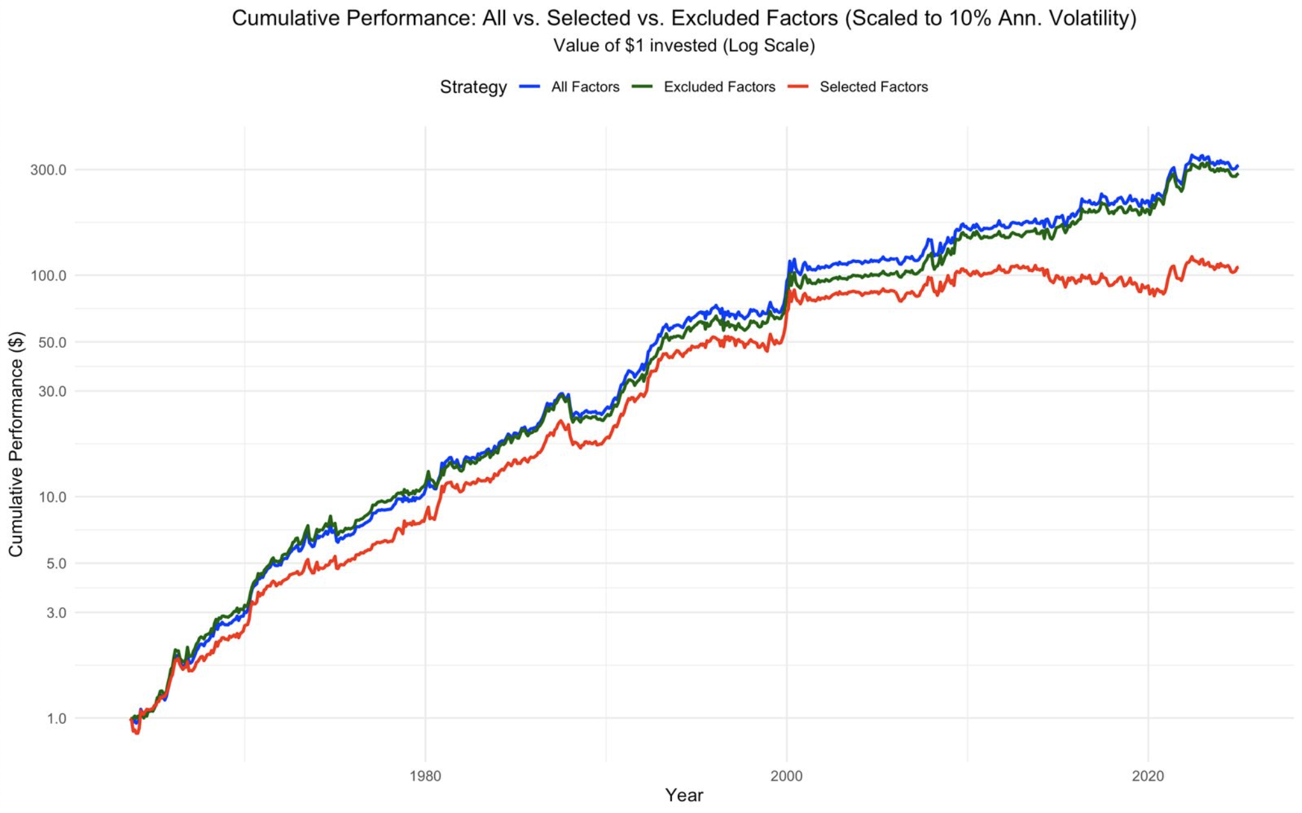
Selected factor performance
Selected factors vs. all
We selected 11 factors based on:
Statistically significant alpha
Thematic Uniqueness
and inclusion of the original FF5 factors.
The selected factor portfolio underperforms both the full factor set and the excluded factors over the full sample.
Its performance flattens after 2000, reducing its attractiveness from an investor perspective.
Given these results, we proceed with the full factor set in the rest of the analysis.

Slide 8
Clustering
Evenly Split Clusters
Cluster Theme | Factors
Financing Activity & Low-Risk Quality | One_Year_Share_Issuance; Total_External_Financing; Profit_Margin; Residual_Variance_RVAR; Firm_Age; Low_Beta_BAB
Quality vs Aggressive Growth & Leverage | Piotroski_F_Score; Growth_in_Inventory; CAPX_Growth_Rate; Asset_Growth_CMA; Sales_Growth; Leverage_Factor
Value & Distress Valuation | Altman_Z_Score; Book_to_Market_HML; Sales_to_Price; Cash_Flow_to_Price; Earnings_to_Price; Enterprise_Multiple
Size, Liquidity & Junk vs Quality | High_Volume_Premium; Size_SMB; Amihud_Illiquidity; Long_Term_Reversals_LTREV; Quality_Minus_Junk_QMJ; Nominal_Price
Profitability & Investment / Working-Capital Policies | Growth_in_Sales_Inventory; Net_Operating_Assets; Abnormal_Investment; Operating_Profitability_RMW; Return_on_Equity; Return_on_Assets
Distress, Accruals & Operating Efficiency | Ohlson_O_Score; Accruals_Factor; Net_Working_Capital_Changes; Debt_Issuance_Factor; Gross_Profitability; Change_in_Asset_Turnover
We cluster factors based on 1 − |⍴|, so that factors whose returns move together end up in the same cluster, while factors that are largely unrelated are separated into different clusters.
Then, instead of letting the algorithm create uneven groups, we force an even split by slicing the ordered dendrogram into 6 consecutive blocks of equal size (6 factors per cluster).
Within each cluster, we again use an even split: top 1/3 of factors long, bottom 1/3 short, middle 1/3 neutral.

Slide 9
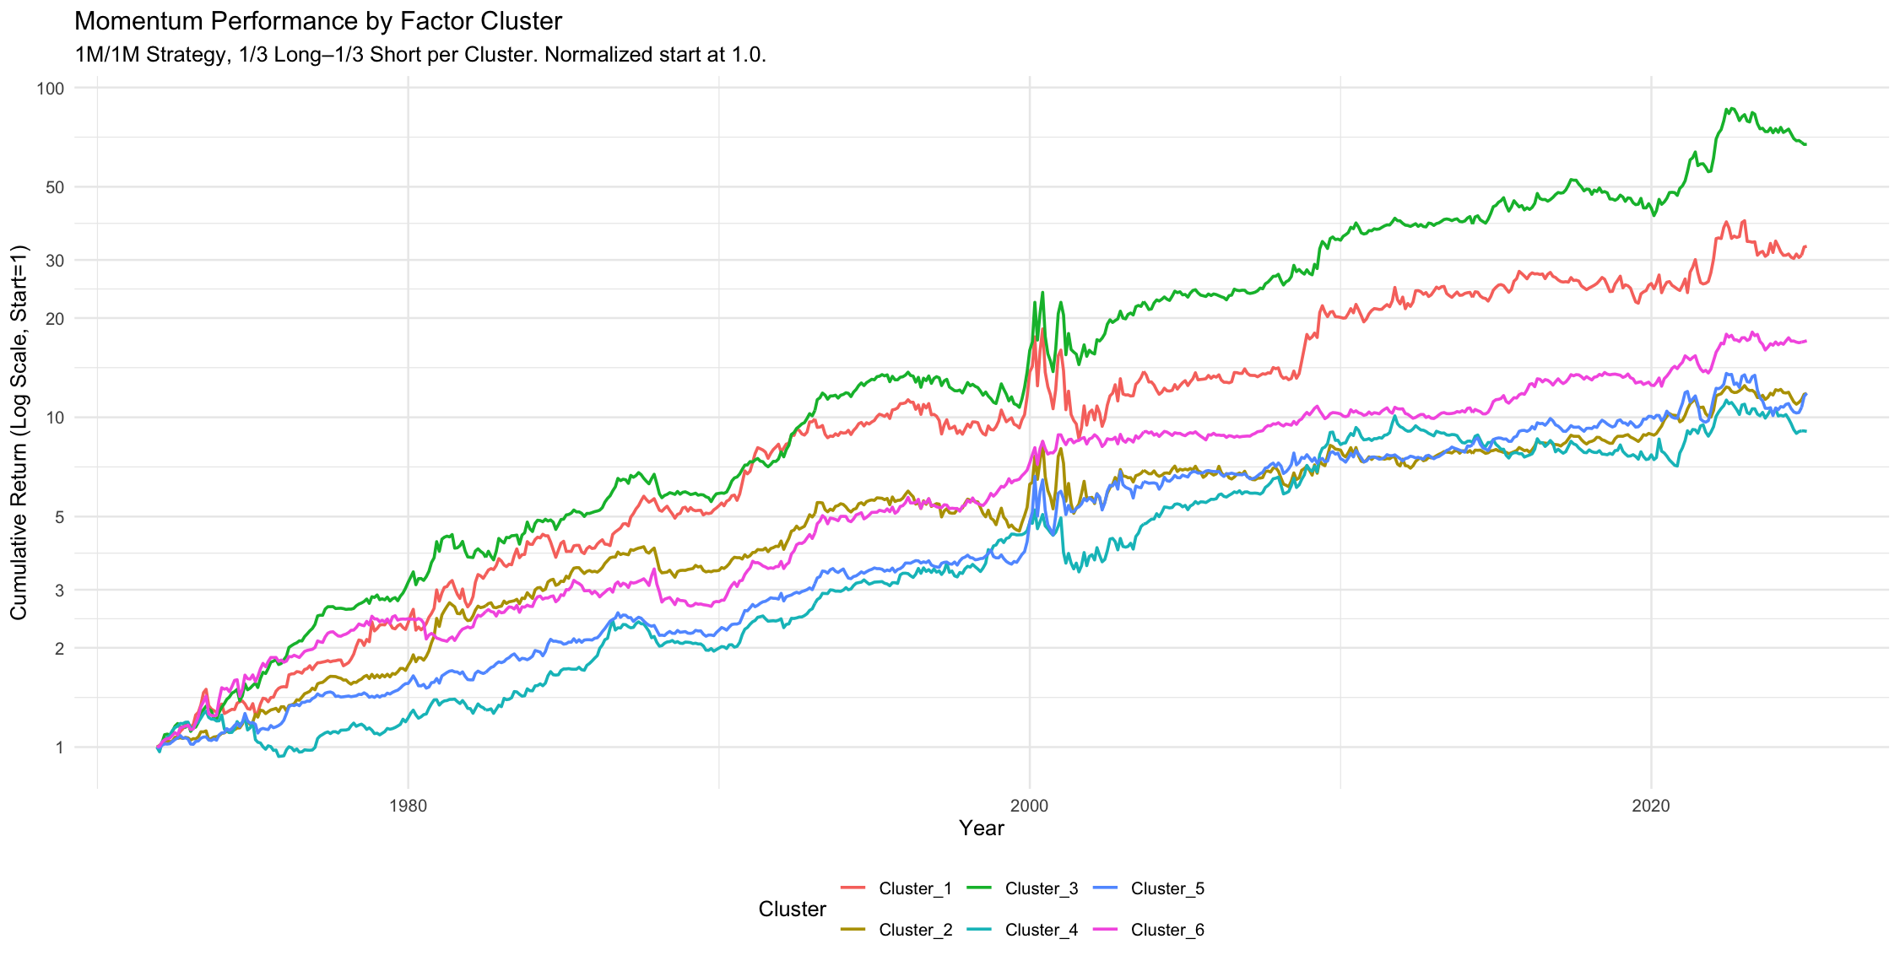
Clustering

Slide 10
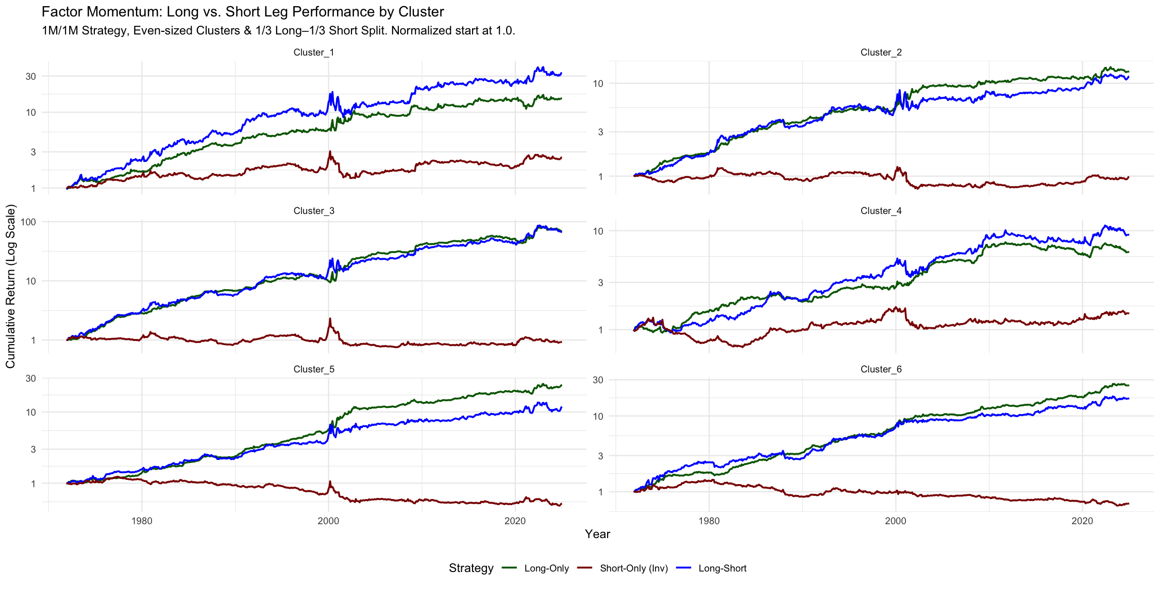
Clustering

Slide 11
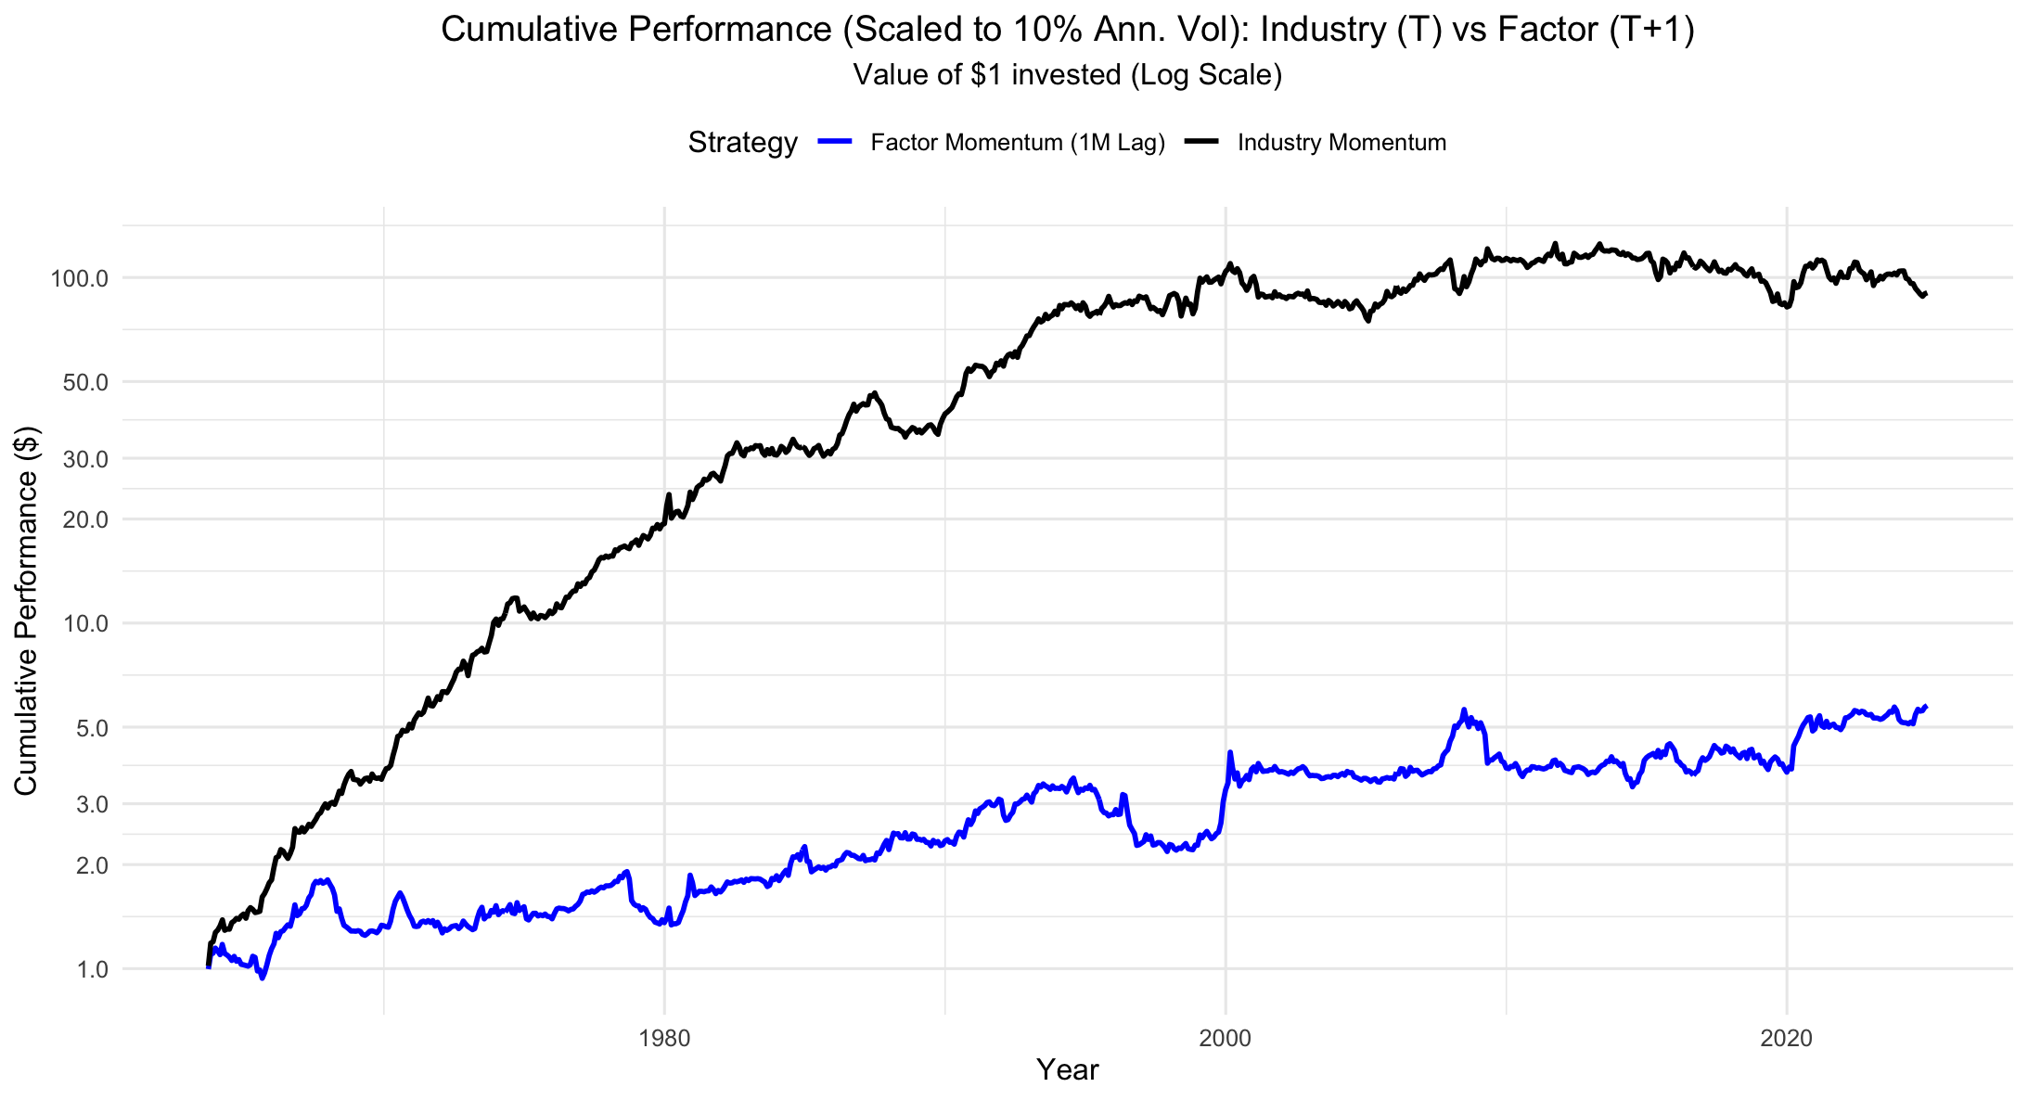
Long/Short Performance & Robustness Checks
Lagging
Once we lag 1 month the outperformance of the factor momentum strategy disappears.

Slide 12
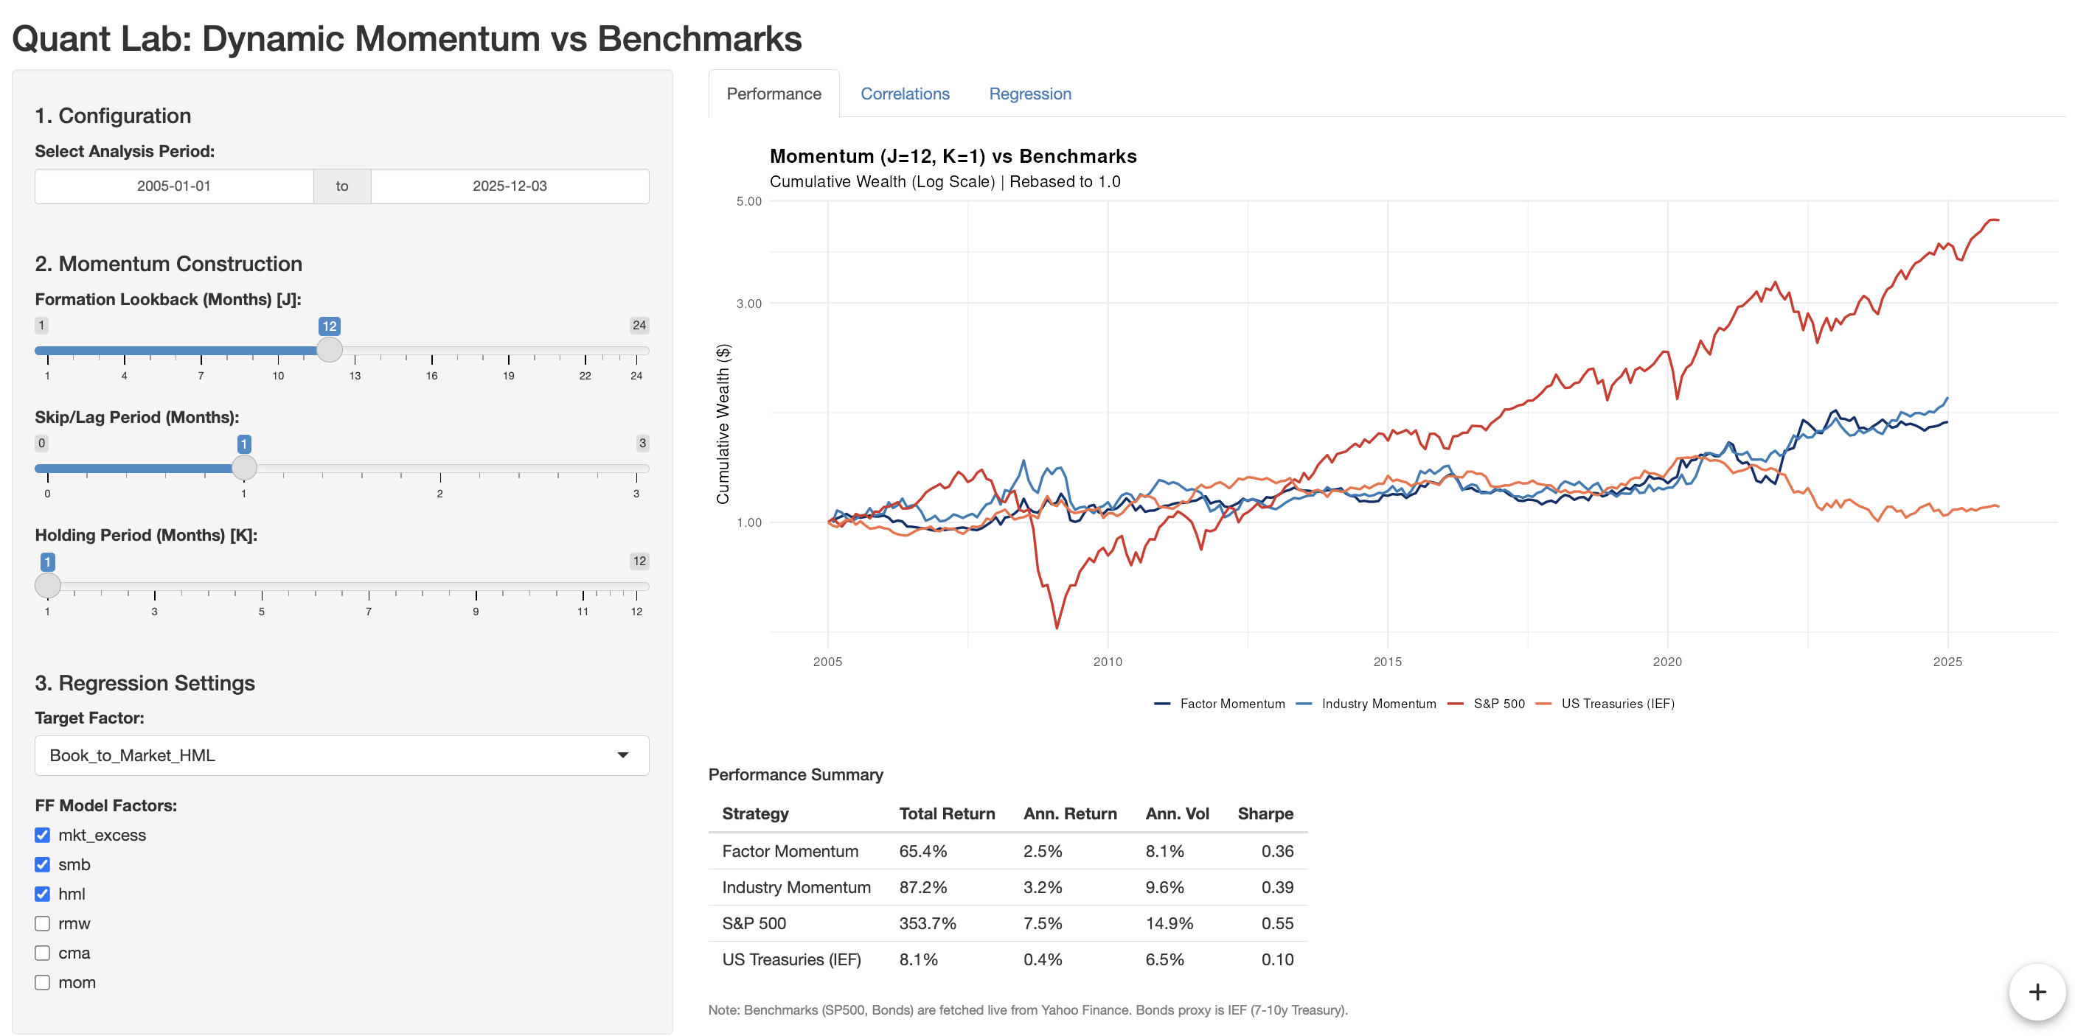
Deeper Analysis
R Shiny App
More interactively what we did:
https://huggingface.co/spaces/farkastallos/Ilab_Factor_Momentum
Credentials:
User: Ilab_member
Password: Ilab_member_12_1

Slide 13
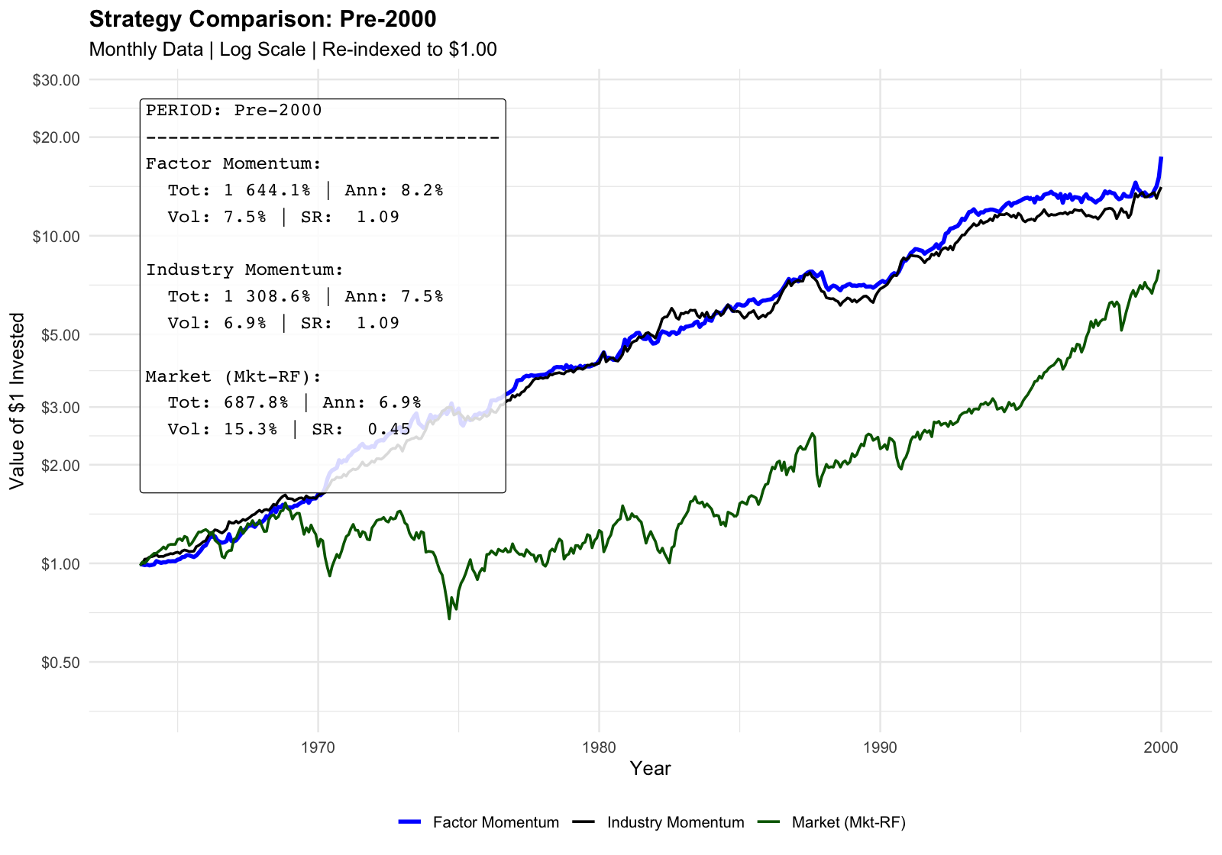
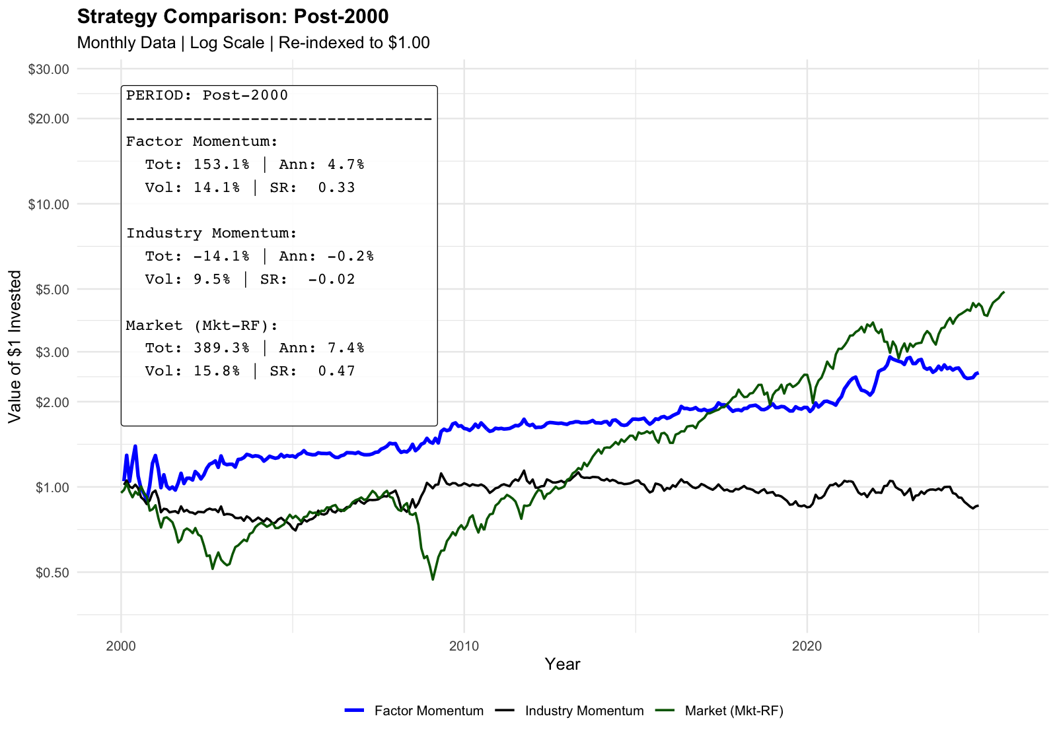
Deeper Analysis
Structural Decay in the Performance Post-2000
Motivates for Optimalization to Exploit the Strategy’s Benefits Today
Why Alpha Has Decayed Post-2000: Structural alpha decay in the modern era (from SR=1.09 to 0.33) is probably driven by increased market efficiency and the crowding of factor strategies following widespread academic publication
To restore investability, in Phase 2 we must pivot to a cost-efficient, long-only implementation that leverages the strategy's proven negative correlation during market stress as a reliable tail-risk hedge (7.2% COVID; +2.8% GFC)

Slide 14
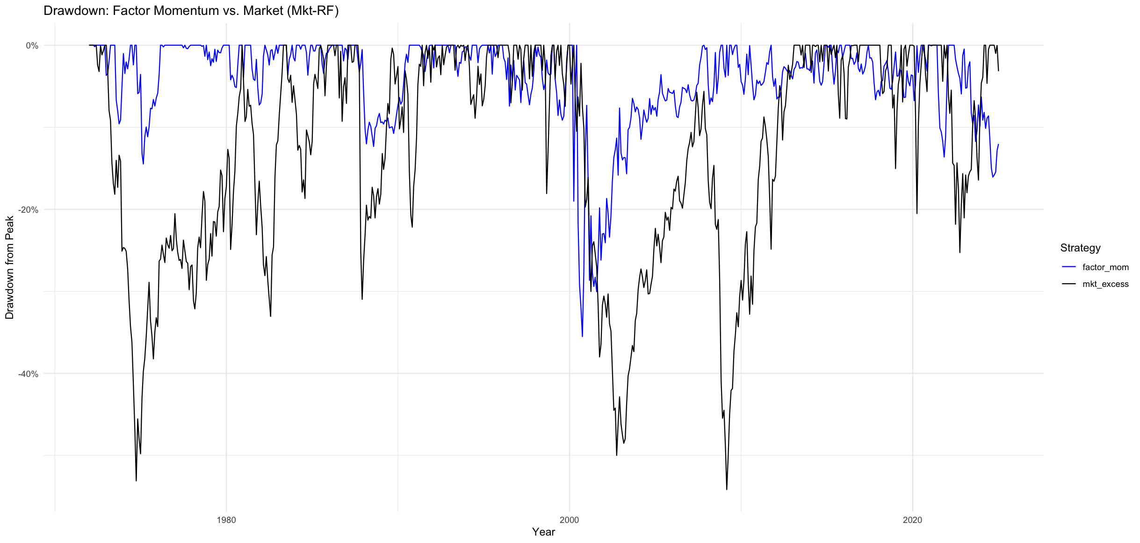
Deeper Analysis
Structural Decay in the Performance Post-2000
Motivates for Optimalization to Exploit the Strategy’s Benefits Today
Why Alpha Has Decayed Post-2000: Structural alpha decay in the modern era (from SR=1.09 to 0.33) is probably driven by increased market efficiency and the crowding of factor strategies following widespread academic publication
To restore investability, in Phase 2 we must pivot to a cost-efficient, long-only implementation that leverages the strategy's proven negative correlation during market stress as a reliable tail-risk hedge (7.2% COVID; +2.8% GFC)

Slide 15
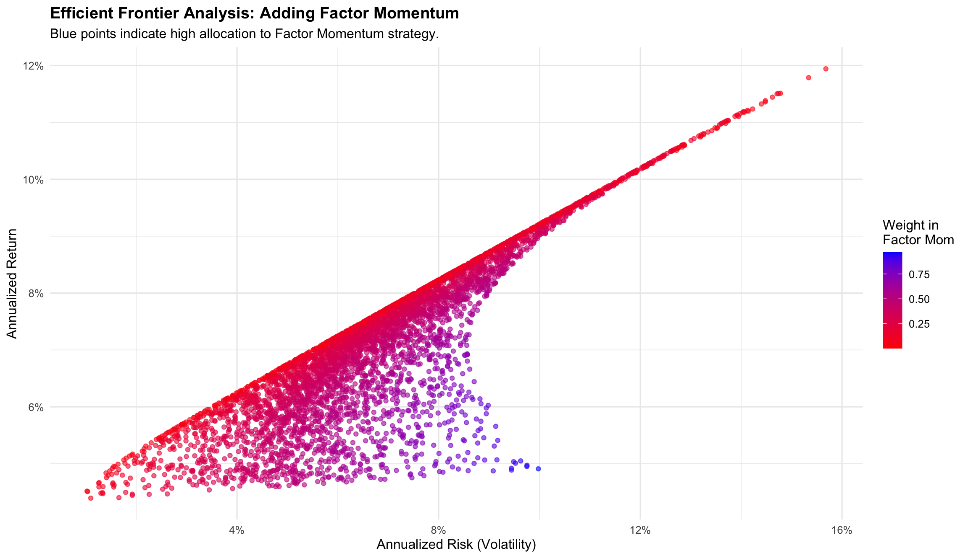
Deeper Analysis
Portfolio Impact: Factor Momentum Acts more as a Volatility Dampener
The efficient frontier reveals that portfolios with high allocations to Factor Momentum (blue points) cluster in the lower-volatility region, sacrificing the raw upside of a pure equity portfolio (red points) to achieve a significantly more stable risk profile.
To restore investability, in Phase 2 we must pivot to a cost-efficient, long-only implementation that leverages the strategy's proven negative correlation during market stress as a reliable tail-risk hedge (7.2% COVID; +2.8% GFC)

Slide 16
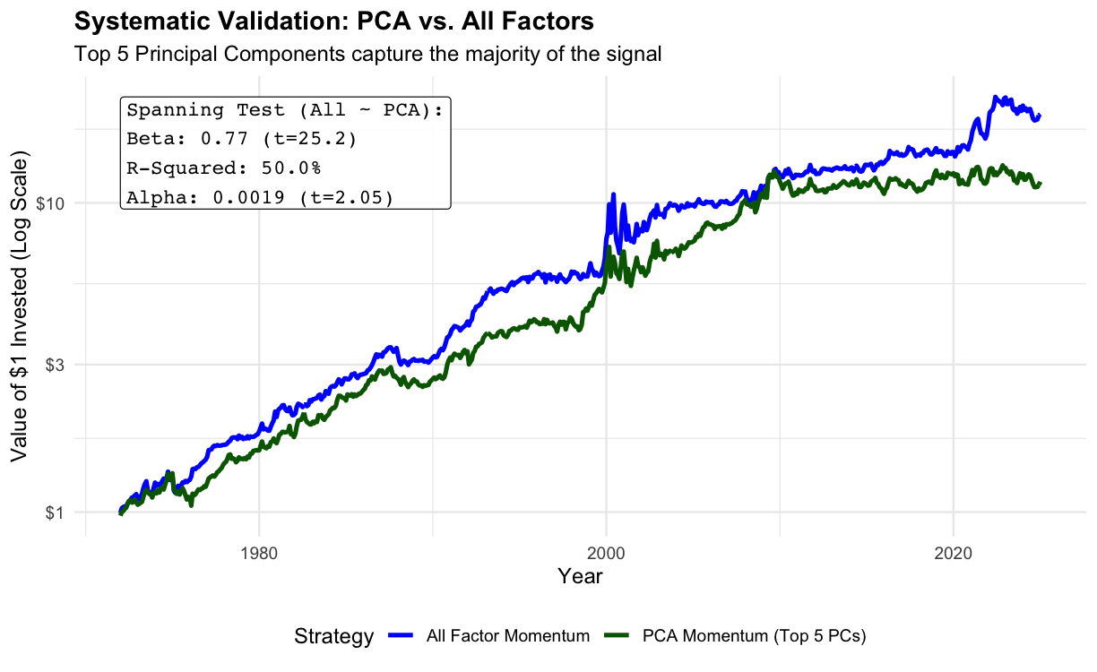
Deeper Analysis
Systematic Validation: Top 5 Principal Components Drive the Strategy
PCA Decomposition: We performed a Principal Component Analysis (PCA) on the entire universe of 36 factors to separate signal from noise.
Result: The Top 5 Principal Components alone explain >80% of the total variance in the factor dataset. The remaining 31 dimensions are largely idiosyncratic noise that do not drive the trend according to the PCA analysis
Systematic Dominance: The simple 5-factor PCA strategy explains 53% of the variation (R2) in the complex 36-factor strategy returns, confirming the signal is driven by systematic risk.
High Beta: The regression reveals a high beta of 0.77 (t-stat: 25.2) with marginally significant alpha. This suggests the "All Factor" strategy is essentially a leveraged bet on these systematic drivers.
Because the Systematic Core (Top 5 PCs) tracks the full strategy so closely, we can focus in Phase 2 only on liquid, major factors, effectively bypassing the limitations of our earlier factor selection process.

Slide 17
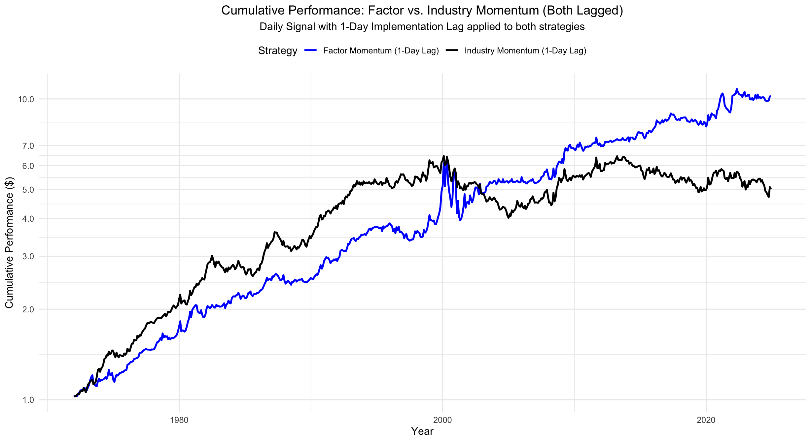
Daily Data
Switching to Daily Data – Closer to Real-life implementation
We tried to switch to daily data to mimic real-life implementation of the Investment Strategy.
Replication - daily data: instead of investing at EoM close prices, invest at 1st day of the following month closing prices.

Slide 18
Conclusion & Investment Summary
Strategy Conclusion
Pros: Diversification & Crisis Resilience
Tail-Risk Hedge: Neg. correlation during market stress → positive returns during the GFC (+2.8%) and COVID-19 (+7.2%).
Superior to Industry Momentum: Factor momentum consistently subsumes industry momentum post-2000, accelerating while industry momentum stagnates.
Uncorrelated Returns: The strategy exhibits low correlation to the traditional 60/40 portfolio, offering valuable diversification benefits.
Long-Leg Strength: The majority of the cumulative performance is driven by the long leg (winners), suggesting the "momentum" signal effectively identifies outperforming factors.
Robustness: Unlike many academic anomalies, Factor momentum survives a realistic T+1 implementation (even though performance is reduced significantly).
Cons: Structural Decay & Implementation Costs
Alpha Decay: There is a structural break in performance post-2000; the Sharpe Ratio dropped from 1.09 (pre-2000) to 0.33 (post-2000), likely due to increased market efficiency & post-publication effects.
Underperformance vs. Equity: Despite volatility scaling, the strategy underperforms the S&P 500 proxy in the modern era.
Execution Sensitivity: The strategy is highly sensitive to timing; introducing a 1-month lag completely erodes the outperformance.
Selection Complexity: A subset of 11 "unique" factors underperformed the broader "all-factor" universe, suggesting that diversification across many factors is necessary to capture the premium.
Given the decay in the short leg and the high execution costs, our findings support a pivot toward a long-only implementation to serve as a cost-efficient tail-risk hedge rather than a standalone alpha generating strategy.

Slide 19
Conclusion & Investment Summary
Investment Decision
1) Rejection of Pure Replication (Long/Short):
We advise against deploying the fully replicated Long/Short Arnott et al. (2023) strategy as a standalone alpha generating strategy.
Reasoning: The structural alpha decay post-2000 (Sharpe Ratio declining from 1.09 to 0.33) implies that the strategy, in its raw form, likely cannot overcome the transaction costs associated with high-turnover shorting.
2) Strategic Pivot: Long-Only Implementation:
We recommend isolating the Long-Only leg for implementation.
Rationale: The replication confirms that the majority of the cumulative performance is driven by the long leg, while the short leg adds volatility without contributing significant returns.
Benefit: Drastically reduces implementation costs (no borrowing costs, lower turnover) while retaining the strategy's primary upside driver.
3) Portfolio Role: Crisis Diversifier:
Sizing: The strategy should be sized as a tail-risk hedge rather than a core equity replacement.
It demonstrates unique resilience during market stress, delivering returns during the GFC (+2.8%) and the COVID-19 crash (+7.2%).
Correlation: -0.034 to the 60/40 portfolio → it provides genuine diversification benefits.
4) Execution Constraints:
Universe: The attempt to select a "unique" subset of 11 factors resulted in underperformance, suggesting that broad diversification is required to capture the momentum premium effectively.
Timing: Our robustness checks show that a 1-month lag completely erodes the outperformance, while the 1-day lag harms it significantly, necessitating a strict rebalancing schedule.

Slide 20
Turning to the 2nd part of the project
Findings from the 1st part – Implementation Bottlenecks
Structural Alpha Decay: The strategy's risk-adjusted performance has degraded significantly, dropping from a Sharpe Ratio of 1.09 (pre-2000) to 0.33 (post-2000).
Timing Sensitivity: The strategy is highly sensitive to execution timing. Introducing a 1-month lag causes the outperformance against industry momentum to completely disappear. With a 1-day lag the strategy still outperforms Industry Momentum but loses a significant part of the performance compared to the non-lag version.
Simplification Constraints: Attempting to simplify the strategy by selecting a subset of 11 "unique" factors resulted in underperformance compared to the full "All Factors" universe.
PCA Results: revealed that there is however a smaller number of drivers that essentially mimic the Factor Momentum Strategy → we will focus on identifying these factors and replicating them from individual stocks in the 2nd part.

Slide 21

Thank you!

