Slide 1

ZZ ILab Presentation
12.01.2026
Giulio Iepure, Caterina Piacentini, Farkas Tallos, Tomas Samaj

Slide 2
1
Long Leg Performance Recap
Agenda
2
Initial Factors Update & New Factors
3
Net Positions
4
Next Steps
Notes:
Tags: divider, simple, no image, left aligned header

Slide 3
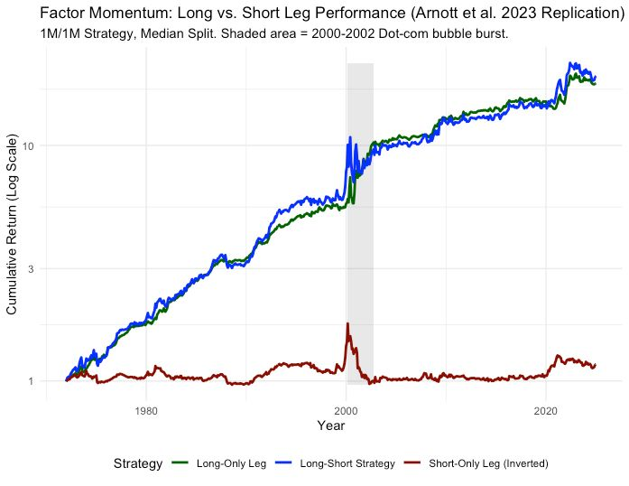
From the last meetings
Long & Short Performance
Most of the performance of the strategy comes from the long leg

Slide 4
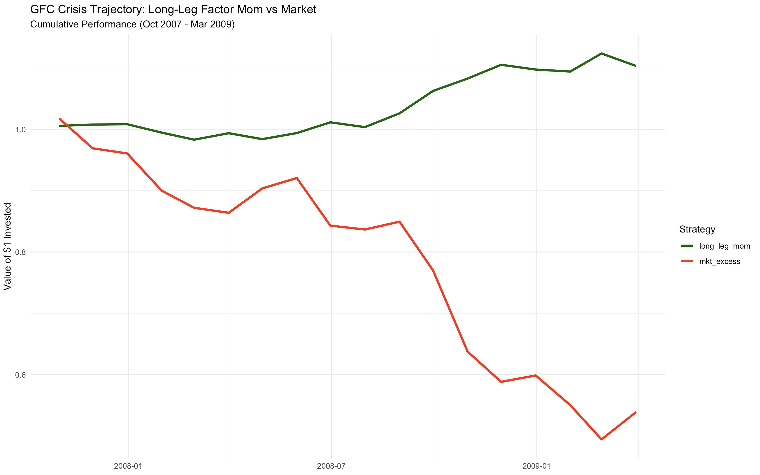
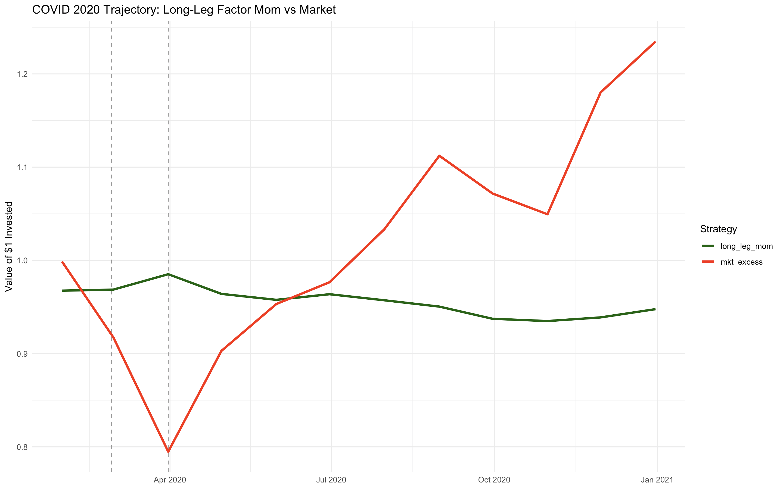
Long Only Performance Recap
Long-Only Performance during Crisis
The crisis-diversifying benefits persist even after excluding the short leg.

Slide 5
Long Only Performance Recap
Long-Only Performance during Crisis
Period | Long Leg Return | Market Return | Correlation | Long Leg Volatility | Market Volatility
Covid | 0.0182 | -0.204 | -1 | 0.039 | 0.128
GFC | 0.103 | -0.461 | - 0.562 | 0.0541 | 0.221
The crisis-diversifying benefits persist even after excluding the short leg.

Slide 6
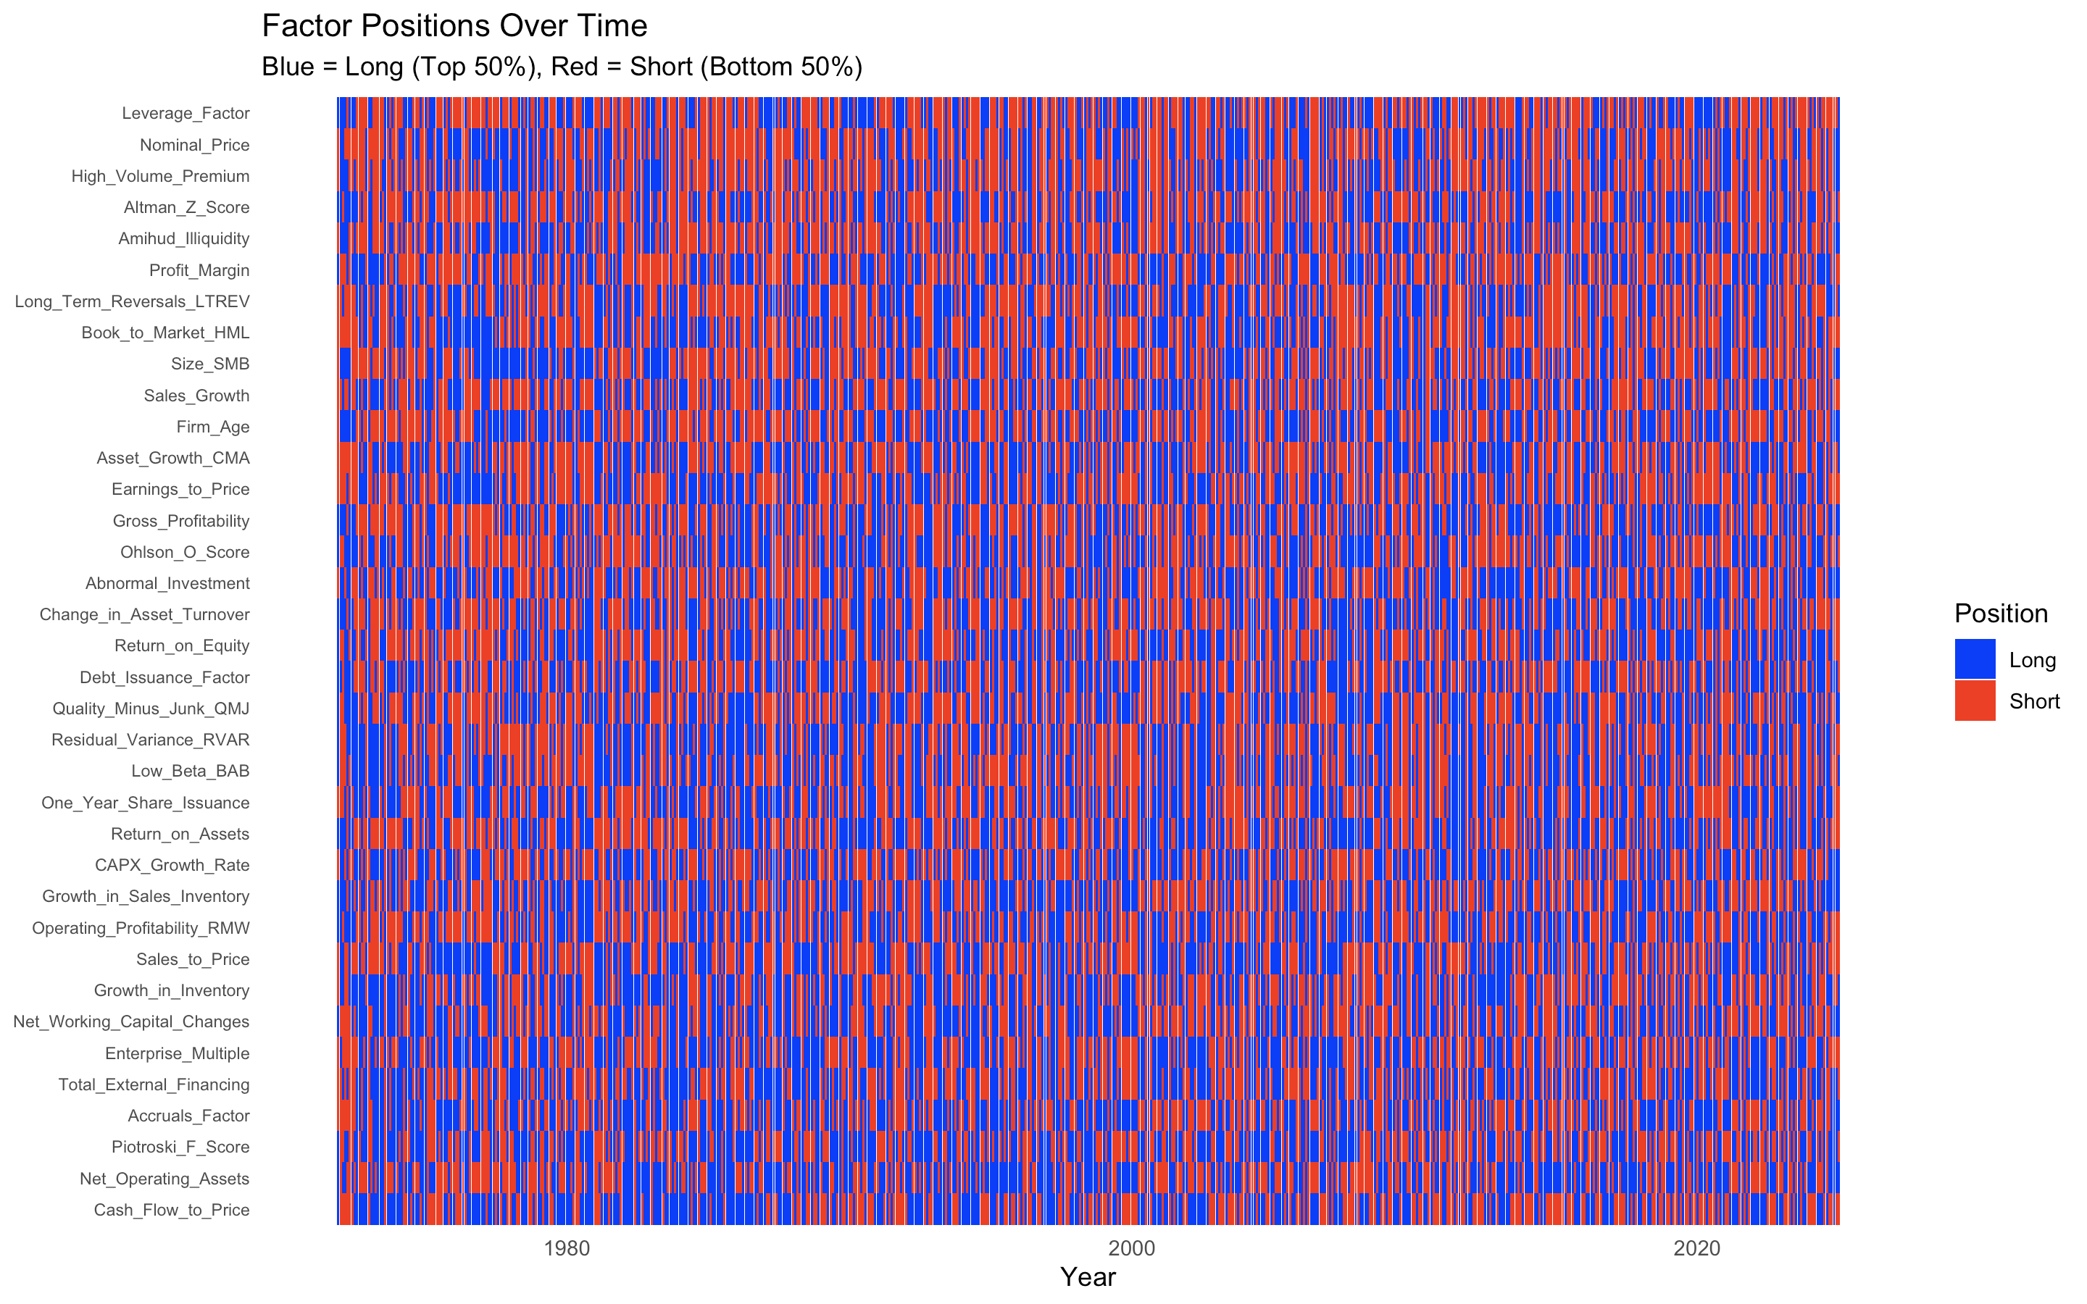
Long/Short Factors
Which factors are mainly long/short?
Factors switch a lot over time

Slide 7
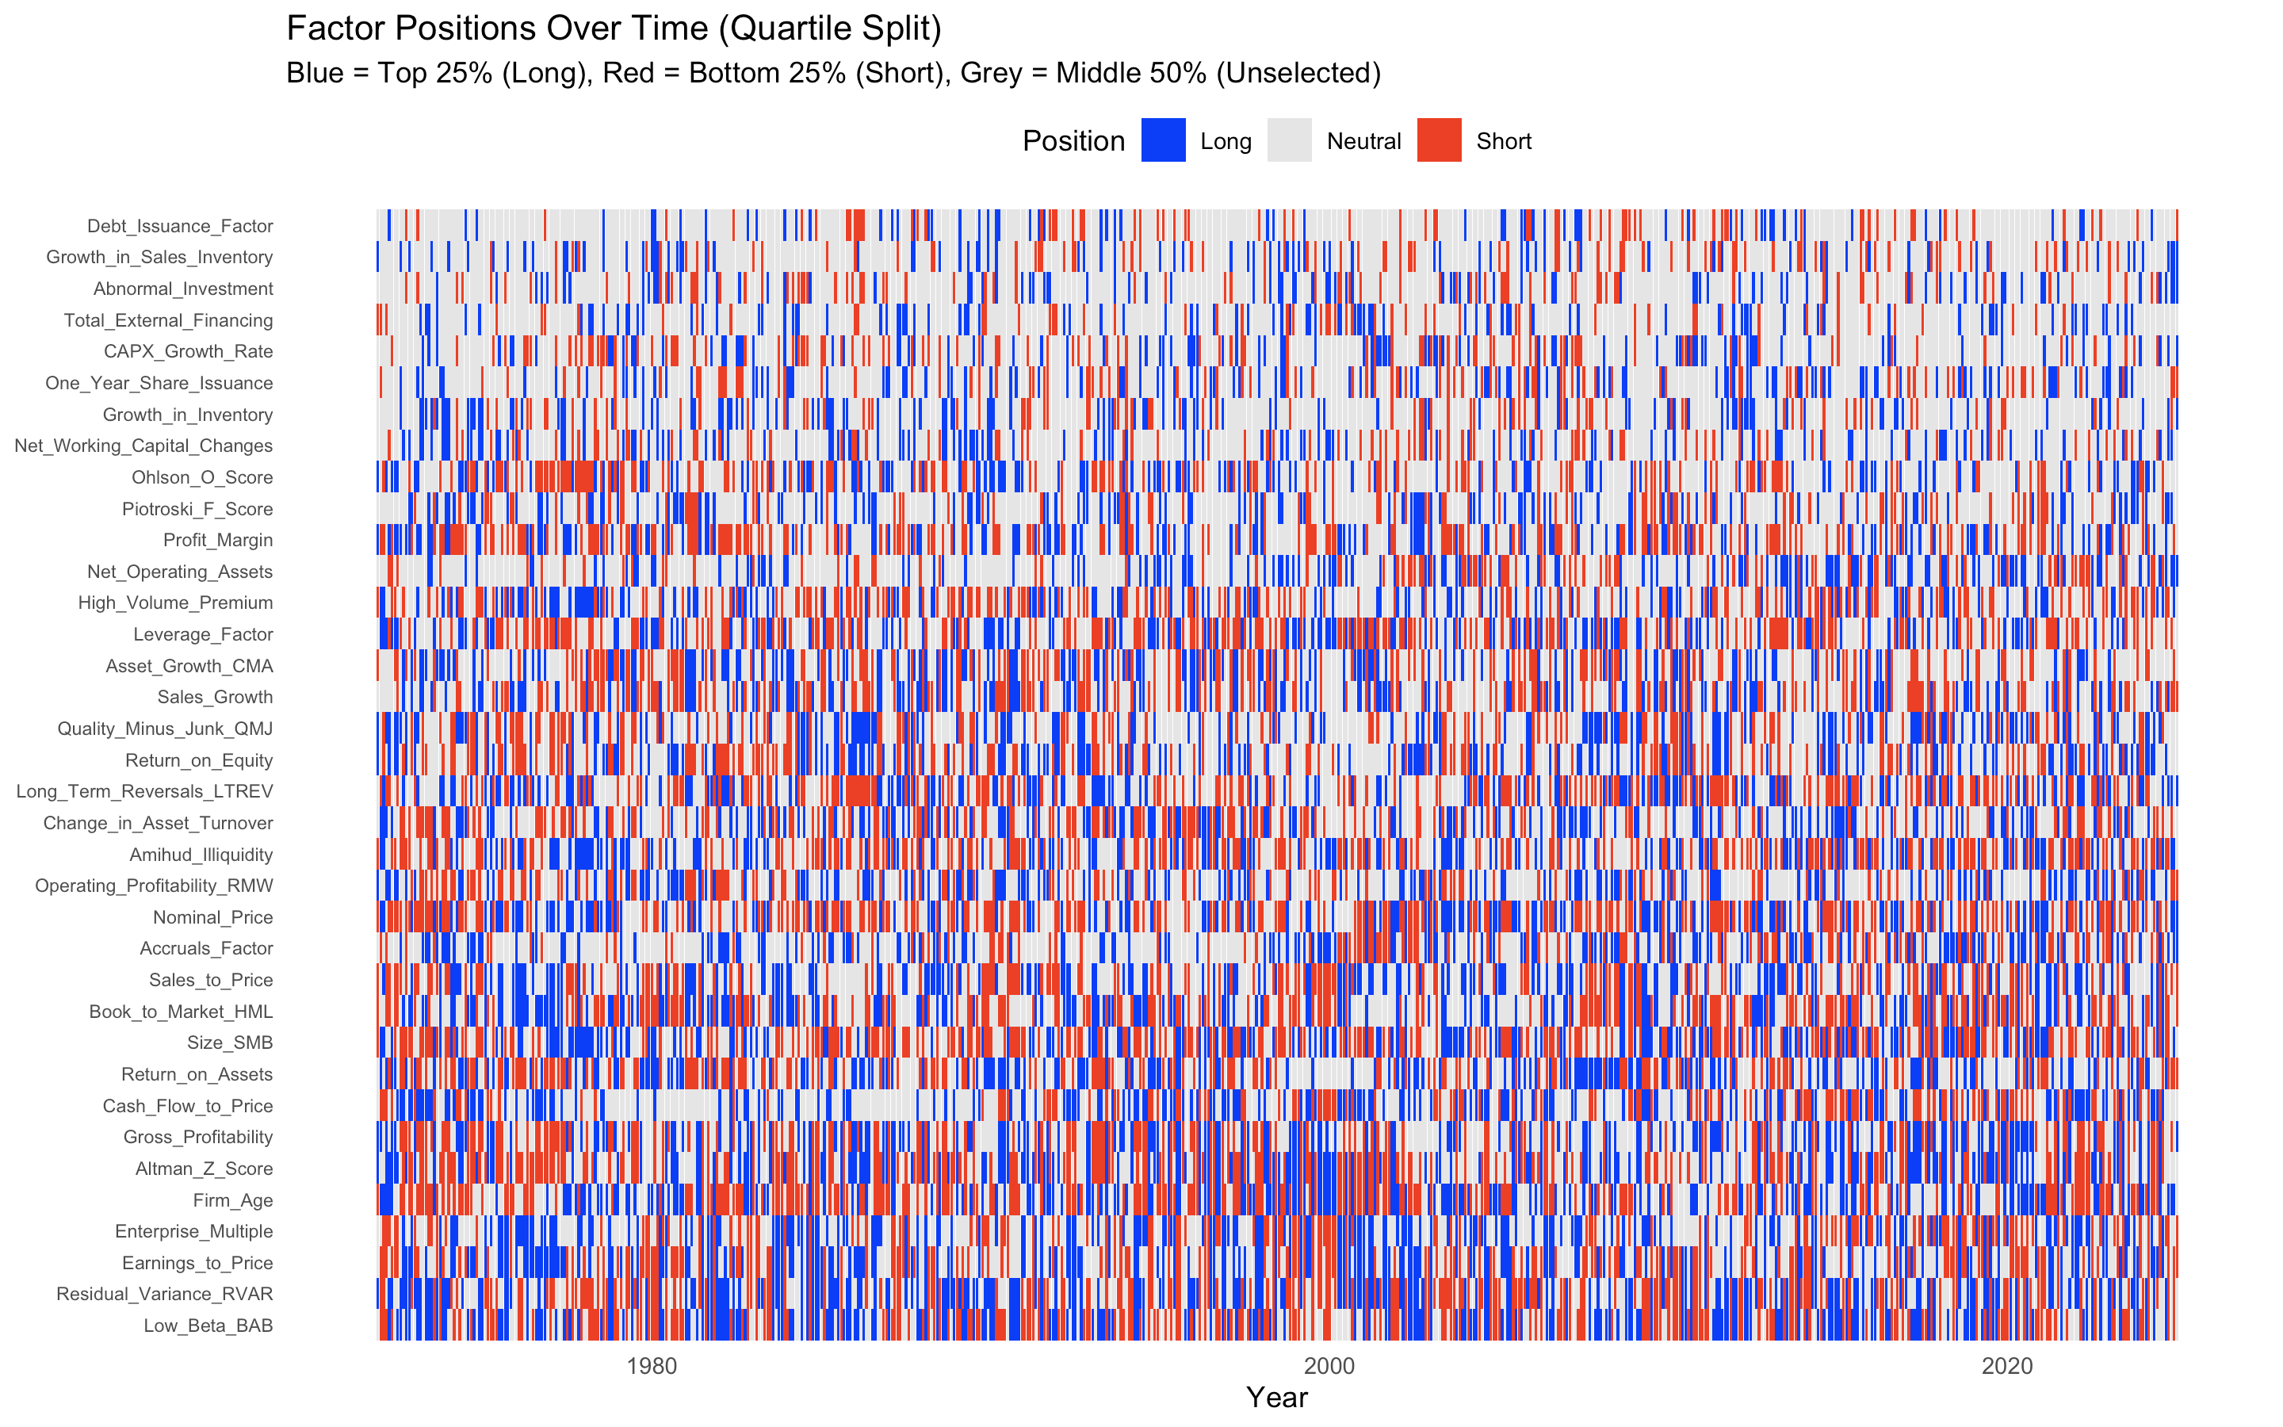
Long/Short Factors
25% - 25% Momentum
Factors switch a lot over time

Slide 8
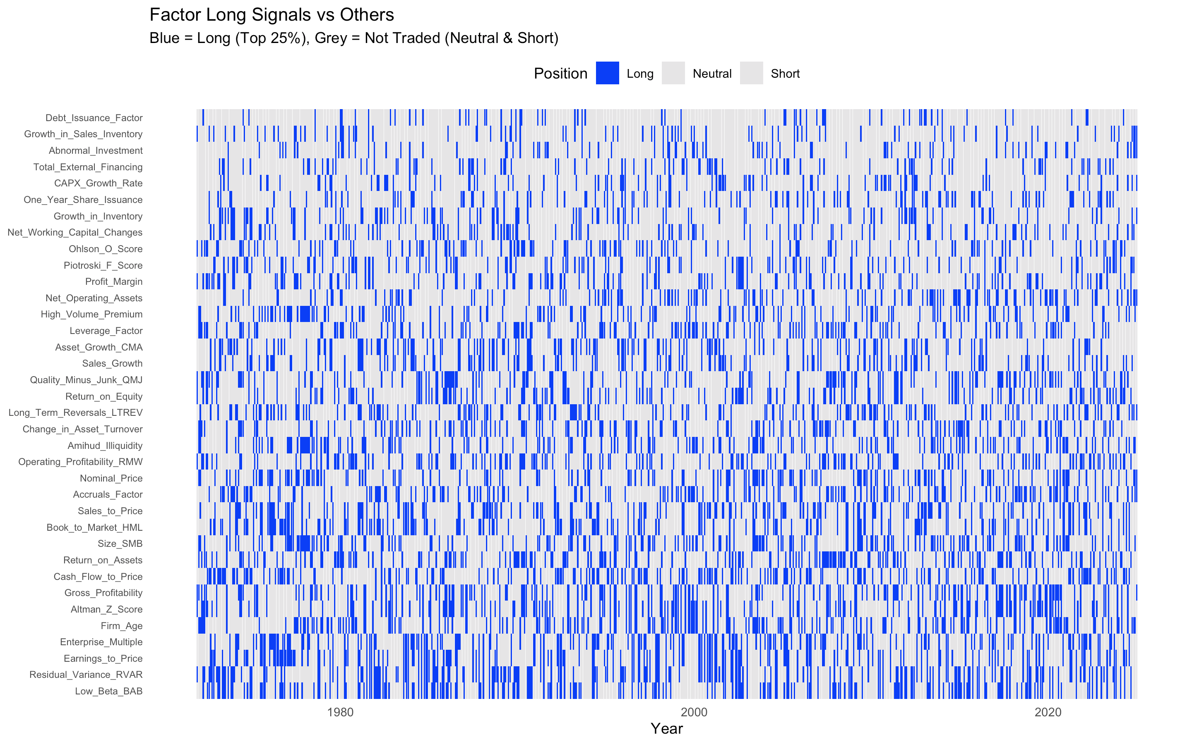
Long/Short Factors
25% - 25% Momentum – Long Leg Only
Factors switch a lot over time

Slide 9
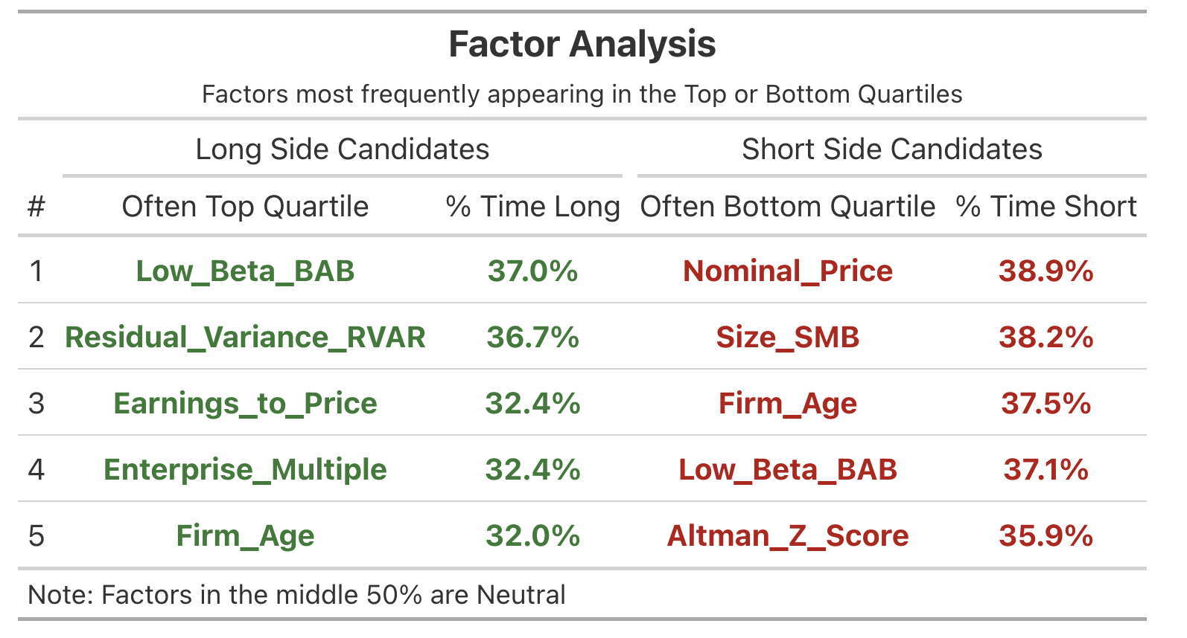
Long/Short Factors
25% - 25% Momentum – Long Leg Only
The heat map shows a scattered pattern instead of solid lines, visually proving that factors switch frequently between Long and Short rather than staying stable over time.
Even the most consistent factors are only in their expected quartile roughly 30/40% of the time, meaning they are neutral or reversed the majority of the time.
Example: Low_Beta_BAB is the #1 Long candidate (37.0%) but simultaneously the #4 Short candidate (37.1%).
Factors switch a lot over time

Slide 10
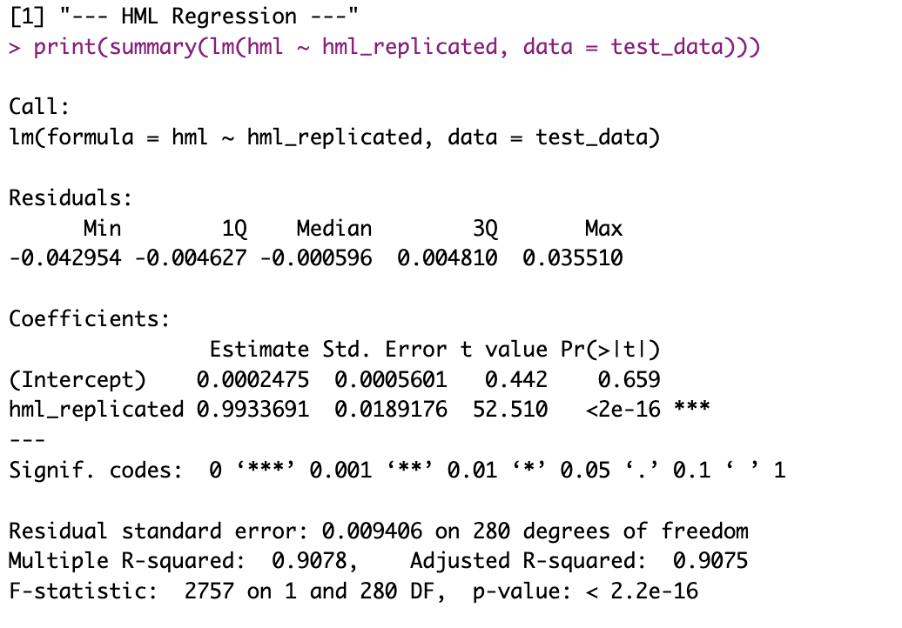
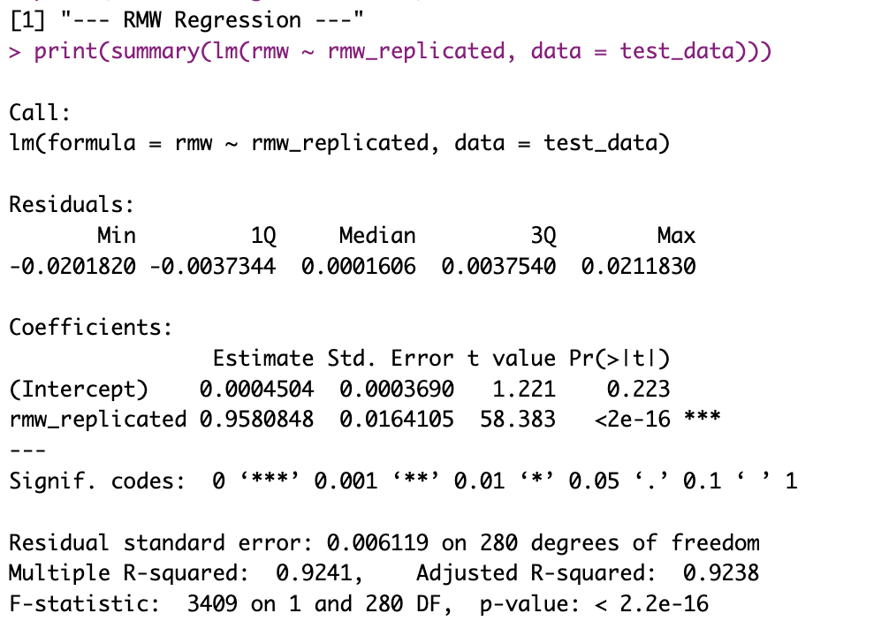
Replicating FF5 + Momentum
Factor replication from single stock data – DECEMBER RESULTS

Slide 11
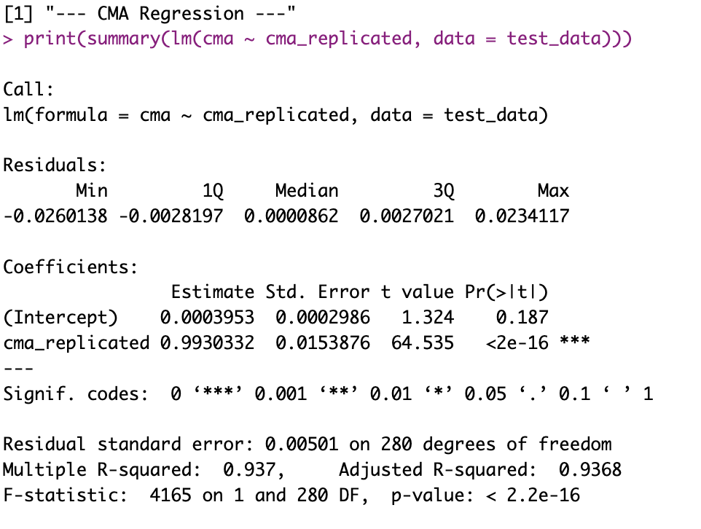
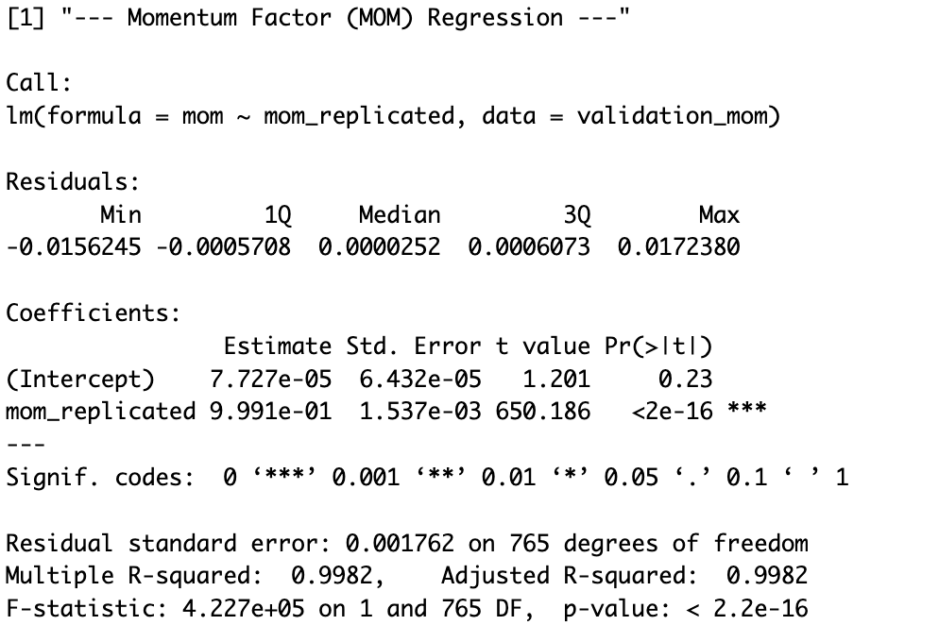
Replicating FF5 + Momentum
Factor replication from single stock data – DECEMBER RESULTS

Slide 12
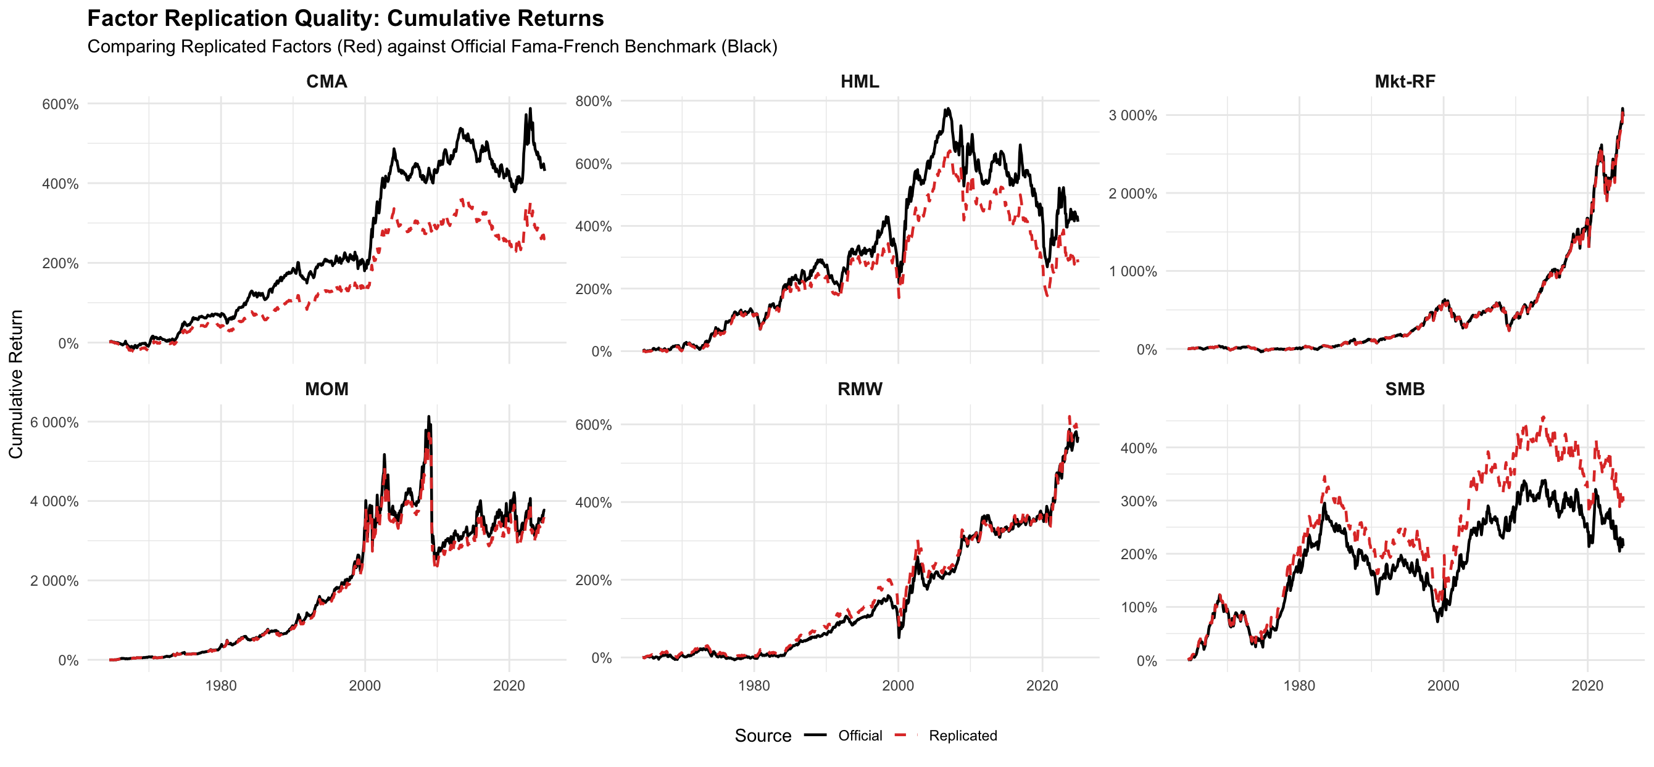
Replicating FF5 + Momentum
Factor replication from single stock data – DECEMBER RESULTS
We managed to replicate all 6 factors closely, with all Betas highly significant and close to 1, compared to the benchmark FF factors.

Slide 13
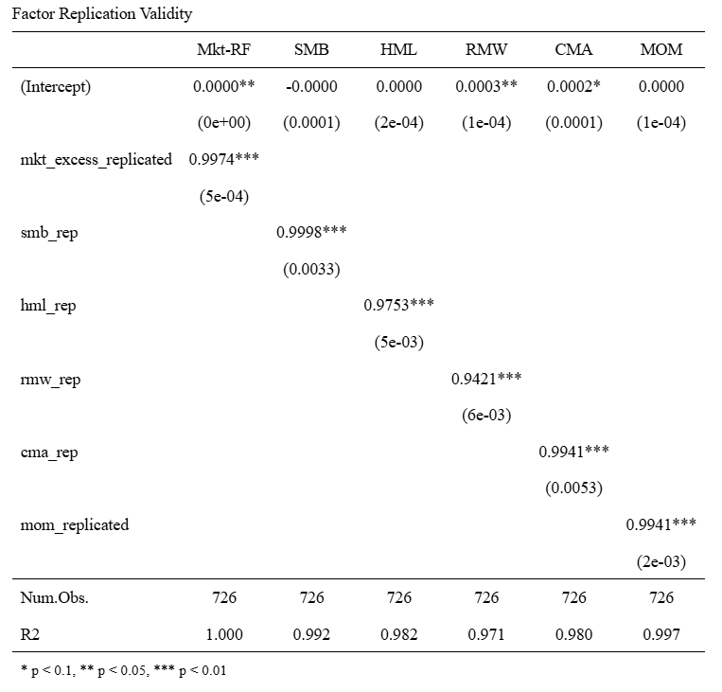
Replicating FF5 + Momentum
Factor replication from single stock data - UPDATE
Changes to FF5 + Momentum Replication
Motivated by Schwarz et al. (2024), we explored changes to the CRSP database & other changes to the FF5 factor constructions.
We implemented the following changes:
Delisting Returns: follow Fama-French methodology – manually apply a return of -30% (for NYSE/AMEX) or -55% (NASDAQ) & remove filtering based on trading status = „active“, as this dropped the return for the month of delisting.
FASB 109 Adjustment (HML): changes in deffered taxes accounting -> FF states: "files produced from August 2016 on no longer add Deferred Taxes and Investment Tax Credit to BE for fiscal years ending in 1993 or later„ -> pre-1993 we add Deferred Taxes to the Book Equity formula; post-1993 we don‘t.
Operating Profitability Revision (RMW): In August 2018, Ken French revised this definition to include Minority Interest in the formula.
CMA universe: previously, we dropped firms without a valid, positive Book Equity and Operating Profitability (required for HML & RMW) also for CMA.
Note: changes to Dividend Reinvestment assumptions are unlikely to create a systematic difference in factor returns and should cancel out over longer time horizons, as they are strongly idiosyncratic -> we did not implement them

Slide 14
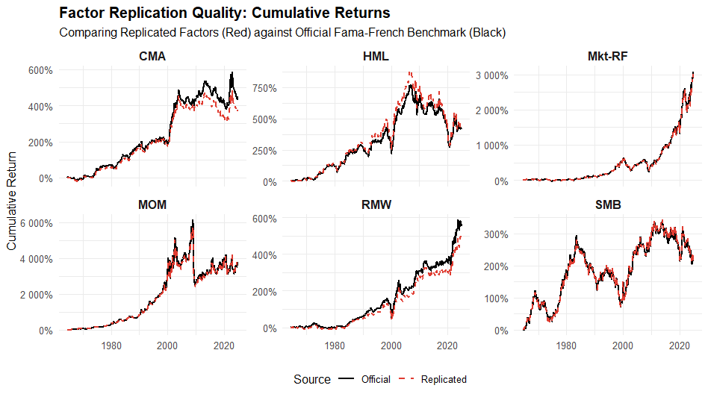
Replicating FF5 + Momentum
Factor replication from single stock data - UPDATE
SMB, CMA and HML improved significantly after the changes applied to the replication of FF5+Momentum factors since the last meeting.

Slide 15
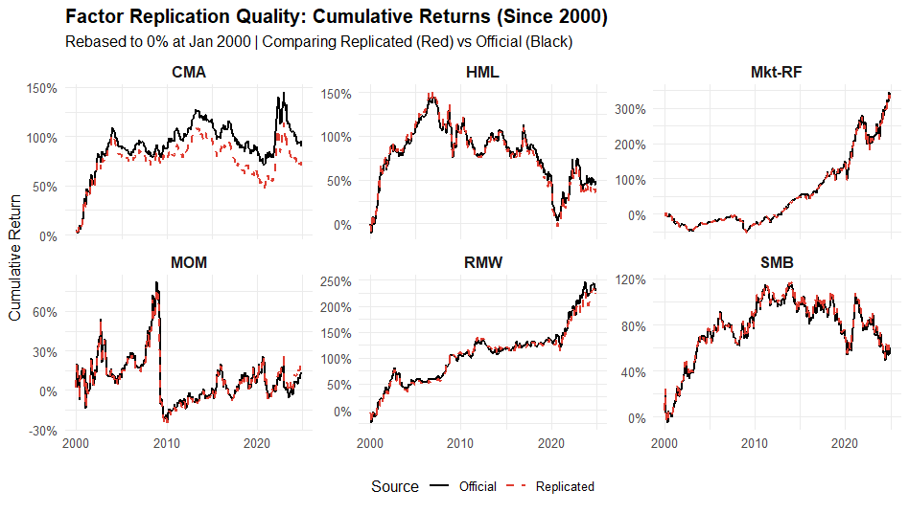
Replicating FF5 + Momentum
Factor replication from single stock data - UPDATE
Post-2000, the replicated versions of the FF5+Momentum factors are tracking the original versions very closely (with some magnitude differences for CMA still present).

Slide 16
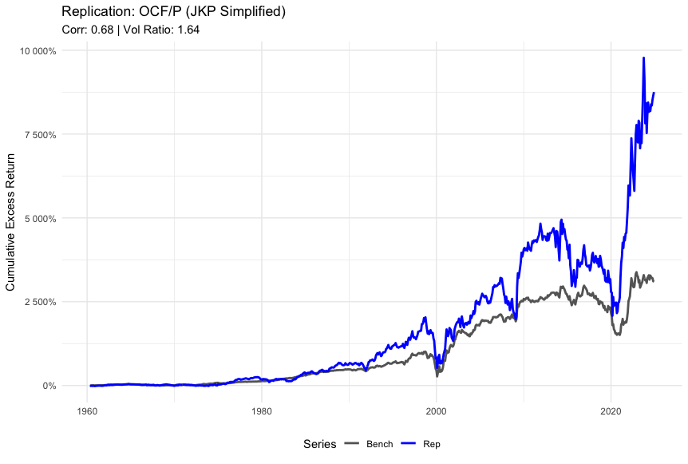
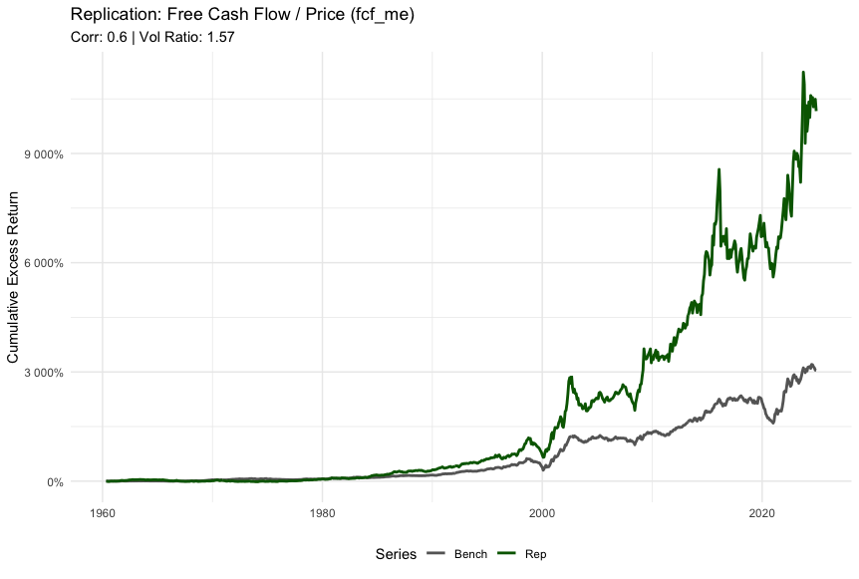
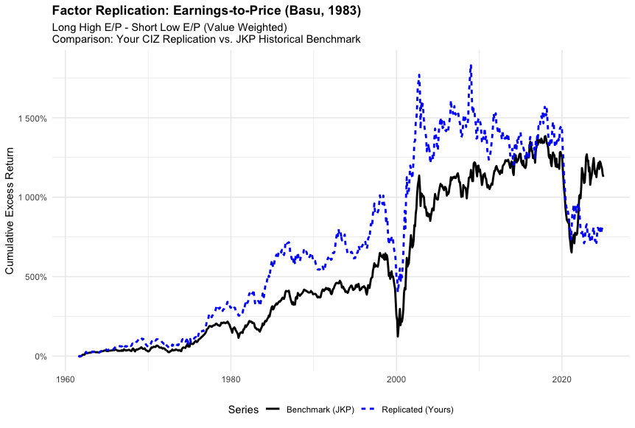
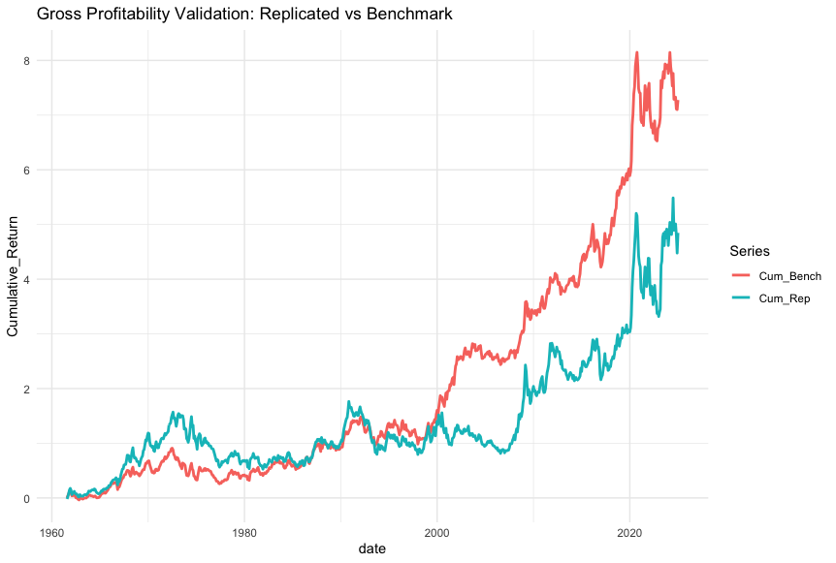
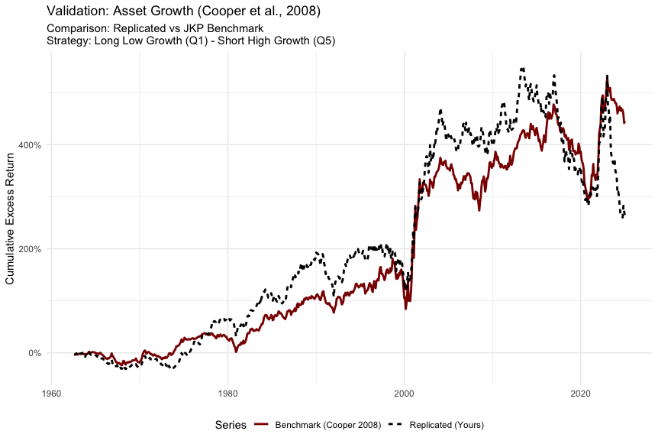
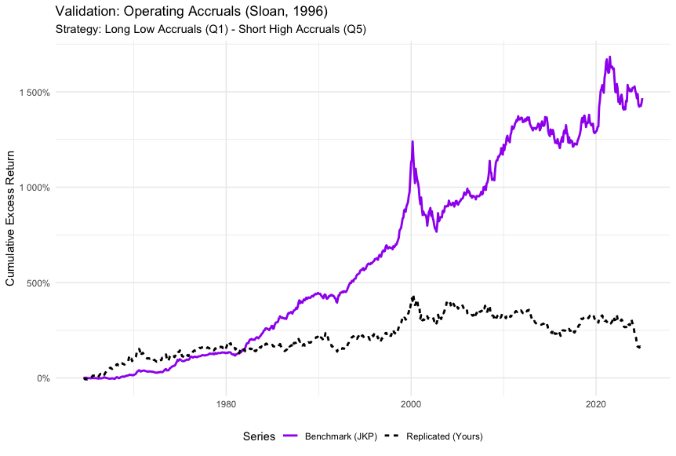
Replicating Further Factors
Factor replication from single stock data - UPDATE
We replicated 6 additional factors with moderate success, work and debugging in progress

Slide 17
Net Positions
Database
Factor
Returns
WRDS
Data
SQLLite
DB
Constructed
Factors
Net
Positions

Slide 18
Net Positions
Database
Benefits
One source of truth: all factors pull the same CRSP/CompStat/link-table inputs → consistent results
Faster + more stable: avoids repeated WRDS pulls (timeouts, credentials, differing filters)
Standardized outputs: every factor writes the same schema factor_returns & factor_holdings
Scalable execution: the tribble is a control panel (TRUE/FALSE) to run many factors, which allows computational time reductions and more robust testing.
Holdings make it possible to compute net book, turnover, and transaction-cost adjusted performance consistently across factors

Slide 19
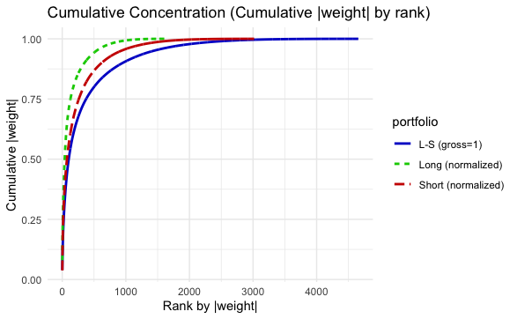
Net Positions
Net Positions 31/12/2024
Portfolios | Top 10 Stocks Weights
L-S | 16.5%
Long | 26.7%
Short | 20.7%
Exposure is highly concentrated: a small number of stocks accounts for a large share of the portfolio’s weights.

Slide 20
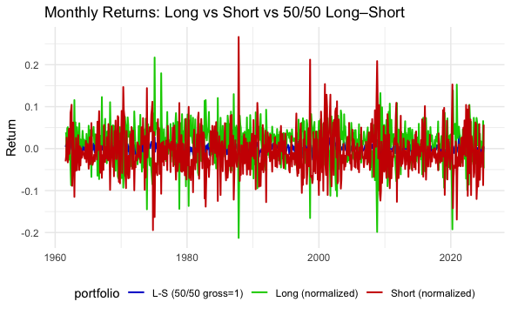
Net Positions
Returns
Standardized Database Factors
Asset Growth
Earnings to Price
Free Cashflow to Price
Gross Profitability
Operating Accruals
Sales to Price
Even with only 6 standardized factors, the long–short construction is enough to confirm how the signal behaves during crisis regimes.

Slide 21
Next Steps
Outline of the 2nd part for January
Continue Replicating Factors. (Cluster with Farkas) DONE
Look more in detail at frictions. (Giulio)
Construct Factor Momentum portfolios (Long leg only).
Compare the performance to the 1st part results. (Farkas)
Implement in the Rshiny app. (Later)
Notes 12.01.2026
What we showed makes a lot of sense + good plan
Add:
Withholding taxes (Tomas) – not complicated and not stock-specific: e.g. if you invest in the U.S. and don’t have a double taxation treaty benefits -> you pay 30% of the dividend on the long leg but have to pay 100% on the shorting cost
Shorting costs – function of trading volume -> use Mkt. cap if we cannot get volume). (Giulio)
Performance in crises positive -> means some stocks performed well -> explore which stocks performed well 8Later when we have portfolios)
Some factors show up in both the short and long leg -> what does that mean (good – good signal quality/bad – more trading) (Cate)

Slide 22

Thank you!

