Slide 1

ZZ ILab Presentation
15.12.2025
Giulio Iepure, Caterina Piacentini, Farkas Tallos, Tomas Samaj

Slide 2
1
Moving to the 2nd part
Agenda
2
Downloading WRDS + macro data
3
Replicating FF5 + Momentum
4
Next Steps
Notes:
Tags: divider, simple, no image, left aligned header

Slide 3
Moving to the 2nd part
What we did since the midterm presentation
Gained access to the WRDS database.
Downloaded single stock data (WRDS) + CPI data (FRED) + Macroeconomic Predictors (Goyal/Welch).
Replicated FF5 + Momentum factors from single stock data using tidyfinance: Results show that we managed to replicate the factors quite precisely.
Tried to replicate other factors from the 1st part: Work in progress.

Slide 4
Downloading WRDS + macro data
Downloading single stock data
From the WRDS database we downloaded (using the RSQLite and RPostgres packages):
CRSP Monthly Returns
Compustat Fundamental Data
We obtain FRED CPI Data and Goyal/Welch Macroeconomic Predictors.
=> Monthly data from Jan. 1960 to Dec. 2024 for a total number of 26,237 unique stocks (avg. 4,396 stocks per month).
We downloaded FF5 + Momentum Factors as benchmarks from Kenneth French‘s Data Library.

Slide 5
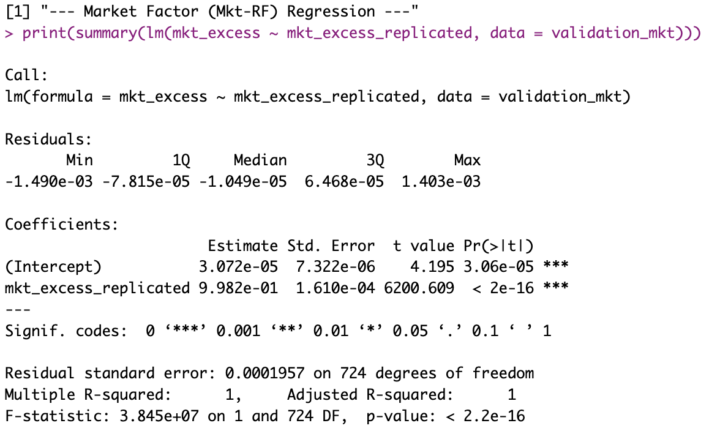
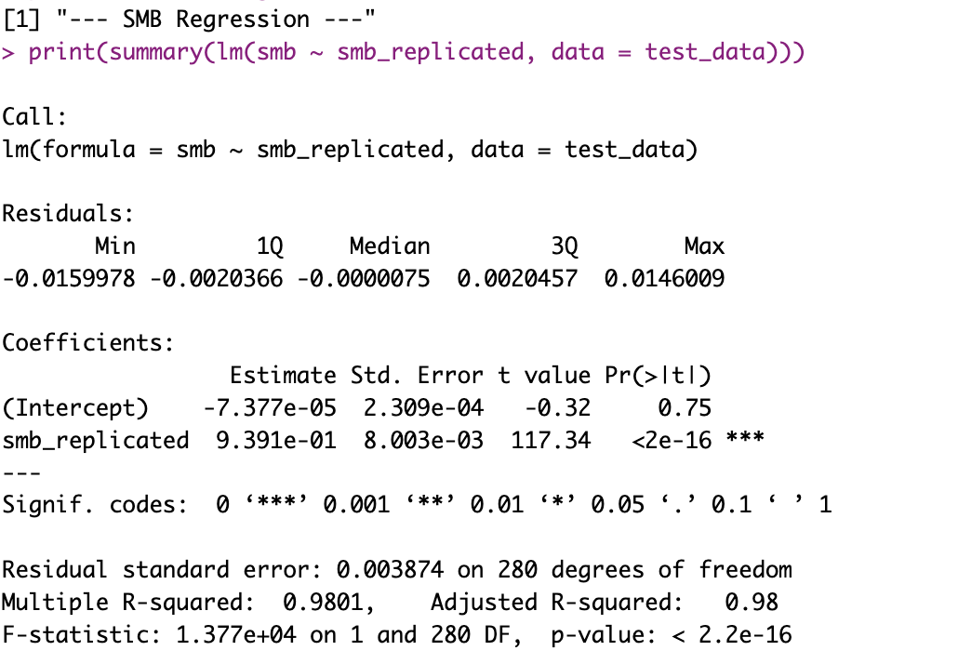
Replicating FF5 + Momentum
Factor replication from single stock data
Replication of FF5 factors using the code from tidyfinance.
Replication of the Momentum factor following the methodology of Jegadeesh & Titman (1993).
=> We regress FF benchmark factors on our replicated factors to see, how close we get with the replication.

Slide 6
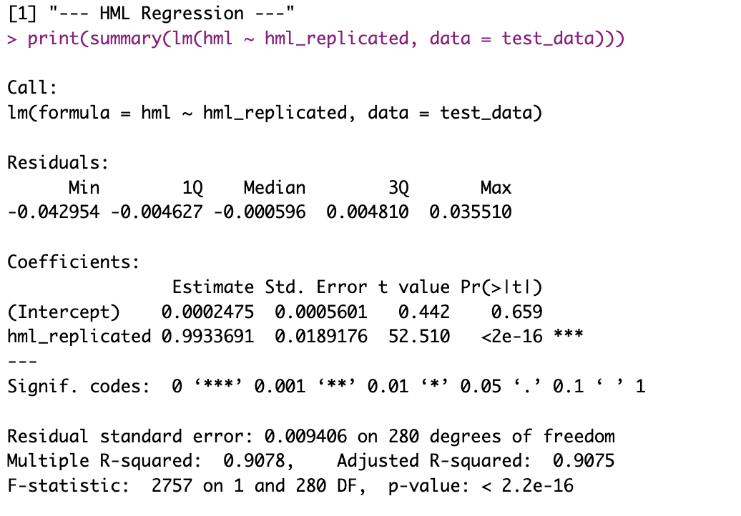
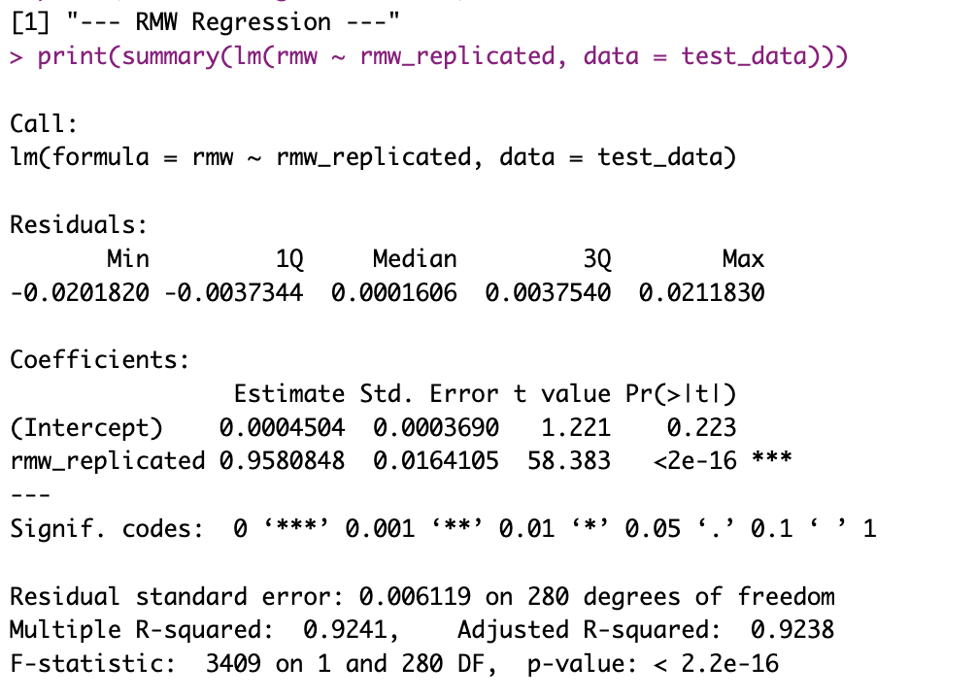
Replicating FF5 + Momentum
Factor replication from single stock data

Slide 7
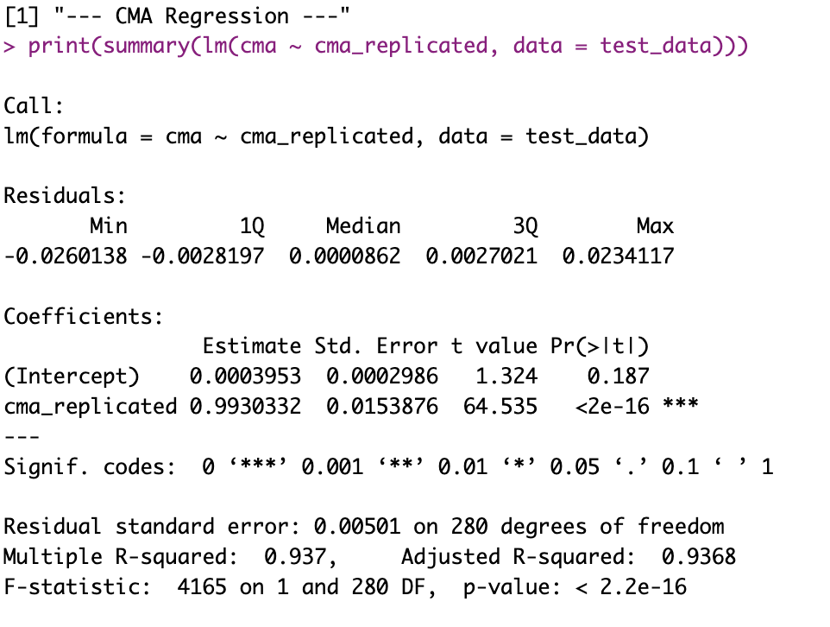
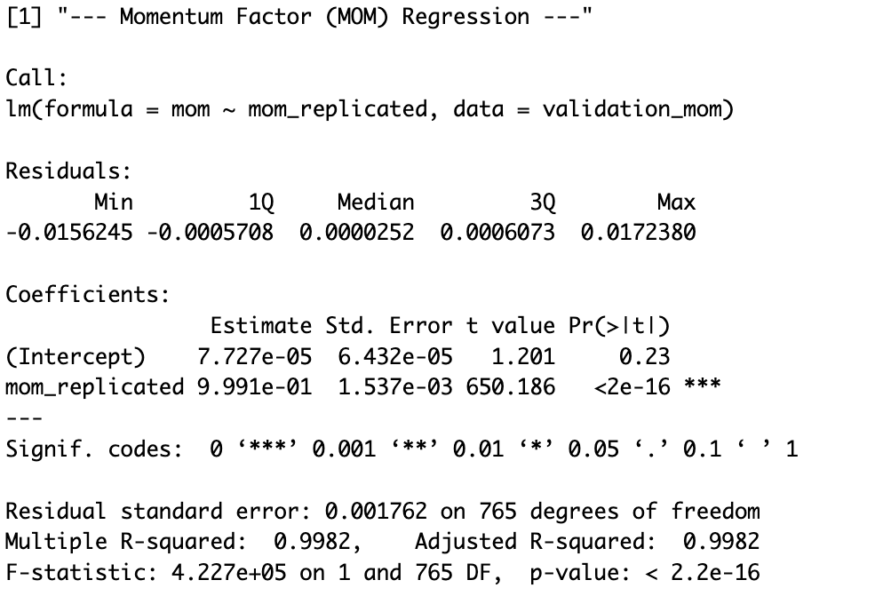
Replicating FF5 + Momentum
Factor replication from single stock data

Slide 8
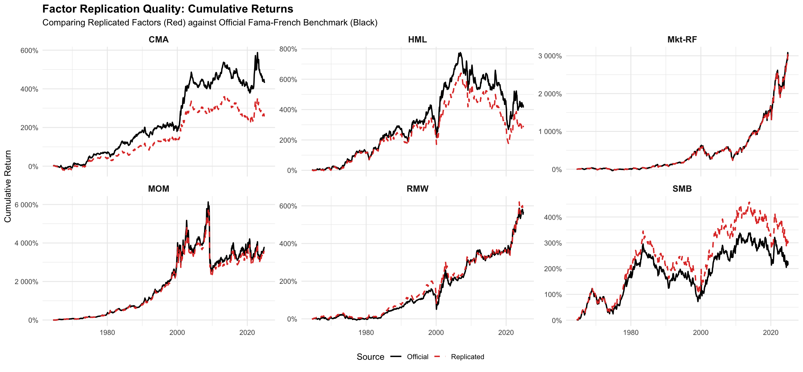
Replicating FF5 + Momentum
Factor replication from single stock data
We managed to replicate all 6 factors closely, with all Betas highly significant and close to 1, compared to the benchmark FF factors.

Slide 9
Next Steps
Outline of the 2nd part for January
Explore the „Crisis Diversifier“ role of the Factor Momentum strategy only using the Long leg.
Try to replicate as many Factors from the 1st part from single stock data as possible.
How many factors to include?
Construct Factor Momentum portfolios (Long-Short / Long leg only?).
Compare the performance to the 1st part results.
Implement in the Rshiny app.

Slide 10

Thank you!

