Slide 1

ZZ ILab Presentation
17.11.2025
Giulio Iepure, Caterina Piacentini, Farkas Tallos, Tomas Samaj

Slide 2
1
What we did
Agenda
2
Regressions
3
Long/Short Performance & Robustness Checks
4
Selected factor performance
5
R-Shiny App
Notes:
Tags: divider, simple, no image, left aligned header

Slide 3
What we did
List of Updates
Factor Regressions on FF3 and FF5+Momentum.
Long/Short Performance.
Clustering Performance
Lagging.
Correlation and Performance during Crises.
Correlation to the 60/40 Portfolio.
New Momentum definition (25% Long - 25% Short).
Selection of Factors.
Performance of Selected Factors.
R Shiny App.
Questions & Next Steps.

Slide 4
Regressions
Factor Regression on FF3 & FF5+Momentum
We regressed all the factors first on FF3, then on FF5 + Momentum
We used this step to identify factors to exclude (e.g., insignificant alpha, beta of approx. 1)
This will be shown better in the next slides.

Slide 5
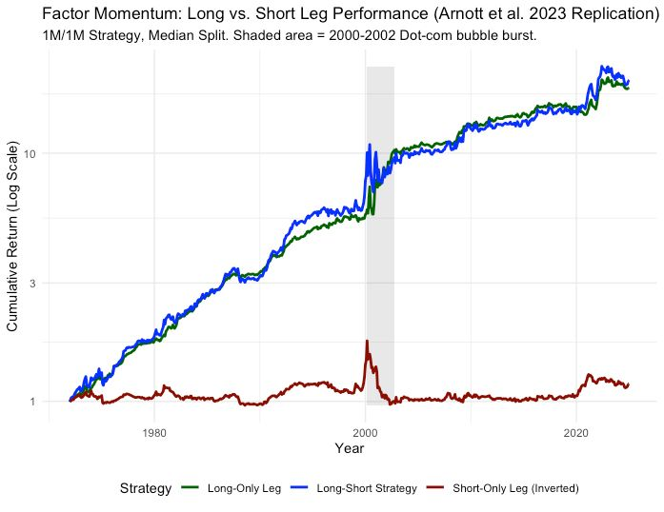
Long/Short Performance & Robustness Checks
Long/Short Performance
Most of the performance of the strategy comes from the long leg

Slide 6
Long/Short Performance & Robustness Checks
Clustering Performance
Cluster Theme | Count | Factors
Size / Microstructure / Trading | 6 | Size_SMB, Long_Term_Reversals_LTREV, Quality_Minus_Junk_QMJ, Amihud_Illiquidity, Nominal_Price, High_Volume_Premium
Valuation & Investment Intensity | 11 | Book_to_Market_HML, Asset_Growth_CMA, Cash_Flow_to_Price, Earnings_to_Price, Enterprise_Multiple, Sales_to_Price, Growth_in_Inventory, Sales_Growth, CAPX_Growth_Rate, Leverage_Factor, Altman_Z_Score
Quality & Earnings Quality | 9 | Operating_Profitability_RMW, Gross_Profitability, Return_on_Equity, Return_on_Assets, Change_in_Asset_Turnover, Accruals_Factor, Net_Working_Capital_Changes, Debt_Issuance_Factor, Ohlson_O_Score
Low-Risk & Financing / Lifecycle | 7 | Residual_Variance_RVAR, Low_Beta_BAB, Firm_Age, Profit_Margin, One_Year_Share_Issuance, Total_External_Financing, Piotroski_F_Score
Asset Expansion (NOA) | 3 | Net_Operating_Assets, Growth_in_Sales_Inventory, Abnormal_Investment

Slide 7
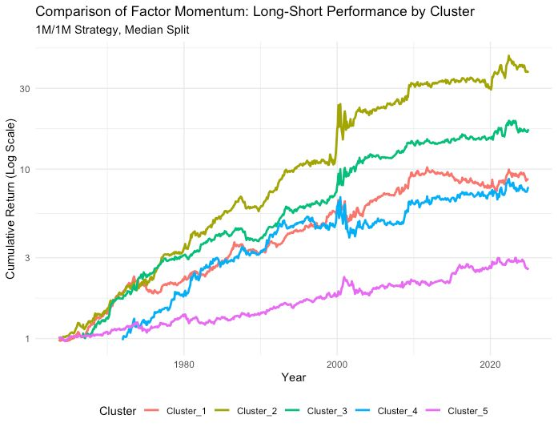
Long/Short Performance & Robustness Checks
Clustering Performance
We see Valuation & Investment Intensity being the main driver

Slide 8
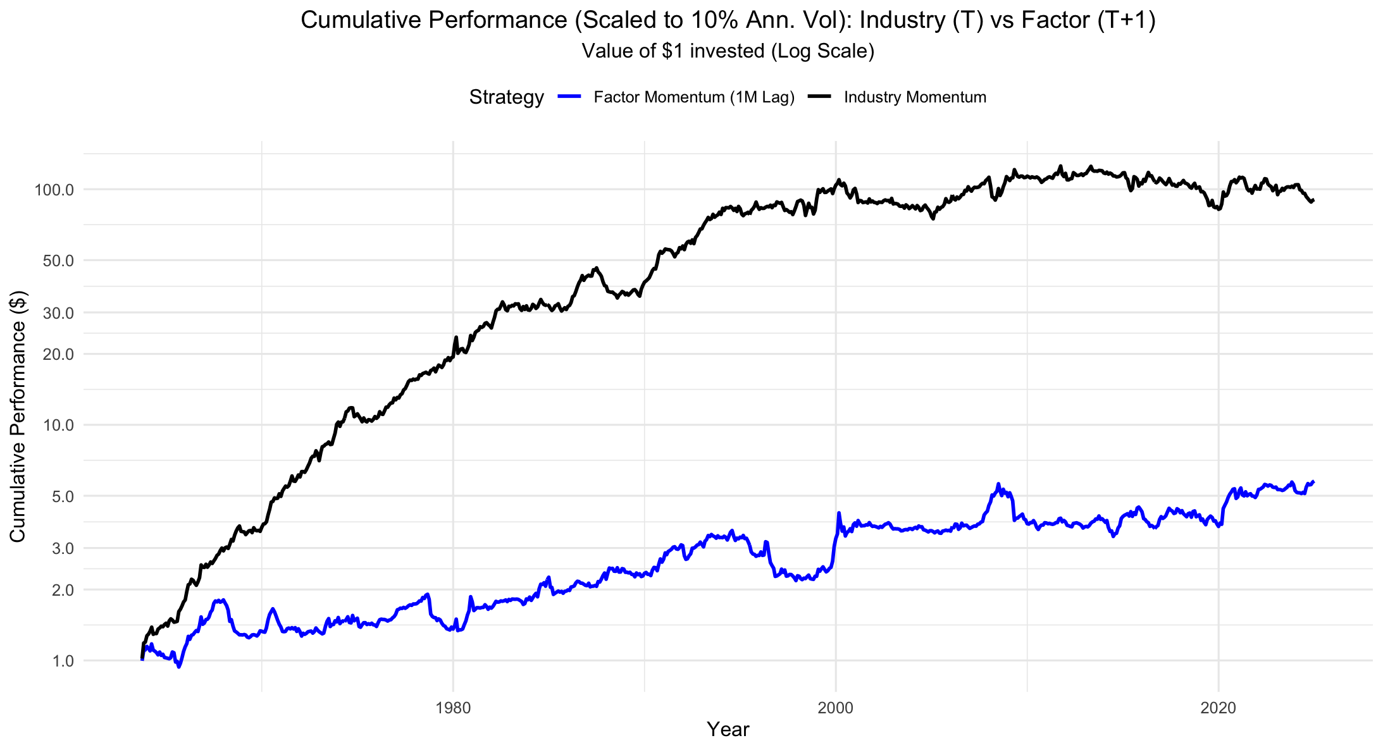
Long/Short Performance & Robustness Checks
Lagging
Once we lag 1 month the outperformance of the factor momentum strategy disappears.

Slide 9
Long/Short Performance & Robustness Checks
Performance during Crises
 | Factor_Mom_Return | Market_Return
COVID (2020) | 0.0801 | -0.204
GFC (2007-2009) | 1.06 | -0.461
Correlation in bad market months (Mkt-Rf < -2%) | -0.016
The Factor Momentum Strategy acts as a powerful diversification tool, especially during market crises

Slide 10
Long/Short Performance & Robustness Checks
Correlation to 60/40 Portfolio
Corr = -0.034
The strategy provides diversification benefits and reduces dependence on traditional risk premia.

Slide 11
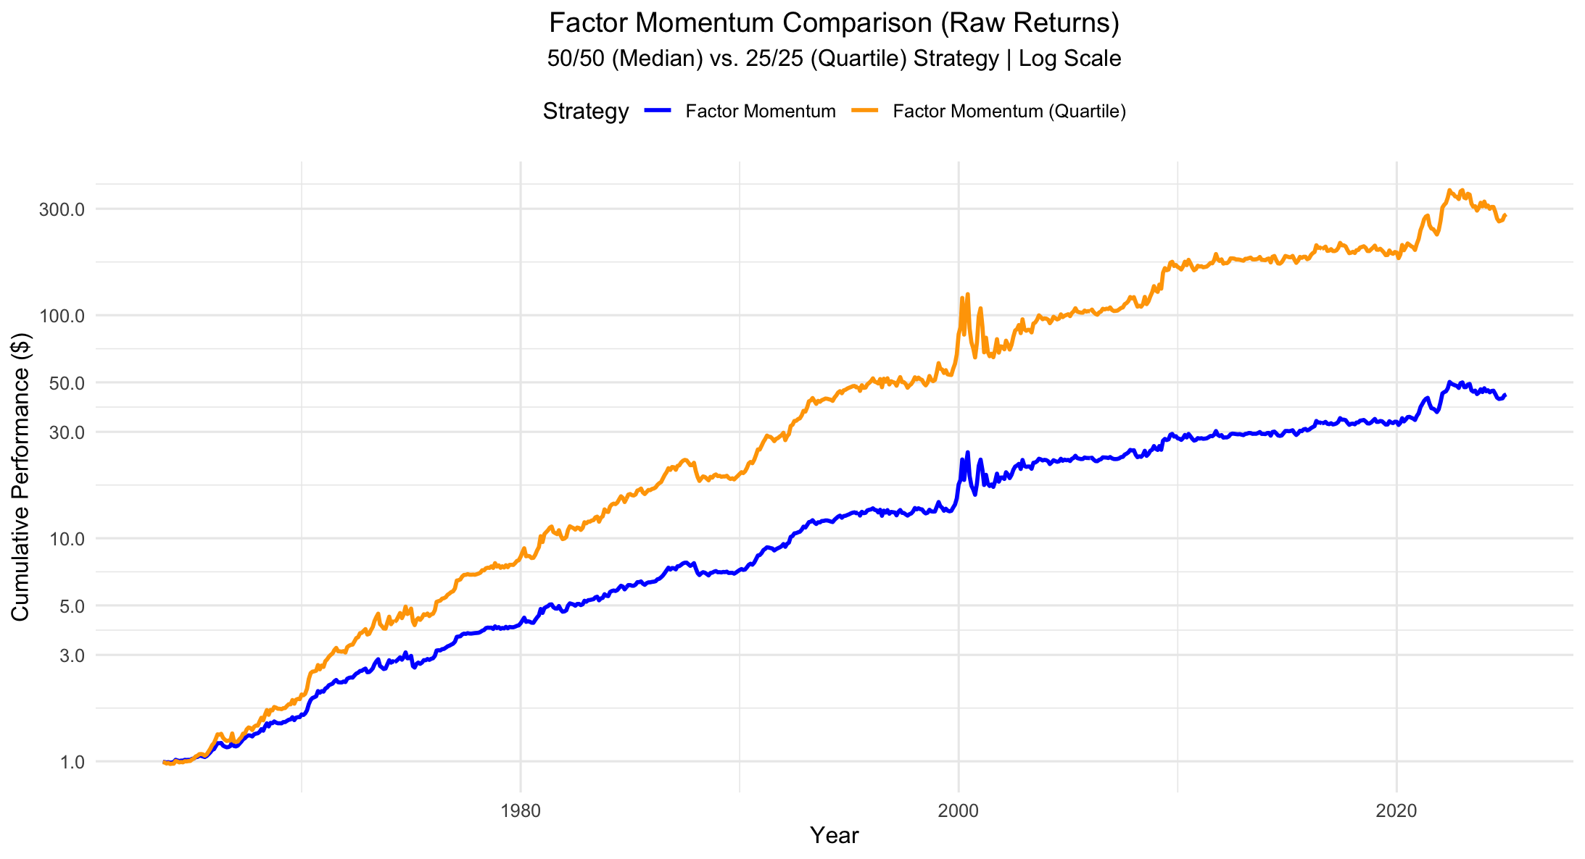
Long/Short Performance & Robustness Checks
Change of Momentum Definition (Long top 25%, Short bottom 25%)

Slide 12
Selected factor performance
Factor selection
Selection Criteria:
Statistical Significance: keep factors with a significant alpha.
Thematic Uniqueness: The factor must provide unique information and not be highly correlated with (or thematically redundant with) other selected factors. If multiple factors represented the same theme (e.one, "Value" or "Profitability"), only one was kept.
We also included the standard Fama French factors.
Selected Factors:
Size_SMB ⁠
Book_to_Market_HML ⁠
Operating_Profitability_RMW ⁠
Asset_Growth_CMA ⁠
Long_Term_Reversals_LTREV ⁠
Low_Beta_BAB ⁠
Firm_Age ⁠
Enterprise_Multiple ⁠
Accruals_Factor ⁠
Total_External_Financing ⁠
Piotroski_F_Score ⁠

Slide 13
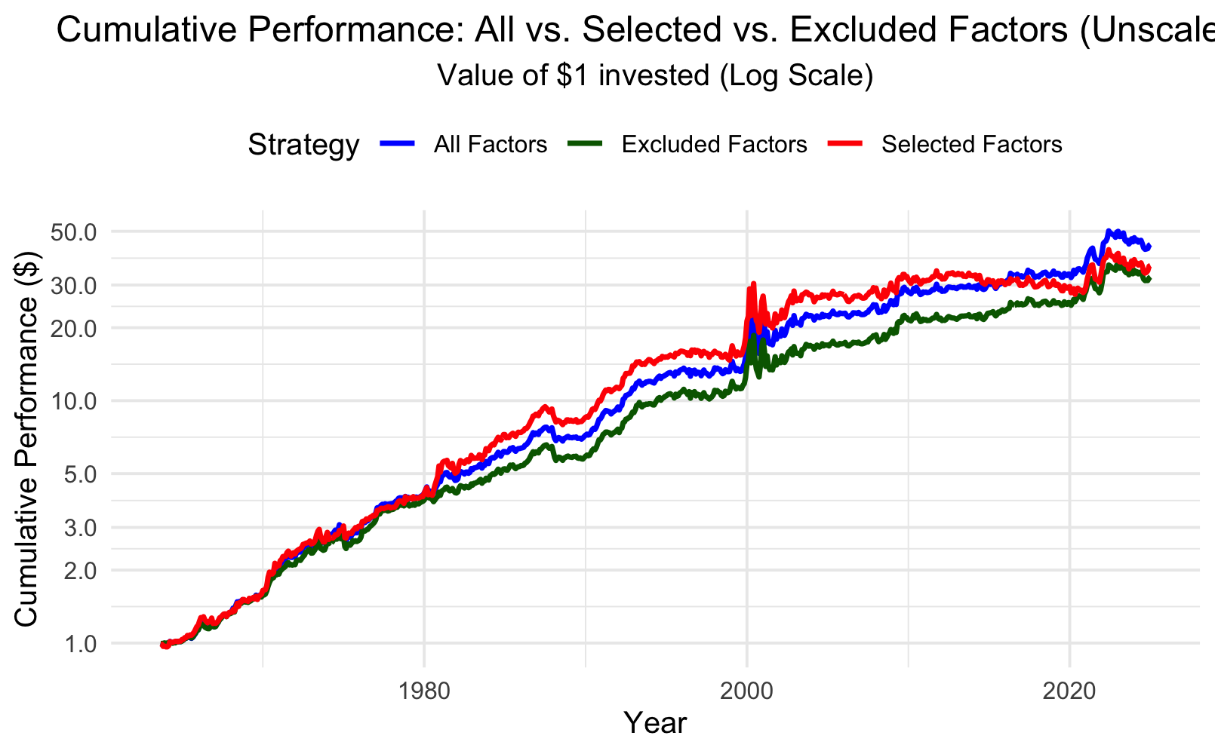
Selected factor performance
Selected factors vs. all
Warning: once we use a volatility scaled strategy, the selected factors underperform the other two.

Slide 14
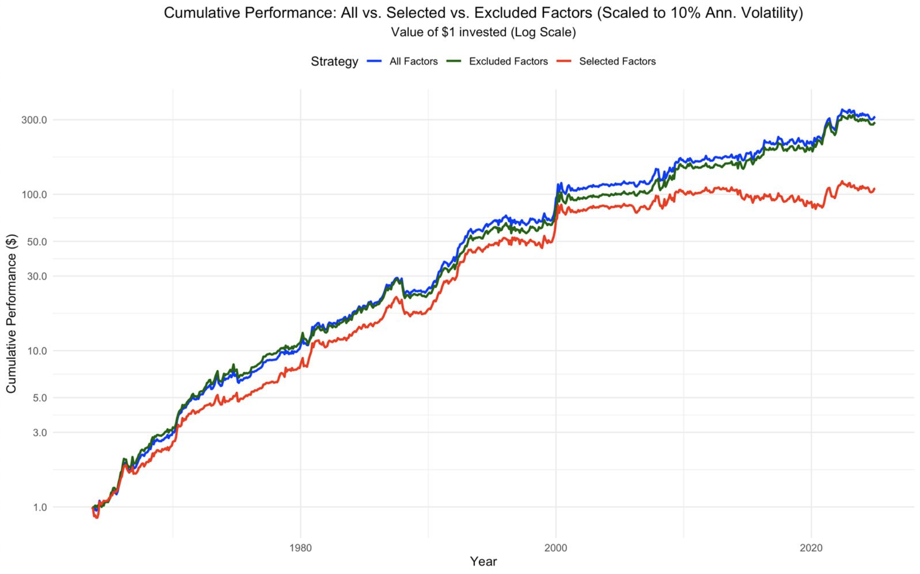
Selected factor performance
Selected factors vs. all
Warning: once we use a volatility scaled strategy, the selected factors underperform the other two.

Slide 15
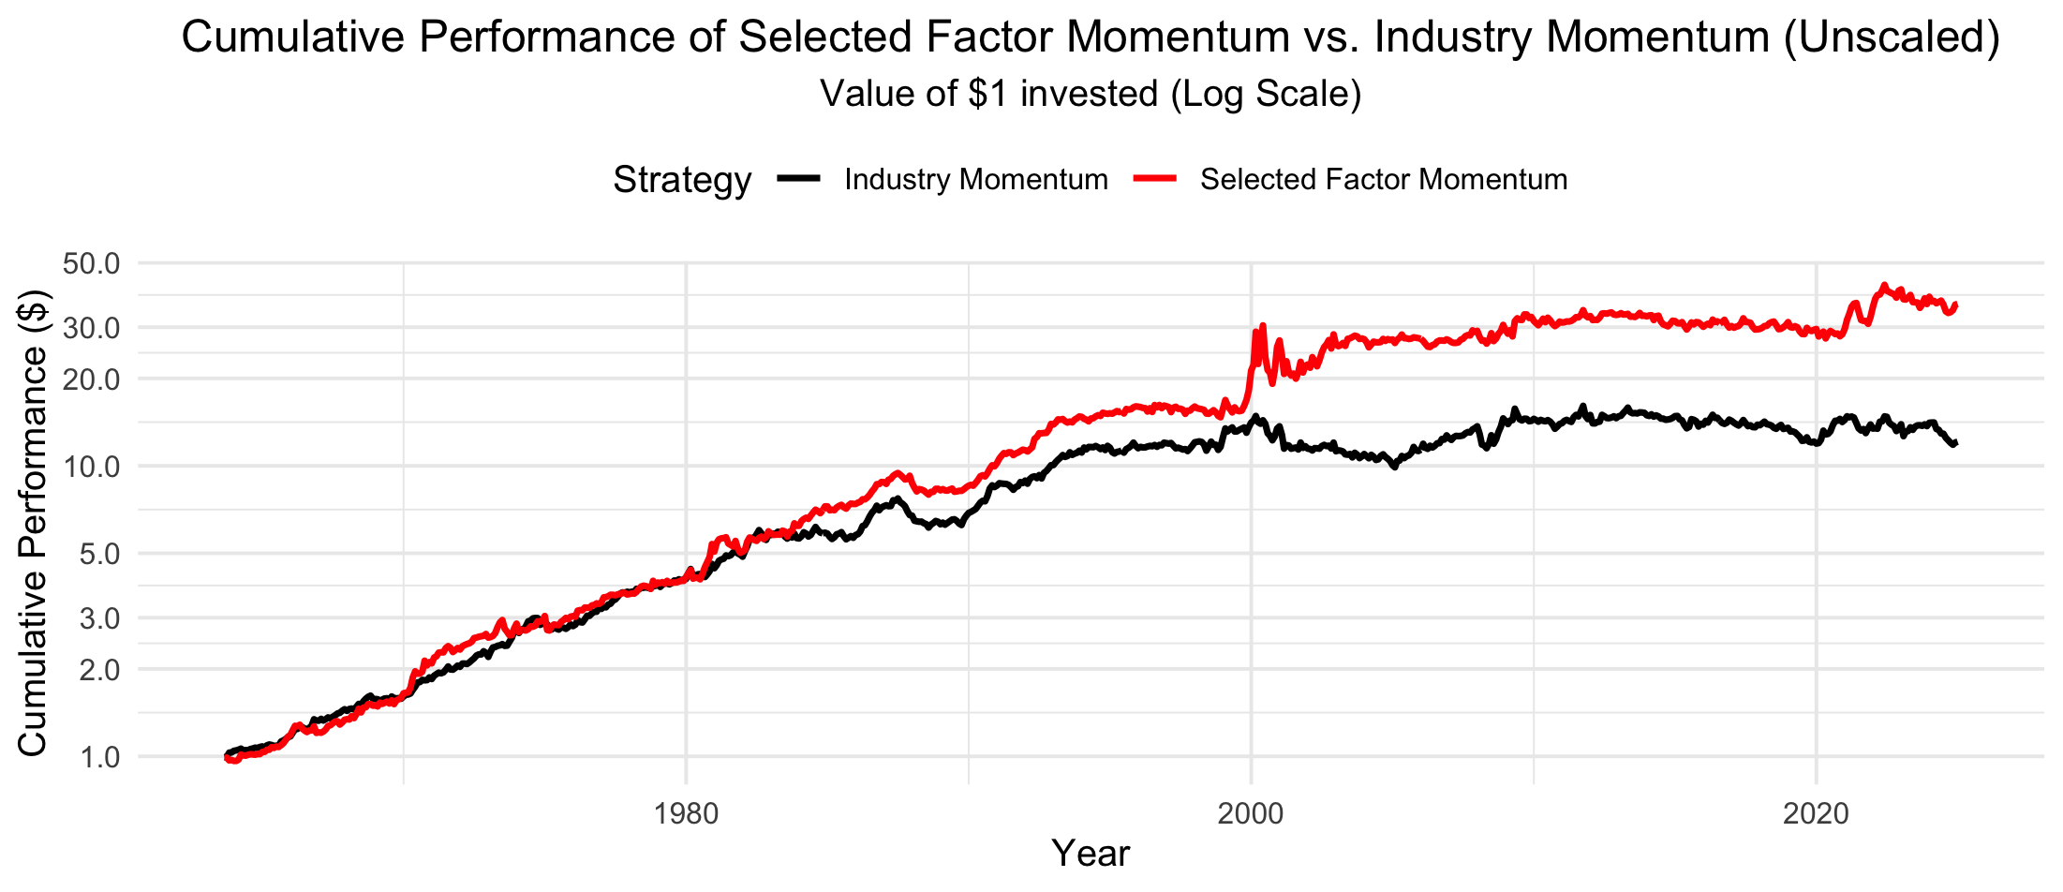
Selected factor performance
Selected factors vs. industry

Slide 16
R-Shiny App
1st version of the R-Shiny App
https://huggingface.co/spaces/farkastallos/Ilab_Factor_Momentum
Credentials:
User: Ilab_member
Password: Ilab_member_12_1

Slide 17
Next Steps
Questions
Does the selection criteria for factors makes sense?
When is our final deadline?

Slide 18

Thank you!

