Slide 1

ZZ ILab Final Presentation:
Factor Momentum
24.02.2026
Giulio Iepure, Caterina Piacentini, Farkas Tallos, Tomas Samaj

Slide 2
1
Introduction – Factor Momentum
2
Part 1 (Factor level) – Performance & Robustness Checks
Agenda
3
Part 2 (Single-stock level) – Replication, Net Positions, Frictions
4
Strategy Conclusion, Portfolio Implications & Implementation Constraints
5
R Shiny App Usage Demonstration
6
Ilab Conclusions: Lessons Learned & Empirical Challenges
Notes:
Tags: divider, simple, no image, left aligned header

Slide 3
Arnott, Kalesnik & Linnainmaa (2023):
Introduction – Factor Momentum
Literature Review & Methodology
Data Description:
Ehsani & Linnainmaa (2022):
Extends momentum research to factor portfolios – showing that factor returns themselves exhibit momentum.
Finds that factor momentum subsumes industry momentum.
Uses principal component analysis to identify systematic sources of momentum.
Shows that momentum in stock returns stems from momentum in factor returns
Factors show strong autocorrelation: winners stay winners, losers stay losers.
Momentum reflects timing of factor exposures, not a separate risk factor.
Replication Methodology:
Fama-French 17 Industry Portfolios: Monthly excess returns (July 1963 - Dec 2024).
JKP Factors: Cross-sectional factor returns (value, profitability, investment, quality, risk).
Thematic Factors: Growth, leverage, volatility, and other economic themes.
Final Sample: July 1963 - December 2024 (U.S. market).
Replicate Arnott et al. (2023) Appendix figure comparing Factor vs. Industry Momentum.
For each month:
Rank all assets by previous month's return.
Go long the top half (winners), short the bottom half (losers).
Apply to Fama-French 17 industries and selected JKP factors.
Equal-weight portfolios; rebalance monthly.
Compute 1-month long-short return.

Slide 4
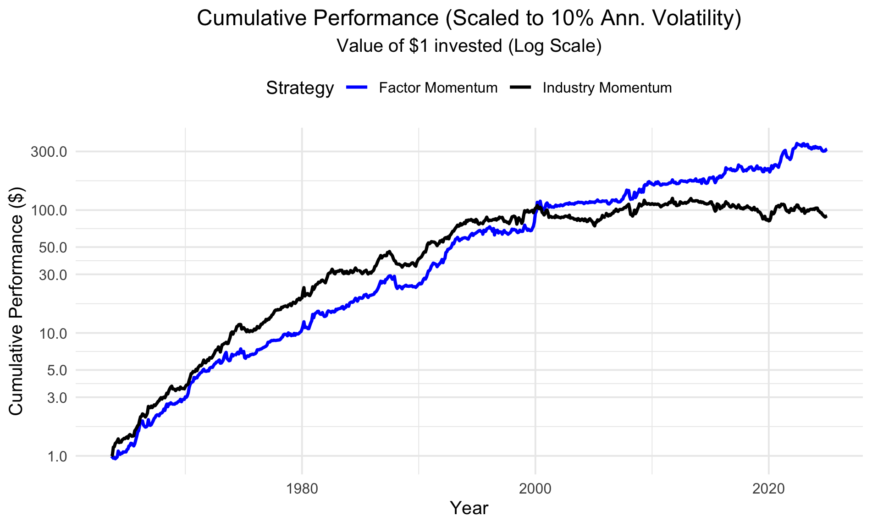
Introduction – Factor Momentum
Replication Results
I
To match the paper’s methodology,
the strategies are scaled to a
target volatility of 10% per year.
Volatility Scaling
II
Industry momentum consistently
outperforms factor momentum,
showing stronger cumulative returns.
Before 2000
III
After 2000
Industry momentum stops growing,
while factor momentum accelerates
and becomes the clear winner.
IV
This trend is even more pronounced
in the unscaled strategy.
… result in a structural shift

Slide 5
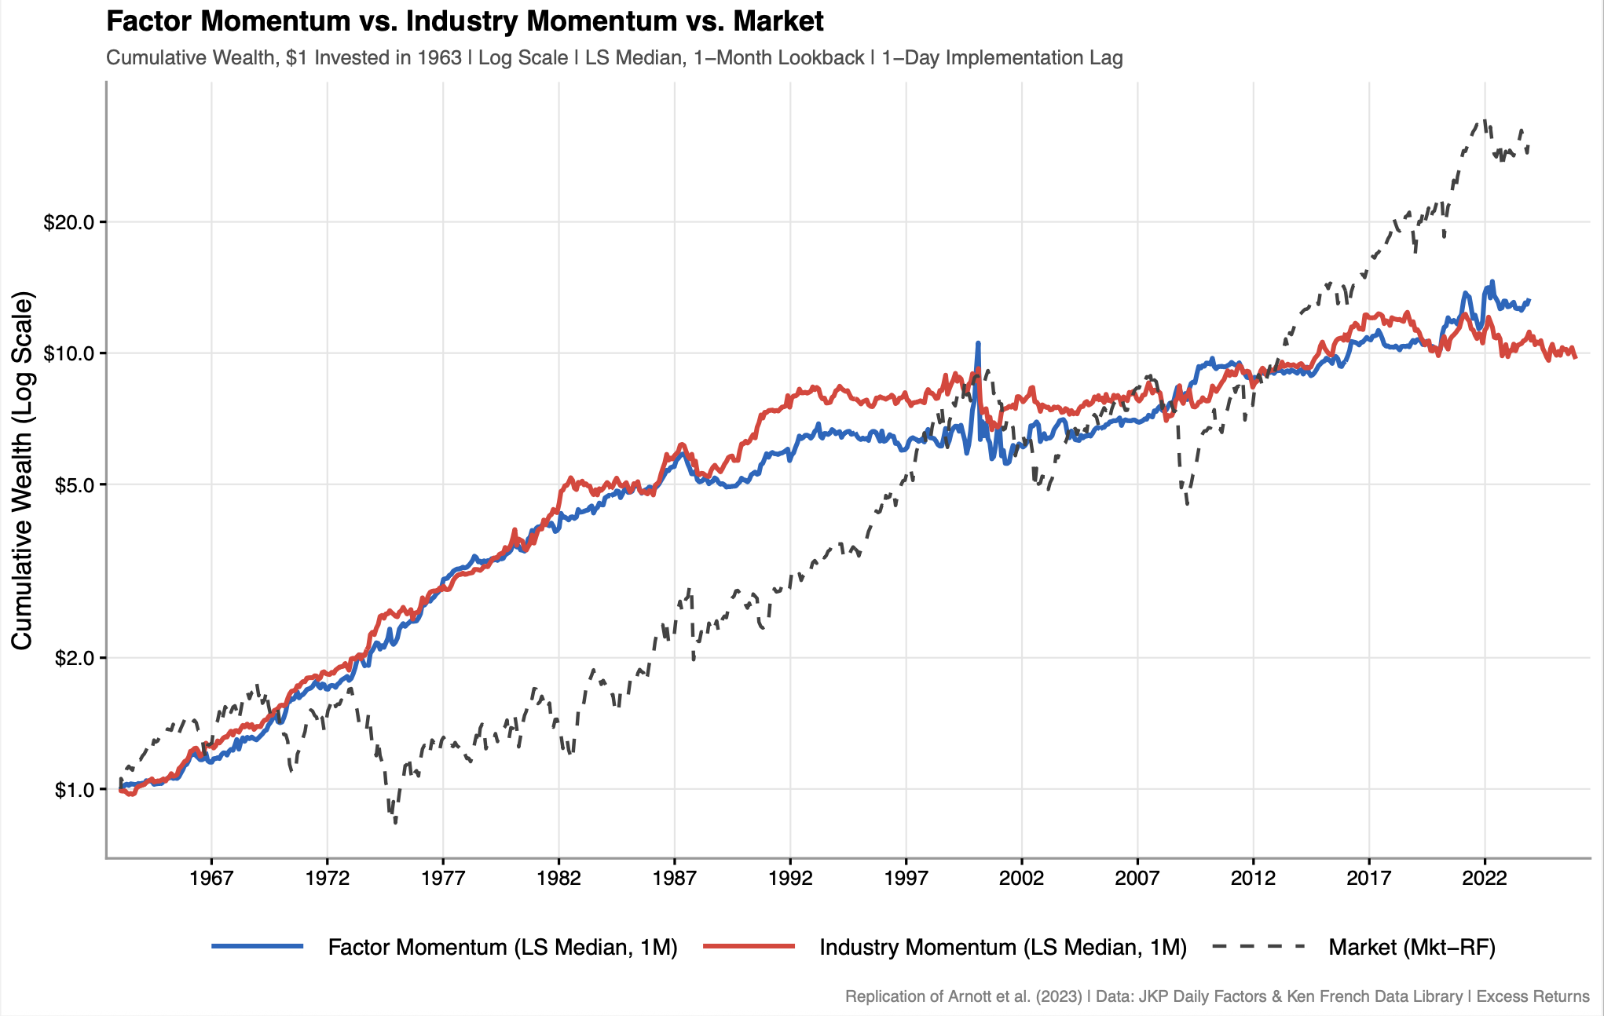
Introduction – Factor Momentum
Replication Results
We add a 1-day Implementation Lag to make the strategy more realistic.
No volatiltiy scaling.
We compare factor momentum and industry momentum against the Fama-French market factor (Mkt−RF) to benchmark their long-run cumulative performance and relative behavior across market regimes.
Industry momentum broadly tracks the direction of the other series but delivers weaker long-run cumulative growth, indicating lower upside over the full sample.
The market factor (Mkt−RF) delivers the strongest long-run cumulative growth in the sample, but with a more pronounced cyclical path and deeper drawdowns.
Factor momentum outperforms industry momentum and remains closer to the market factor over the long run, with a smoother trajectory.
Overall, factor momentum stands out as the strongest alternative to market, while industry momentum behaves more defensively but with limited upside.

Slide 6
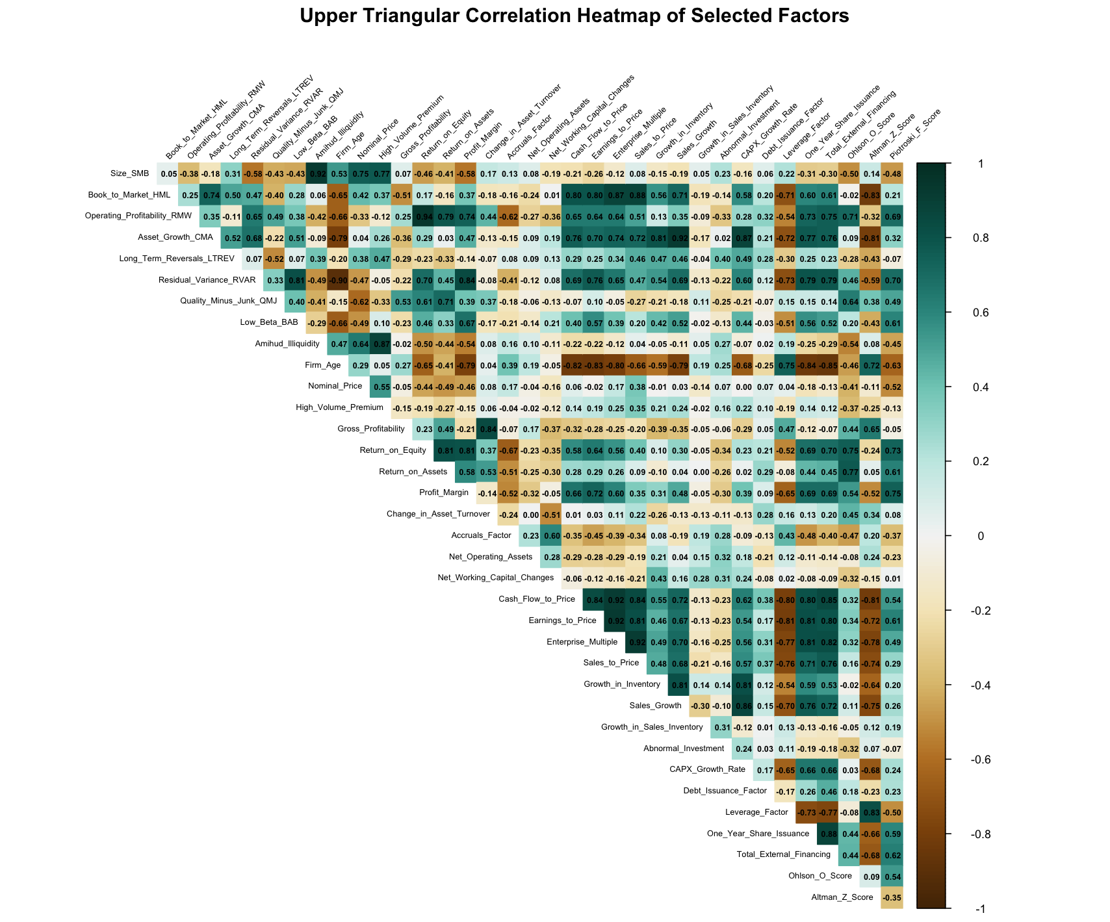
Part 1 (Factor level) – Performance & Robustness Checks
Factor Correlation Heatmap
Correlation across JKP Factors
We observe clusters of highly correlated factors (dark green), such as profitability and investment factors, as well as groups with low or negative correlation (brown).
Uncorrelated Factors
Size (SMB) and momentum-related factors remain largely orthogonal, reflecting their distinct economic drivers.
Effects on Momentum
Fundamental factors move together, reinforcing systematic momentum.

Slide 7
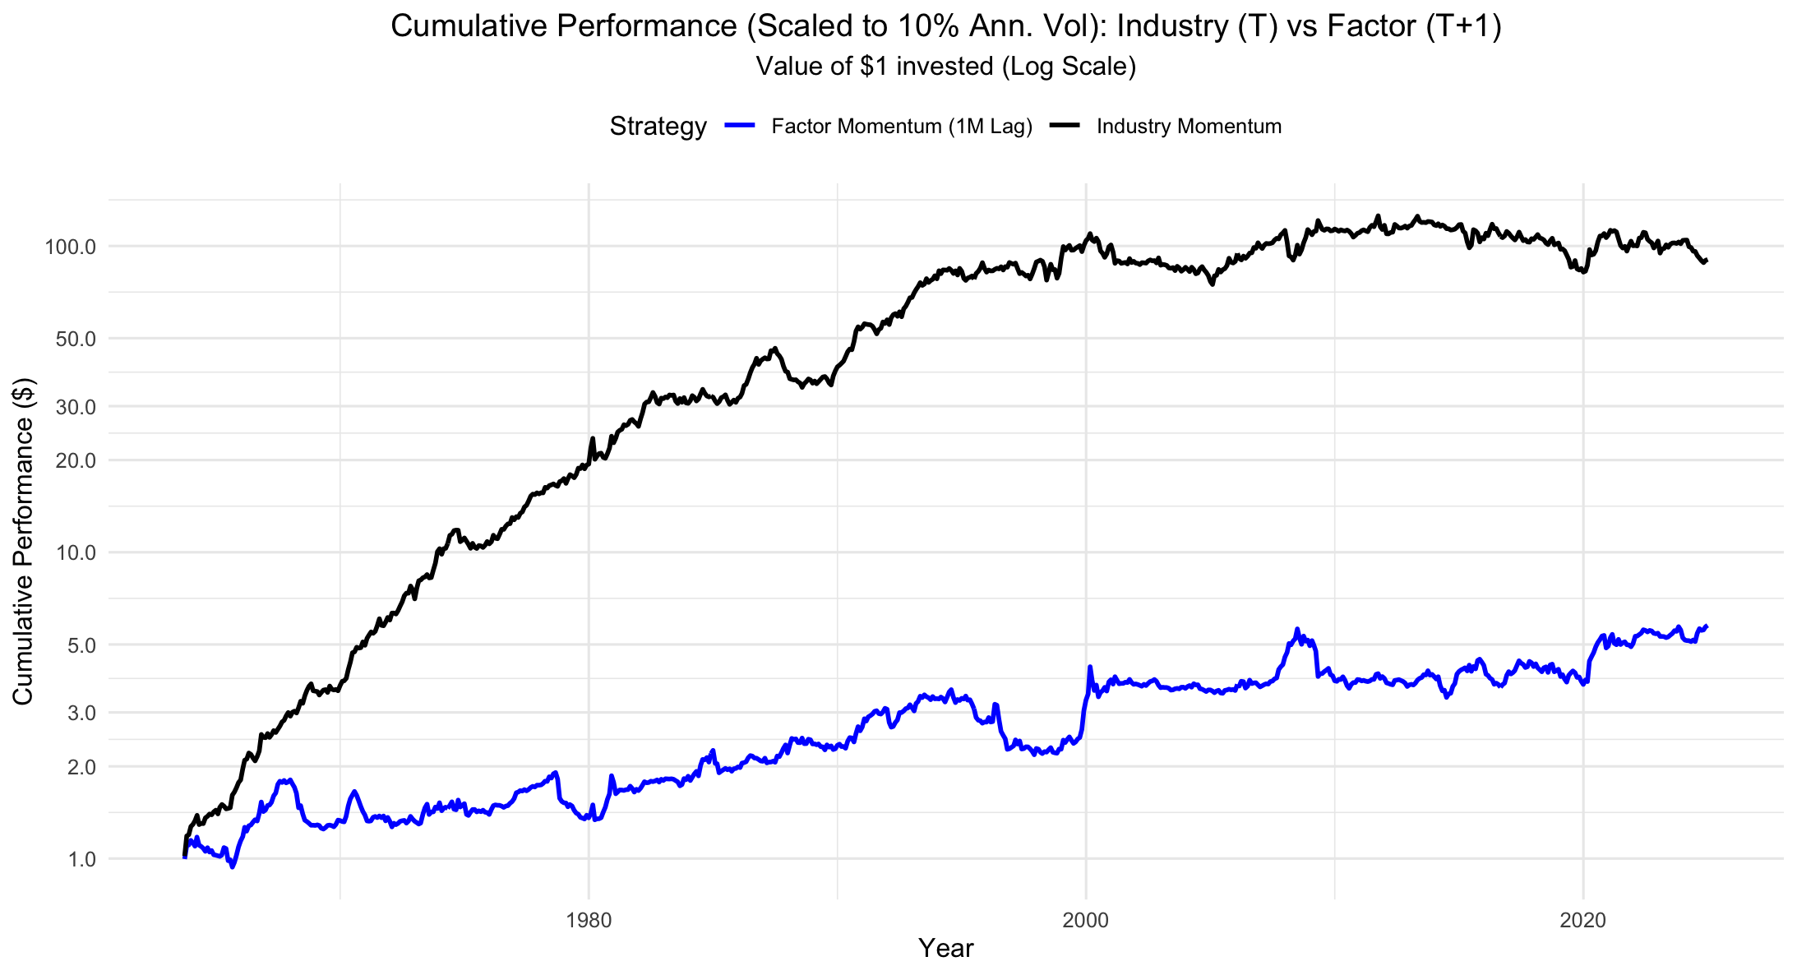
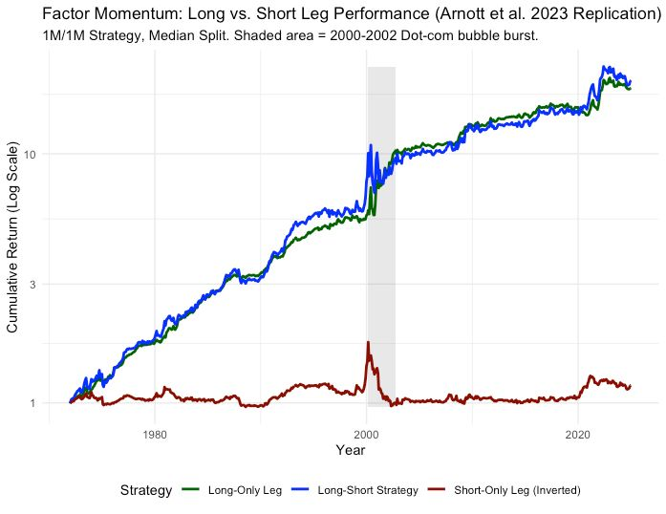


Part 1 (Factor level) – Performance & Robustness Checks
Robustness Checks
Lagging
Long/Short Performance
Lagging the signal by 1 month kills the performance.
Most of the performance of the strategy comes from the long leg.

Slide 8
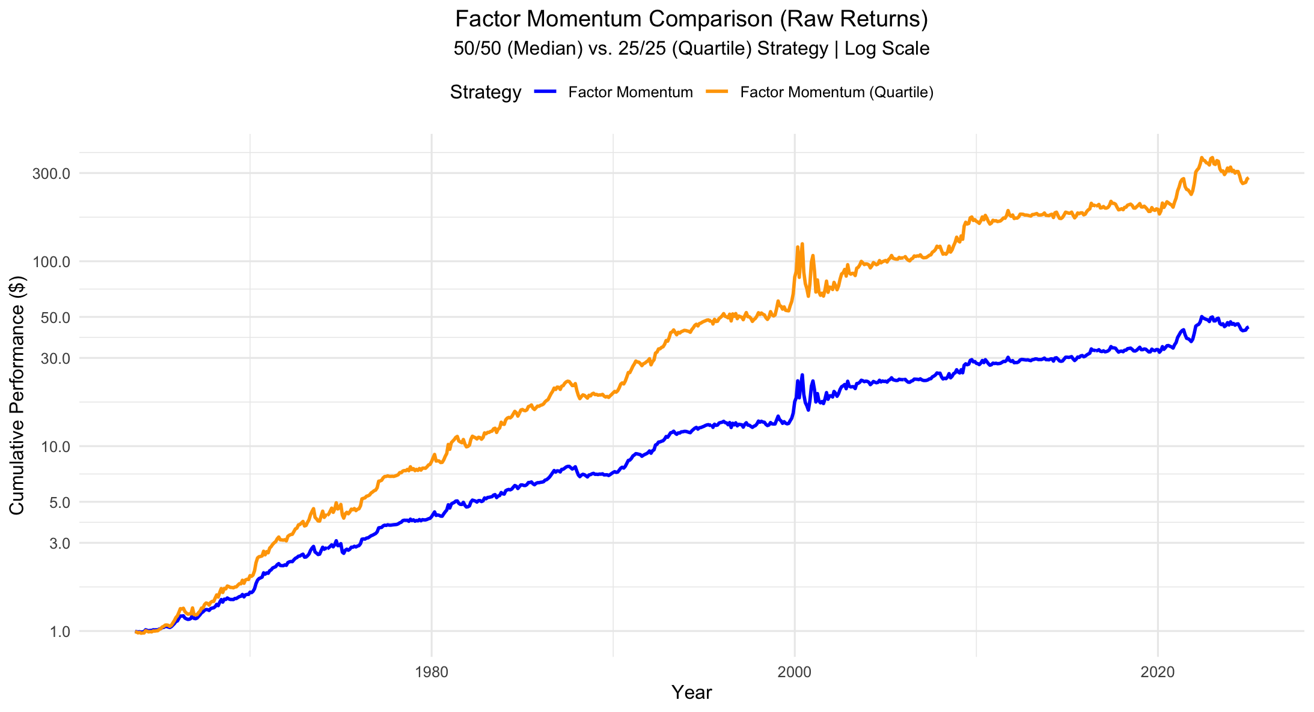




Part 1 (Factor level) – Performance & Robustness Checks
Change of Momentum Definition
We changed the definition of momentum to 25%/25%: the orange line is long top 25% and short bottom 25%.
Tail-sorting strengthens the signal: focusing on extreme winners/losers widens the spread and boosts momentum.
The top-25% long-short portfolio delivers the highest standalone returns.

Slide 9
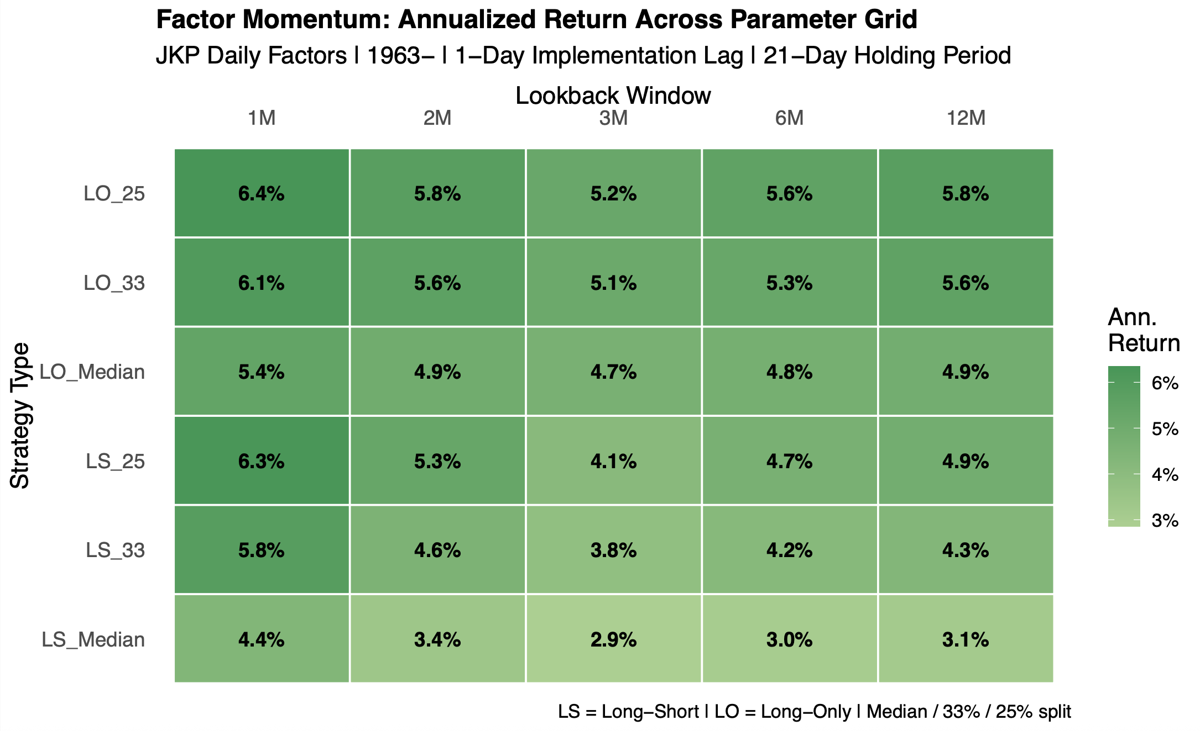
Part 1 (Factor level) – Performance & Robustness Checks
Change of Momentum Definition
Annualized Returns
The heatmap confirms that performance depends materially on the momentum definition, with clear differences across portfolio construction and lookback choices.
Lookback Period
Shorter lookback windows perform best overall, with the strongest results concentrated at the 1-month lookback.
Final Pick
The best-performing specification is the 25% long-only strategy with a 1-month lookback, which delivers the highest annualized return overall.

Slide 10
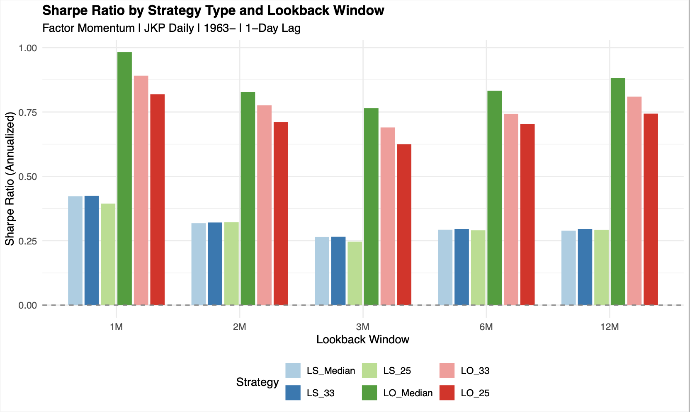



Part 1 (Factor level) – Performance & Robustness Checks
Change of Momentum Definition
The original LS median specification is the worst-performing strategy in every lookback window.
Across all lookback windows, long-only specifications consistently outperform the corresponding long-short alternatives, indicating that the short leg weakens overall performance.
Even though the long-only top 25% delivers the highest returns, it also comes with higher volatility, which reduces its risk-adjusted performance relative to others long-only alternatives.

Slide 11
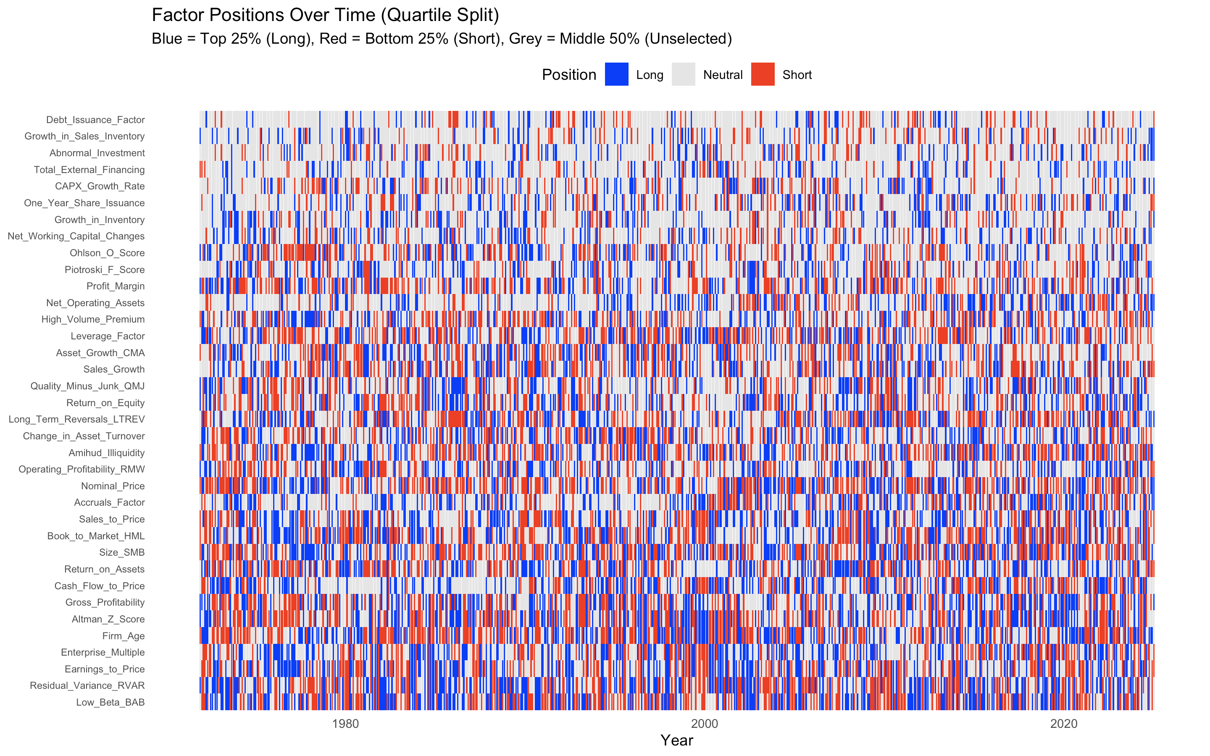



Part 1 (Factor level) – Performance & Robustness Checks
Is it Possible to Reduce the Number of Factors?
The Heatmap: Factors move in and out of the top and bottom quartiles frequently, so there is no stable subset of ‘always-long’ or ‘always-short’ factors.
Long Factors: Top 5 Long factors are Low_Beta_BAB (37.0%), Residual_Variance_RVAR (36.7%), Earnings_to_Price (32.4%), Enterprise_Multiple (32.4%), and Firm_Age (32.0%).
Short Factors: Top 5 Short factors are Nominal_Price (38.9%), Size_SMB (38.2%), Firm_Age (37.5%), Low_Beta_BAB (37.1%), and Altman_Z_Score (35.9%).
The factor universe cannot be reduced in a stable way. Rankings are highly time-varying, and even leading candidates frequently switch sign (e.g., Low_Beta_BAB).

Slide 12
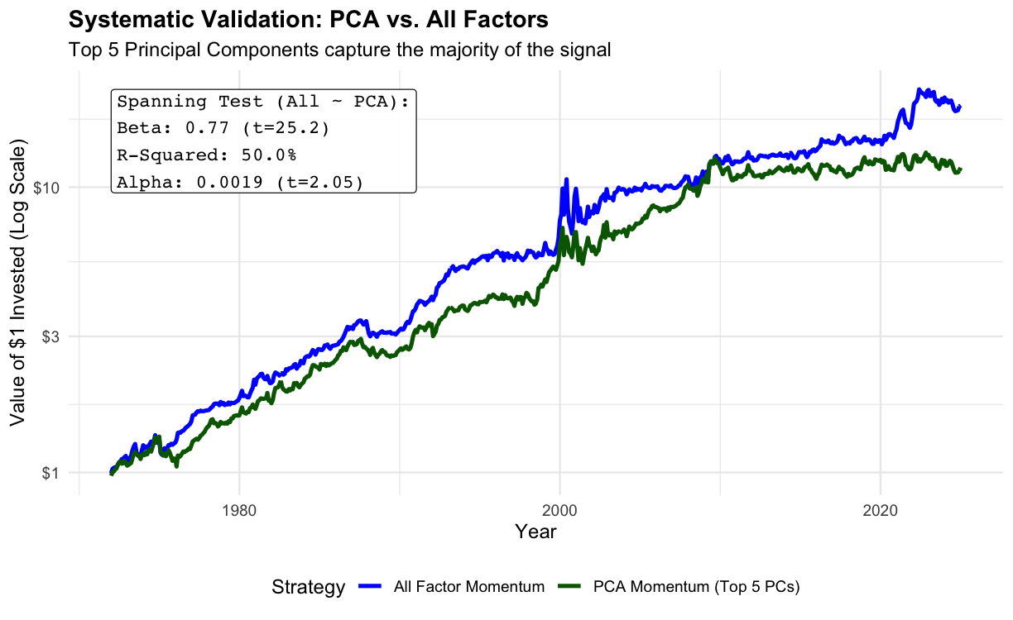
Part 1 (Factor level) – Performance & Robustness Checks
Systematic Validation: Top 5 Principal Components Drive the Strategy
The PCA decomposition shows that the top 5 principal components explain more than 80% of total variance in factor returns. This means the factor universe is largely driven by a small set of common, time-varying systematic forces, while the role of individual factors changes over time. As these dominant exposures rotate, the PCA results do not support a stable pre-selection of “best” factors.
We proceed with the rest of the analysis using the full 36-factor universe.
PCA Decomposition: We performed a Principal Component Analysis (PCA) on the entire universe of 36 factors to separate signal from noise.
Result: The Top 5 Principal Components alone explain >80% of the total variance in the factor dataset. The remaining 31 dimensions are largely idiosyncratic noise that do not drive the trend according to the PCA analysis
Systematic Dominance: The simple 5-factor PCA strategy explains 53% of the variation (R2) in the complex 36-factor strategy returns, confirming the signal is driven by systematic risk.
High Beta: The regression reveals a high beta of 0.77 (t-stat: 25.2) with marginally significant alpha. This suggests the "All Factor" strategy is essentially a leveraged bet on these systematic drivers.

Slide 13
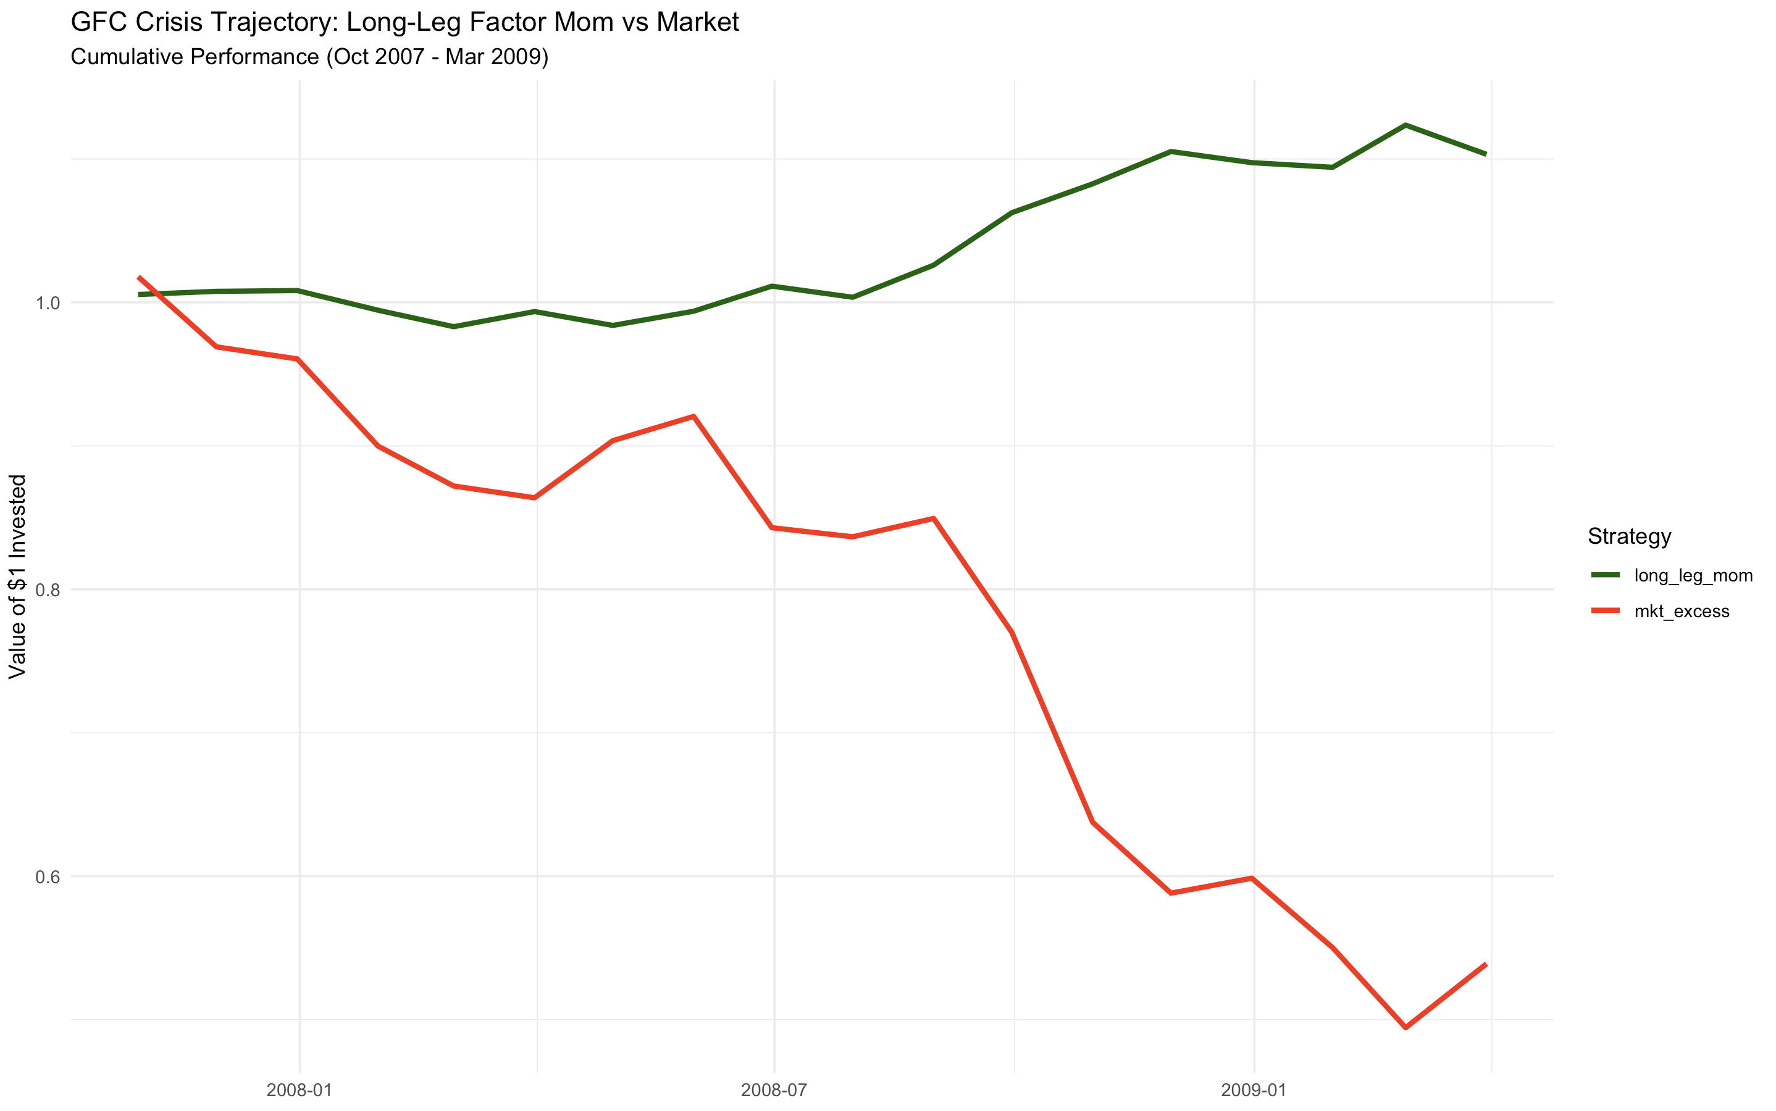
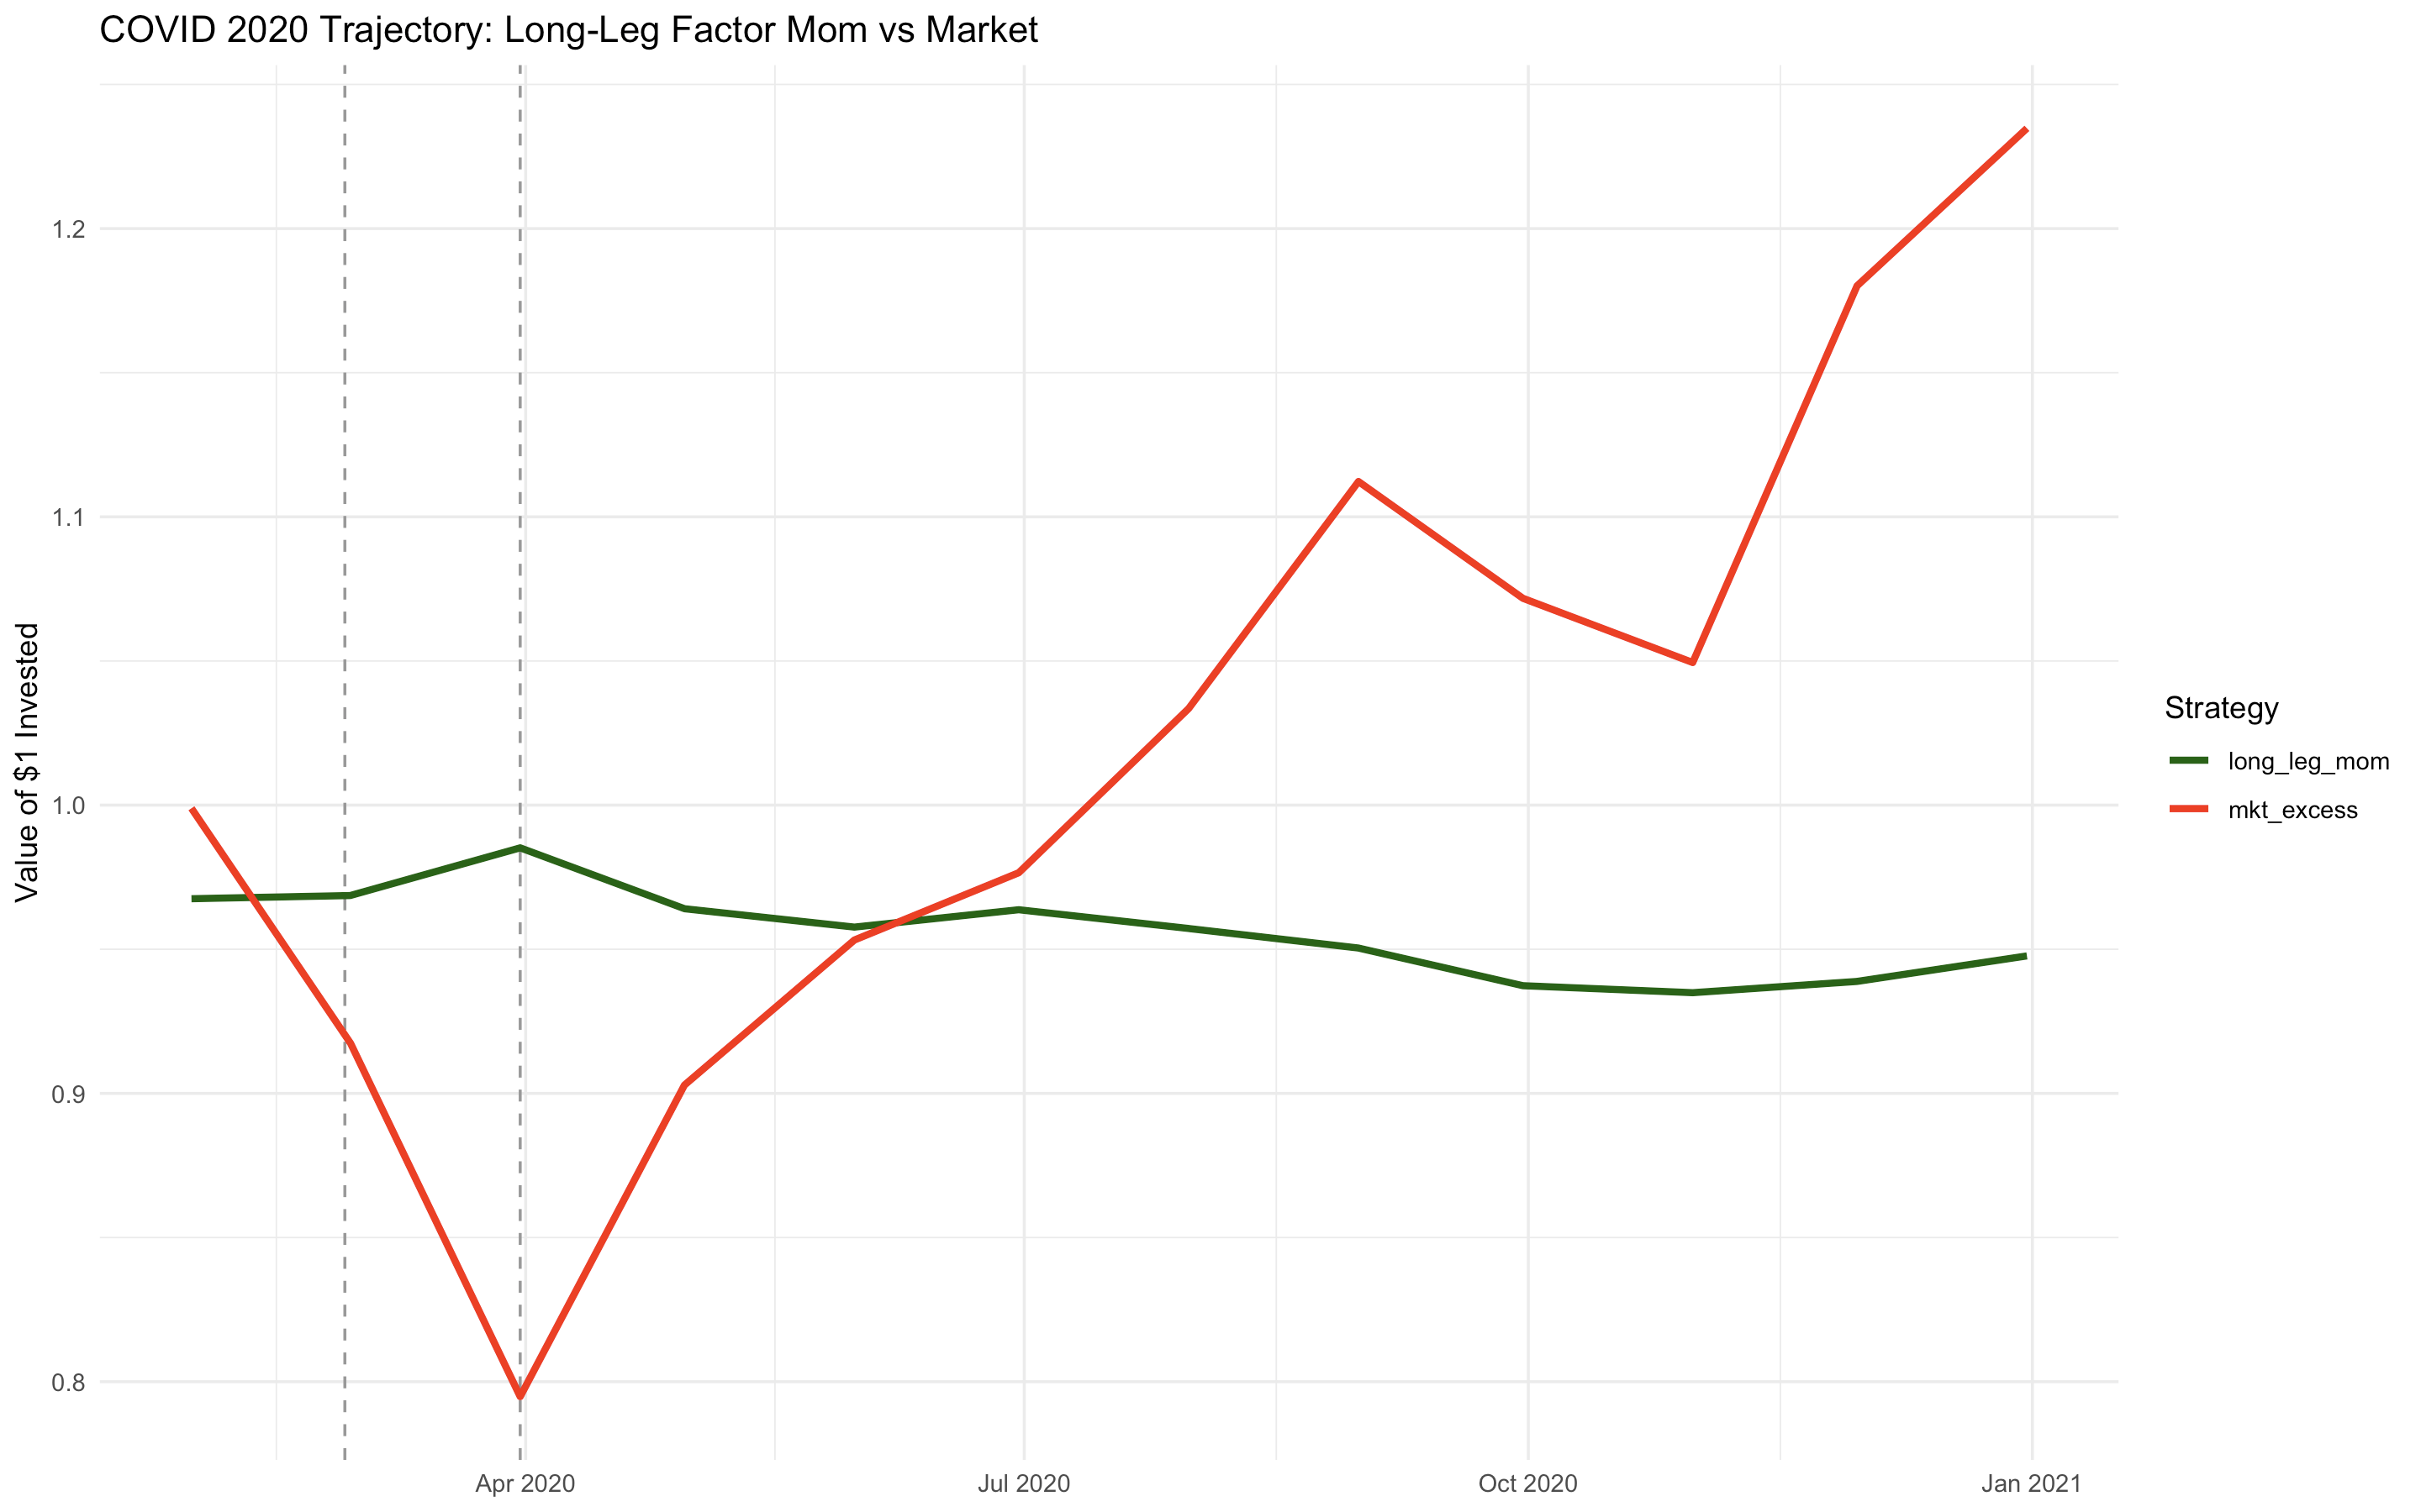
Part 1 (Factor level) – Performance & Robustness Checks
Performance During Crisis (Long-Only)
Period
Long Leg Return
Market Return
Correlation
Long Leg Volatility
Market Volatility
Across crisis episodes, the strategy provides a consistent diversifying hedge, helping stabilize portfolio outcomes in drawdowns.
Covid
GFC
0.0182
0.103
-0.204
-0.461
-1
- 0.562
0.039
0.0541
0.128
0.221

Slide 14
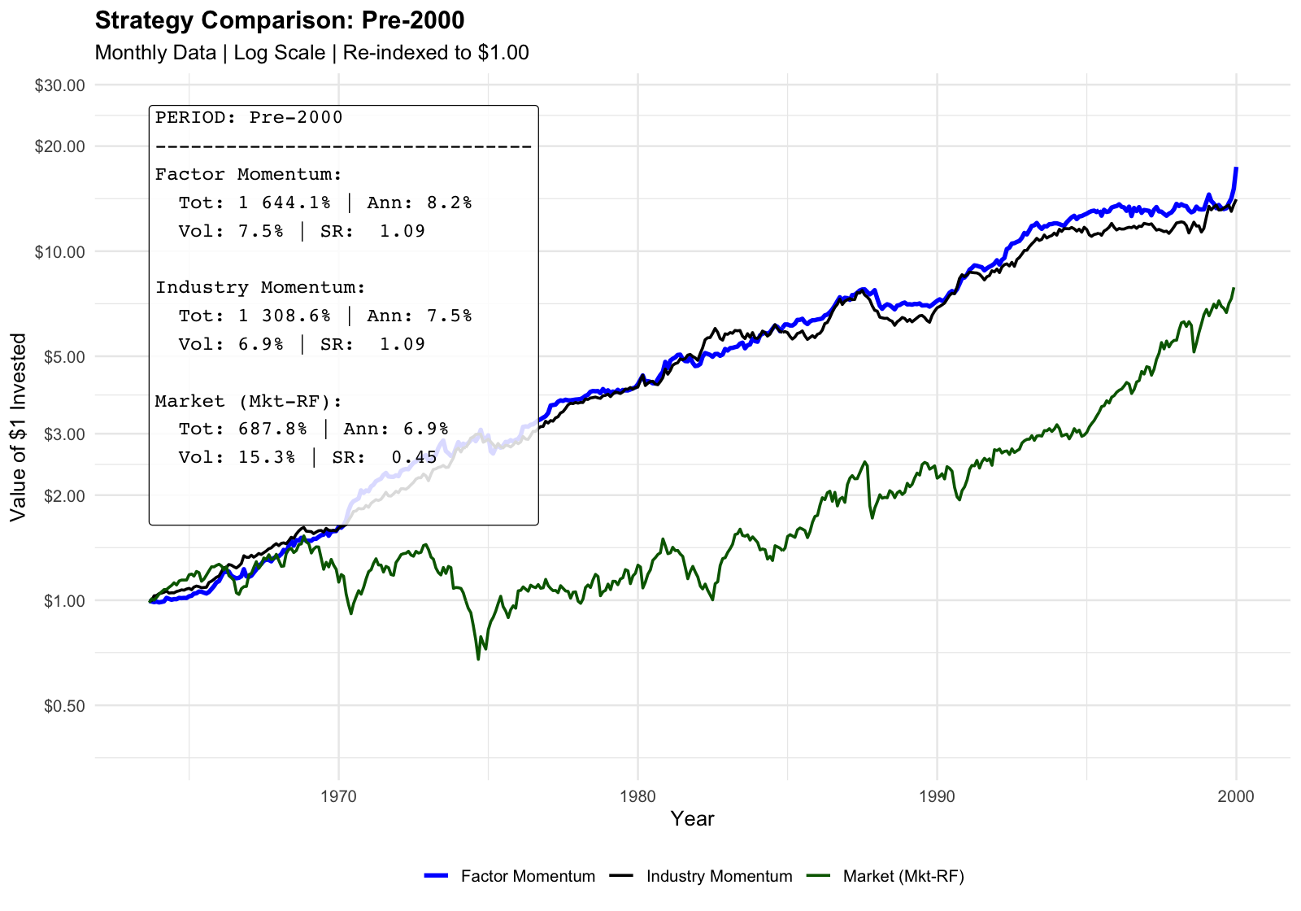
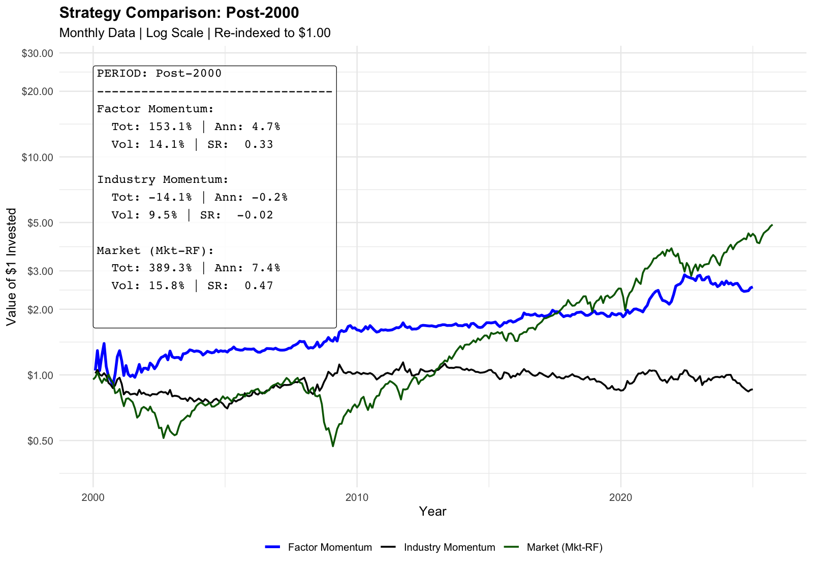

Part 1 (Factor level) – Performance & Robustness Checks
Structural Decay in the Performance Post-2000
Why Alpha Has Decayed Post-2000: Structural alpha decay in the modern era (from SR=1.09 to 0.33) is probably driven by increased market efficiency and the crowding of factor strategies following widespread academic publication.
To restore investability, in Phase 2 we pivot to 25% long-only implementation that leverages the strategy's proven negative correlation during market stress as a reliable tail-risk hedge.

Slide 15
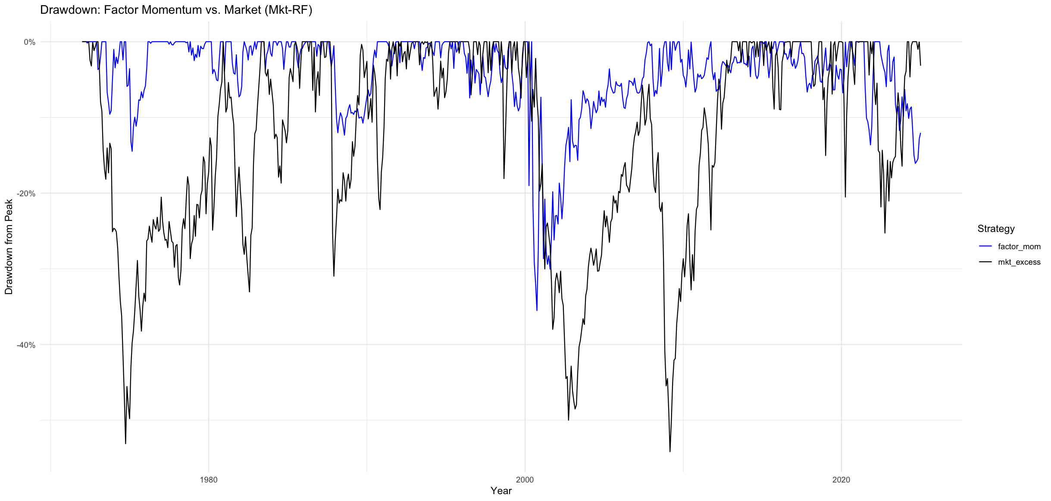
Part 1 (Factor level) – Performance & Robustness Checks
Structural Decay in the Performance Post-2000
Why Alpha Has Decayed Post-2000: Structural alpha decay in the modern era (from SR=1.09 to 0.33) is probably driven by increased market efficiency and the crowding of factor strategies following widespread academic publication.
To restore investability, in Phase 2 we pivot to 25% long-only implementation that leverages the strategy's proven negative correlation during market stress as a reliable tail-risk hedge.

Slide 16
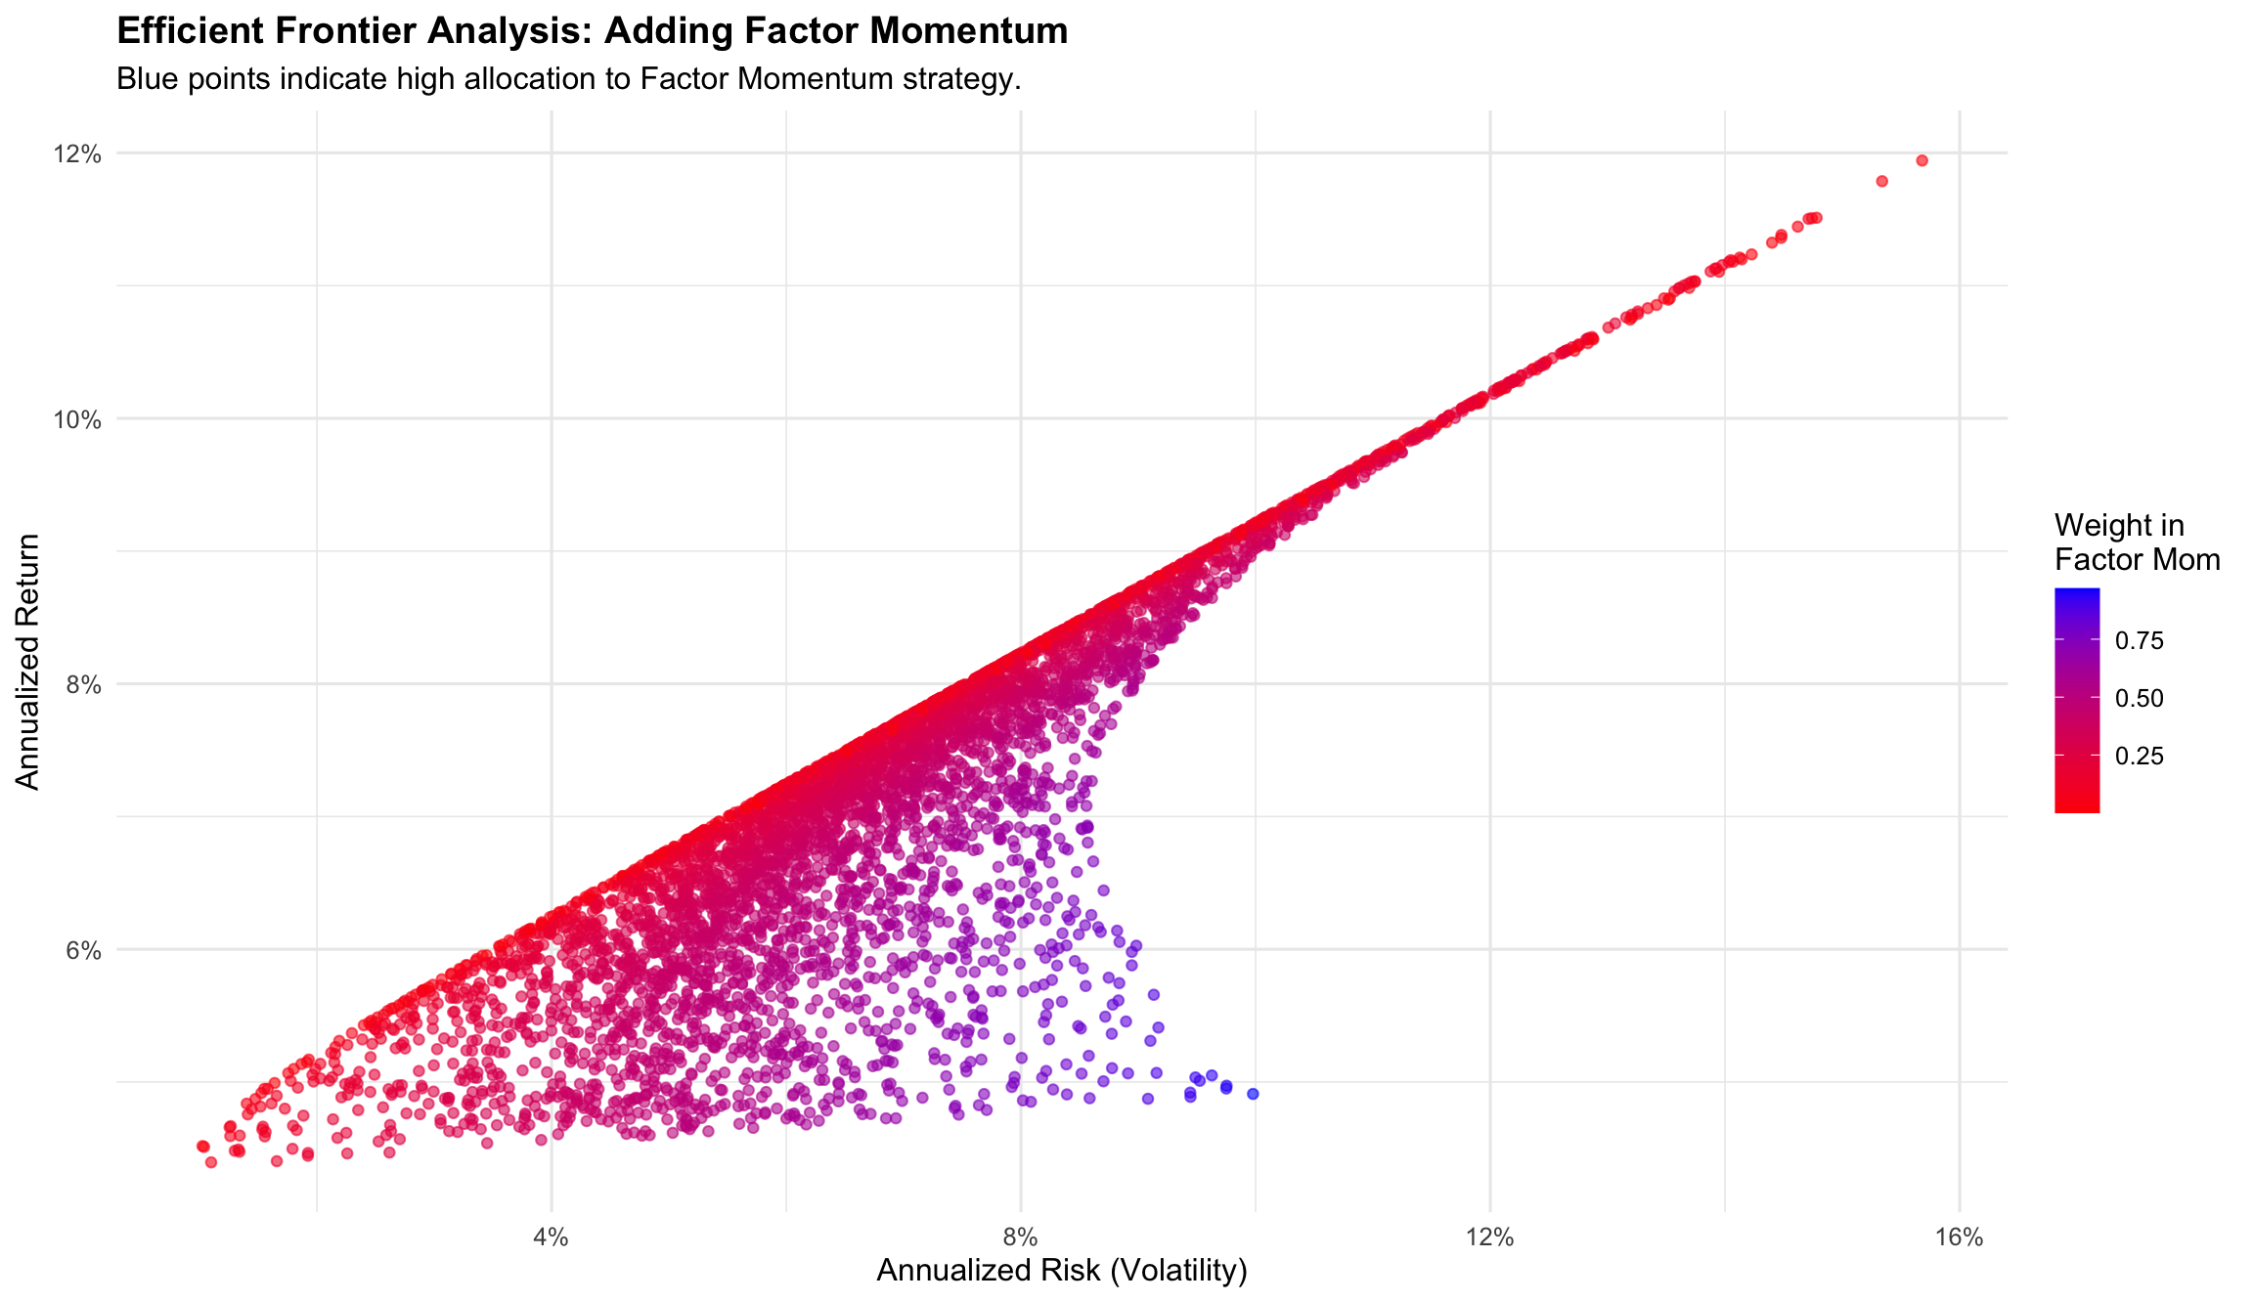

Part 1 (Factor level) – Performance & Robustness Checks
Portfolio Impact: Factor Momentum Acts more as a Volatility Dampener
The efficient frontier reveals that portfolios with high allocations to Factor Momentum (blue points) cluster in the lower-volatility region, sacrificing the raw upside of a pure equity portfolio (red points) to achieve a significantly more stable risk profile.
To restore investability, in Phase 2 we pivot to 25% long-only implementation that leverages the strategy's proven negative correlation during market stress as a reliable tail-risk hedge.

Slide 17
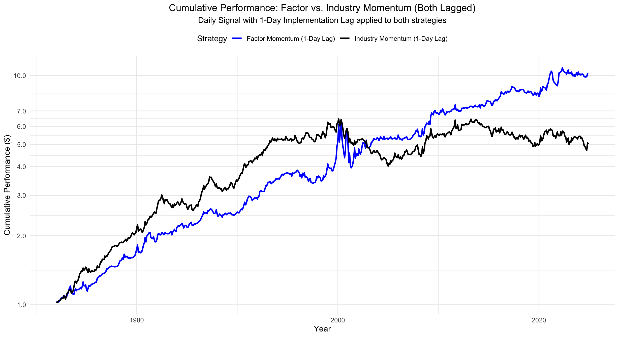
Part 1 (Factor level) – Performance & Robustness Checks
Switching to Daily Data – Closer to Real-life implementation
We switched to daily data to mimic real-life implementation of the Investment Strategy.
We invest at 1st day of the following month closing prices.
The performance of both strategies decreases, but Factor Momentum stays the winner.

Slide 18
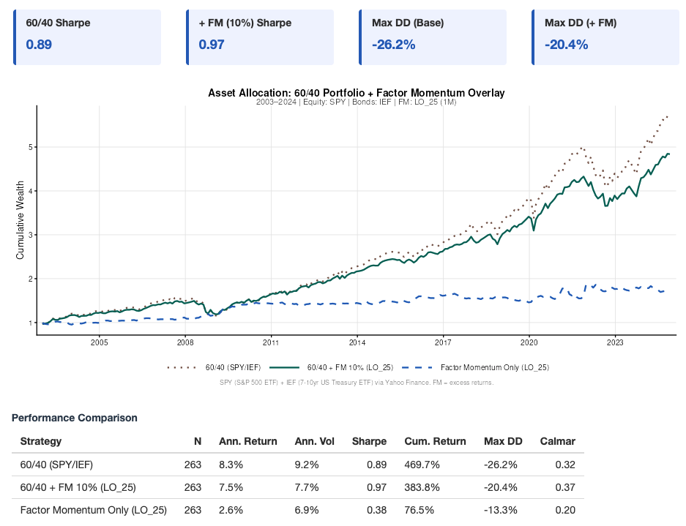
Adding Factor Momentum to 60/40 Portfolio
Adding Factor Momentum to 60/40 Portfolio, 1M and LO 25%
I
We compare 60/40 portfolio,
60/40 + factor momentum overlay (10%),
and factor momentum.
Comparison Setup
II
Adding a 10% factor momentum overlay
improves the 60/40 portfolio’s risk-adjusted
performance (Sharpe 0.89 → 0.97).
Risk-Adjusted Improvement
III
Drawdown Reduction
The overlay smooths the path of returns and
reduces downside risk, improving max
drawdown from -26.2% to -20.4%.
IV
The correlation between the Factor
Momentum strategy and the 60/40 Portfolio is
negative, equal to -0.034.
Correlation

Slide 19
1) Rejection of Pure Replication (Long/Short):
Part 1 (Factor level) – Performance & Robustness Checks
Going into Part Two
3) Portfolio Role - Crisis Diversifier:
2) Strategic Pivot: Long-Only Implementation:
We recommend isolating the 25% Long-Only leg for implementation.
Rationale: The results show that the 25% Long-Only definition delivers the strongest performance, and the replication further confirms that most of the cumulative return is driven by the long leg, while the short leg mainly adds volatility without contributing significant returns.
Benefit: This choice preserves the upside driver in the framework while significantly reducing implementation costs and improving practical scalability.
We advise against deploying the fully replicated Long/Short Arnott et al. (2023) strategy as a standalone alpha generating strategy.
Reasoning: The structural alpha decay post-2000 (Sharpe Ratio declining from 1.09 to 0.33) implies that the strategy, in its raw form, likely cannot overcome the transaction costs associated with high-turnover shorting.
4) Execution Constraints:
Sizing: The strategy should be sized as a tail-risk hedge rather than a core equity replacement.
It demonstrates unique resilience during market stress, delivering returns during the GFC (+2.8%) and the COVID-19 crash (+7.2%).
Correlation: -0.034 to the 60/40 portfolio → it provides genuine diversification benefits.
Universe: The attempt to select a "unique" subset of factors resulted in underperformance, suggesting that broad diversification is required to capture the momentum premium effectively.
Timing: Our robustness checks show that a 1-month lag completely erodes the outperformance, while the 1-day lag harms it marginally, necessitating a strict rebalancing schedule.

Slide 20
Part 2 (Single-stock level) – Replication, Net Positions, Frictions
Factor Mapping and Replication from Single Stocks
The JKP (2025) Framework
Factor Name | Variable Key | Factor Name | Variable Key
Size_SMB | market_equity | Net_Working_Capital_Changes | cowc_gr1a
Book_to_Market_HML | be_me | Cash_Flow_to_Price | ocf_me
Operating_Profitability_RMW | ope_be | Earnings_to_Price | ni_me
Asset_Growth_CMA | at_gr1 | Enterprise_Multiple | ebitda_mev
Long_Term_Reversals_LTREV | ret_60_12 | Sales_to_Price | sale_me
Residual_Variance_RVAR | ivol_ff3_21d | Growth_in_Inventory | inv_gr1
Quality_Minus_Junk_QMJ | qmj | Sales_Growth | sale_gr1
Low_Beta_BAB | betabab_1260d | Growth_in_Sales_Inventory | dsale_dinv
Amihud_Illiquidity | ami_126d | Abnormal_Investment | capex_abn
Firm_Age | age | CAPX_Growth_Rate | capx_gr1
Nominal_Price | prc | Debt_Issuance_Factor | dbnetis_at
High_Volume_Premium | dolvol_126d | Leverage_Factor | at_be
Gross_Profitability | gp_at | One_Year_Share_Issuance | chcsho_12m
Return_on_Equity | ni_be | Total_External_Financing | netis_at
Return_on_Assets | niq_at | Ohlson_O_Score | o_score
Profit_Margin | ebit_sale | Altman_Z_Score | z_score
Change_in_Asset_Turnover | at_turnover | Piotroski_F_Score | f_score
Accruals_Factor | oaccruals_at | Net_Operating_Assets | noa_at
Phase 1: Mapped 36 characteristics to the Factor Momentum literature using the Jensen, Kelly, and Pedersen (JKP) framework.
The Breakthrough: After initial challenges finding suitable code and struggling with replication of other factors than the FF from Tidy Finance, we recently identified the official JKP Python replication repository, released in December 2025.
Implementation
Infrastructure: Leveraged the WU Cluster to handle the high computational load (matching JKP’s requirement of 450GB RAM / 128 CPU cores).
Status: Successfully replicated all factors with near-exact benchmark matches through Year-End 2024.
Implemented Update: Adapted to a new CRSP data structure via a JKP update released in January 2026.

Slide 21
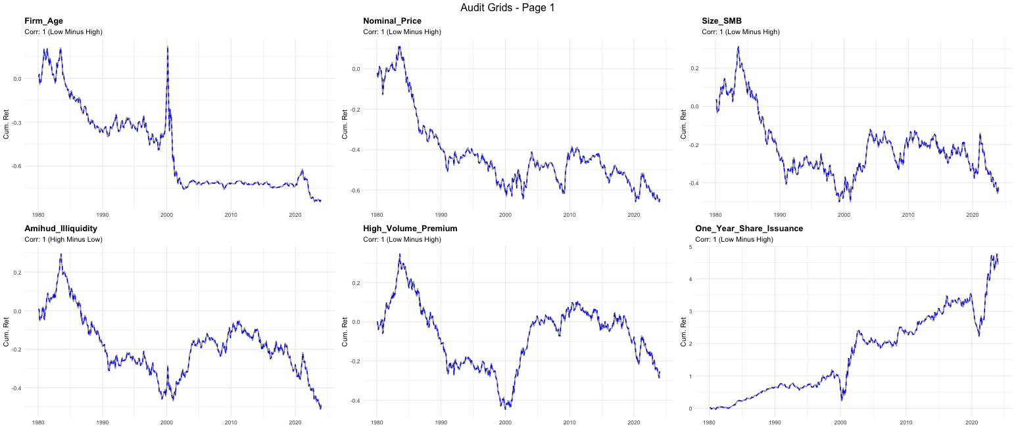
Part 2 (Single-stock level) – Replication, Net Positions, Frictions
Factor Replication (Example)

Slide 22
1) Replication of Factors
Part 2 (Single-stock level) – Replication, Net Positions, Frictions
3) Net Positions
Factor Momentum Strategy Replication
2) Factor Momentum Strategy
We replicate all 36 factors using single stock data from WRDS (CRSP, Compustat).
Weights of single stocks (long/short positions) are saved within the factor construction process.
The Arnott et al. (2023) Factor Momentum strategy is constructed from the replicated factors, similarly to the 1st part.
We proceed with the Long-only 25% Factor Momentum Strategy, as it yielded the best results in the 1st part.
4) Frictions
Net positions for the Factor Momentum strategy are calculated on the single stock level across factors.
As a certain stock can have a long positions in one factor, but a short position within another, it is crucial to net out and work with the resulting position before implementing frictions.
We implement the following frictions to mimic real-life implementation of the strategy:
Transaction Costs.
Shorting Costs.
Withholding tax on Dividends.
This framework allows us to move from factor-level signals to an implementable single-stock strategy and quantify how real-world frictions affect performance.

Slide 23
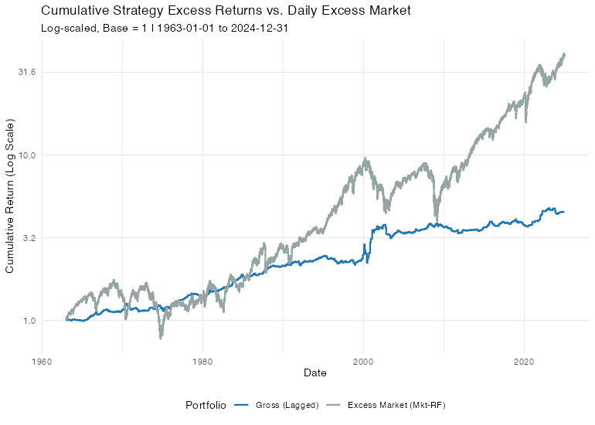
Part 2 (Single-stock level) – Replication, Net Positions, Frictions
Factor Momentum Strategy Performance
Strategy Metrics | Gross (Lagged) | Mkt-RF
Ann. Return | 0.0266 | 0.0723
Ann. Volatility | 0.0724 | 0.1613
Sharpe (Rf=0%) | 0.3681 | 0.4501
The replication of the Long-only 25% Factor Momentum Strategy (1-day lag) from single stocks shows a steadily growing performance over the whole sample. While the Market delivered a higher absolute performance it did so with a 2.2x higher volatility.

Slide 24
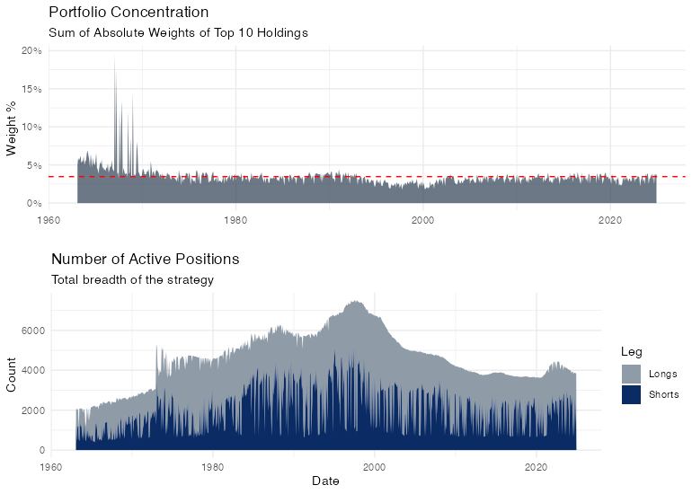



Part 2 (Single-stock level) – Replication, Net Positions, Frictions
Position Analysis
The Factor Momentum portfolio is not very concentrated, with the top 10 holdings summing to ~3% on average.
Number of stocks per month Plot + Strategy Performance
The strategy is composed of 2,584 long and 2,028 short positions on average every month.
This implies a huge universe size needed to replicate the Factor Momentum Strategy using single stocks.

Slide 25
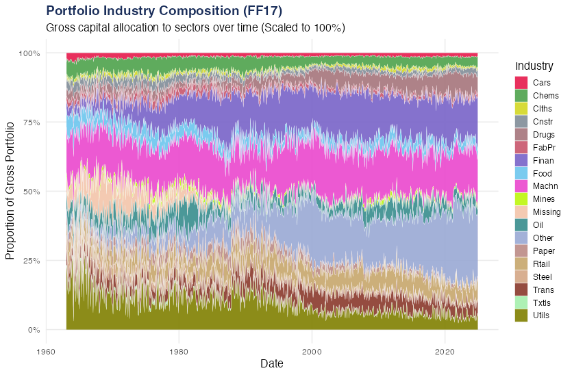



Part 2 (Single-stock level) – Replication, Net Positions, Frictions
Factor vs. Industry Momentum?
On average, the portfolio looks well-diversified (e.g., Machinery averages just 16.8%, Financials 13.4%).
During market shifts, the strategy concentrates into a few single sectors (e.g., Utilities hit a massive 27.7%, Financials hit 25.5%).
Because factors and industries are so deeply intertwined, factor momentum periodically abandons diversification and turns into extreme industry momentum. This finding coincides with Arnott et al. (2023).

Slide 26

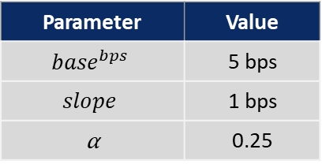
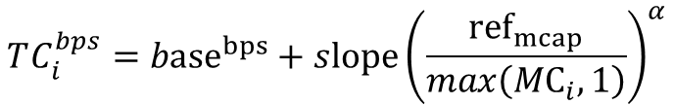
Part 2 (Single-stock level) – Replication, Net Positions, Frictions
Transaction Costs
Transaction costs are modelled in basis points as a decreasing function of market capitalization.
We choose slope so that a representative large-cap has 5-10 bps one-way implementation shortfall, then let costs rise smoothly for smaller caps.
$TC_{i}^{bps}$ : estimated one-way transaction cost (bps) for stock i.
${base}^{bps}: \text{fixed} \text{min}\text{. }\text{cost} \text{level}\text{ (}\text{bps}\text{) }\text{applied} \text{to} \text{very} \text{liquid} \text{names}\text{.}$
$slope:$calibrated sensitivity parameter (bps).
${ref}_{mcap}:$ median market cap. of the S&P 500.
⍺: curvature parameter that controls how quickly costs rise (⍺ > 0).
$max\left({MC}_{i},1\right): \text{numerical} \text{guard} \text{to} \text{avoid} \text{division} \text{by} \text{zero}\text{.}$
Max. TC is capped at 100 bps to avoid extreme values.
Parameter | Value
$${base}^{bps}$$ | 5 bps
$$slope$$ | 1 bps
⍺ | 0.25
$$TC_{i}^{bps}={base}^{bps}+slope{\left(\frac{{ref}_{mcap}}{max\left({MC}_{i},1\right)}\right)}^{α}$$
This allows us to approximate transaction costs using market capitalization for real world application.

Slide 27
Part 2 (Single-stock level) – Replication, Net Positions, Frictions
Shorting Costs
D’Avolio (2002) “The Market for Borrowing Stock” (Journal of Financial Economics).
Key takeaway: The stock borrow fee (Fed Funds rate minus the rebate rate) is typically small for liquid U.S. stocks, with 91% of loans under 1% annually and an overall value-weighted average of roughly 24 bps.
Adjustment: we want to penalize small stocks with greater relative shorting costs; therefore we use a similar function as for TCs to calculate the final SCs as a function of market cap.
We incorporate borrow fees as an annualized charge on short notional (adjusted for market cap), as most liquid U.S. equities are cheap to borrow.

Slide 28
Part 2 (Single-stock level) – Replication, Net Positions, Frictions
US-Austria Cross-Border Equity Tax Frictions
Bilateral Treaty Efficiency (Double Taxation Convention 1996): Capital gains on US equities are taxed exclusively in Austria (0% US liability). Dividends benefit from a treaty-reduced withholding tax of 15% (Form W-8BEN required), which is fully creditable against the Austrian liability
The "Long" Leg Tax Drag: All realized gains and dividends are subject to the Austrian 27.5% special tax rate (Kapitalertragsteuer; Investment Income Tax). Post-2025 regulations mandate Tax-Base Netting; however, losses cannot be carried forward and expire annually.
The "Short" Leg Asymmetry: Short positions face a "deadweight loss." Manufactured dividends paid to lenders are non-deductible for private investors due to the Austrian income-related expense deduction ban (S20 Abs 2 EStG), creating a significant "negative alpha" hurdle.
Strategy Implications: Dividends on the long-leg side must be tax-adjusted to account for the tax differences of long/short positions.
We implement a parameter to asymmetrically tax dividends (27.5% rate) received on the long leg, while paying 100% of the manufactured dividends on the short leg.

Slide 29
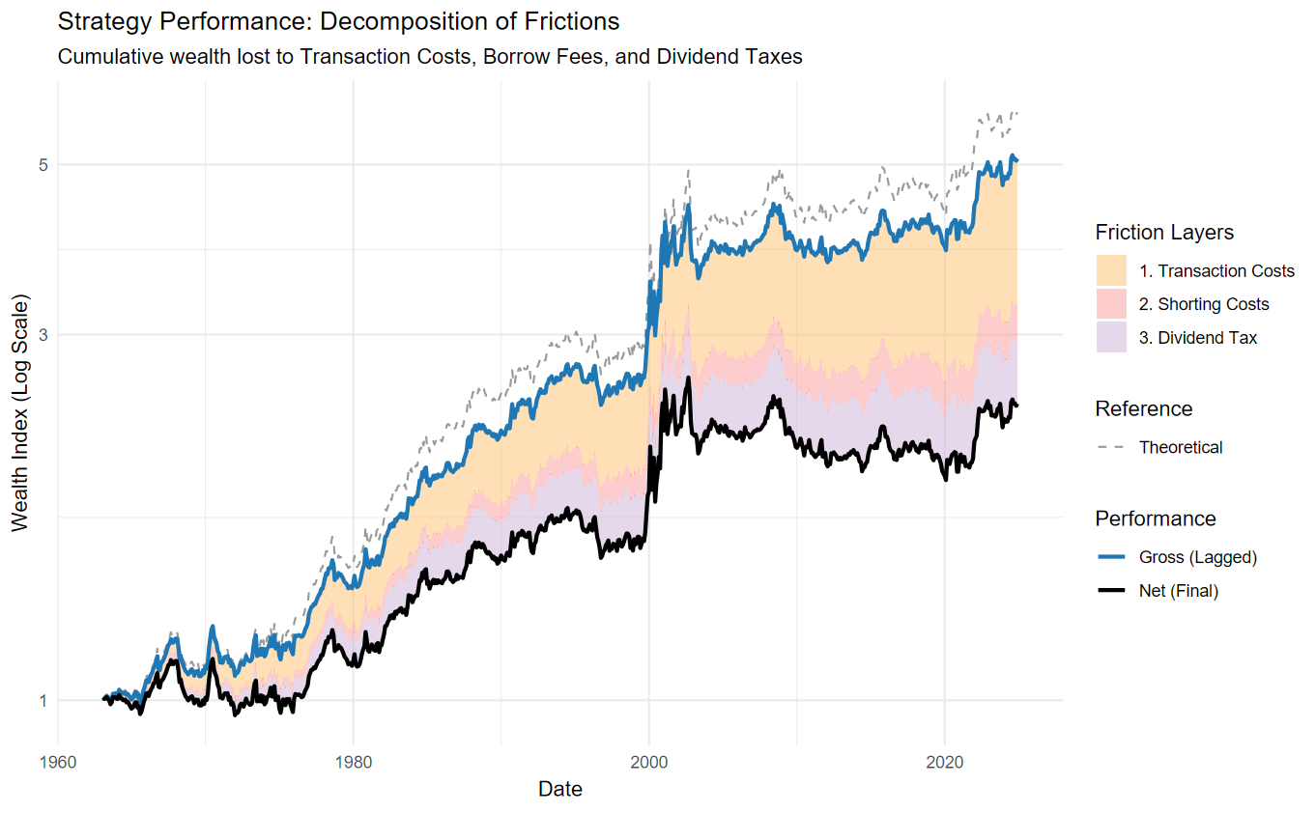

Part 2 (Single-stock level) – Replication, Net Positions, Frictions
Frictions
Strategy Metrics | Theoretical | Gross (Lagged) | Net (Final)
Ann. Return | 0.0289 | 0.0266 | 0.0145
Ann. Volatility | 0.0742 | 0.0724 | 0.0723
Sharpe (Rf=0%) | 0.3901 | 0.3681 | 0.2004
Transaction costs hurt the performance most (high turnover).
Shorting costs seem to be manageable.
After all frictions, the Sharpe ratio decreases to 0.2.
Post-2000 the strategy performance flats out.

Slide 30
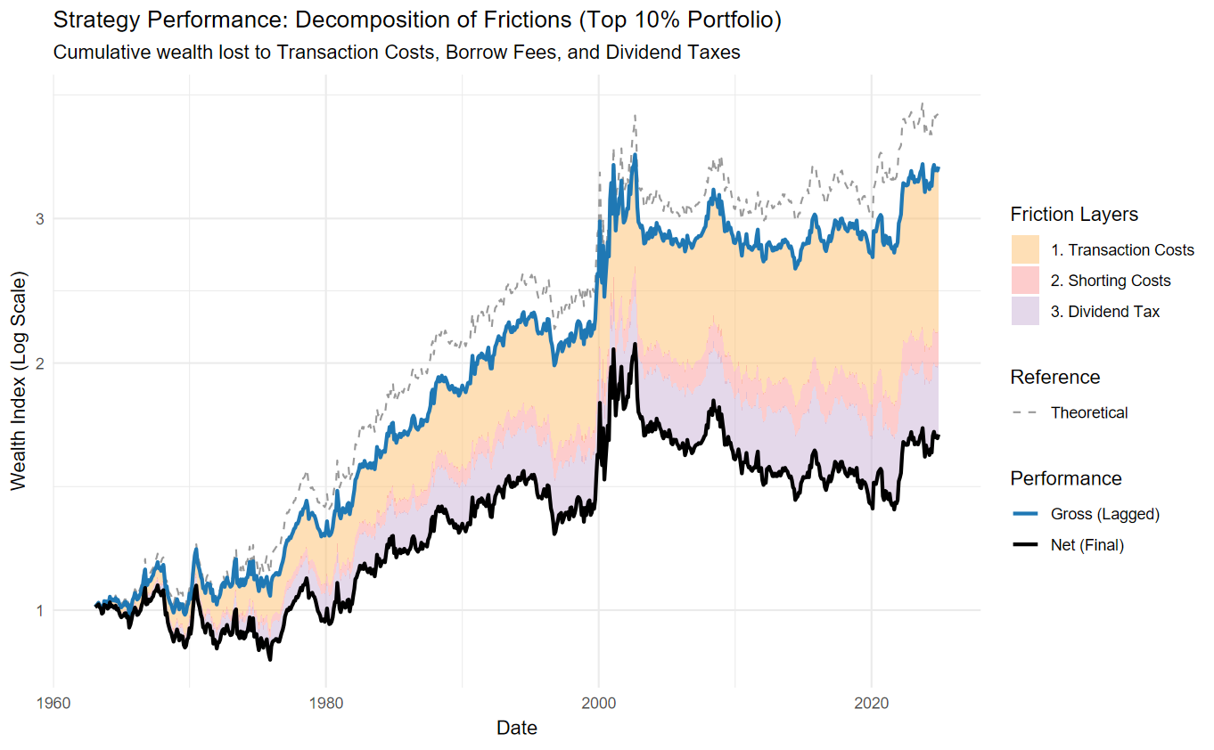


Part 2 (Single-stock level) – Replication, Net Positions, Frictions
Limited number of positions – (Top 5% long-short)
Strategy Metrics | Theoretical | Gross (Lagged) | Net (Final)
Ann. Return | 0.0228 | 0.0203 | 0.0080
Ann. Volatility | 0.0835 | 0.0816 | 0.0816
Sharpe (Rf=0%) | 0.2735 | 0.2488 | 0.0980
We try to limit the number of traded stocks by taking the top 5% long/short positions only.
Absolute performance (as well as risk-adjusted measures) halves and the performance is hit significantly.

Slide 31



Strategy Conclusion, Portfolio Implications & Implementation Constraints
Conclusions
Theory (Phase 1)
Real Implementation (Phase 2)
Replication is successful: Exact replication of Arnott et al. (2023) works well at the factor level and confirms that the factor momentum premium exists in theory.
High Barrier to Entry: Replicating all 36 factors via the JKP (2025) framework is computationally severe. Processing single-stock CRSP data required the WU Cluster.
Extreme Breadth & Turnover Drag: Translating factor signals into net single-stock trades creates a highly scattered portfolio of ~4,600 positions (2,584 long / 2,028 short). The portfolio is unconcentrated (Top 10 holdings = 3%) and drives a massive 635% annualized turnover.
Long-Only is the better approach: Testing different parameters showed that a 25% Long-Only setup performs best. The short leg mostly adds volatility without contributing meaningful returns.
Well Defined Universe
No consistent "winning" factors: Capturing the momentum premium requires broad factor diversification, as no individual factors consistently drive performance and concentrating on a smaller subset actively hurts returns.
Real-World Frictions Destroy Alpha: High turnover, shorting costs, and withholding taxes on dividends severely drag performance. After all frictions, the Sharpe ratio plummets to 0.20, and post-2000 performance completely flatlines.
Short Leg Burden
Add-on Role: Factor Momentum is highly effective as a defensive tool. Its crisis-positive behavior introduces genuine alpha during drawdowns, making it a resilient, low-volatility diversifier that enhances the risk-adjusted returns of a standard 60/40 portfolio.
Position Capping Fails: Attempting to solve the big universe size by limiting trades to the top 5% highest-conviction positions cut absolute and risk-adjusted returns in half. The factor momentum premium relies entirely on broad, scattered diversification and fails when concentrated.
While Factor Momentum shows strong theoretical returns, the massive netted single stock portfolio and trading frictions required for stock-level execution ultimately erase its performance.

Slide 32
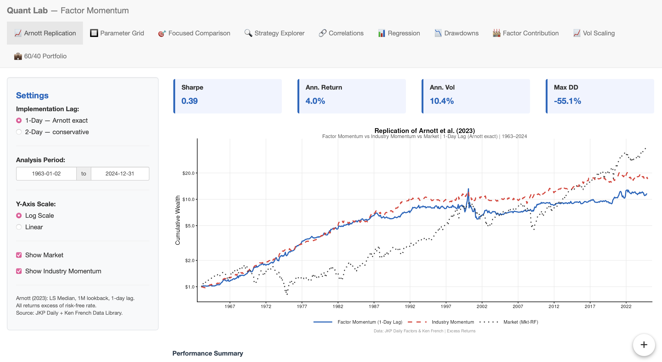

R Shiny App usage demonstration
R Shiny App
More interactively what we did:
https://huggingface.co/spaces/farkastallos/Ilab_Factor_Momentum
Credentials:
User: Ilab_member
Password: Ilab_member_12_1

Slide 33
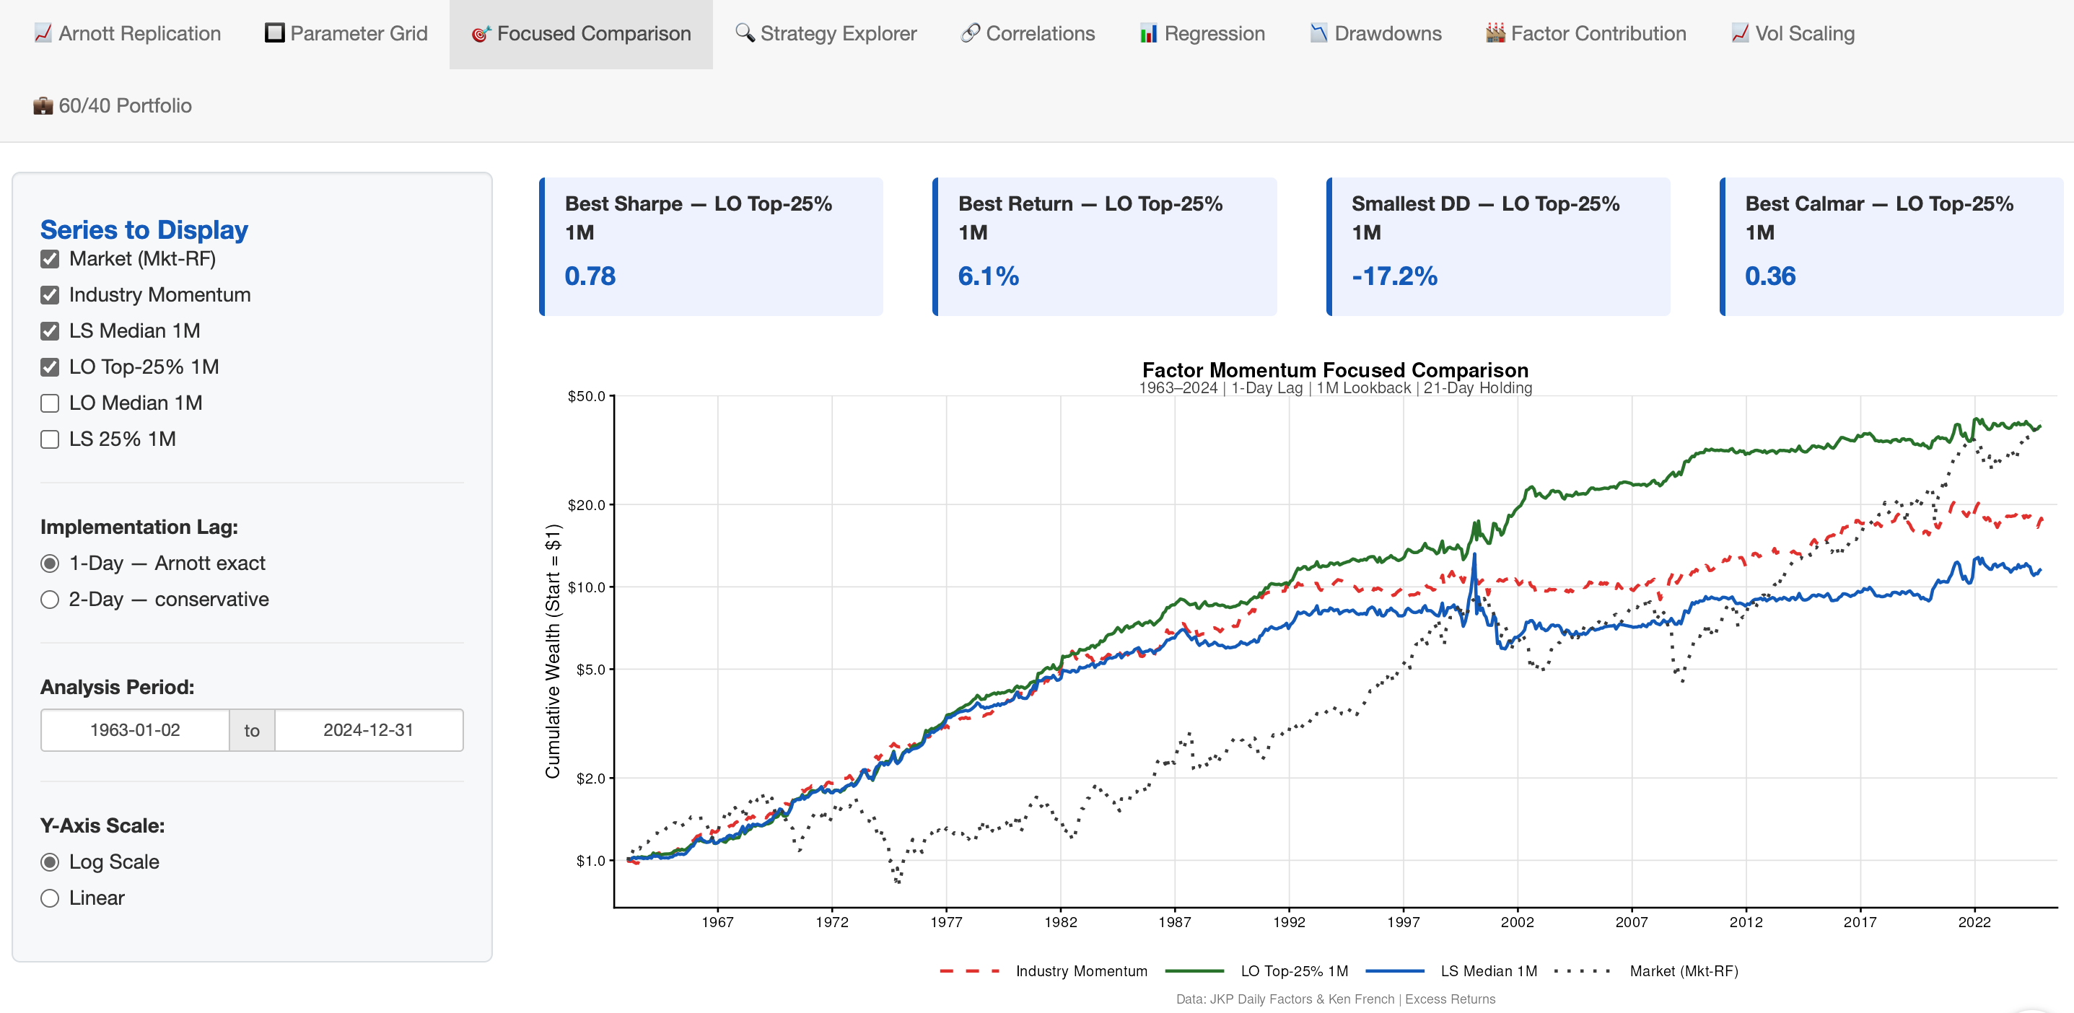
R Shiny App usage demonstration
R Shiny App

Slide 34
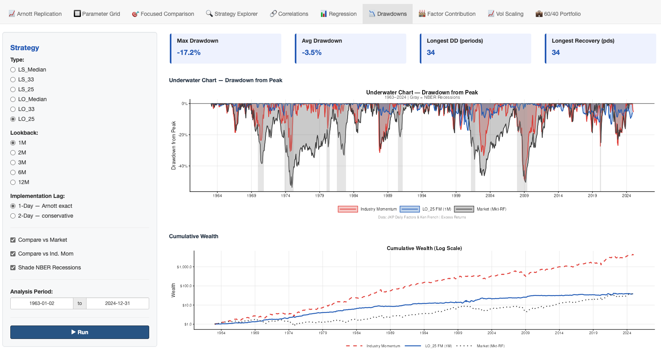
R Shiny App usage demonstration
R Shiny App

Slide 35
Single Stock Implementation
Strategy Conclusion, Portfolio Implications & Implementation Constraints
ILAB Lessons Learned
Frictions Implementation
Processing Power Required
We realized that academic, factor-level backtests often look deceptively perfect on paper and overstate how easily a strategy can be implemented.
By actually building the strategy stock-by-stock, we learned how to identify and manage the messy, real-world concentration and idiosyncratic risks that high-level summaries usually hide.
We quickly outgrew standard laptops and had to level up our practical data engineering skills to handle the computationally intensive security-level replication.
Managing massive data taught us how to build scalable workflows, efficiently store large Parquet files, and successfully run heavy models using the WU HPC cluster and the JKP repository.
Empirical Implementation Reality Check
Transaction Costs: Transaction costs and short financing are material at scale. Once implemented, a significant share of gross alpha was absorbed by trading costs and shorting expenses.
Lagging the signal by one trading day reduced implementation bias and more accurately reflected real execution/availability of inputs, though it weakened raw back-test performance.
Bridging the gap between published factor momentum research and a scalable, real-world portfolio was our most valuable takeaway.
We learned that a clean academic anomaly is only useful to the industry if the portfolio construction can actually survive the brutal reality of turnover, borrowing costs, and execution lags.

Slide 36

Thank you!

Slide 37
Sources
Sources
Bibliography
Arnott, R. D., Kalesnik, V., & Linnainmaa, J. T. (2023). Factor momentum. The Review of Financial Studies, 36(8), 3034–3070.
D'Avolio, G. (2002). The market for borrowing stock. Journal of Financial Economics, 66(2-3), 271–306.
Ehsani, S., & Linnainmaa, J. T. (2022). Factor momentum and the momentum factor. The Journal of Finance, 77(3), 1877–1919.
Jensen, T. I., Kelly, B., & Pedersen, L. H. (2023). Is there a replication crisis in finance? The Journal of Finance, 78(5), 2465–2518. https://doi.org/10.1111/jofi.13249
Schwarz, P., Walter, D., & Weiss, P. (2026). Rewriting CRSP history: Impact of altered monthly returns on asset pricing. SSRN. https://ssrn.com/abstract=4723461
Data and Code
WRDS Database
Kenneth French Data Library
JKP Github: https://github.com/bkelly-lab/jkp-data

Slide 38
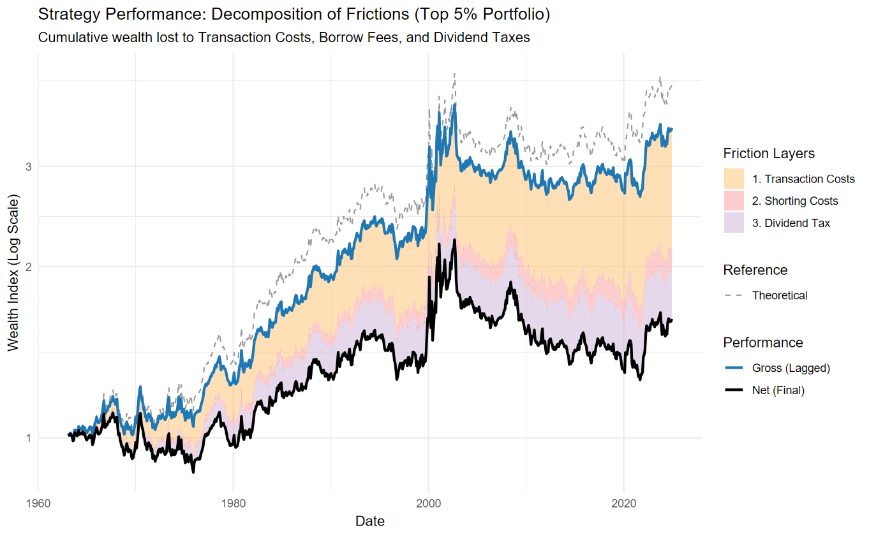
Appendix
Limited number of positions – (Top 2.5% long-short)
Strategy Metrics | Theoretical | Gross (Lagged) | Net (Final)
Ann. Return | 0.0233 | 0.0205 | 0.0078
Ann. Volatility | 0.0927 | 0.0907 | 0.0907
Sharpe (Rf=0%) | 0.2515 | 0.2257 | 0.0861

Slide 39
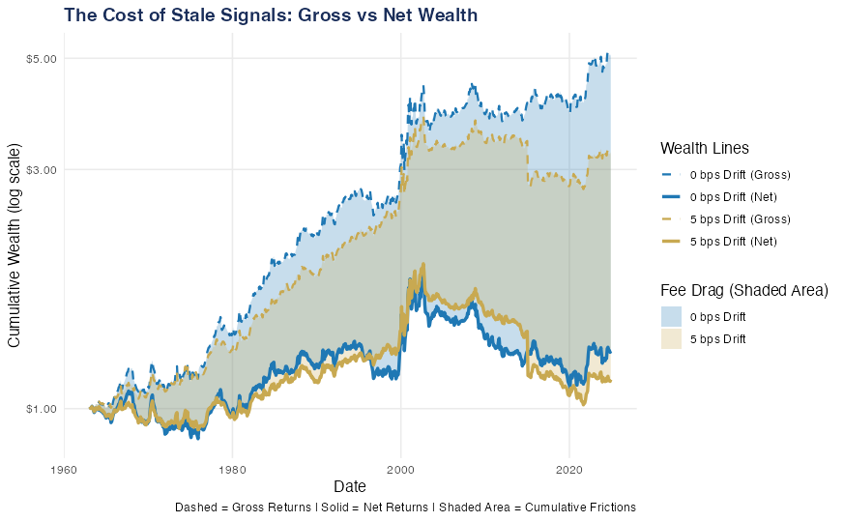


Appendix
Attempting to Limit Turnover– (5 bps Drift-Band Rebalancing)
Adding a 5 bps threshold successfully dropped our average monthly turnover from 53% down to 39%, significantly cutting our transaction fees.
Holding onto "stale" positions killed our returns. The net Sharpe ratio dropped even more.

