Slide 1

ZZ ILab Presentation
26.01.2026
Giulio Iepure, Caterina Piacentini, Farkas Tallos, Tomas Samaj

Slide 2
1
Factor Replication From Single Stocks
Agenda
2
Net Positions & Frictions
3
Final Presentation Proposal
4
Next Steps
Notes:
Tags: divider, simple, no image, left aligned header

Slide 3
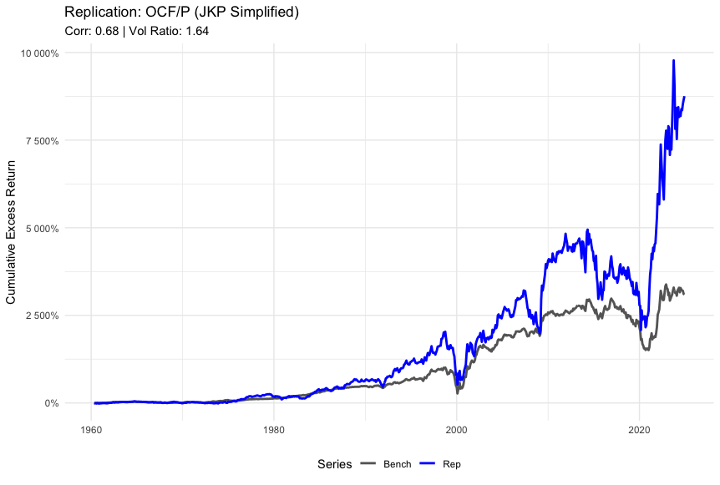
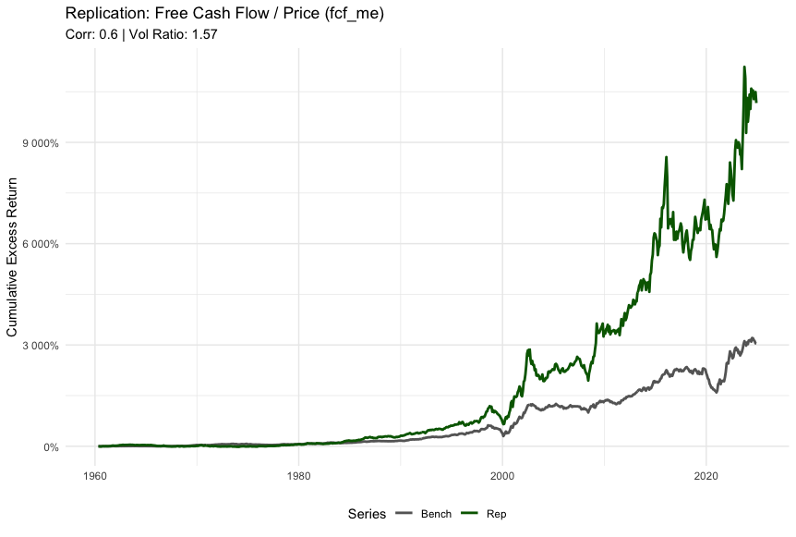
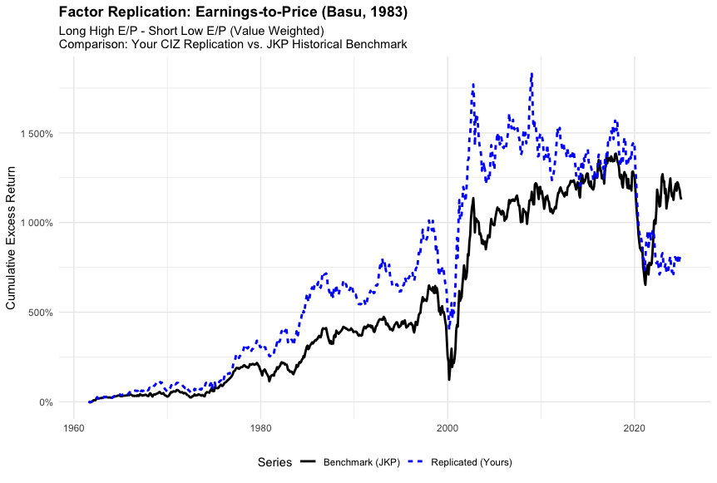
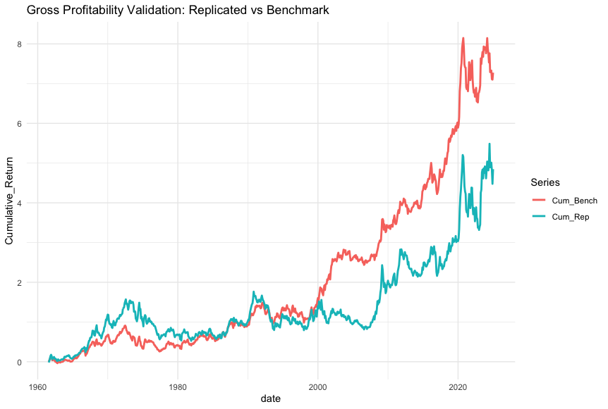
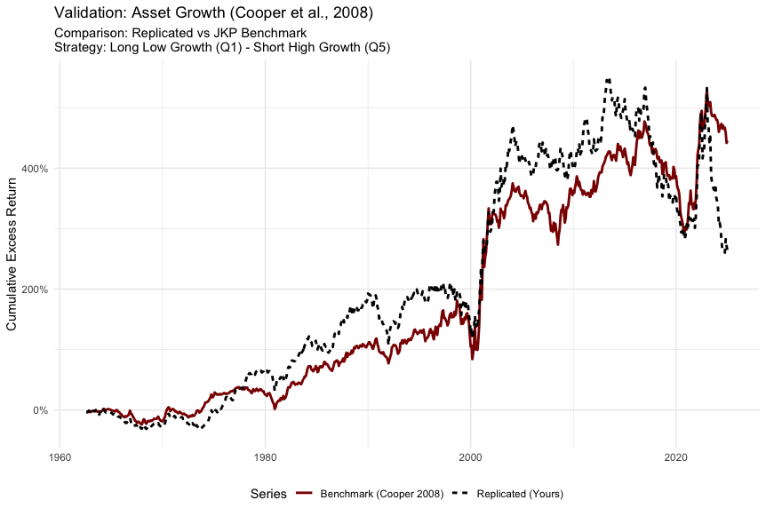
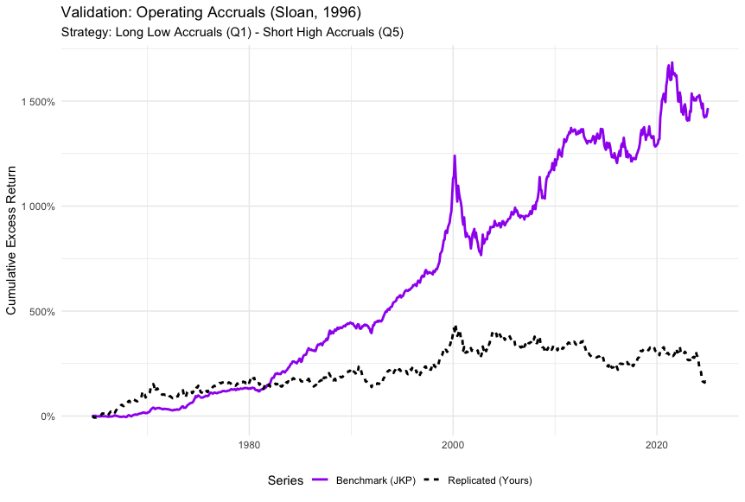
From the Last Meeting…
Factor replication from single stock data – Jan. 12th
We replicated 6 additional factors with moderate success, work and debugging in progress

Slide 4
Replication Summary
Factors Mapped in Phase 1 and Recent Work
The JKP (2025) Framework
Phase 1: Mapped 36 characteristics to the Factor Momentum literature using the Jensen, Kelly, and Pedersen (JKP) framework.
The Breakthrough: After initial challenges finding suitable code and struggling with replication of other factors than the FF from Tidy Finance, we recently identified the official JKP Python replication repository, released in December 2025.
Implementation & Success
Infrastructure: Leveraged the WU Cluster to handle the high computational load (matching JKP’s requirement of 450GB RAM / 128 CPU cores).
Current Status: Successfully replicated all factors with near-exact benchmark matches through Year-End 2023.
Ongoing Update: Adapting to the new CRSP data structure via a JKP update released 4 days ago.
Currently processing on the cluster to extend the dataset through Year-End 2024.
Factor Name | Variable Key | Factor Name | Variable Key
Size_SMB | market_equity | Net_Working_Capital_Changes | cowc_gr1a
Book_to_Market_HML | be_me | Cash_Flow_to_Price | ocf_me
Operating_Profitability_RMW | ope_be | Earnings_to_Price | ni_me
Asset_Growth_CMA | at_gr1 | Enterprise_Multiple | ebitda_mev
Long_Term_Reversals_LTREV | ret_60_12 | Sales_to_Price | sale_me
Residual_Variance_RVAR | ivol_ff3_21d | Growth_in_Inventory | inv_gr1
Quality_Minus_Junk_QMJ | qmj | Sales_Growth | sale_gr1
Low_Beta_BAB | betabab_1260d | Growth_in_Sales_Inventory | dsale_dinv
Amihud_Illiquidity | ami_126d | Abnormal_Investment | capex_abn
Firm_Age | age | CAPX_Growth_Rate | capx_gr1
Nominal_Price | prc | Debt_Issuance_Factor | dbnetis_at
High_Volume_Premium | dolvol_126d | Leverage_Factor | at_be
Gross_Profitability | gp_at | One_Year_Share_Issuance | chcsho_12m
Return_on_Equity | ni_be | Total_External_Financing | netis_at
Return_on_Assets | niq_at | Ohlson_O_Score | o_score
Profit_Margin | ebit_sale | Altman_Z_Score | z_score
Change_in_Asset_Turnover | at_turnover | Piotroski_F_Score | f_score
Accruals_Factor | oaccruals_at | Net_Operating_Assets | noa_at

Slide 5
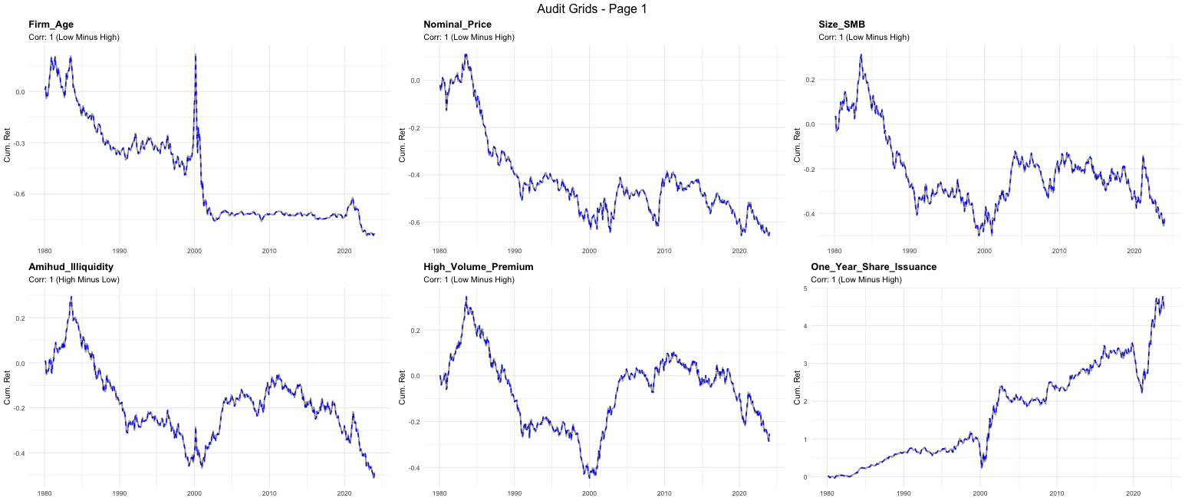
Factor Replication From Single Stocks
New Factor Replication 1/6

Slide 6
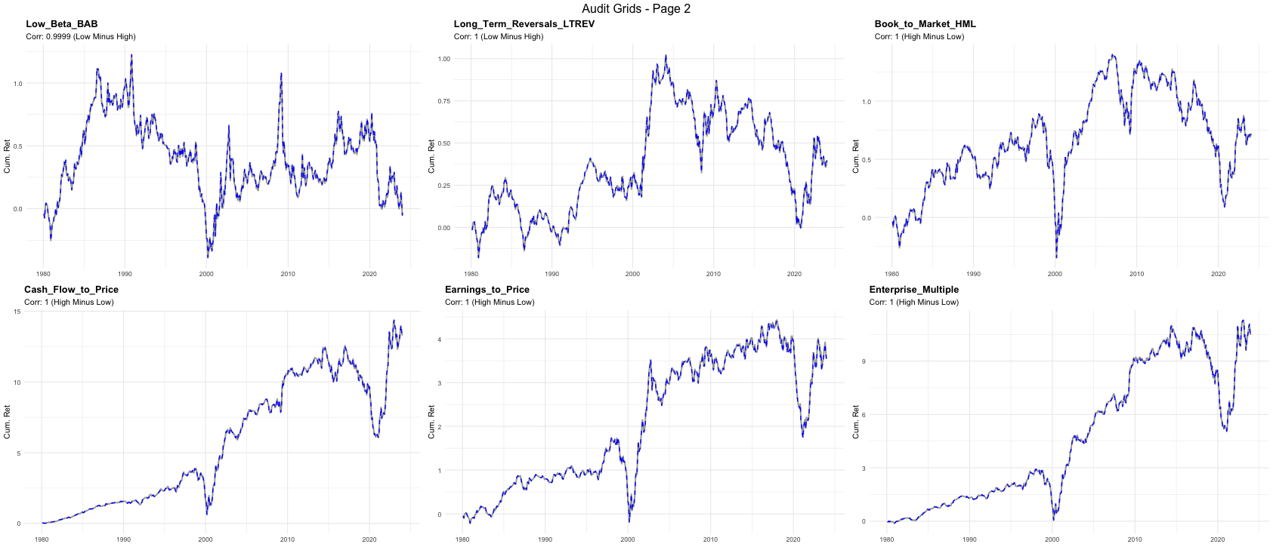
Factor Replication From Single Stocks
New Factor Replication 2/6

Slide 7
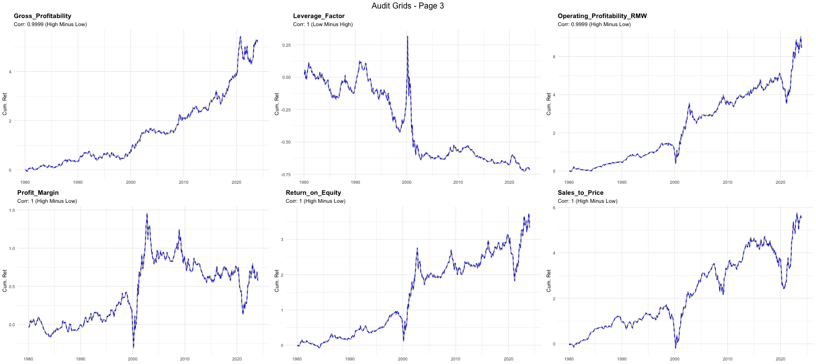
Factor Replication From Single Stocks
New Factor Replication 3/6

Slide 8
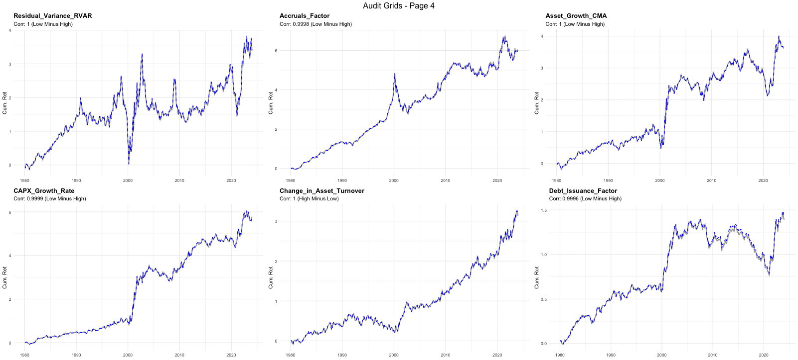
Factor Replication From Single Stocks
New Factor Replication 4/6

Slide 9
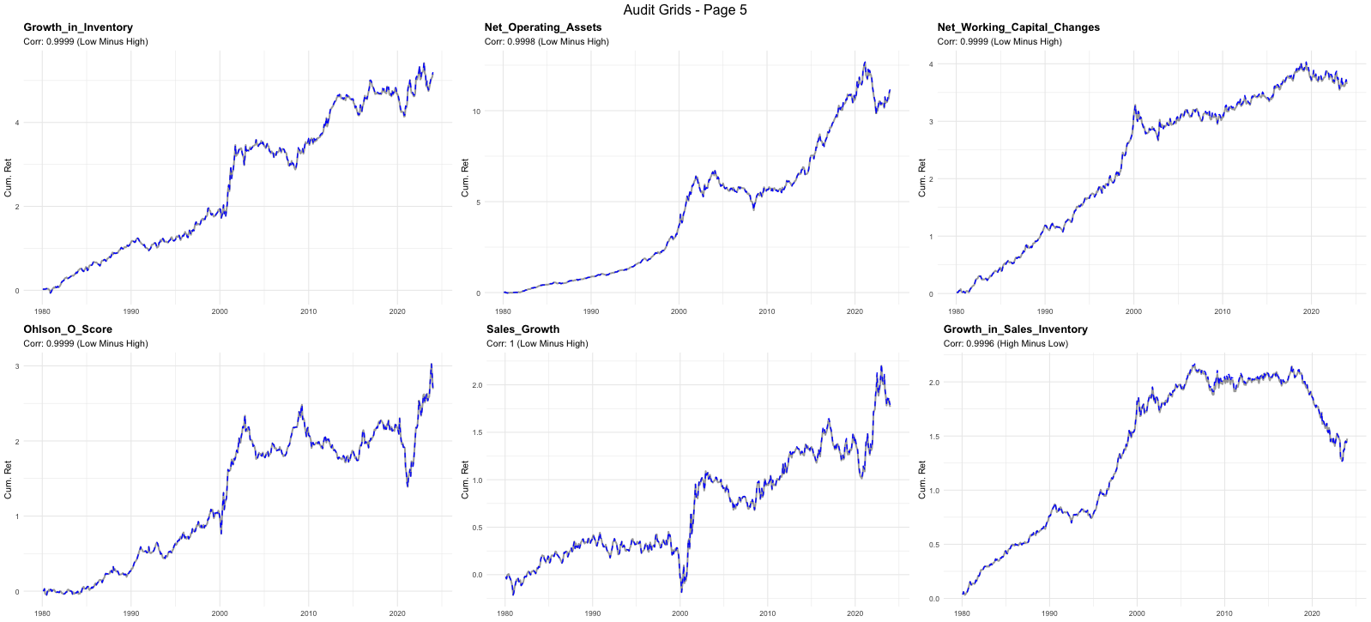
Factor Replication From Single Stocks
New Factor Replication 5/6

Slide 10
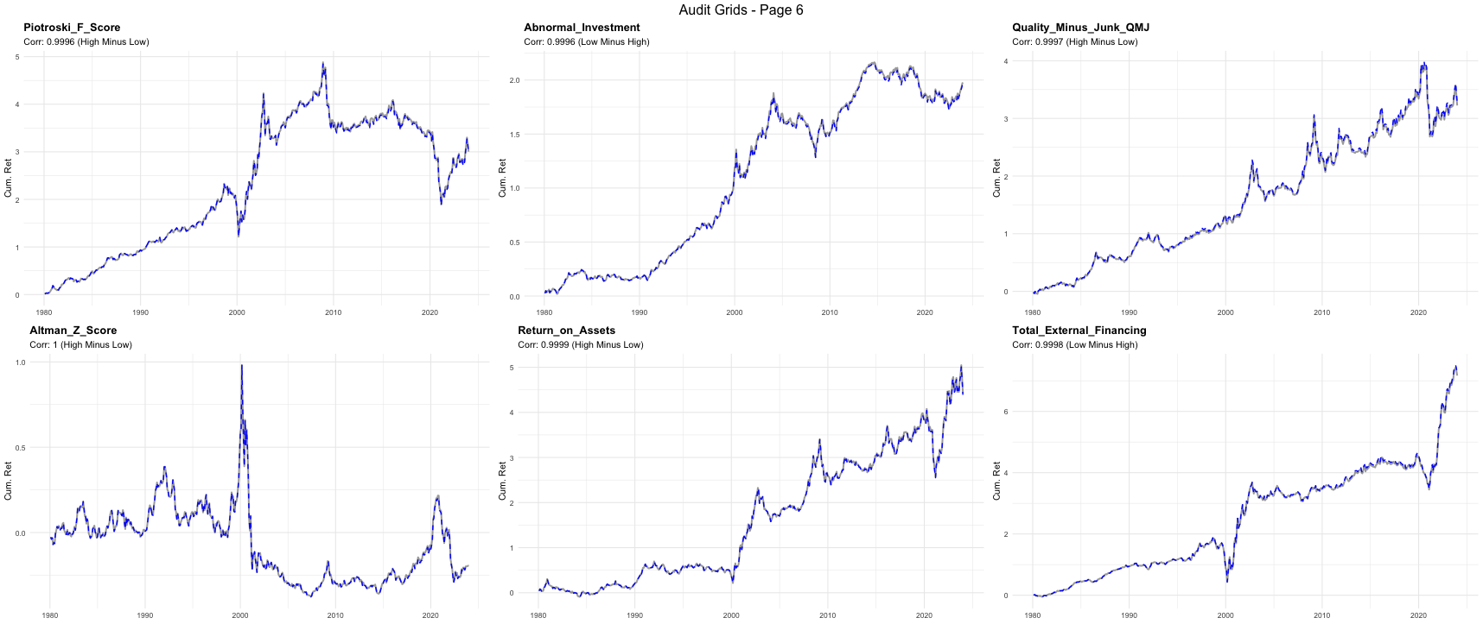
Factor Replication From Single Stocks
New Factor Replication 6/6

Slide 11
Net Positions & Frictions
Net Positions
Goal
After replicating all 36 factors from single stock data, we calculate Net Positions in single stocks to implement frictions, limit the number of positions, and execute the strategy efficiently.
Implementation in Theory
Instead of hard-coding weights in the data generation phase, we will try to dynamically reconstruct the exact portfolio weights in R using the finalized characteristic files (result of the replication).
Logic: We map the traded factors (from the Factor Momentum strategy) back to their constituent stocks using the generated Scores and Market Caps, then net any overlapping exposures.
Small Positions & Risk Control
Selection: To avoid an overly fragmented portfolio with negligible position sizes, we restrict holdings to the top/bottom quintiles (using NYSE Breakpoints to avoid micro-cap bias).
Weighting: We proportion weights using Capped Value-Weighting (e.g., 10% cap) to reflect the concentration of the signal while preventing single-stock dominance.

Slide 12
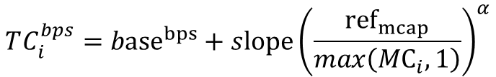
Net Positions & Frictions
Transaction Costs
Transaction costs are modelled in basis points as a decreasing function of market capitalization.
We choose slope so that a representative large-cap name has 5-10 bps one-way implementation shortfall, then let costs rise smoothly for smaller caps.
$$TC_{i}^{bps}={base}^{bps}+slope{\left(\frac{{ref}_{mcap}}{max\left({MC}_{i},1\right)}\right)}^{α}$$
$TC_{i}^{bps}$ : estimated one-way transaction cost for stock i, in basis points.
${base}^{bps}: \text{fixed} \text{minimum} \text{cost} \text{level}\text{ (}\text{bps}\text{) }\text{applied} \text{to} \text{very} \text{liquid} \text{names}\text{.}$
$slope:$calibrated sensitivity parameter (bps) *Currently fixed at 5bps.
${ref}_{mcap}:$ median market capitalization of the S&P 500 - anchor point for the curve.
⍺: curvature parameter controlling how quickly costs rise as market cap declines (⍺ > 0). *Fixed at 0.5.
$max\left({MC}_{i},1\right): \text{numerical} \text{guard} \text{to} \text{avoid} \text{division} \text{by} \text{zero}\text{ / }\text{invalid} \text{market}\text{−}\text{cap} \text{values}\text{.}$
This allows us to approximate transaction costs using market capitilization for real world application.

Slide 13
Net Positions & Frictions
Shorting Costs
D’Avolio (2002), “The Market for Borrowing Stock” (Journal of Financial Economics).
On the short side, the main additional friction is the stock borrow fee. D’Avolio (2002) measures this as the implied loan fee.
Which is the difference between the Fed Funds rate and the rebate rate paid on the short-sale collateral.
The key takeaway is that for large, liquid U.S. stocks, borrow costs are usually small: about 91% of loans have fees below 1% per year, and the value-weighted average is roughly 17 bps per year for general collateral, about 24 bps per year overall.
In an Austrian corporate trading vehicle, stock-borrow fees are typically deductible as trading/financing expenses, subject to general deductibility rules and potential limitations for net borrowing costs.
We will incorporate borrow fees as an annualized charge on short notional because most liquid U.S. equities are cheap to borrow.

Slide 14
Net Positions & Frictions
US-Austria Cross-Border Equity Tax Frictions
Bilateral Treaty Efficiency (Double Taxation Convention 1996): Capital gains on US equities are taxed exclusively in Austria (0% US liability). Dividends benefit from a treaty-reduced withholding tax of 15% (Form W-8BEN required), which is fully creditable against the Austrian liability
The "Long" Leg Tax Drag: All realized gains and dividends are subject to the Austrian 27.5% special tax rate (Kapitalertragsteuer; Investment Income Tax). Post-2025 regulations mandate Tax-Base Netting; however, losses cannot be carried forward and expire annually.
The "Short" Leg Asymmetry: Short positions face a "deadweight loss." Manufactured dividends paid to lenders are non-deductible for private investors due to the Austrian income-related expense deduction ban (S20 Abs 2 EStG), creating a significant "negative alpha" hurdle.
Strategic Optimization: Dividends on the long-leg side must be tax-adjusted to account for the tax differences of long/short postions.
We propose to implement a parameter to assymetrically tax dividends (27.5% rate) received on the long leg, while paying 100% of the manufactured dividends on the short leg.

Slide 15
Final Presentation Proposal + Next Steps
Final Presentation Outline Proposal I
1
Introduce Factor Momentum.
Introduction to the Project
Arnott, Kalesnik & Linnainmaa (2023), Factor Momentum
Ehsani & Linnainmaa (2022), Factor Momentum and the Momentum Factor
2
1st Part (Factor level) Performance.
Full sample Replication
Pre- & Post-2000 Performance
25% - 25% Factor Momentum Strategy
Long/Short Leg Performance
Crisis Diversifier Role
3
1st Part (Factor level) Robustness Checks.
Lags, Clustering, PCA
Factor Selection

Slide 16
Final Presentation Proposal + Next Steps
Final Presentation Outline Proposal II
4
2nd Part (Single-stock level).
Factor Replication
Strategy Replication
Net positions
Frictions (Shorting Costs, Taxes, Turnover etc.)
5
Strategy Conclusion, Portfolio Implications & Implementation Constraints.
6
R Shiny App, usage demonstration.
7
Ilab Conclusions: Lessons Learned + Empirical Challenges.

Slide 17
Final Presentation Proposal + Next Steps
Outline of the workload before the Final Presentation
Implement netting to single stocks across factors (limit to a smaller number of net positions).
Apply proposed logic for frictions – taxes on dividends, shorting costs & transaction costs.
Compare the performance with vs. without frictions.
Implement the final version of our analysis in the Rshiny app.
Questions
Final presentation – How long? Who will attend and what are their expectations (theoretical insights/practical implications)? Online/in-person? How should it differ from the previous presentations?
R Shiny App – feasible for the second part data?

Slide 18

Thank you!

