Slide 1
Project Caravela
Technical Approach & Findings
Brazilian E-Commerce Analytics Pipeline | Olist Dataset | ~100k orders, 2016–2018
5-Agent AI Architecture + Human Orchestrator
DSAI Module 2 Assignment • March 2026

Slide 2
Pipeline Architecture
End-to-end flow across 6 layers — modular, each independently replaceable
CSV
9 files
~1.1M rows
Meltano
tap-csv →
target-bigquery
BigQuery
olist_raw
9 tables
dbt
staging (9 views)
marts (7 tables)
BigQuery
olist_analytics
Star Schema
Jupyter
4 notebooks
11 metrics
Parquet
6 files
data/
Streamlit
5-page dashboard
▸ AUTOMATED — Dagster-orchestrated (daily 09:00 SGT + manual trigger)
▸ MANUAL — Notebooks, Parquet export, Streamlit dashboard
All credentials from single .env file: GOOGLE_APPLICATION_CREDENTIALS, GCP_PROJECT_ID, BIGQUERY_RAW_DATASET, BIGQUERY_ANALYTICS_DATASET
Parquet files decouple dashboard from BigQuery — Streamlit requires no GCP credentials
dbt build interleaves models + tests — failing staging test blocks dependent marts

Slide 3
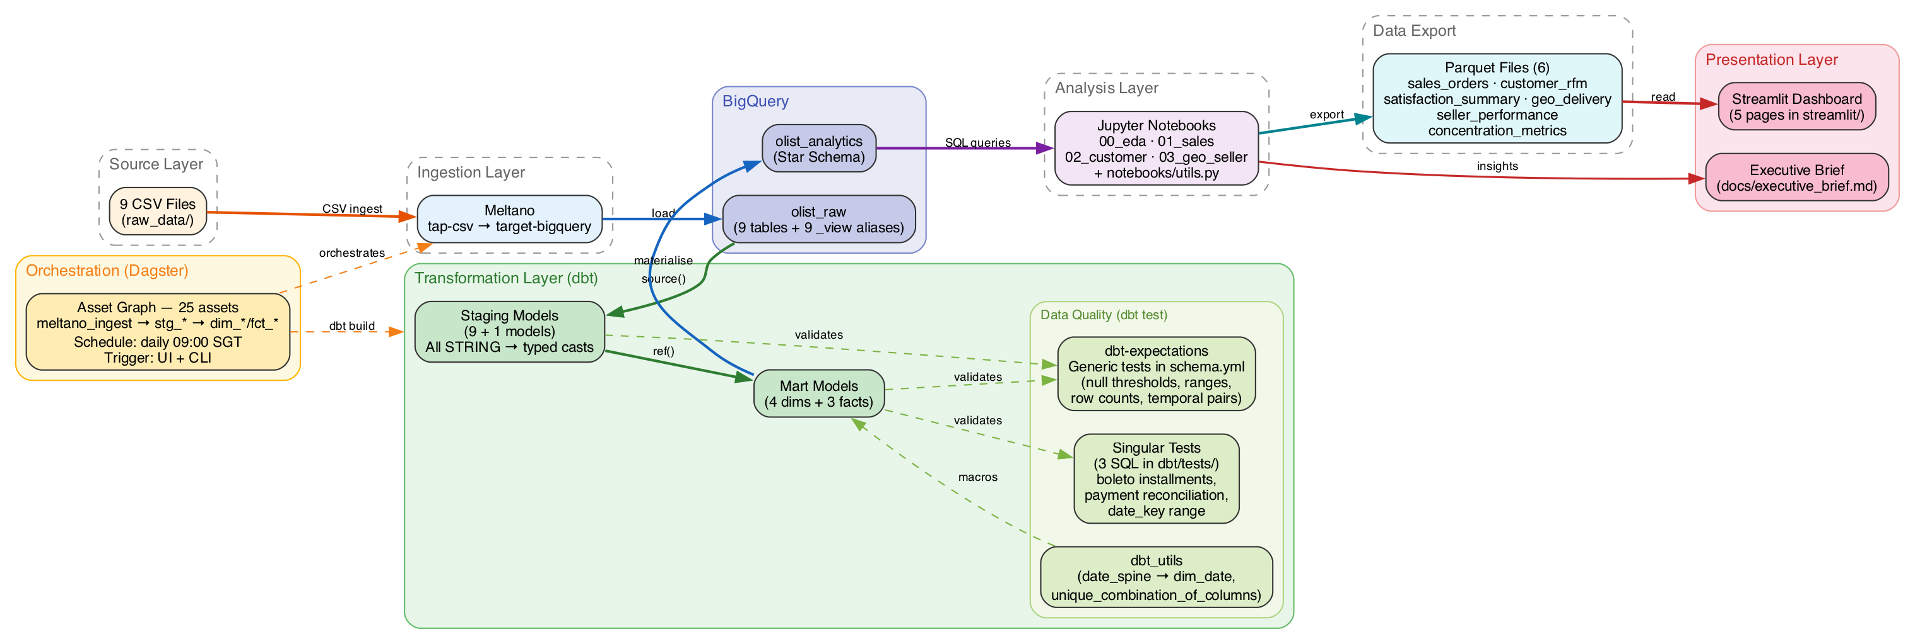
Pipeline Architecture
End-to-end flow across 6 layers — modular, each independently replaceable

Slide 4
Tool Selection Rationale
Each tool chosen for a specific architectural property — decoupling is the design principle
Layer | Selected | Key Rationale | Alternatives Rejected
Ingestion | Meltano (tap-csv) | Declarative YAML; Singer protocol separates extract from load; WRITE_TRUNCATE for full refresh | Custom Python scripts bq load CLI
Transformation | dbt 1.11 on BigQuery | SQL-first ELT with ref() lineage; staging views + mart tables; all type casting centralised in staging | pandas transforms BQ stored procedures
Data Quality | dbt-expectations + singular SQL | Integrated in DAG — failing test blocks downstream marts; 76 tests, 0 failures | Great Expectations Soda
Orchestration | Dagster 1.12 + dagster-dbt | Asset-centric model; 1 asset per dbt model auto-generated; daily 09:00 SGT schedule | Airflow Prefect cron
Analysis | Jupyter + google-cloud-bigquery | Self-contained notebooks; Parquet export decouples dashboard from BigQuery | Python scripts dbt metrics
Dashboard | Streamlit 1.55 | Python-native; reads Parquet (no GCP credentials); 4 global filters | Looker, Metabase Dash (Plotly)

Slide 5
Star Schema Design
Fact Tables
Dimension Tables
fct_sales — order-item grain (~112k rows)
Composite PK: order_id + order_item_id
4 FKs → dim_customers, dim_products, dim_sellers, dim_date
total_sale_amount = price + freight_value
3-source CTE: items → orders → customers
fct_reviews — review grain (~97k rows, post-dedup)
PK: review_id (789 source duplicates removed)
FK: order_id → stg_orders (NOT fct_sales)
⚠ 756 itemless orders have reviews but no sales rows
fct_payments — payment-method grain
Compound PK: order_id + payment_sequential
Nullable date_key via LEFT JOIN to stg_orders
dim_customers — PK: customer_unique_id
Deduped via ROW_NUMBER; geolocation lat/lng (nullable)
dim_products — PK: product_id
COALESCE(english → portuguese → 'uncategorized')
7 nullable numeric columns via SAFE_CAST
dim_sellers — PK: seller_id
Geolocation enrichment by zip code prefix
dim_date — PK: date_key (DATE type)
Generated: dbt_utils.date_spine (2016-01-01 to 2018-12-31)
No raw data source — see ADR-001
Why star schema? Single fact-to-dim joins for analytics • Dims evolve independently • Clear grain per fact table prevents 'universal fact table' anti-pattern • Staging layer (views) fixes all data defects once — every downstream consumer inherits clean data

Slide 6
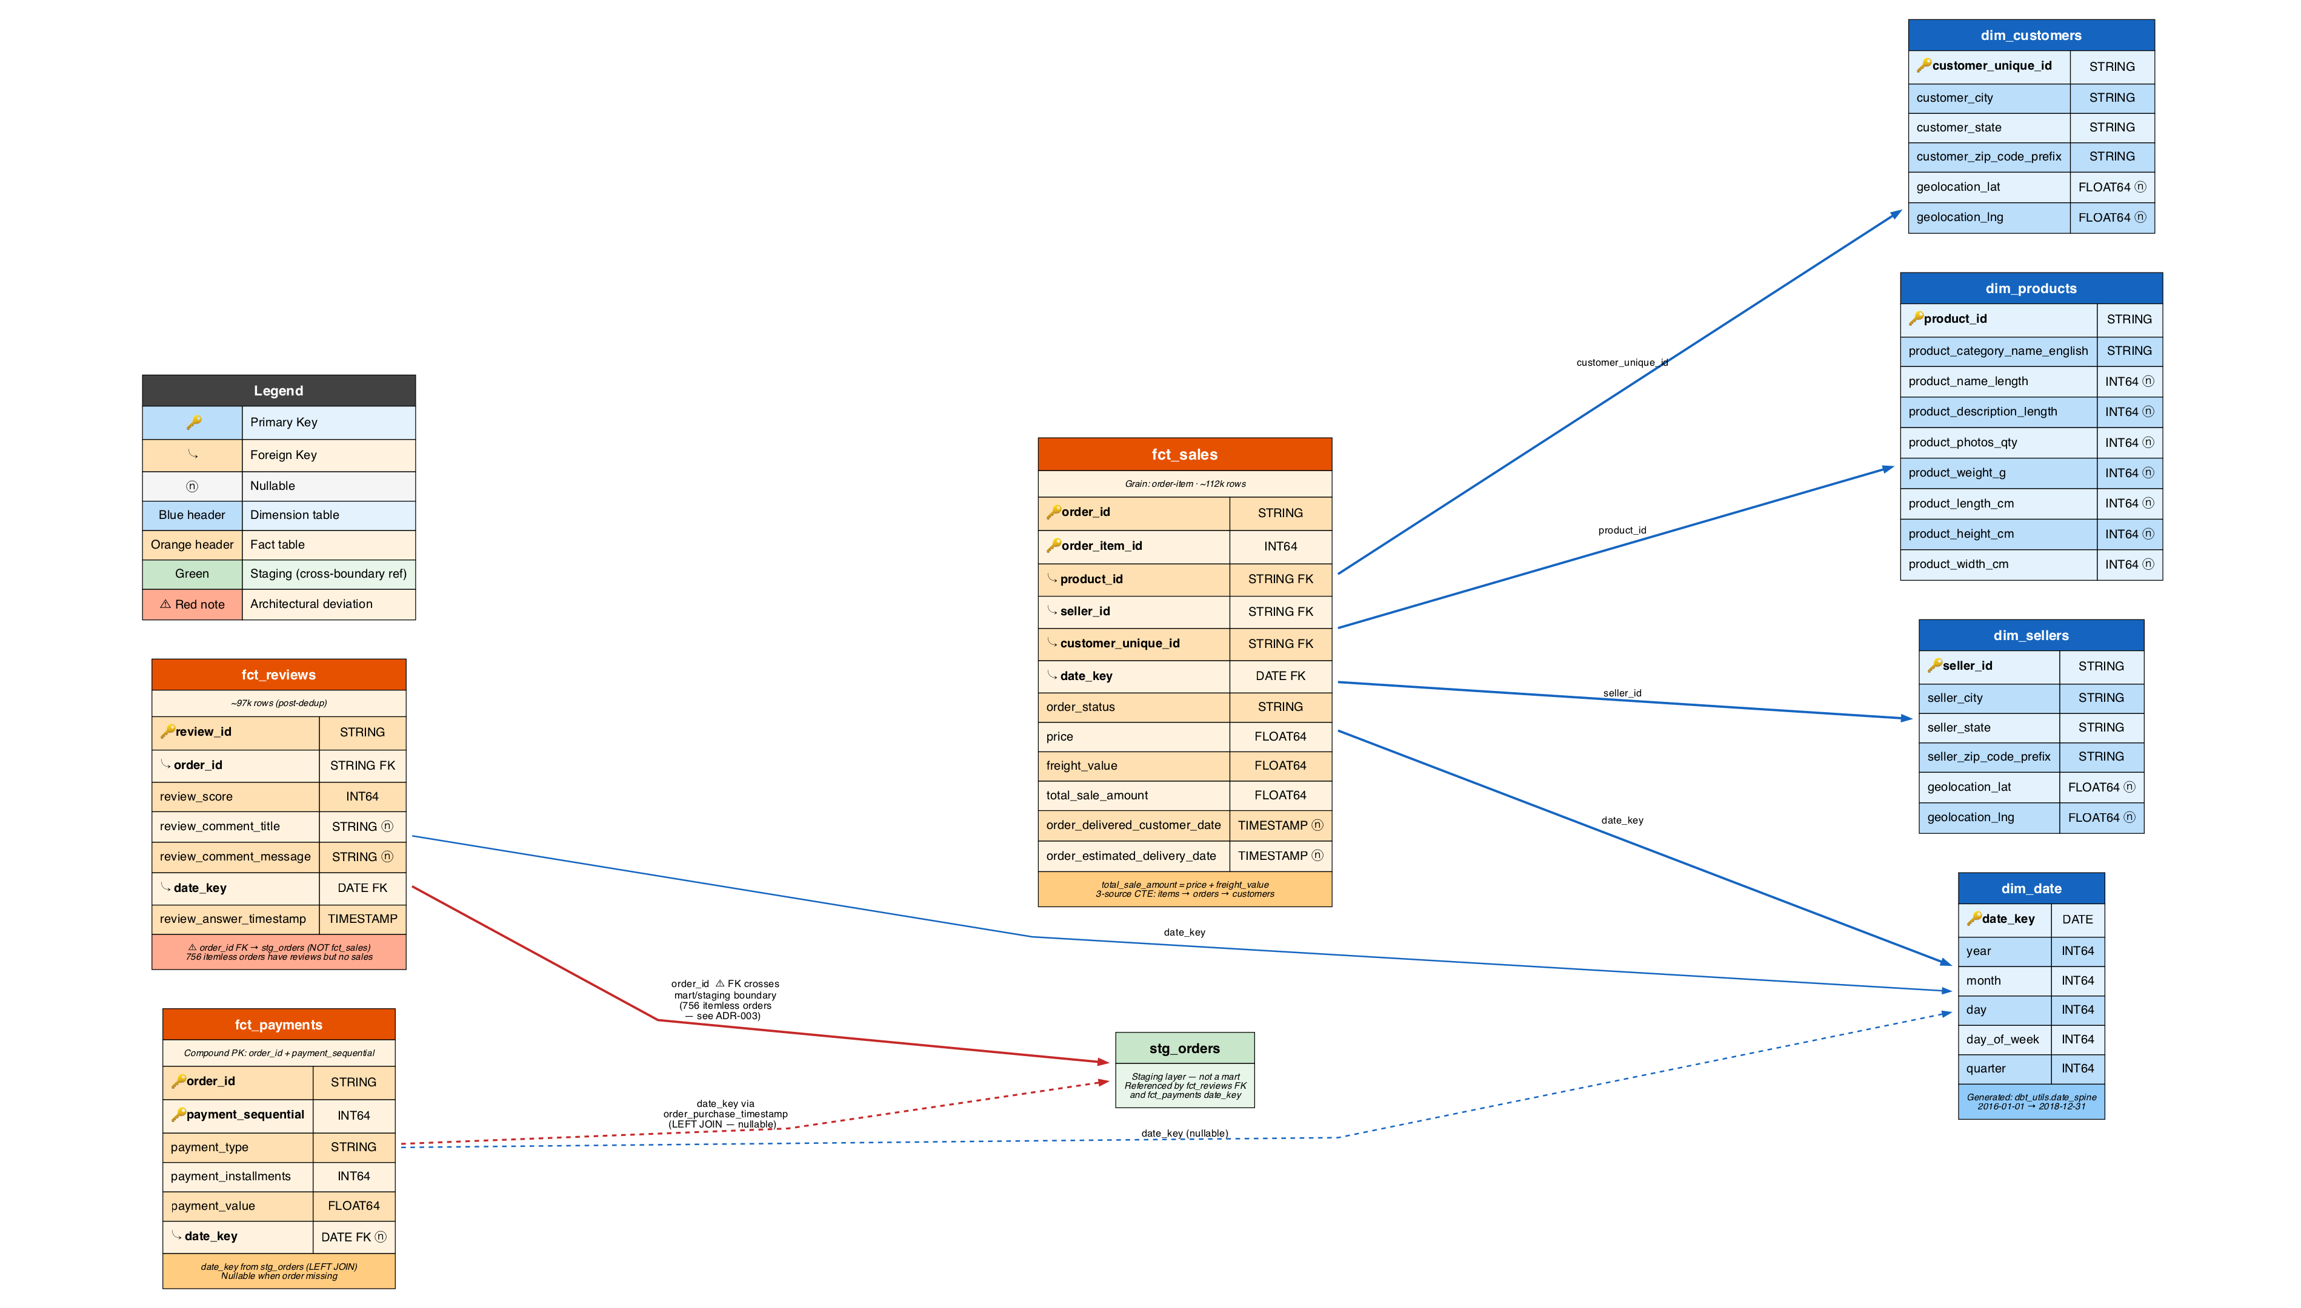
Star Schema Design
Star schema balances query performance with analytical flexibility. Each fact table has a clear grain (order-item, review, payment), and dimension tables provide reusable lookup attributes for filtering and grouping.

Slide 7
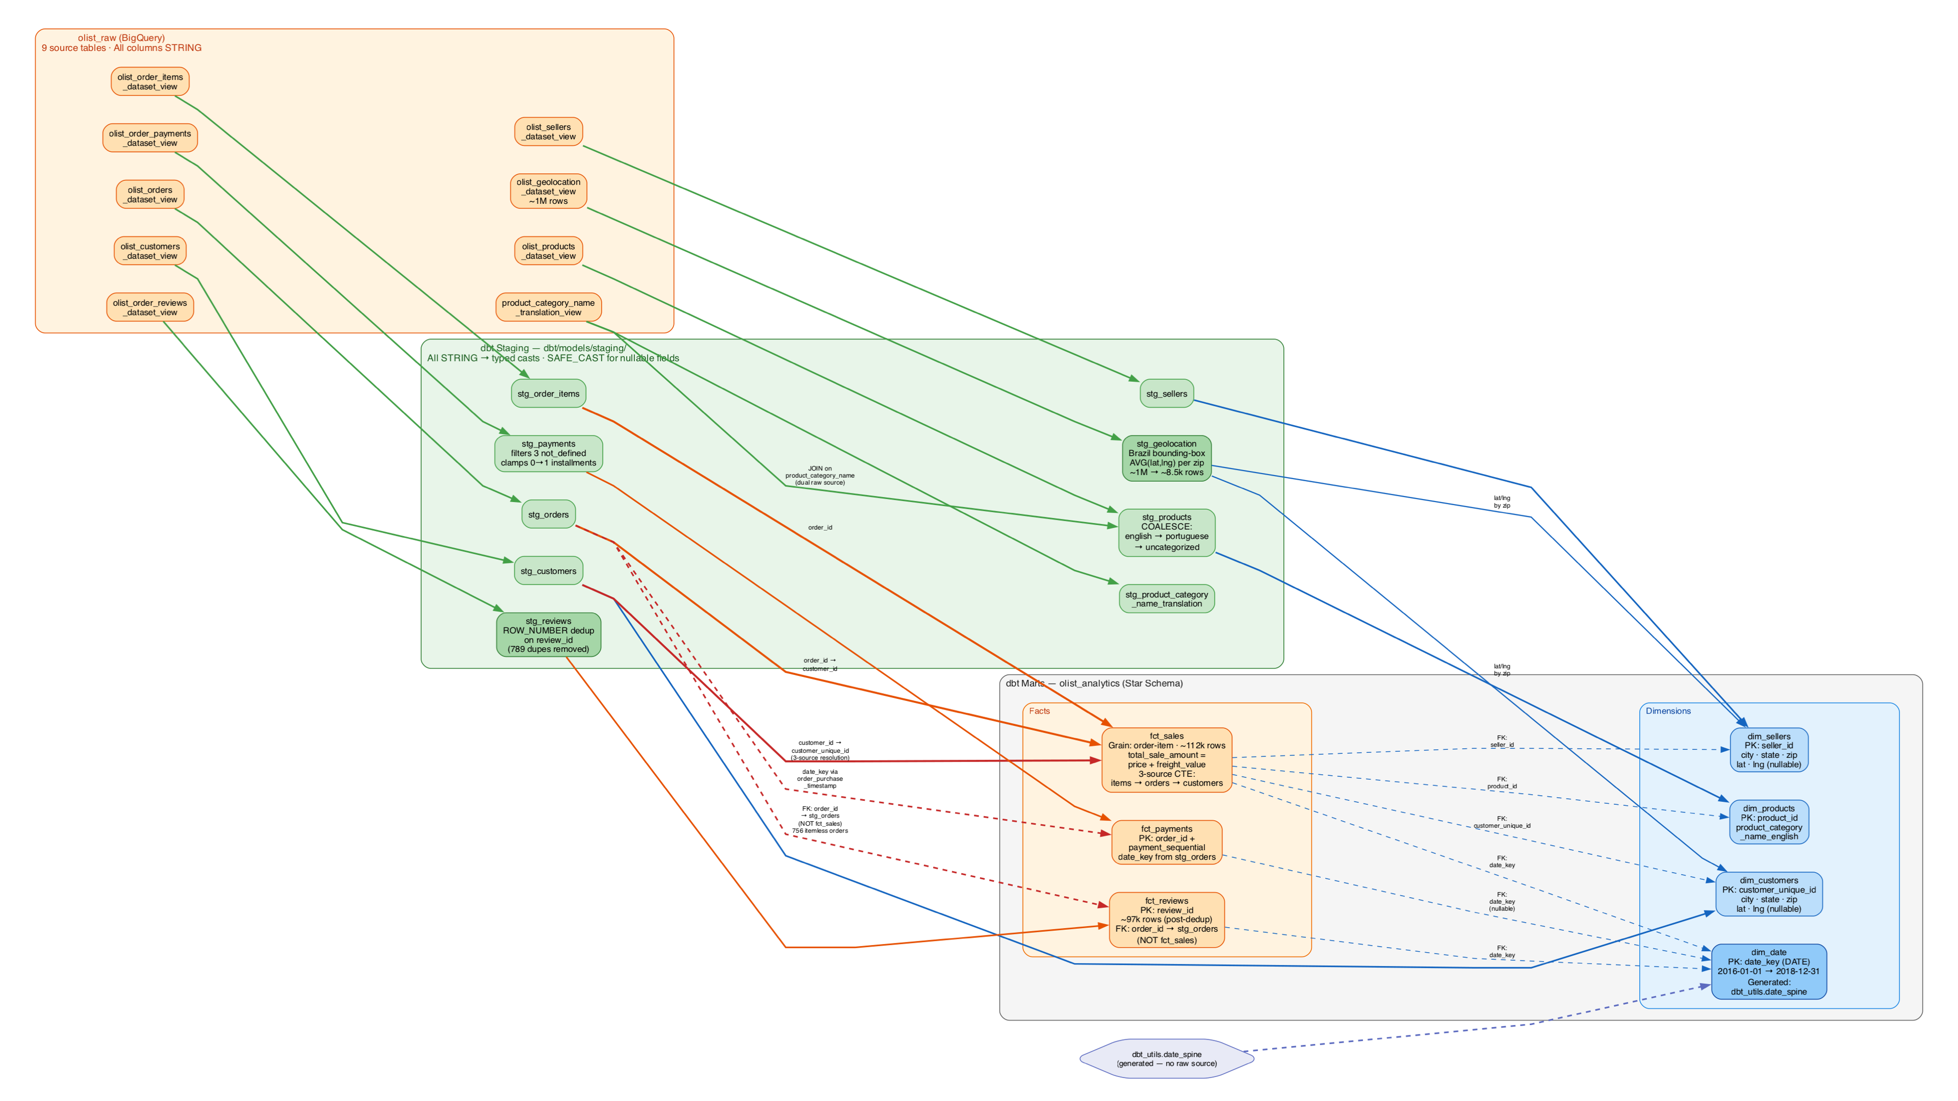
Data Lineage
In data engineering, this relationship is often described as a transformation hierarchy (similar to the Medallion Architecture of Bronze, Silver, and Gold). Each layer progressively refines the data from its messy original state into a polished, business-ready format.

Slide 8
Data Quality Framework
76 tests, 2 mechanisms, 0 failures — enforced at staging layer
Generic Tests (schema.yml)
Singular Tests (SQL files)
not_null, unique — PK/FK enforcement
accepted_values — order_status, payment_type
expect_column_values_to_be_between — numeric ranges
expect_table_row_count_to_be_between — fan-out guards
unique_combination_of_columns — compound PKs
Temporal pair tests — timestamp ordering
relationships — FK referential integrity
assert_boleto_single_installment.sql
Boleto payments must have exactly 1 instalment
assert_payment_reconciliation.sql
SUM(payment_value) ≈ SUM(total_sale_amount) per order
assert_date_key_range.sql
All fact table date_keys within 2016-01-01 to 2018-12-31
Staging Layer Data Defect Corrections
Model | Fix | Impact
stg_reviews | ROW_NUMBER dedup on review_id | 789 duplicates removed
stg_geolocation | Brazil bounding-box filter + AVG(lat,lng) per zip | ~1M → ~19k rows
stg_payments | Filter payment_type='not_defined'; clamp installments 0→1 | 3 + 2 rows fixed
stg_products | Rename 'lenght'→'length'; COALESCE category | 610 products labelled 'uncategorized'

Slide 9
Architecture Decisions & Lessons Learned
ADR | Decision | Key Rationale
ADR-001 | date_key as DATE (not INTEGER) | dbt_utils.date_spine natively produces DATE; INTEGER adds unnecessary casting everywhere
ADR-002 | Dataset names: olist_raw / olist_analytics | 'raw' is a BigQuery SQL reserved word; requires backtick-quoting
ADR-003 | fct_reviews.order_id → stg_orders (not fct_sales) | 756 itemless orders have reviews but no fct_sales rows; FK would orphan them
ADR-004 | Meltano extractor: tap-csv | Streaming file reads; community-maintained; simpler config than tap-spreadsheets-anywhere
Non-Obvious Implementation Patterns
3-source CTE for fct_sales
items → orders → customers (direct join = zero matches)
customer_id is in stg_orders; customer_unique_id in stg_customers
batch_job method for Meltano loader
gRPC idle timeout on 1M-row geolocation file
Write API streams go idle during sequential file processing
@multi_asset(specs=...) for Dagster producer
@asset(deps=...) made meltano_ingest downstream of raw tables
@multi_asset declares it as the PRODUCER — correct topology
metaplane/dbt-expectations constraint
Fork v0.10.8 has no 'mostly' parameter on any macro
4 proportion-based tests documented but unenforceable

Slide 10
AI Multi-Agent Architecture
Human Orchestrator + 5 Specialised AI Agents — contract-driven isolation
Agent | Role | Key Deliverables | Worktree
Agent 1a–1d | Data Engineer (4 phases) | Meltano config, 9 staging models, 7 mart models, 76 dbt tests | worktrees/agent-1
Agent 2 | Platform Engineer | Dagster orchestration, schedule, launch scripts, .env integration | worktrees/agent-2
Agent 3 | Analytics Engineer | 4 Jupyter notebooks, 6 Parquet exports, utils.py, analytical methodology | worktrees/agent-3
Agent 4 | Dashboard Engineer | Streamlit 5-page dashboard, 4 global filters, Lorenz/Gini charts | worktrees/agent-4
Agent 5 | Data Scientist | Executive brief, slide deck, speaker notes, generate_slides.py | worktrees/agent-5
Orchestrator | Human + Claude (Opus) | Gate management, merge conflicts, diagrams, technical report, progress | main branch
Architecture Principles
Isolation: Each agent in a separate git worktree
Dependency gates: GATE-1→4 enforce execution order
Contract surfaces: CLAUDE.md (spec), sources.yml
(Meltano↔dbt), Parquet schemas (notebooks↔dashboard)
42 changelog entries tracking all deviations
Agents communicate through shared specifications,
not directly — the orchestrator manages gates
and resolves merge conflicts across worktrees

