Slide 1
Brazilian E-Commerce Insights
Project Caravela — Data Pipeline Findings
Analysis Period: January 2017 – August 2018 | ~100,000 Orders | R$15.8M GMV

Slide 2
Executive Summary
R$15.8M
98,353
63.6
91.9%
Total GMV
Total Orders
NPS Score
On-Time Rate
R$160.51
3.1%
0.46%
~103%
Avg Order Value
Repeat Purchase Rate
Cancellation Rate
H1→H2 2017 Growth
• GMV doubled from H1 to H2 2017, driven by volume (not higher order values)
• 96.9% of customers make only one purchase — retention is the critical challenge
• Northeast delivery lags at 85.7% on-time (vs 92.9% South) — impacting satisfaction
• Southeast dominates with 64.6% of GMV; São Paulo alone = 37.4%

Slide 3
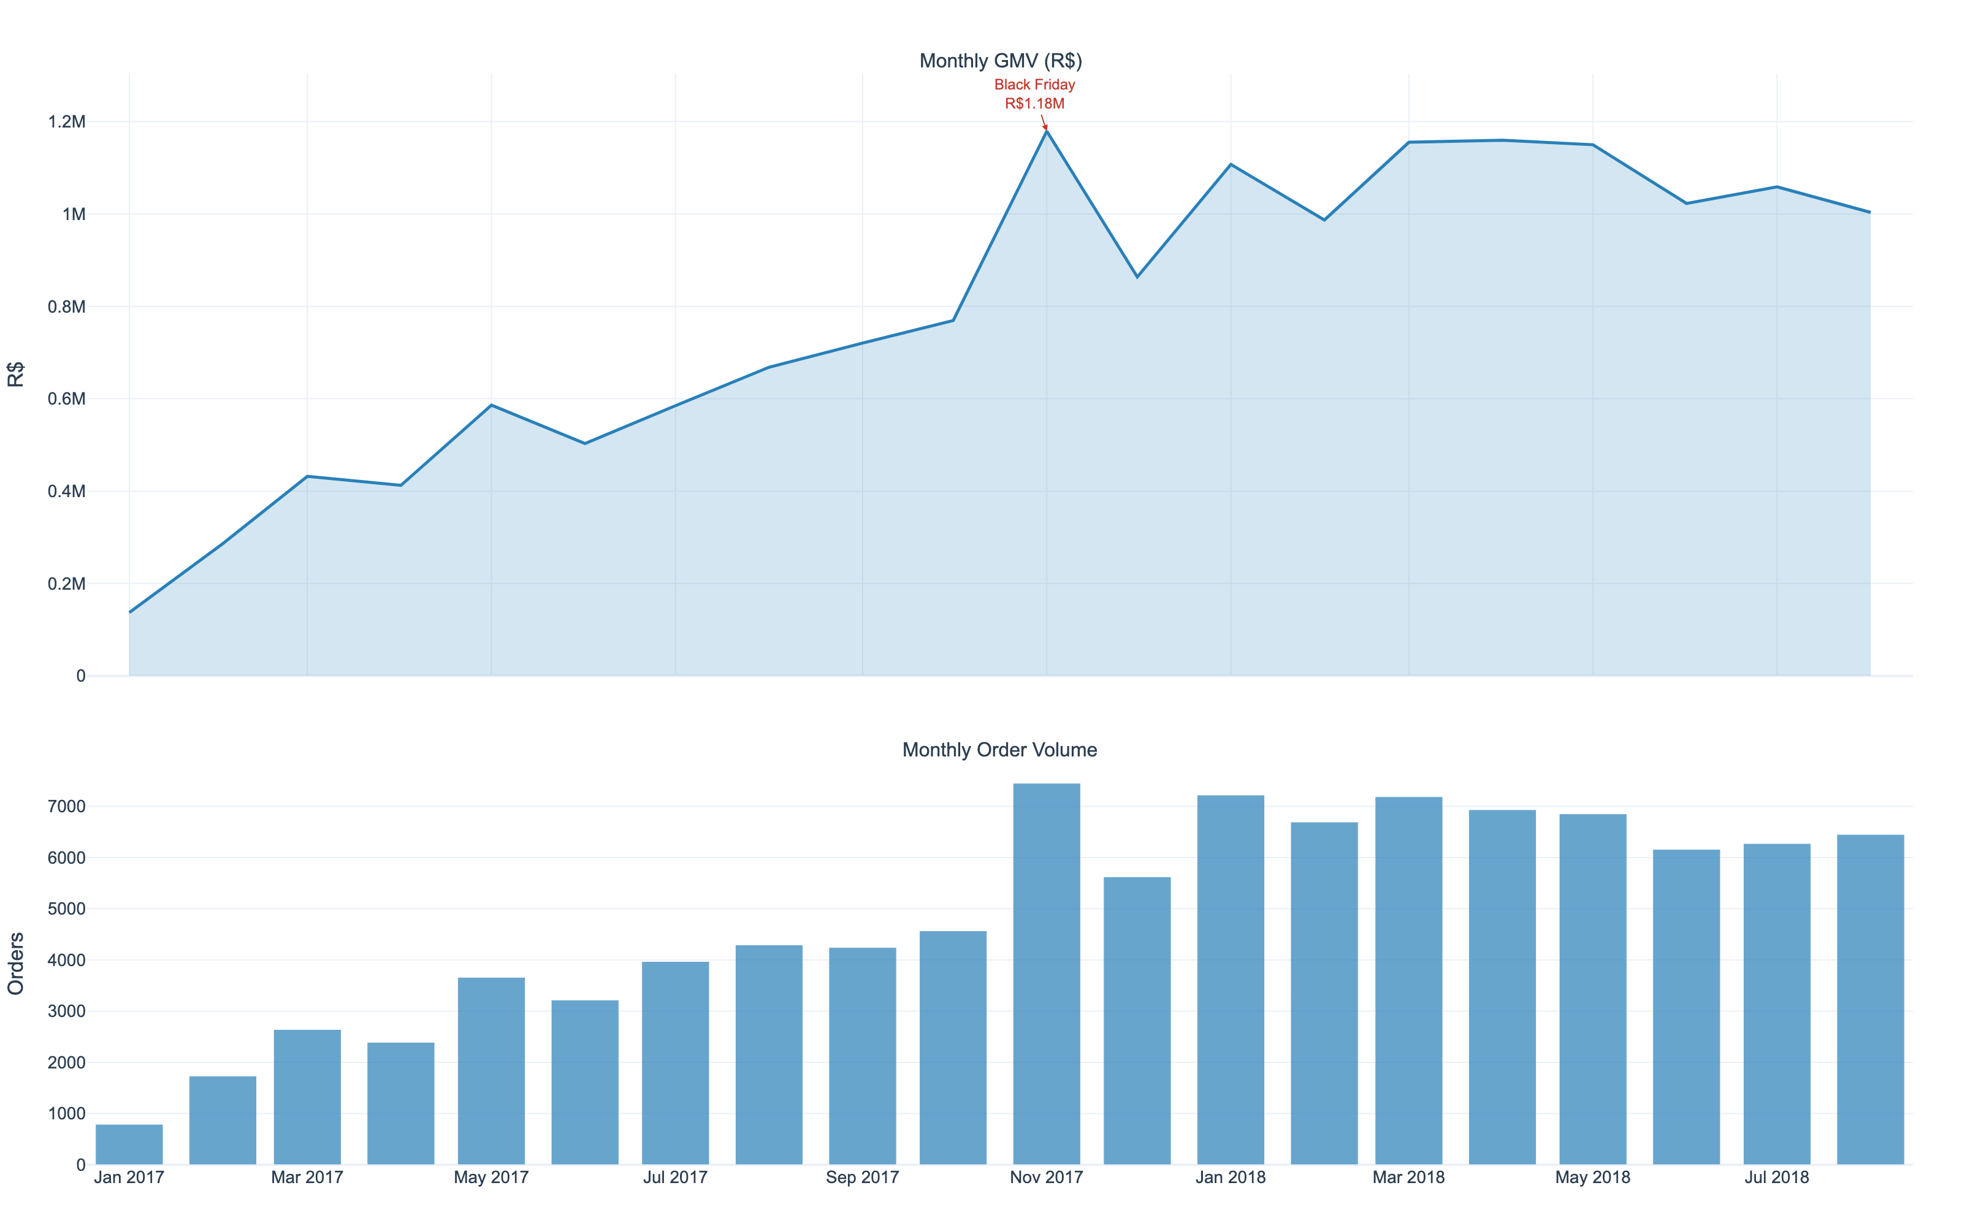
Market Overview: Monthly GMV & Volume
Jan 2017 – Aug 2018 | Peak: Nov 2017 (Black Friday)
H1→H2 2017: ~103% GMV growth
H2 2017→H1 2018: ~38% (decelerating)
Nov 2017 peak: 7,451 orders, R$1.18M
Black Friday was volume-driven — AOV dropped 6%
Sep/Oct 2018 excluded (data artefacts)

Slide 4
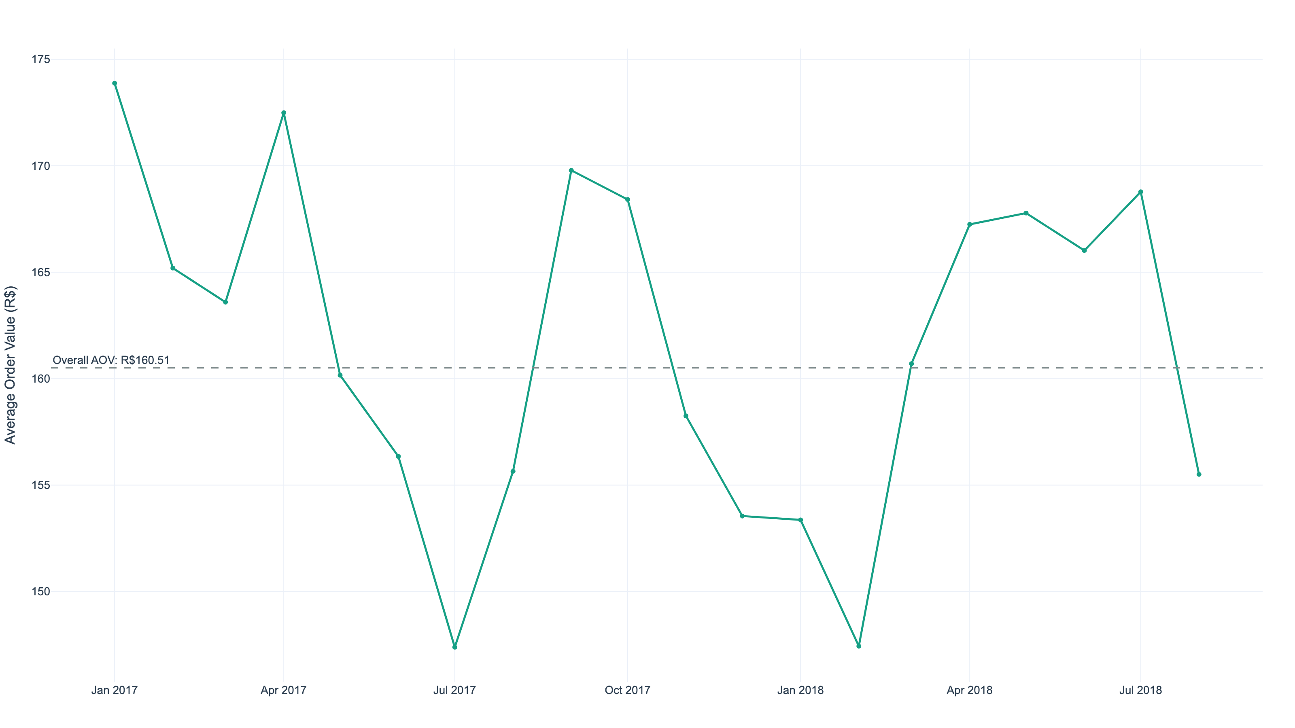
Average Order Value Trend
Stable at R$160.51 — growth is volume-driven, not ticket-size-driven
Overall AOV: R$160.51
Remarkably flat across 20 months
Credit card AOV: R$152
Boleto AOV: R$127 (−20%)
Instalment access enables larger baskets

Slide 5
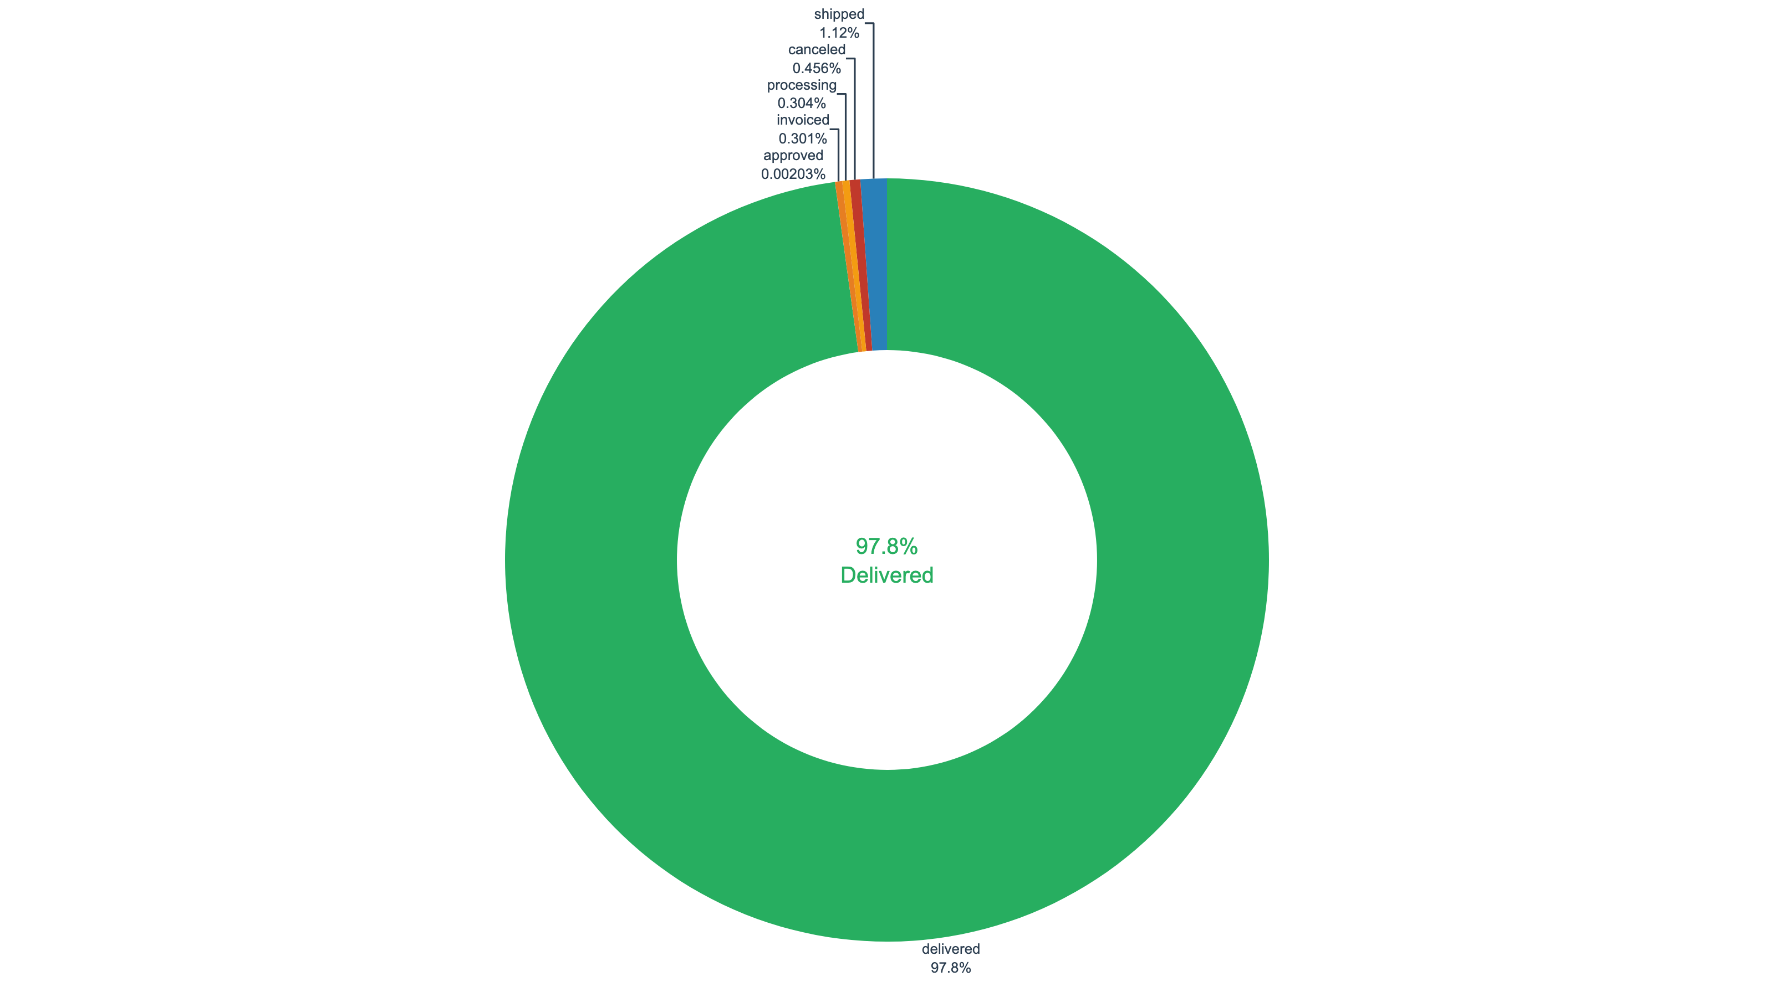
Order Fulfilment & Cancellation
97.8% delivered | 0.46% cancellation rate
97.8% of orders delivered successfully
Cancellation rate: just 0.46% (448 orders)
Strong inventory management
Remaining 1.7%: in-transit pipeline statuses

Slide 6
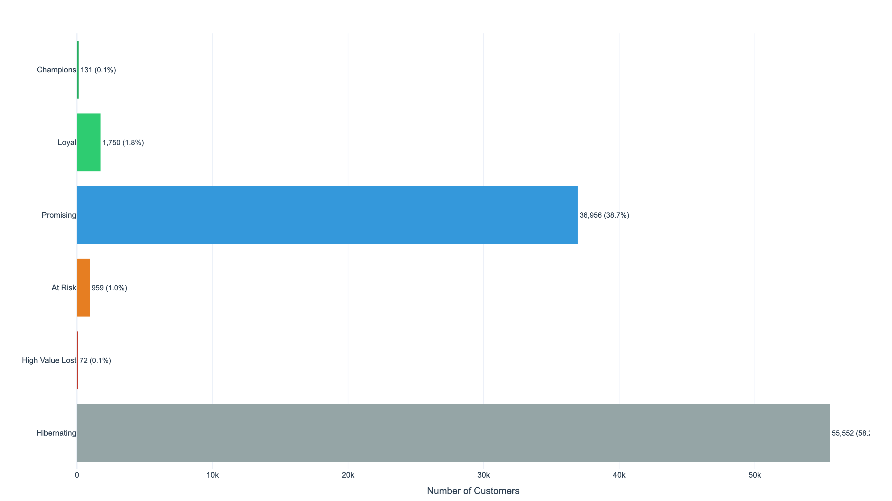
Customer Segmentation (RFM Analysis)
95,420 unique customers | Reference date: 31 Aug 2018
58.2% Hibernating (55,552)
38.7% Promising (36,956)
Only 3.1% repeat purchase rate
131 Champions (0.1%) — crown jewels
Marketplace model = low platform loyalty
Promising segment = top retention target

Slide 7
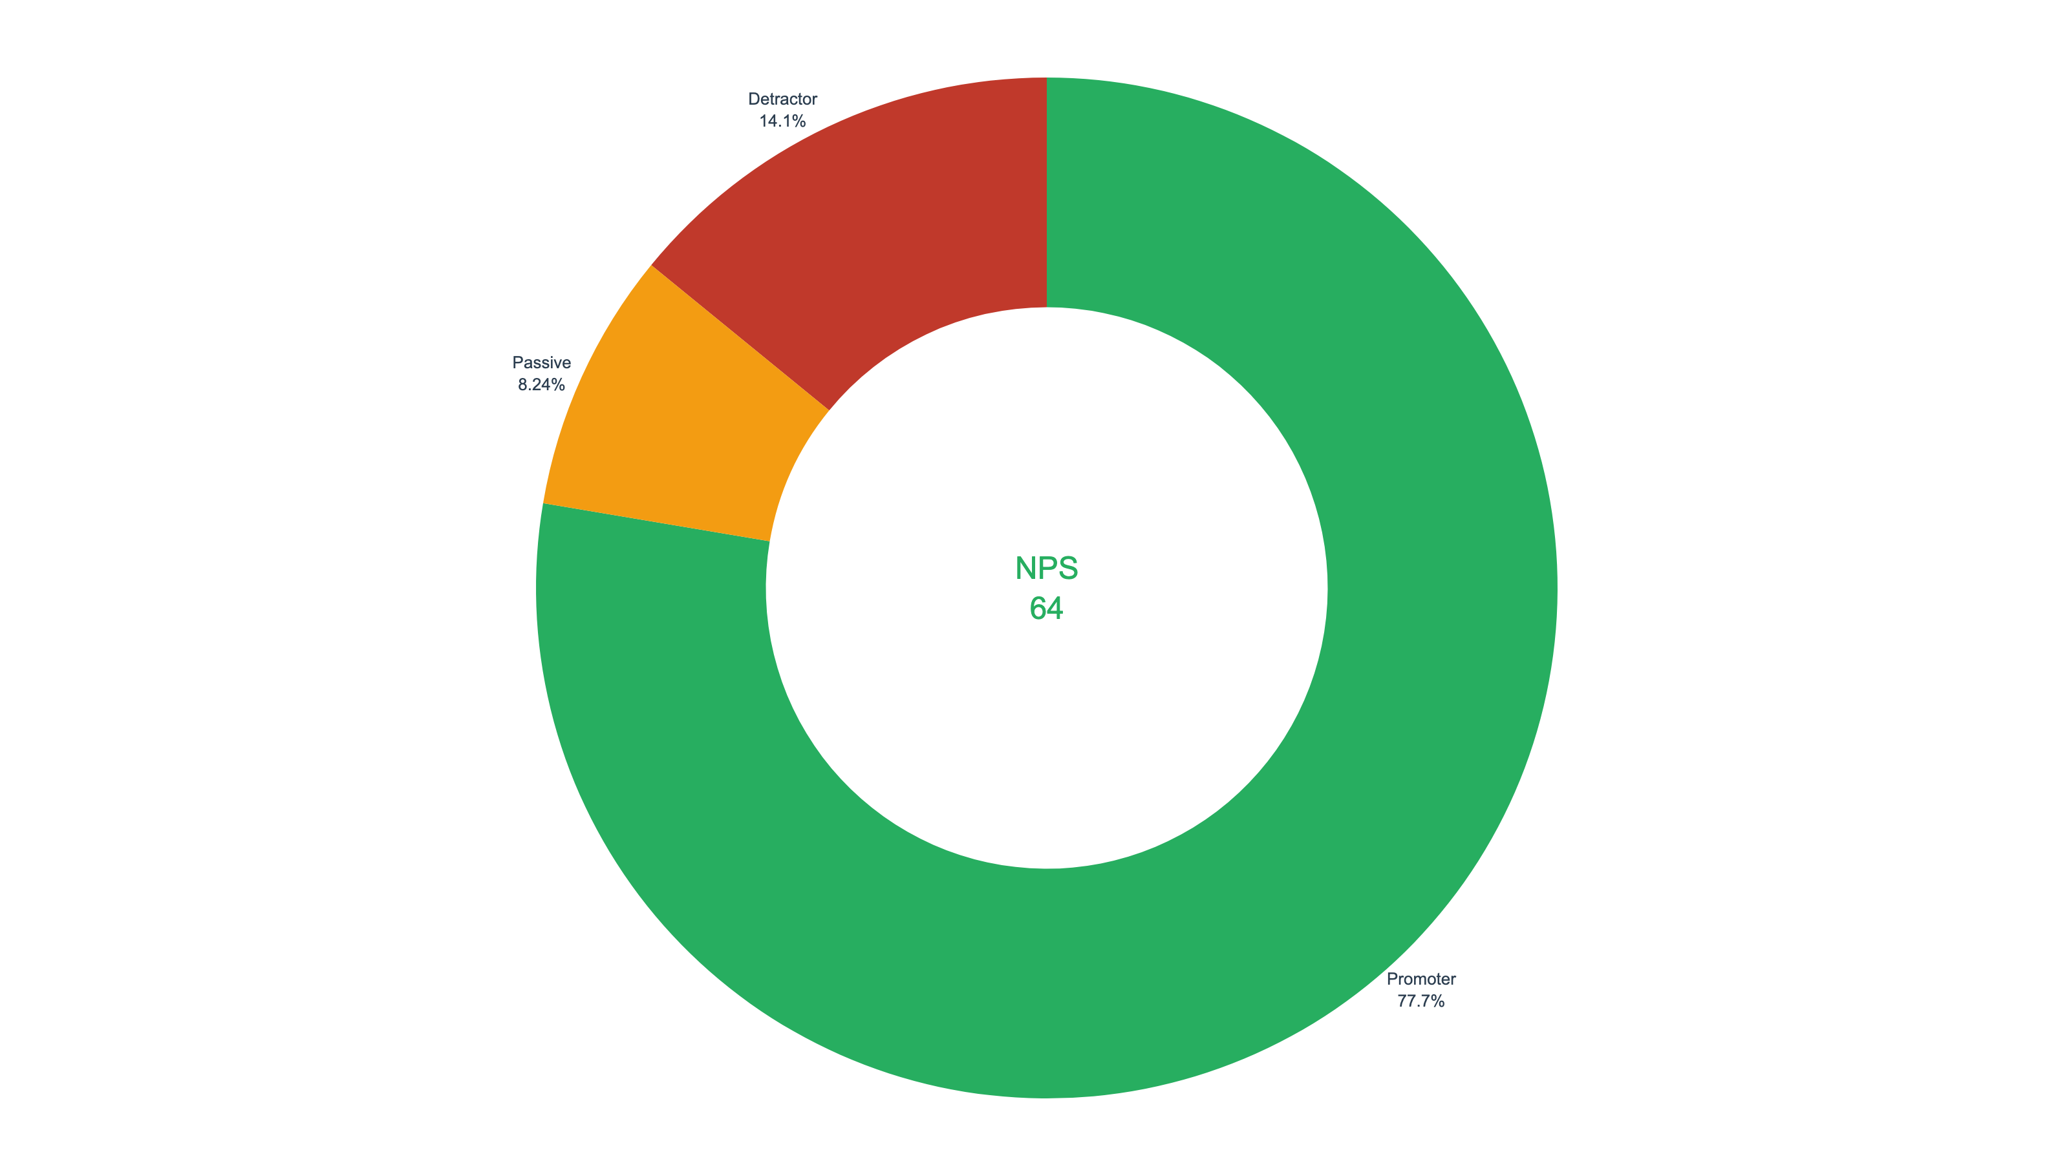
Customer Satisfaction — NPS Proxy
Net Promoter Score: 63.6 (Strong)
Promoters (score 4–5): 77.7%
Detractors (score 1–2): 14.1%
NPS = 77.7% − 14.1% = 63.6
Strong overall, but delivery delays
are the #1 driver of detractors

Slide 8
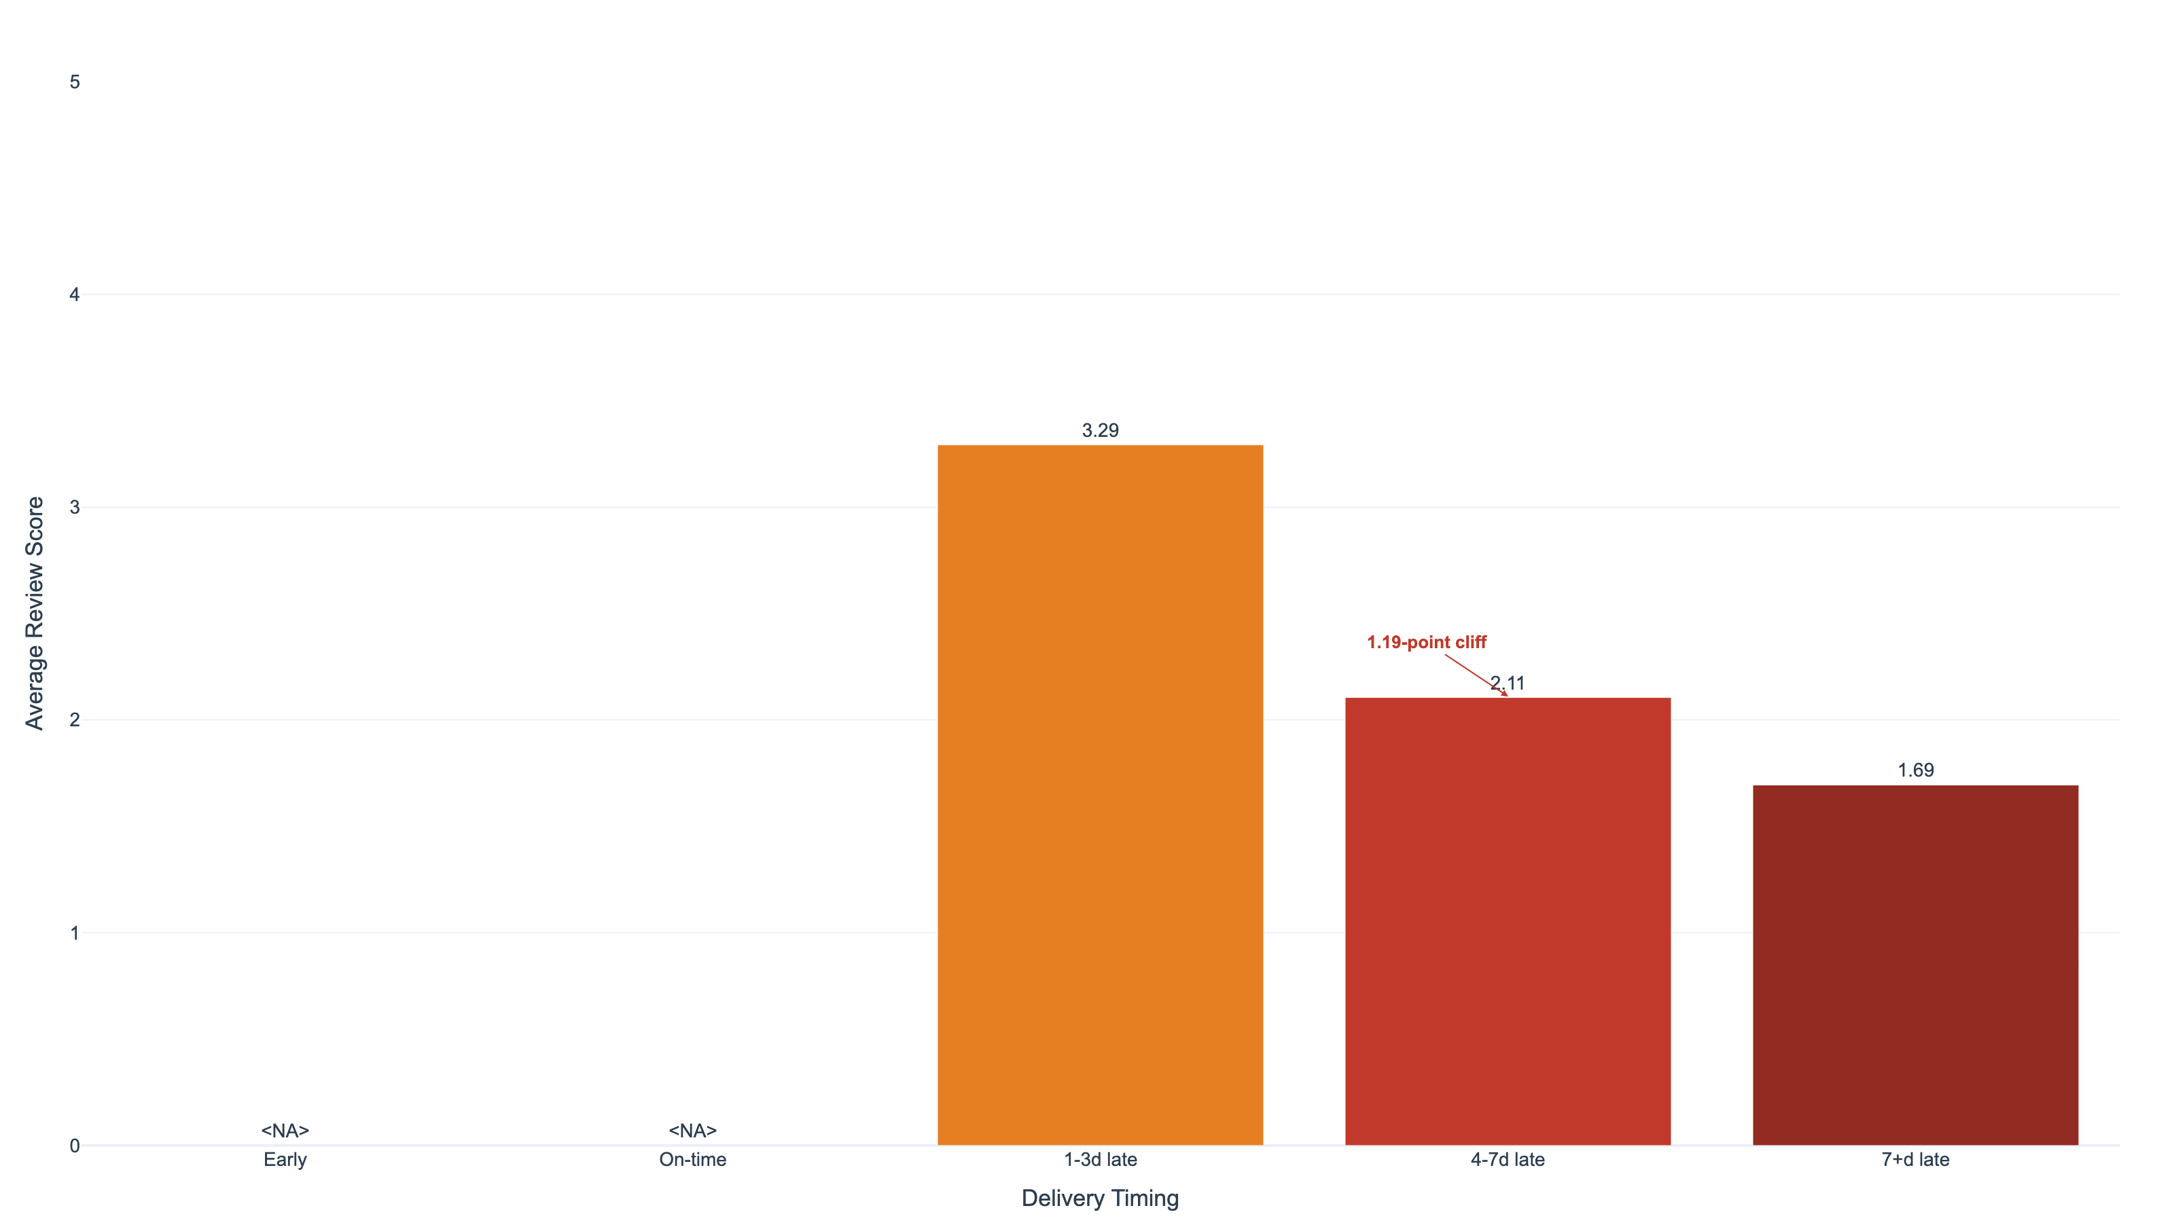
Key Insight: Delivery Delays Destroy Satisfaction
2.61-point score drop from early delivery to 7+ days late
Early delivery: score 4.30
On-time: 3.89
1–3 days late: 3.29
4–7 days late: 2.11 (−1.19 cliff!)
7+ days late: 1.69
The 4-day mark is where
customer patience breaks.
6,359 orders (6.6%) were late.

Slide 9
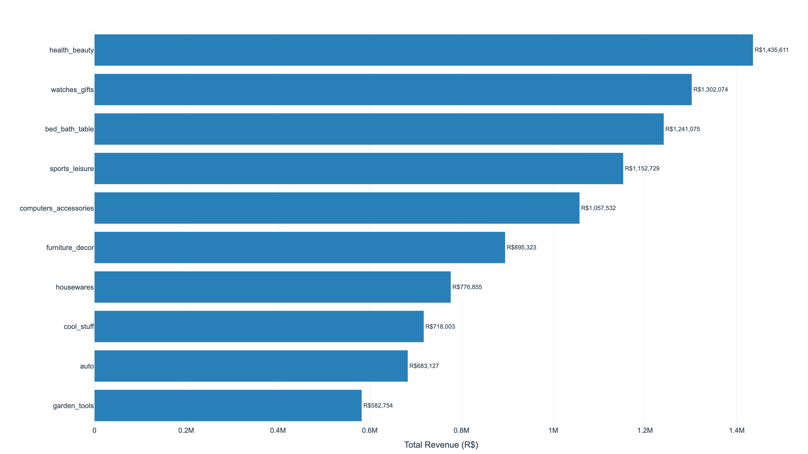
Product & Revenue: Top Categories
Top 15 categories = 76.4% of GMV | 74 categories total
#1 Health & Beauty: 9.1%
#2 Watches & Gifts: 8.2%
#3 Bed, Bath & Table: 7.9%
Category Gini: 0.71 (long tail)
HHI: 484 (competitive, no dominance)
Freight = 14.2% of GMV (R$2.24M)

Slide 10
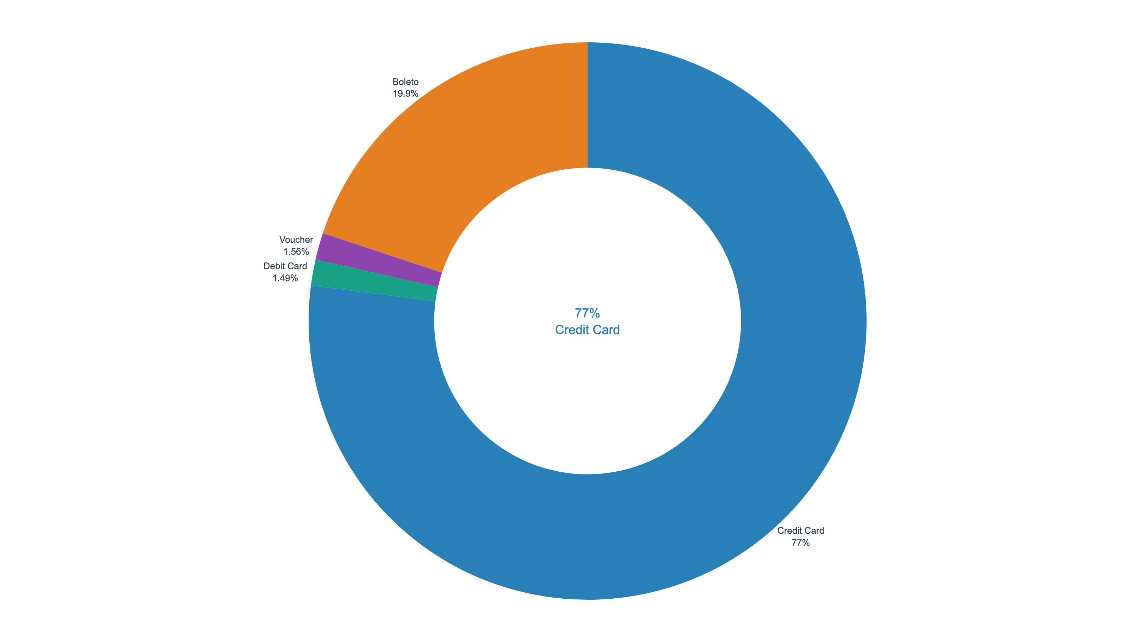
Payment Method Distribution
Credit card dominance with instalment culture
Credit Card: 77.0% of orders
Boleto: 19.9%
Debit: 1.5% | Voucher: 1.6%
Median instalments: 3
7.3% choose 10+ instalments
CC AOV 20% higher than boleto

Slide 11
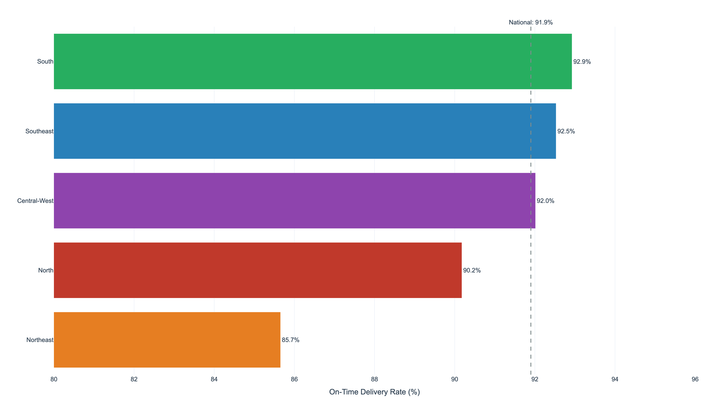
Delivery Performance by Region
National on-time rate: 91.9% | Northeast lags at 85.7%
South: 92.9% (best)
Southeast: 92.5%
Central-West: 92.0%
North: 90.2%
Northeast: 85.7% (worst)
NE transit: 20.6 days avg
vs SE: 12.9 days avg
7.2pp gap → satisfaction gap

Slide 12
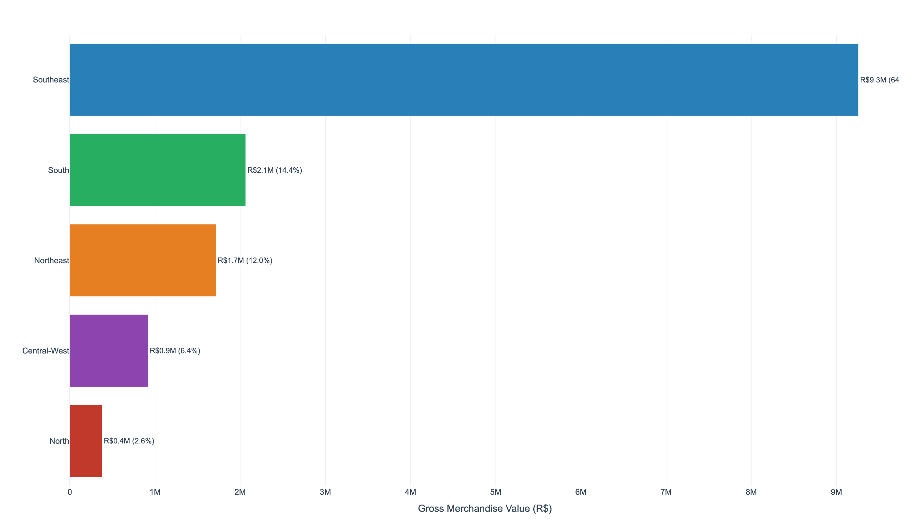
Geographic Revenue Distribution
Southeast = 64.6% of GMV | São Paulo alone = 37.4%
Southeast: R$10.2M (64.6%)
South: R$2.3M (14.5%)
Northeast: R$1.9M (11.9%)
Central-West: R$1.0M (6.5%)
North: R$0.4M (2.6%)
North + Central-West = 9.1%
but >20% of Brazil’s population

Slide 13
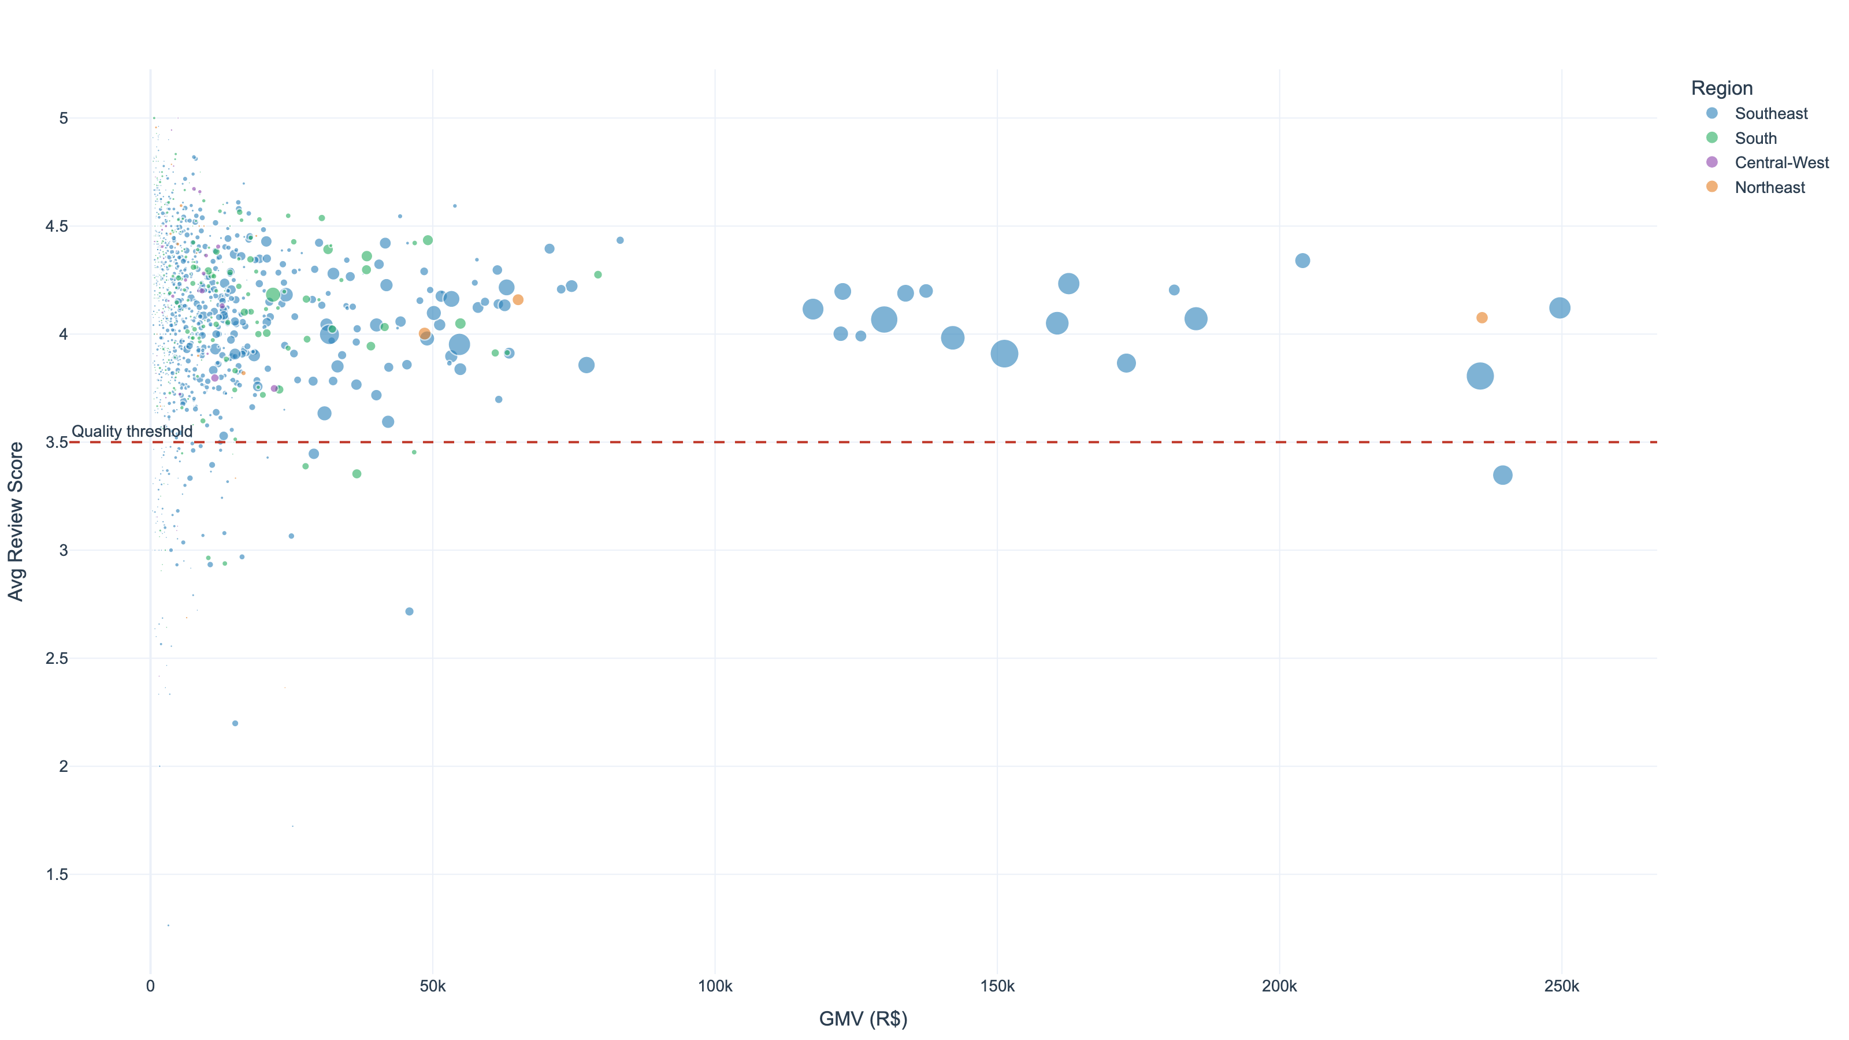
Seller Performance Landscape
3,068 sellers | Top 18.3% generate 80% of GMV
Seller Gini: 0.78 (high inequality)
CR4: 6.1% (no monopoly)
HHI: 35 (competitive market)
767 Premium sellers (score ≥4.3)
37 At Risk sellers (score <3.0)
Avg platform score: 3.98/5

Slide 14
Key Risks & Mitigations
Technical Risk: Historical Data Limitations
• Dataset covers 2016–2018 — consumer behaviour has evolved since then
• Mitigation: Pipeline is repeatable; refresh with current data and monitor metric drift quarterly
Business Risk: Single-Purchase Customer Dominance
• 96.9% of customers buy only once — CAC amortised over a single transaction
• As high-penetration regions saturate, acquisition costs increase unsustainably
• Mitigation: Target 36,956 Promising customers with post-purchase engagement programmes
Business Risk: Regional Delivery Disparity
• Northeast on-time rate 85.7% vs South 92.9% — a 7.2pp gap
• Late deliveries score 1.69 vs 4.30 for early — compounding NE growth barriers
• Mitigation: Regional carrier partnerships + distribution centres in NE and North

Slide 15
Strategic Recommendations
1. Customer Retention Programme
• Target 36,956 Promising segment customers within 30 days of first purchase
• Evidence: Repeat rate declining from 5.3% (2017) to 2.6% (2018 cohorts)
2. North & Northeast Delivery Infrastructure
• Partner with regional carriers; establish fulfilment hubs in Recife and Manaus
• Evidence: NE on-time rate 85.7% vs South 92.9%; North transit 23.6 days avg
3. Optimise Delivery Promise Accuracy
• A/B test tighter estimates in SE (actual 12.9d vs promised 24.5d = 11.6d buffer)
• Hypothesis: Tighter promises increase checkout conversion without hurting on-time rate
4. Seller Quality Intervention
• 37 At Risk sellers (avg score 2.74, 5.4% cancel rate) — 90-day improvement window
5. Instalment-Driven AOV Uplift
• CC AOV R$152 vs boleto R$127; promote instalments to boleto-inclined buyers

Slide 16
Thank You
Project Caravela | Questions & Discussion
Interactive dashboard available at: streamlit run dashboard.py

