Slide 1
Bachelor Thesis – Final Presentation Multipath Transmission for CCN in Vehicular ad-hoc Networks
Thomas Kolonko
Prof. Dr. Torsten Braun
Communication and Distributed Systems
University of Bern

Slide 2
Table of Contents
Introduction to Named Data Networking (NDN)
Simulation framework: ns-3 and ndnSIM
Current implementation in ndnSIM v2.0
Goals and implementation
Conclusion and Future works
Questions

Slide 3
Introduction to Named Data Networking (NDN)
Current network is dominated by content distribution
It is based on host-to-host communication
Problems:
Huge amount of data that need to be re-distributed
Mobility and the Internet of Things (IoT)
Security Considerations
“HTTPS by default” still not used by 79% of top websites (Google Transparency Report)
Notes:
The current network has become dominated by content distribution, which has not been the case 10 or 20 years ago. The current Internet protocols are still based on a host-to-host communication, where a connection has to be set up and kept alive for the time of the transmission. Today the ”where” has become less important then the “what”. We know what we want but not necessarily where to get it from. Examples are weather information, media like movies or songs, software or search requests through search engines. The amount of transferred data has risen exponentially in the last few years and it does not seem to slow down. Distributing all this data by endpoint-to-endpoint connections is wasteful on the bandwith to say the least. With mobility and intermittent connectivty these connections get more expensive to be supported at all times. MobileIP has been introduced to tackle this problem but it comes with an overhead. Most security on the internet is still based on the destination server being able to authenticate itself. With HTTP all the data is transferred in plain text, HTTPS by default is still not used on 79% of the webpages

Slide 4
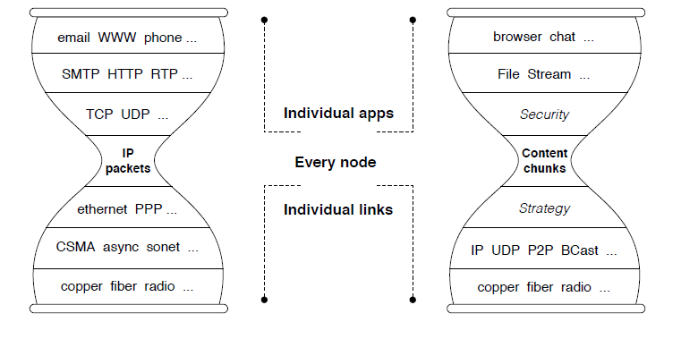
Components of NDN

Slide 5
Components of NDN
Content
Consumer
Producer
Interest
Data
Node
Interface
Router
FIB
CS
PIT

Slide 6
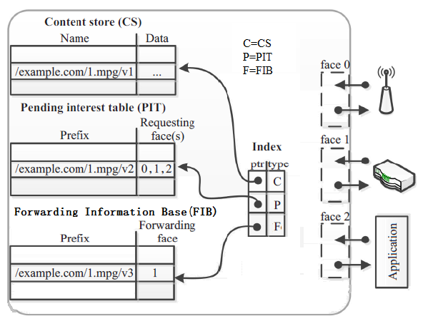
The main tables of NDN

Slide 7
The main tables of NDN

Slide 8
Simulation framework: ns-3 and ndnSIM
ns-3 is a network simulator
1) Topology definition
2) Model development
3) Node and link configuration
4) Execution
5) Performance analysis
6) Graphical Visualization
ndnSIM is an implementation of the basic components of a NDN network.

Slide 9
Current implementation in ndnSIM v2.0
Used base strategy: multicast strategy
Every interest is being broadcast to all upstream faces
Data is broadcast to all downstream faces „following“ the breadcrumbs left by the interests
Problems:
Broadcasting slows down the network and creates unneccessary traffic which leads to congestions
Multihop currently (v2.0) not possible with wireless communication

Slide 10
Goals and implementation
Change the datastructures in order to support origin and target node identification

Slide 11

Questions?

Slide 12
References
www.named-data.net (September 2016)
www.nsnam.org/ (September 2016)
www.ndnsim.net (September 2016)
https://www.google.com/transparencyreport/https/grid/ (September 2016)
Van Jacobson, Diana K. Smetters, James D. Thornton, Michael F. Plass, Nicholas H. Briggs, Rebecca L. Braynard, „Networking Named Content“ (Palo Alto Research Center, Palo Alto, CA, USA)
Dnyanada P. Arjunwadkar, „Introduction of NDN with Comparison to Current Internet Architecture based on TCP/IP“, University of Pune Maharashtra, India

Slide 13
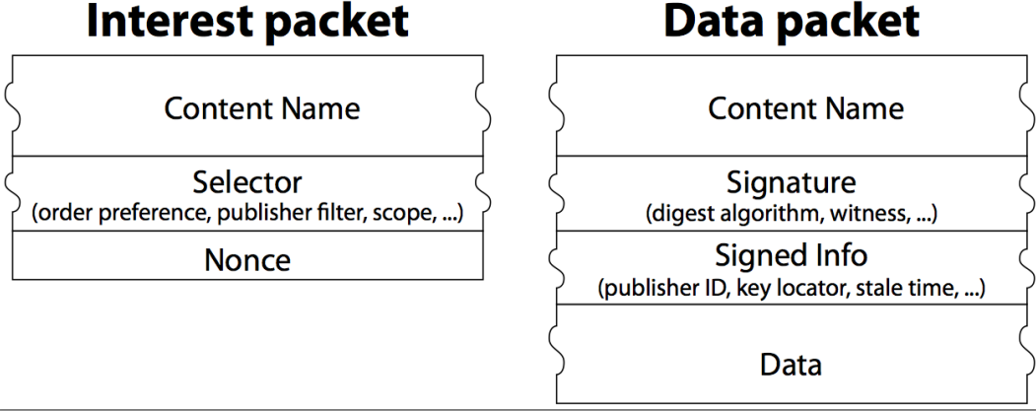
Extra Slides

Slide 14
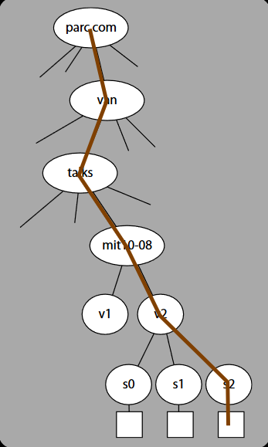
Extra Slides

Slide 15
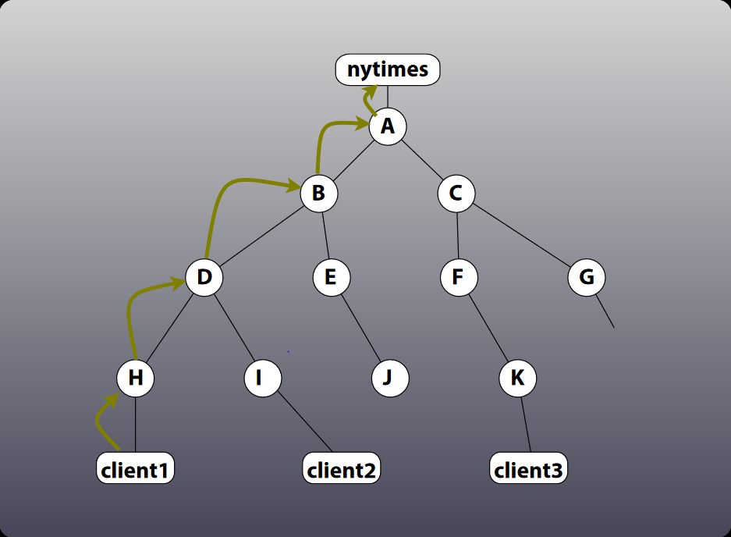
Extra Slides

Slide 16
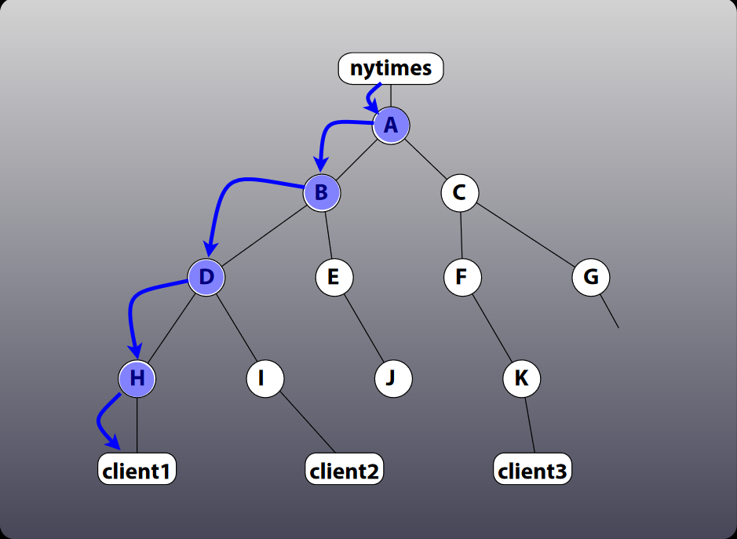
Extra Slides

Slide 17
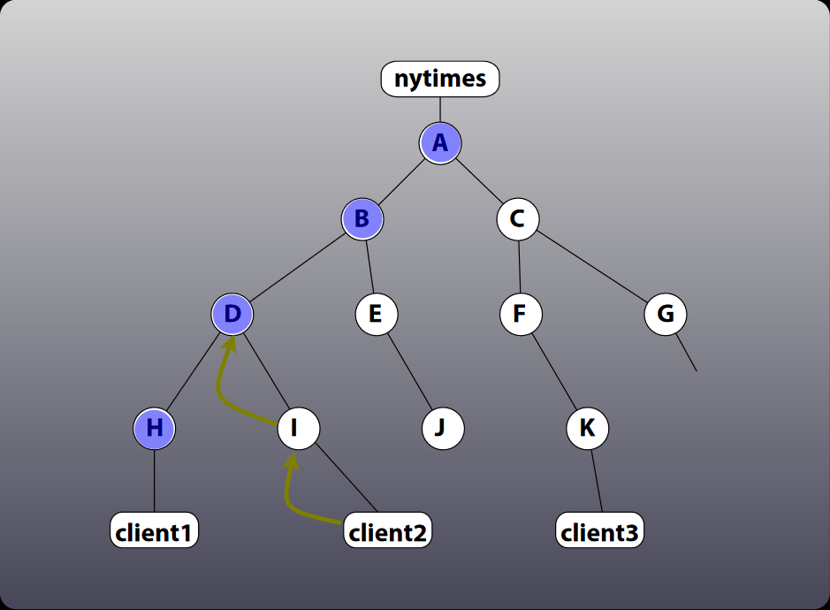
Extra Slides

Slide 18
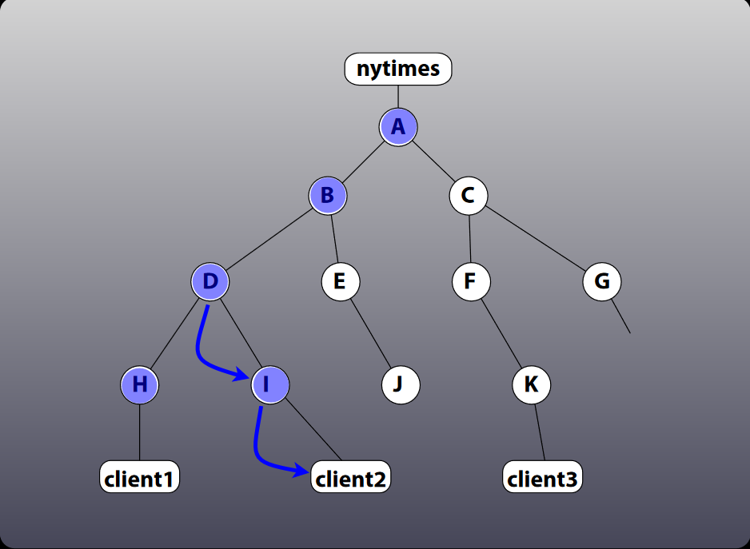
Extra Slides

