Slide 1


DIce poker
TOMASZ LESZCZYŃSKI & ARKADIUSZ KOWALCZYK

Slide 2
STARTING FROM SCRATCH
Discussing the project
Setting up a plan (main functions)
Implementing features
Testing
Fixing minor or major problems with the code
Presenting final product
Testing

Slide 3
THe mechanism of the game
Our game consists of 2 key elements: hand and points (score table)
After rolling the dices and showing us our hand, the program is checking what figures we had scored and is giving us a chance to re-roll our dices
If any dices are chosen to be re-rolled, the program is giving us a new hand and asks us to choose figure we want to add to score table
It may happen that you will have no figures that you can add to the table, the script will then ask you to cross out unused figure preventing you from getting additional points in future rounds

Slide 4
BIGGEST CHALLENGE

Slide 5
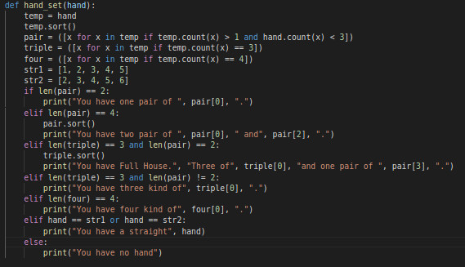
DETECTING FIGURES

Slide 6
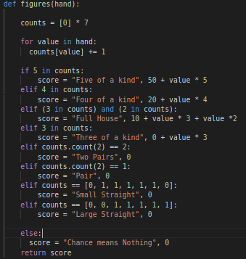
DETECTING FIGURES

Slide 7
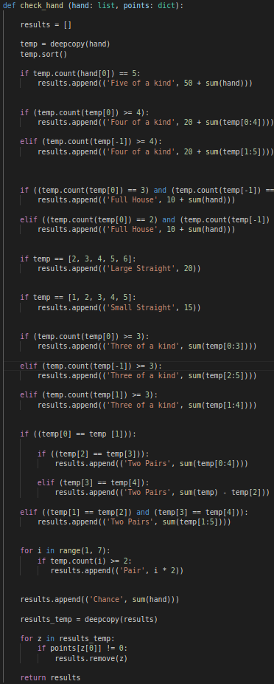
DETECTING FIGURES

Slide 8
PLANS FOR THE FUTURE
Upgrading audiovisual side of the the game
Implementing PVP and PVAI mode
Gambling system

