Slide 1
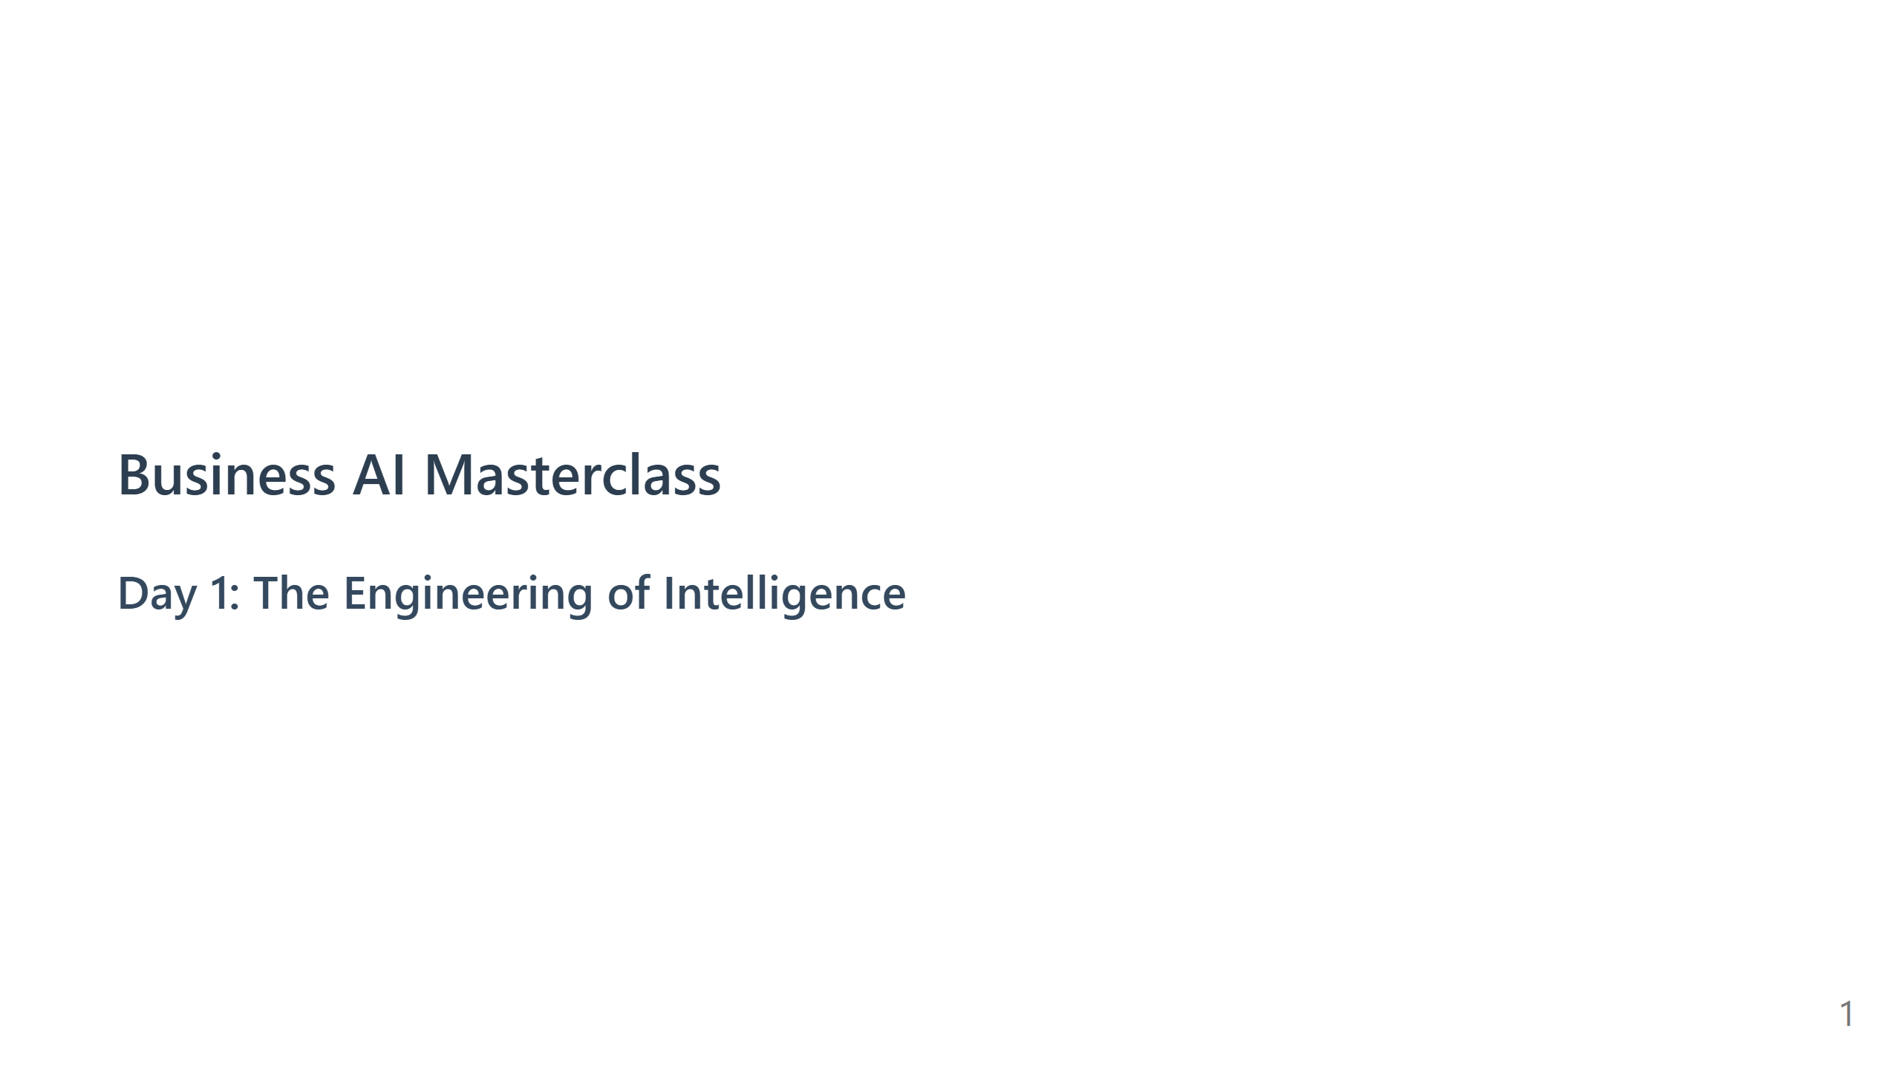
Notes:
Speaker Note: - Welcome the group. - State the goal: "We are moving from Magic to Math." - Set expectations: This is a technical deep dive.

Slide 2
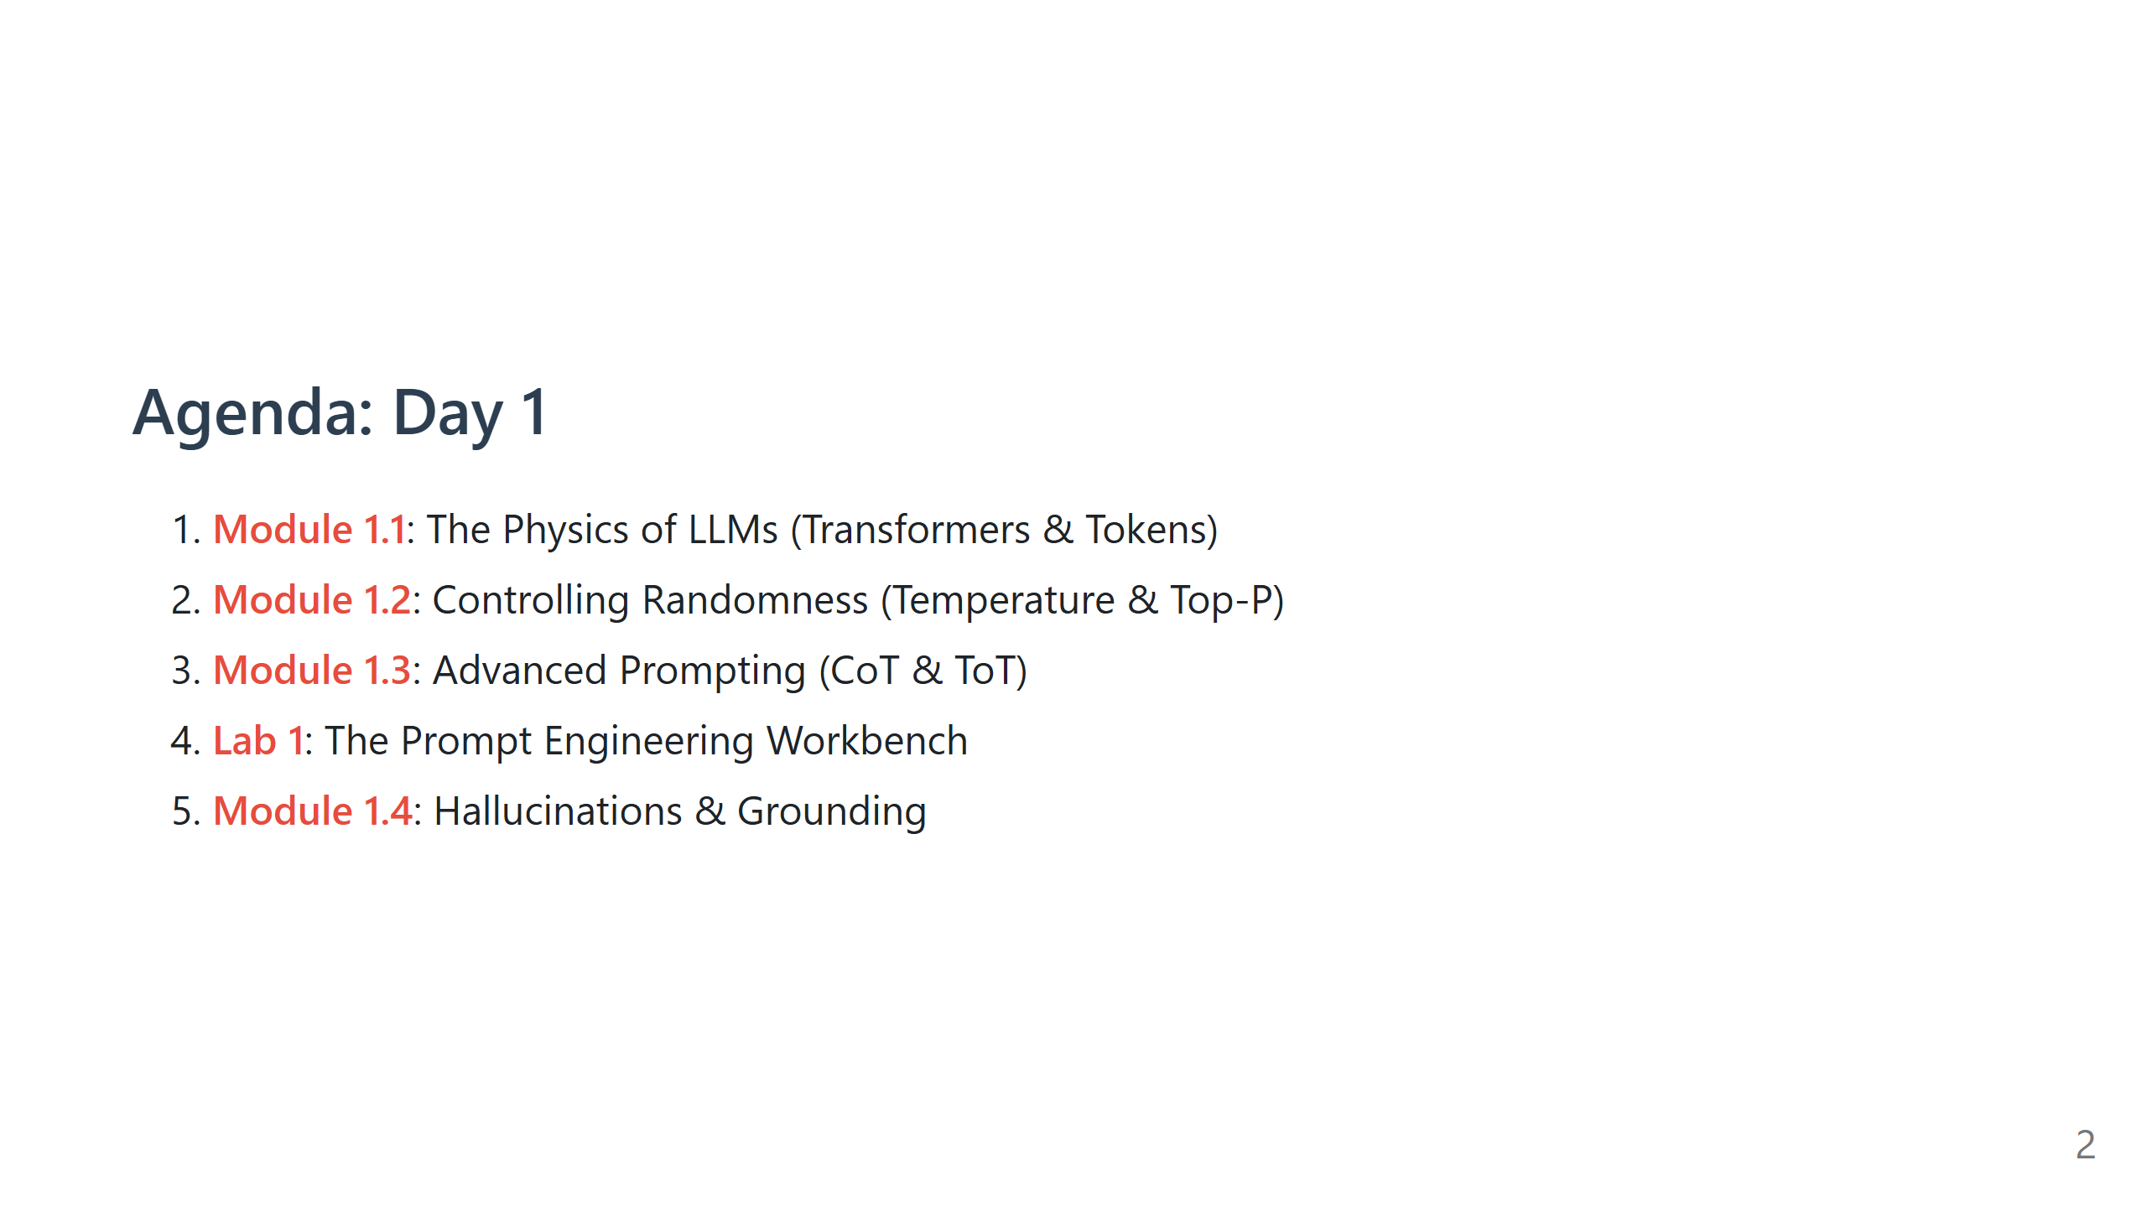

Slide 3
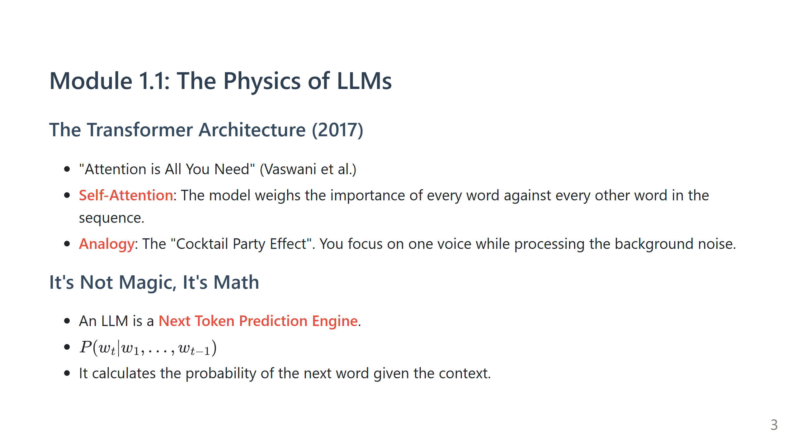
Notes:
Speaker Note: - Draw a simple diagram: Input -> [Attention Mechanism] -> Output. - Explain "Self-Attention": It allows the model to handle long-range dependencies. In the sentence "The animal didn't cross the street because it was too tired", what does "it" refer to? Self-attention links "it" to "animal".

Slide 4
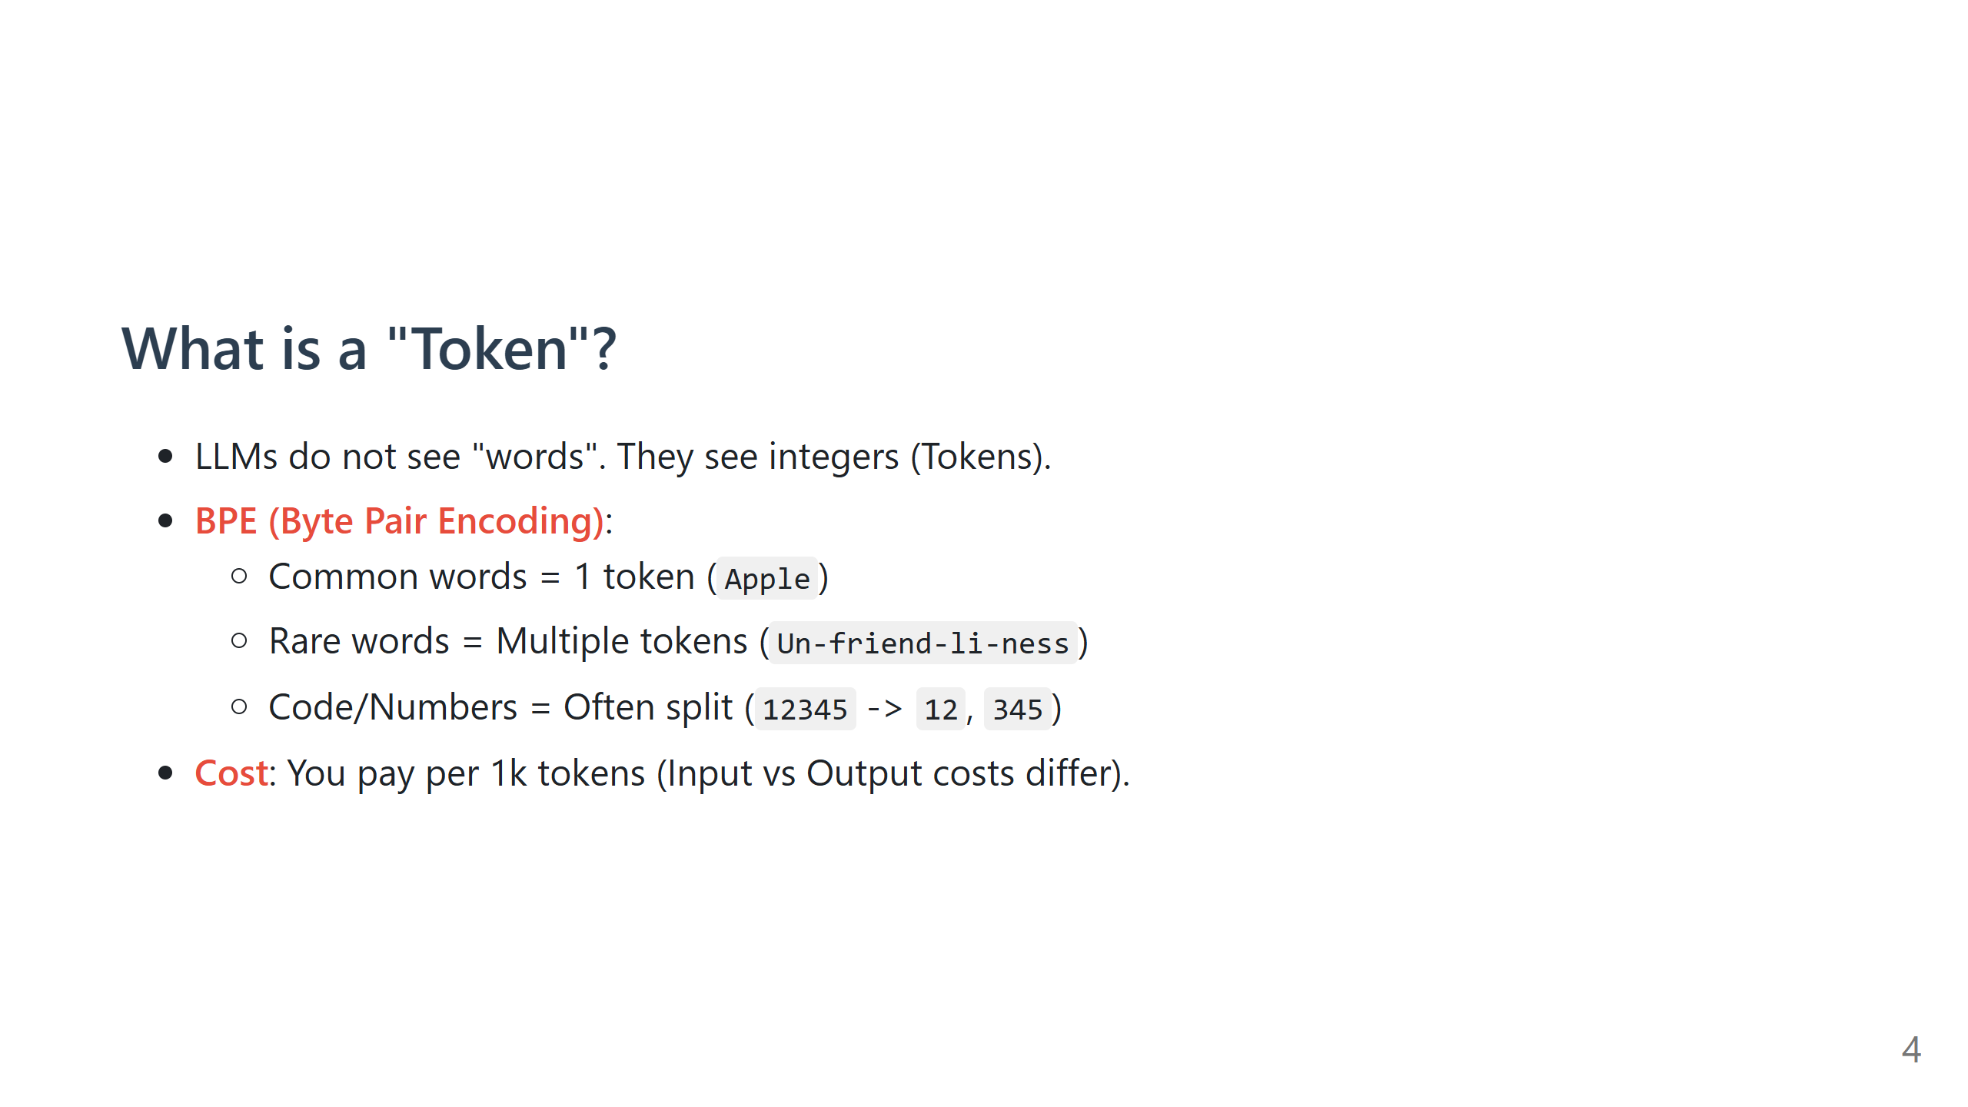
Notes:
Speaker Note: - Open the OpenAI Tokenizer page (platform.openai.com/tokenizer) if you have internet. - Show "Hamburger" (1 token) vs "Lollipop" (often 2-3 tokens). - Explain why LLMs fail at math: They see numbers as separate tokens, not numerical values.

Slide 5
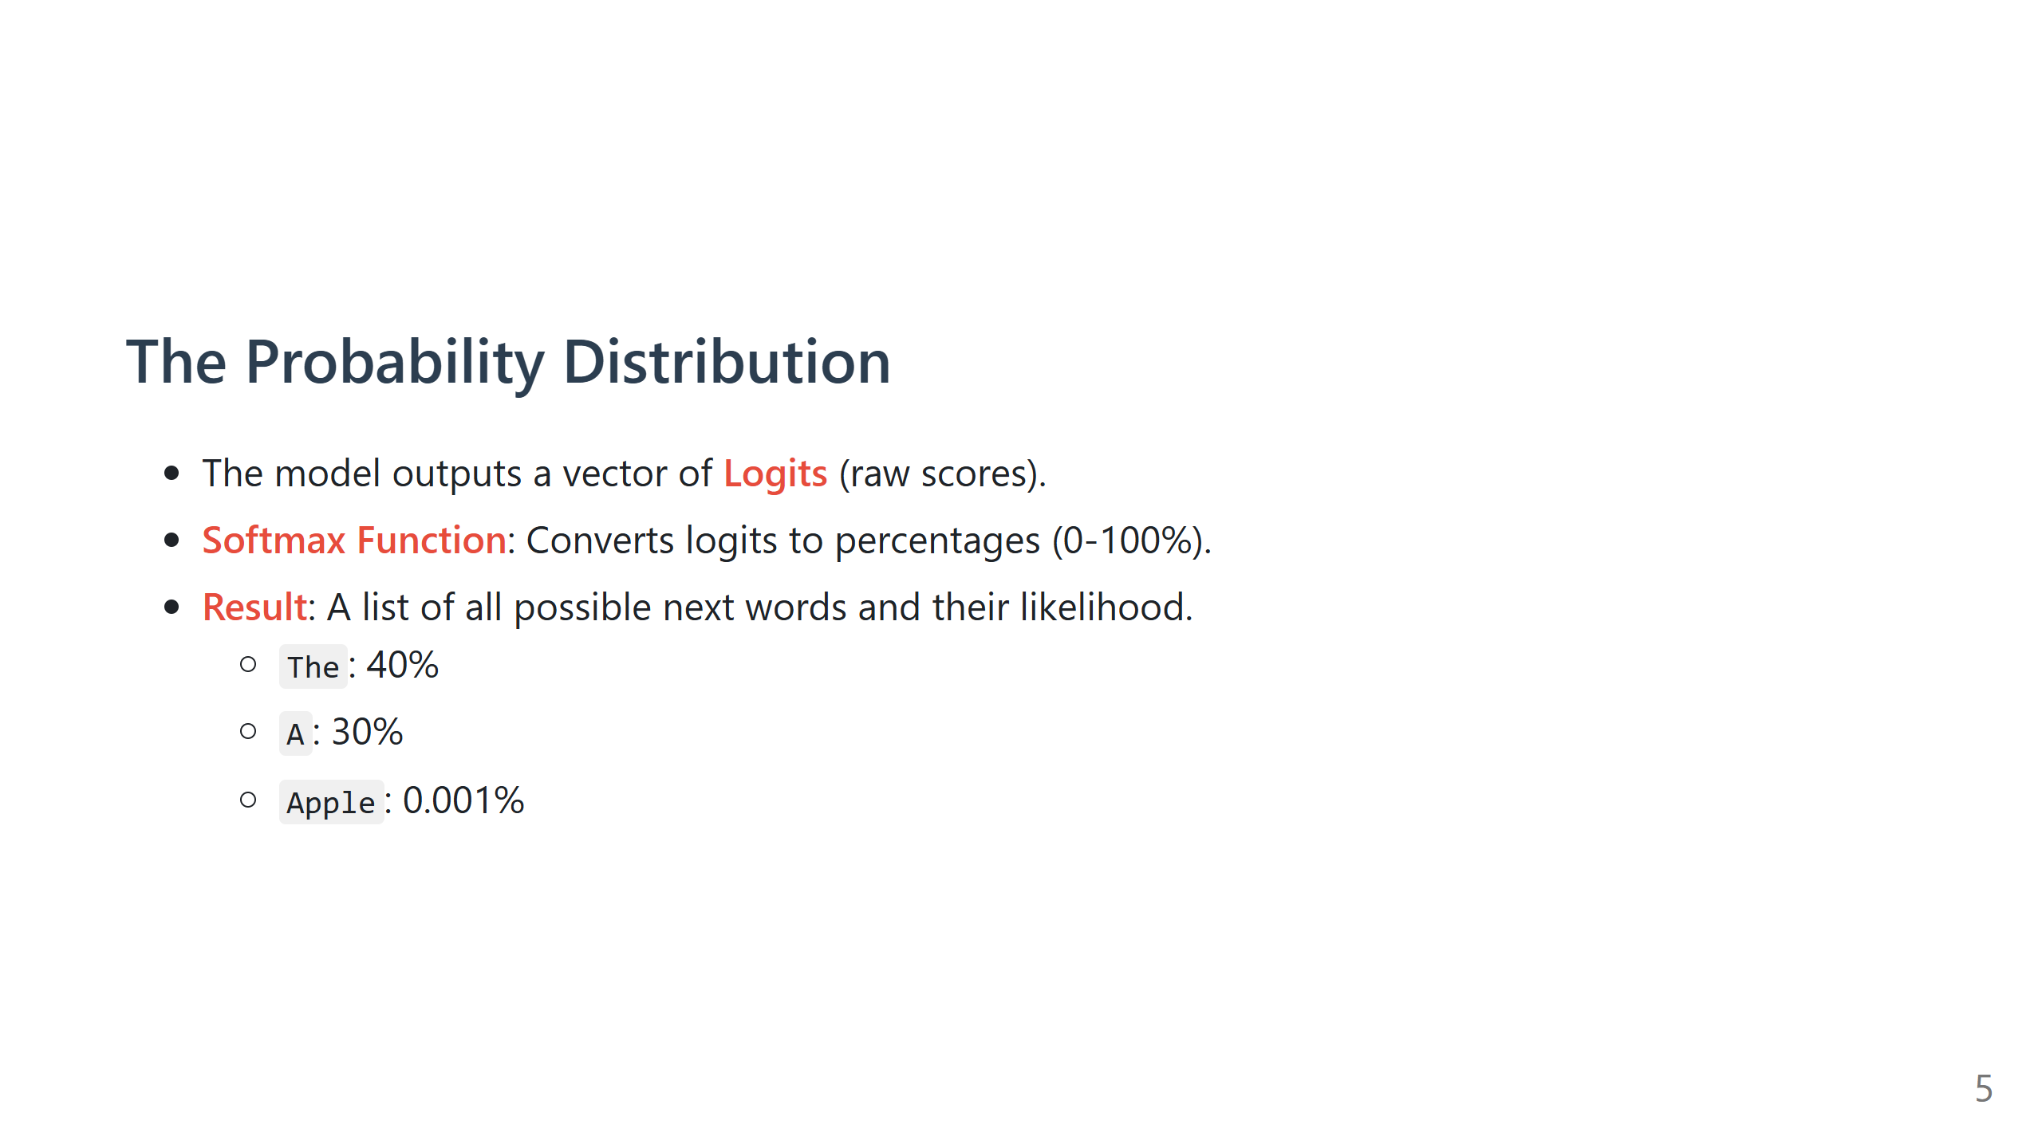
Notes:
Speaker Note: - Emphasize that the model essentially rolls a dice. - Even if "The" is 40%, there is a chance it picks "A". This is the source of creativity AND hallucination.

Slide 6
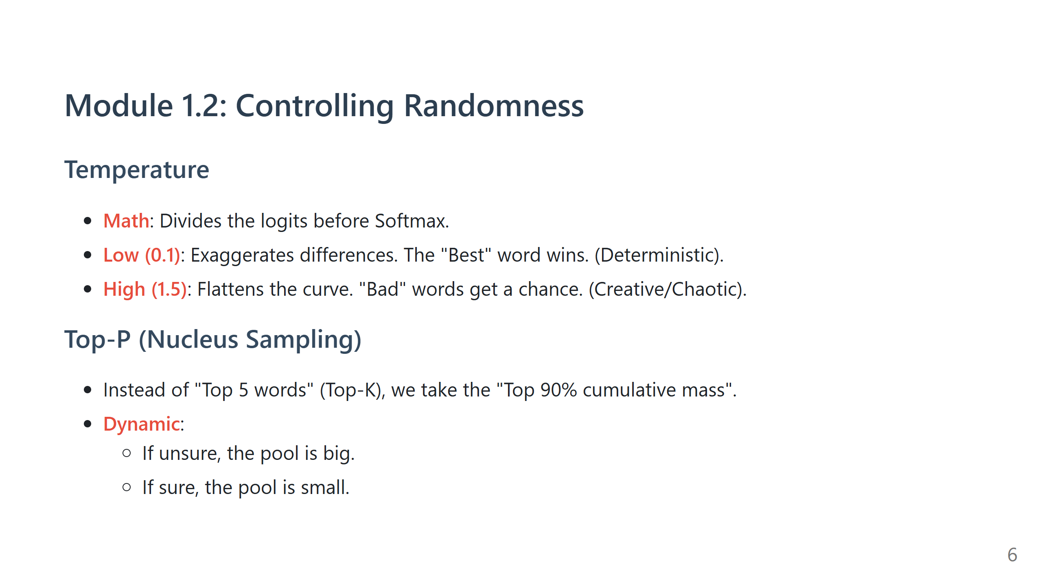
Notes:
Speaker Note: - Use the "Slot Machine" analogy. - Low Temp = The machine is rigged to always give the jackpot. - High Temp = The machine is fair (or chaotic).

Slide 7
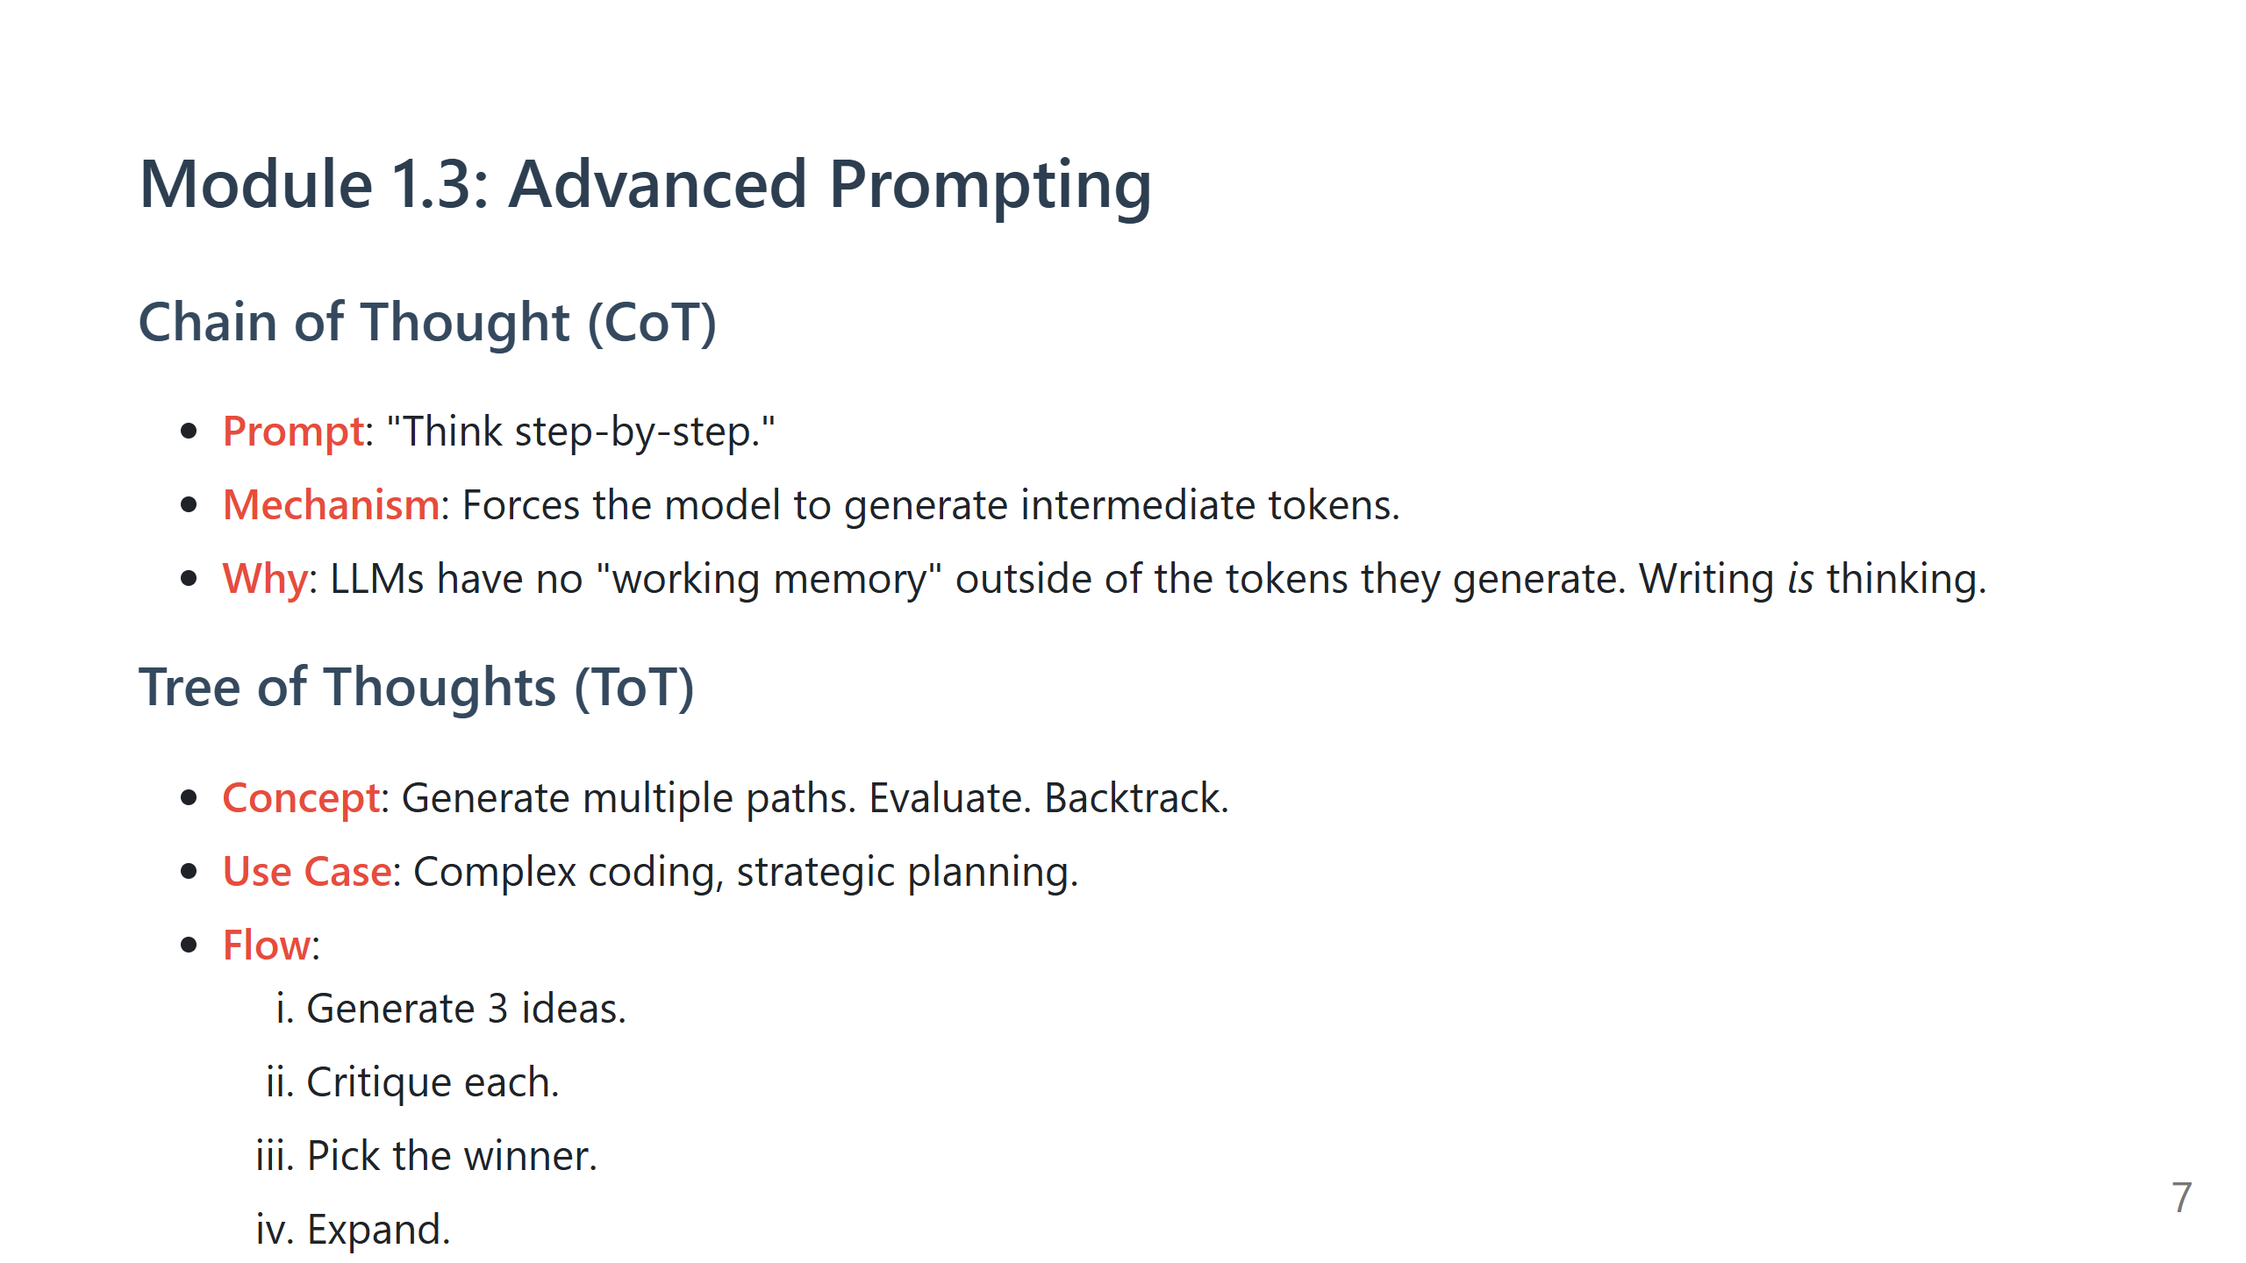
Notes:
Speaker Note: - This is the single most important technique. - Explain: If you ask a human to multiply 342 * 912 in their head, they fail. If you give them paper, they succeed. - CoT is the "paper" for the LLM.

Slide 8
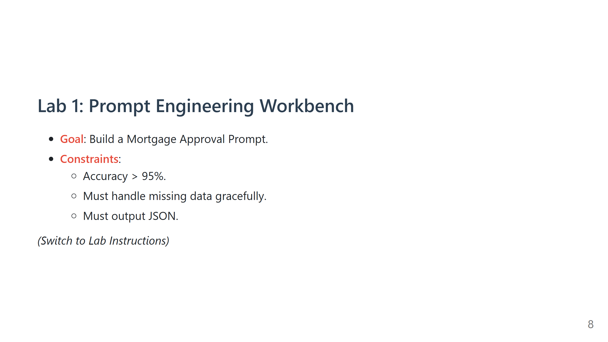
Notes:
Speaker Note: - Walk around. - Look for people struggling with JSON format. Suggest "Few-Shot" examples. - Look for people struggling with math. Suggest "Chain of Thought".

Slide 9
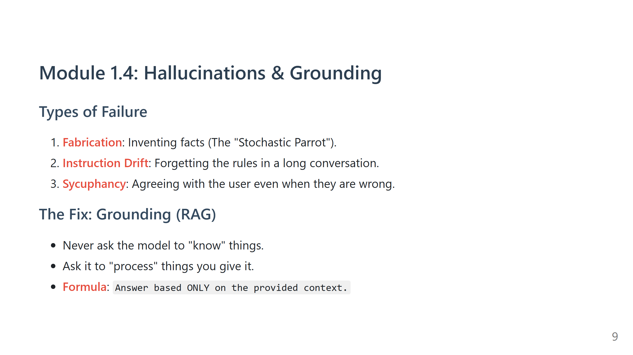

Slide 10
