Slide 1


Slide 2
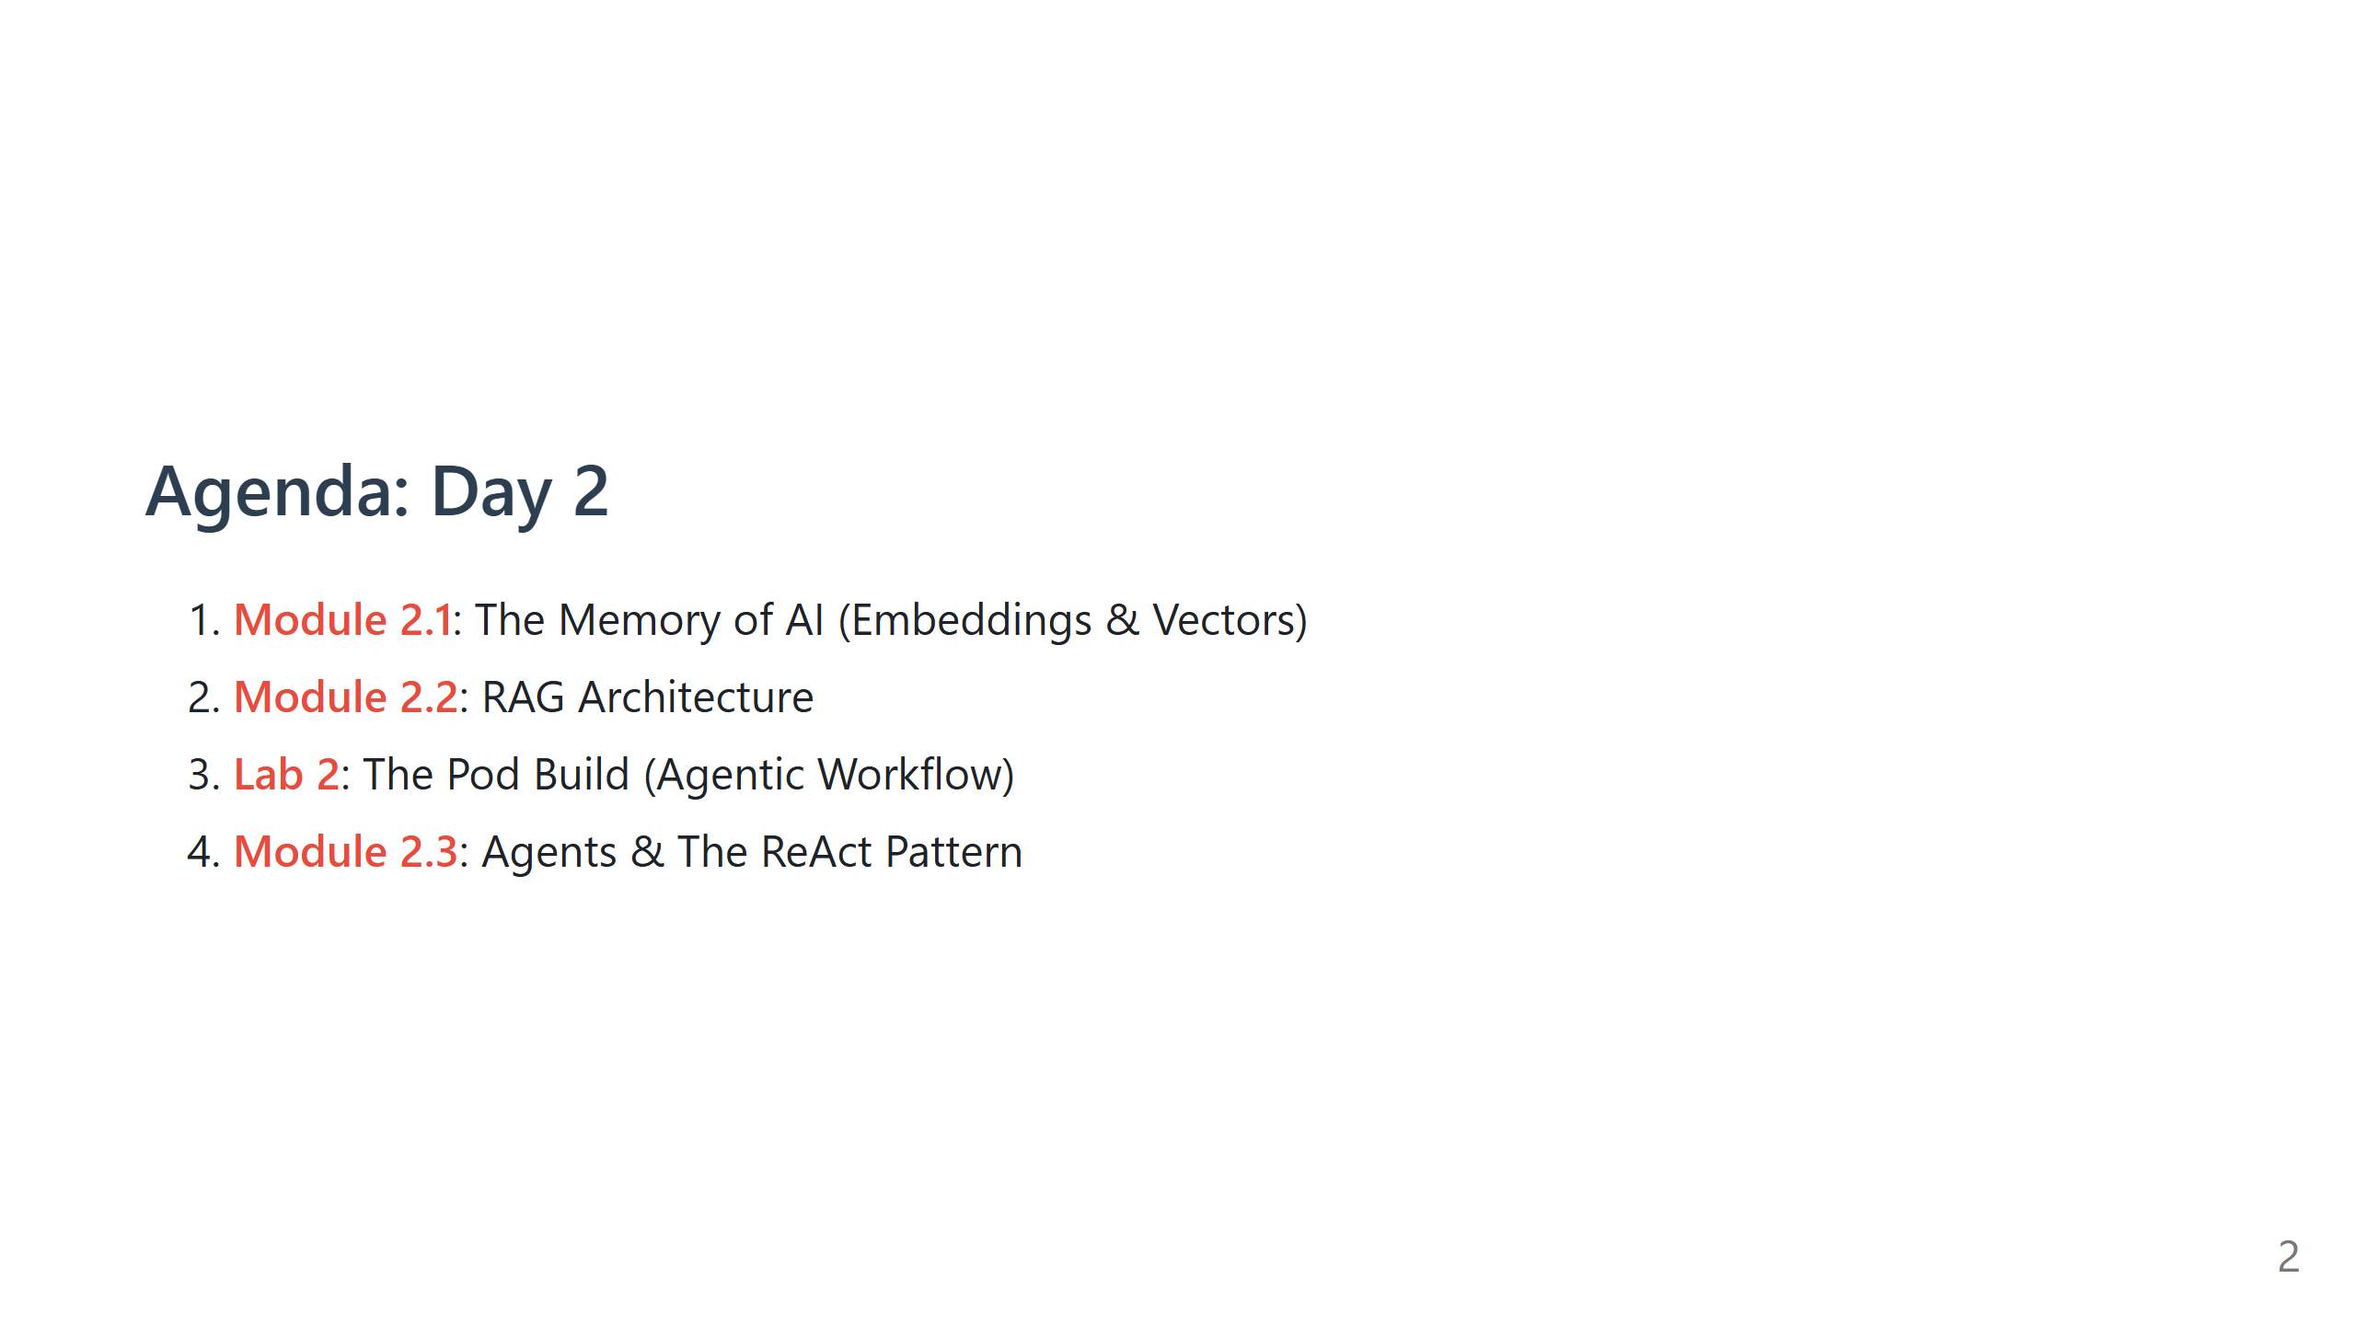

Slide 3
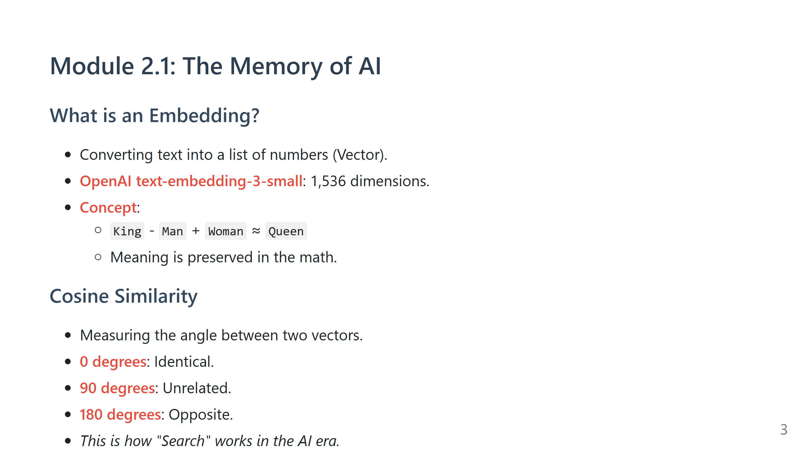

Slide 4
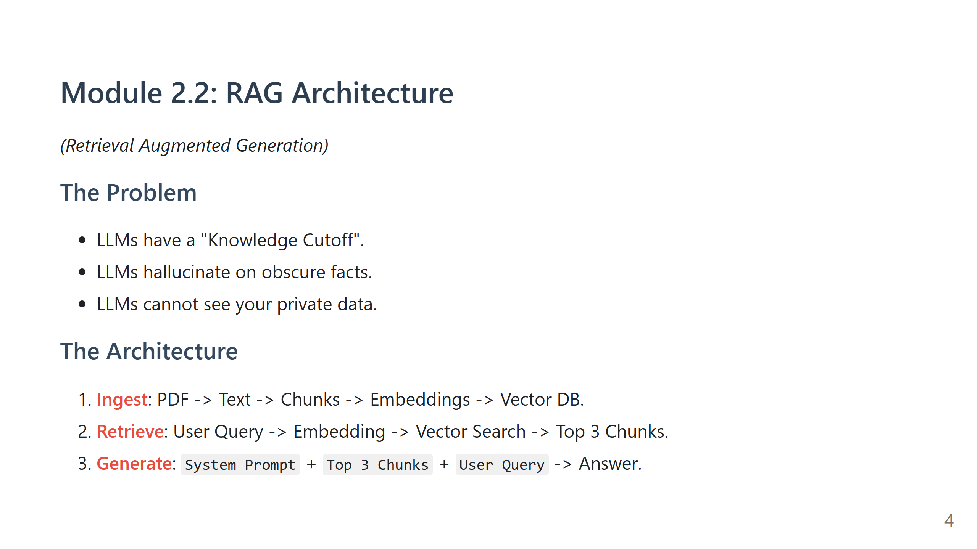
Notes:
Speaker Note: Draw the pipeline. Explain "Chunking" (Fixed size vs Semantic).

Slide 5
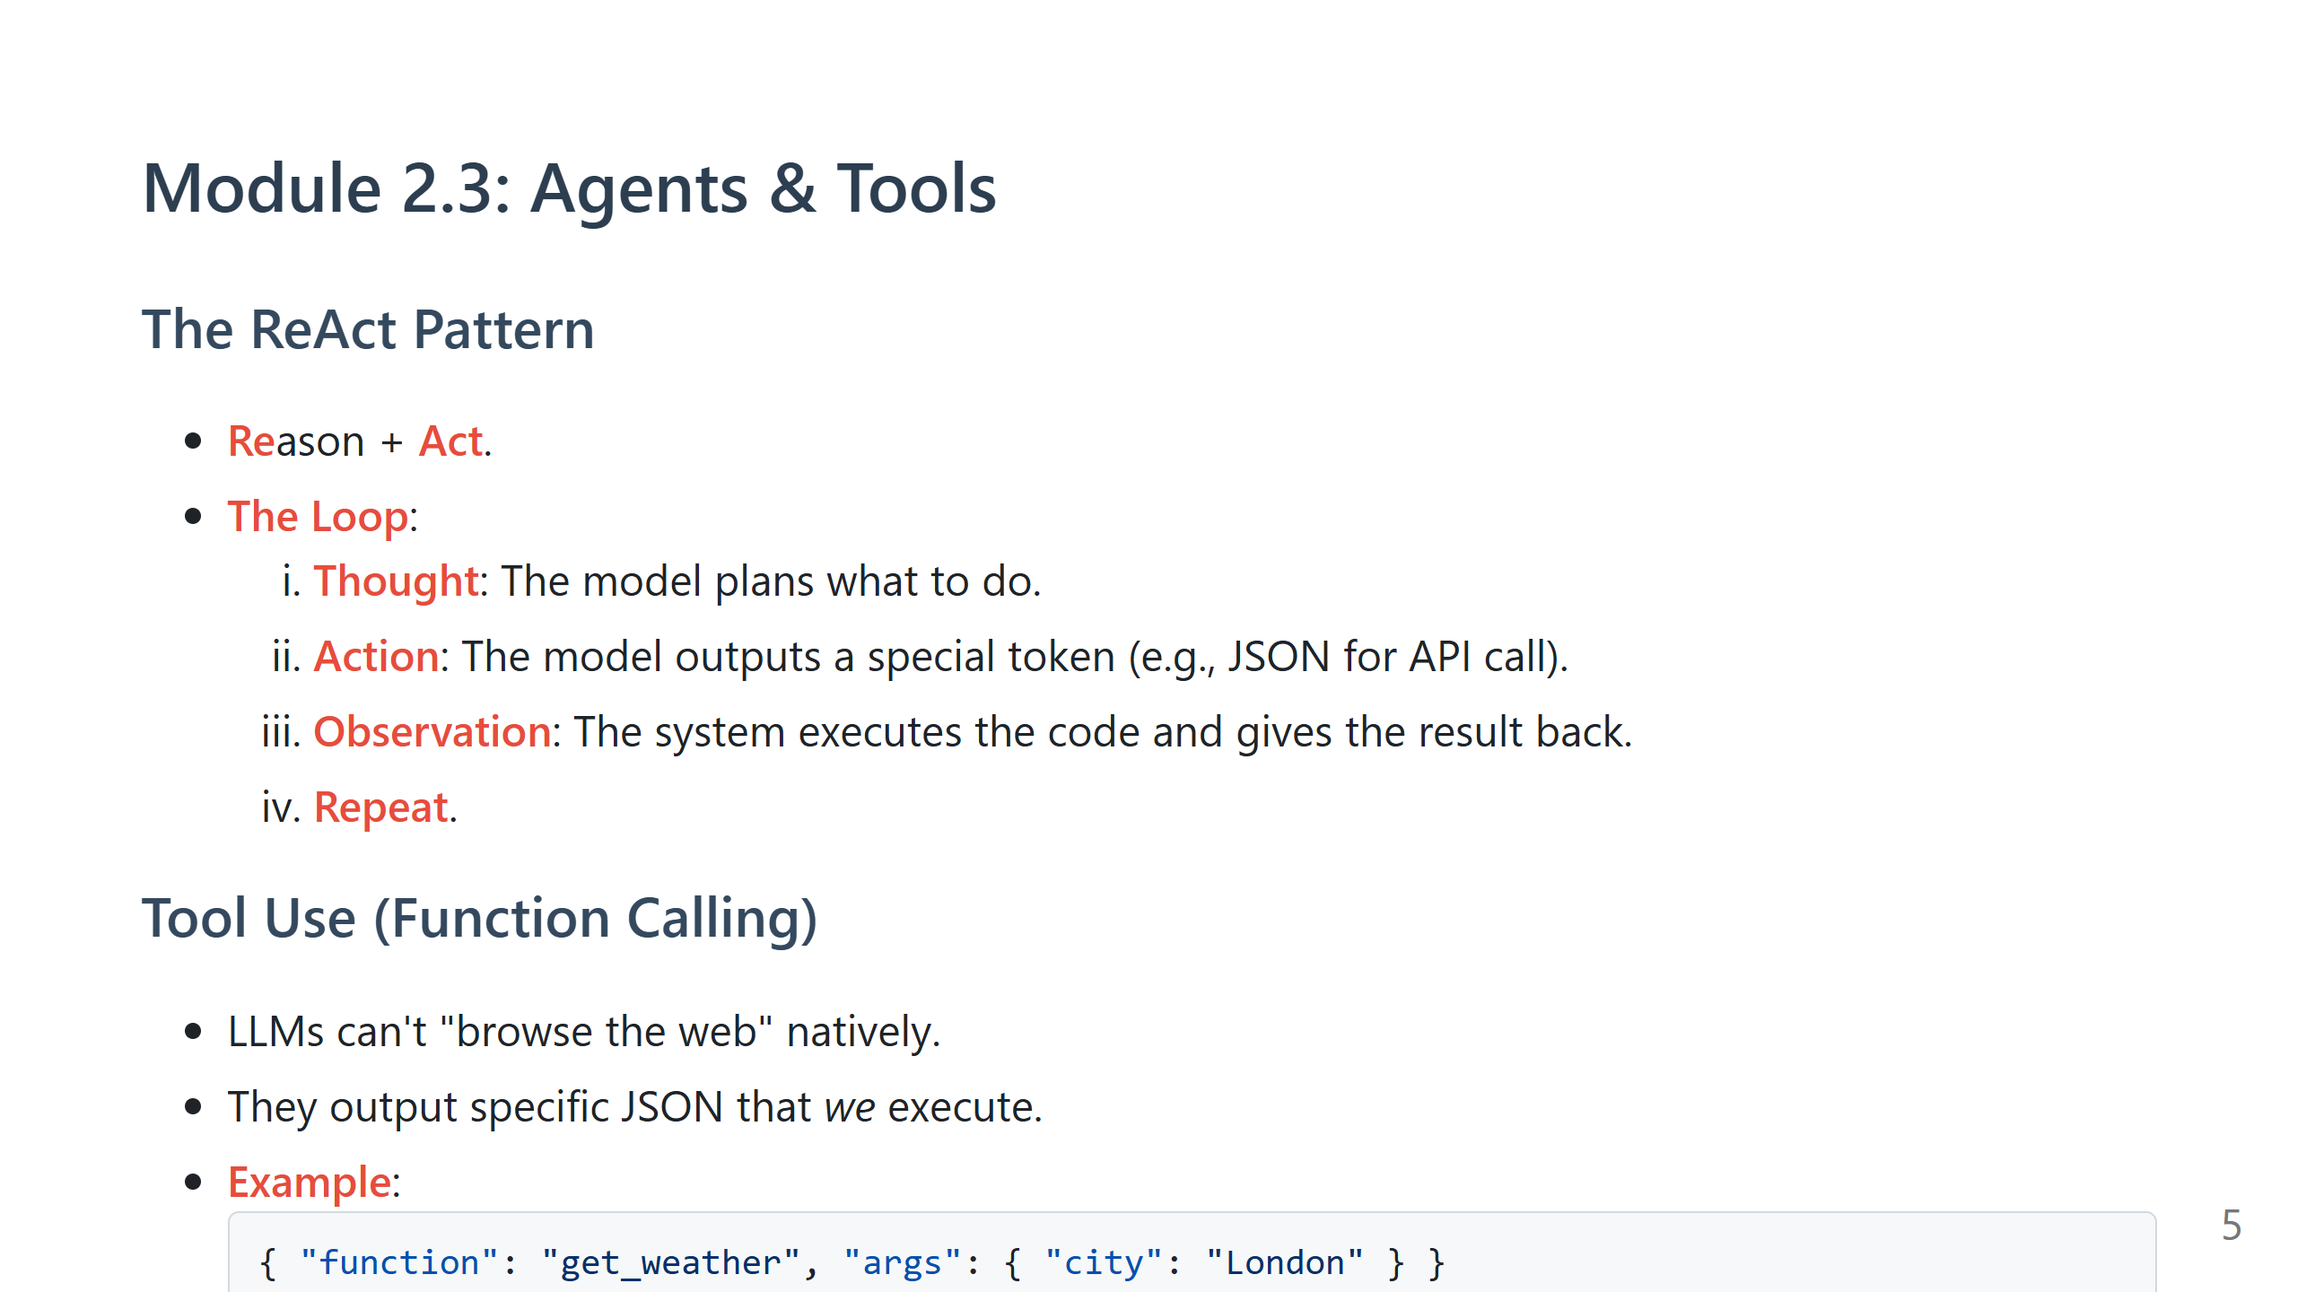

Slide 6
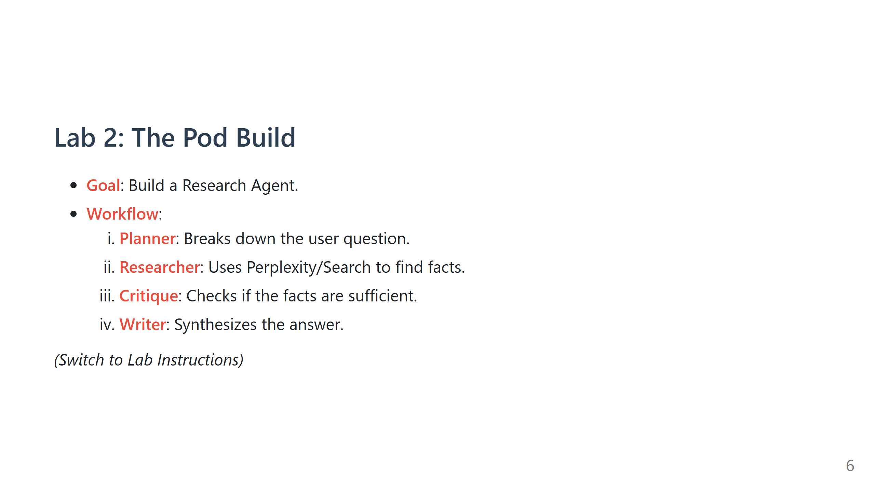

Slide 7
