Slide 2
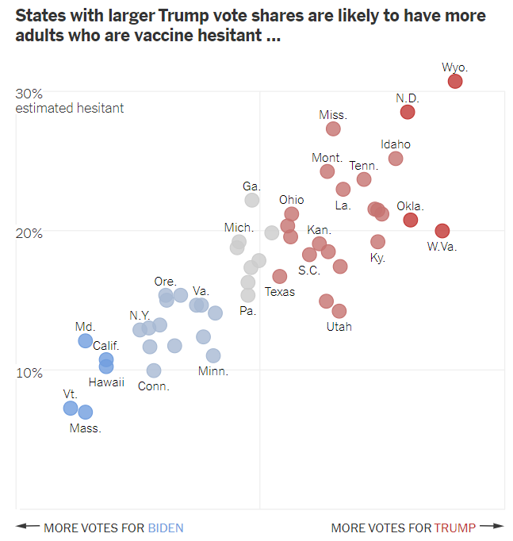
Title clearly states takeaway.
Scatter plot is appropriate for this point.
Each element has a “just right” amount of information.

