Slide 1
Microsoft Fabric Graph — An Introduction
Tom Martens
2026-04-02

Slide 2
Content
Who I am
Why Graphs, Why Now?
Graph Fundamentals • Relational vs. Graph
GQL • Fabric Graph • Live Demo
Key Takeaways • Resources

Slide 3

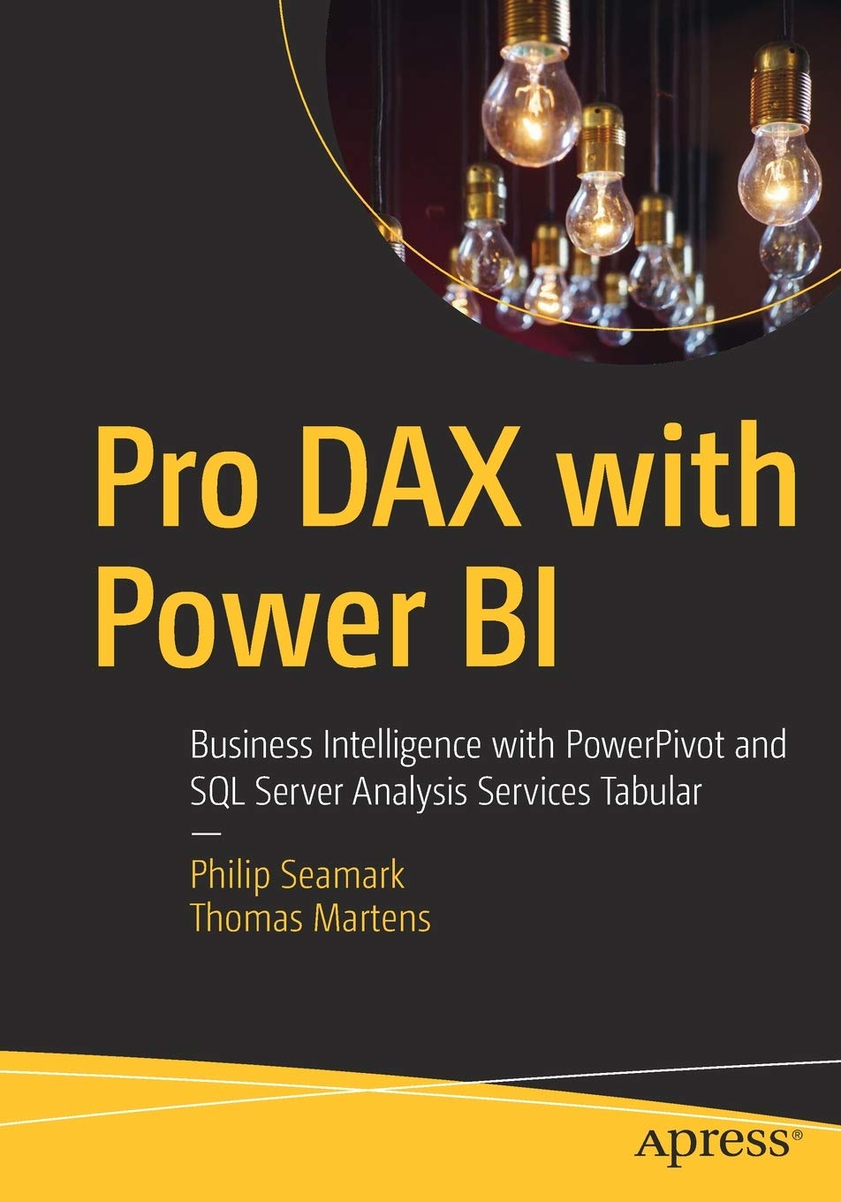
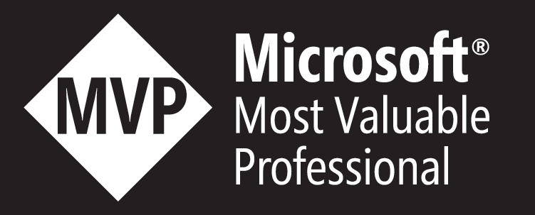
Tom Martens
Solution Architect @ Munich Re
29 years of experience designing analytical solutions using the Microsoft data platform
/tommartens68
@tommartens68

Slide 4
Why Graphs, Why Now?
Three developments creating a tipping point

Slide 5
Three Developments Creating a Tipping Point
GQL Standardization (ISO/IEC 39075, April 2024) — the first new ISO database query language since SQL in 1987
Microsoft Fabric Graph (Public Preview, Oct 2025) — graph analytics on OneLake, no ETL, no data duplication
AI & LLM Convergence — knowledge graphs as connective tissue for AI agents
Natural Language to GQL (NL2GQL) makes graph accessible to business users

Slide 6
Graph Fundamentals
Nodes, Edges & Properties

Slide 7
The Three Building Blocks
Nodes (Vertices)
Edges (Relationships)
The entities: people, products, cities
Can have one or more labels
Carry properties as key-value pairs
The connections: knows, purchased, reports_to
Always directed (source → target)
Can also carry properties (since, weight)

Slide 8
The Labeled Property Graph Model
Think of edges like fact rows — a customer bought 6 items at the bakery in Munich — with measures as properties
Labels type-tag nodes — and one node can have multiple labels (:Person AND :Employee AND :BoardMember) simultaneously
Properties = columns on each entity — Node: {city: "Munich"}, Edge: {quantity: 6, amount: 42.50}
Edges are directed (like cross-filter direction) — :purchased flows Customer → Product, traversable both ways
Same customer, same product, three purchases — three direct edges, no junction table needed

Slide 9
Relational vs. Graph
The paradigm shift

Slide 10
It's 45 minutes to lunch. Your manager asks: Our top 10 customers bought certain products. Other customers bought the same products. What else did those customers buy?
AdventureWorks. Three hops. How many JOINs until you eat?

Slide 11
"Six tables, five JOINs — and we've only traversed two hops. Every additional hop costs another JOIN."
— The relational way of modeling relationships

Slide 12
The Relational Way (AdventureWorks)
SELECT DISTINCT p2.Name FROM SalesOrderHeader soh1
JOIN SalesOrderDetail sod1 ... JOIN SalesOrderDetail sod2 ON sod1.ProductID = sod2.ProductID
JOIN SalesOrderHeader soh2 ... JOIN SalesOrderDetail sod3 ... JOIN Product p2
Self-joins, deduplication, exclusions — and we haven't filtered the top 10 yet. Lunch is getting cold.

Slide 13
The Graph Way — 1 Pattern, 4 Lines, Go Eat
MATCH (c:Customer)-[:purchased]->(p:Product)
<-[:purchased]-(other:Customer)
-[:purchased]->(rec:Product)
WHERE c IN top10 AND c <> other AND NOT (c)-[:purchased]->(rec) RETURN rec.Name — Go eat.

Slide 14
Relational vs. Graph — At a Glance
Relational Database
Graph Database
Tables, rows, columns
Implicit relationships (FK + JOINs)
Best for: aggregations, set operations
Nodes, edges, properties
Explicit relationships (stored as edges)
Best for: traversals, pattern matching

Slide 15
Three Engines, Three Questions
Relational / Lakehouse
Graph
"Total revenue by region for Q3?"
Columnar storage, filtered aggregation
Semantic Model: "Sales by product, sliced by quarter?"
"Who connects A to C through B?"
Traversals, pattern matching, networks
Not a replacement — the missing piece

Slide 16
The Semantic Model as a Graph
A bridge for BI professionals

Slide 17
Semantic Model ≈ Graph
Semantic Model
Key Insight
Table → Node Label
Row → Node Instance
Relationship → Edge
Both materialize relationships in memory
VertiPaq: filter propagation across star schema
Graph: path traversal across connected nodes

Slide 18
Questions Graph Answers That BI Can't
Which customers are connected through shared purchases? (community detection)
What's the shortest path between supplier A and outlet B? (supply chain)
Which products are frequently co-purchased by customers who also bought X?
Fraud rings, recommendation engines, identity resolution
The semantic model gives you the surface — graph reveals the network beneath

Slide 19
Where the Semantic Model Excels
Semantic Model Strengths
Where Graph Struggles
Filtered aggregations at scale — billions of rows in milliseconds
Interactive slice and dice — change a slicer, everything recalculates
Time intelligence — SAMEPERIODLASTYEAR, DATEADD built into DAX
Bulk aggregation — scatters column values across adjacency structures
No slicer propagation — no concept of automatic filter context flow
No built-in time intelligence — explicit pattern construction required

Slide 20
Analogies are ladders — they help you climb to understanding. Edges are not fact tables. Labels are not table names. These comparisons got us here — now let's meet graph on its own terms.
— Similar concepts, fundamentally different beasts

Slide 21
GQL — The New ISO Standard
ISO/IEC 39075:2024 — first new query language since SQL (1987)

Slide 22
GQL Core Concepts
MATCH → find patterns in the graph using ASCII-art syntax
FILTER / LET → keep rows matching conditions, define variables
RETURN → output results with ORDER BY and LIMIT
Patterns look like the graph: (alice:Person)-[:knows]->(friend:Person)
Draws from openCypher (Neo4j) and SQL/PGQ — familiar if you know either

Slide 23
Microsoft Fabric Graph
Architecture & capabilities

Slide 24
Under the Hood: LinkedIn's LIquid Engine
270+ billion edges — powering LinkedIn's Economic Graph
2 million queries per second at 99.99% availability
4th-generation graph DB with constant-time relationship access
Horizontally scalable, shared-nothing architecture
Battle-tested at LinkedIn scale — now adapted for Fabric on OneLake

Slide 25
Fabric Graph — Core Principles
No data duplication — operates directly on OneLake Delta tables
Scale-out design — horizontal sharding across multiple workers
Unified capacity — same Fabric CUs, no separate license
Built-in algorithms: Shortest Path, PageRank, Louvain Community Detection
NL2GQL — business users query in natural language

Slide 26
Demo Time
From relational to graph — three views of the same data

Slide 27
Live
demo

Slide 28
Key Takeaways
Five things to remember

Slide 29
Five Things to Remember
Graph databases store relationships explicitly — no JOINs, no junction tables
GQL is the new ISO standard — SQL's sibling, not its successor
Your semantic model is already a graph — tables = nodes, relationships = edges
Fabric Graph = graph analytics on OneLake — no ETL, no duplication
Graph and relational are complementary — right tool, right question

Slide 30
What's Next: Fabric IQ
Graph as the foundation for intelligent agents

Slide 31
Graph + Semantic Model = Fabric IQ
Fabric IQ unifies Lakehouse + semantic models + graph + real-time data into one intelligence layer
Semantic models define what things are — graph defines how they connect
Together they form the Ontology — the shared business vocabulary for AI agents
Data Agents and Operations Agents use this ontology to reason about your business
Announced at FabCon 2026 (March) — Graph is nearing General Availability

Slide 32
Powering much of Fabric IQ is a combination of Power BI's industry-leading semantic model technology and graph in Fabric, our highly scalable graph database.
— Arun Ulagaratchagan, CVP Azure Data, Microsoft (FabCon 2026)

Slide 33
Your semantic models define what things are. Graph defines how they connect. Together, they power the next generation of AI in Fabric.
— From data platform to intelligence platform

Slide 34
Resources
Resources
learn.microsoft.com/en-us/fabric/graph/overview
Getting Started with GQL (Packt, 2025) — Sun, Zhang, Simione
gqlstandards.org • aka.ms/graphavailability

Slide 35
Thank you!
/tommartens68
@tommartens68

