Slide 1
Security app
Jenny Min

Slide 2
Problem statement
28% of smartphone owners does not secure their phone while they are in risk of loosing their device that may contain sensitive data such as personnel information.
Each year, more than 70 million smartphones get lost in the United States and smartphone sales are increasing which can be interpreted there will be more lost phone in the future.
22% of smartphone owners have installed software that can find the phone if it’s lost.
36% of smartphone owners set 4-digit PIN to secure their phone, which is the weakest lock method

Slide 3
Why do we need to secure our phone?
“Cyber security experts recommend that smartphone owners take a number of steps to keep their mobile devices safe and secure.” (Anderson, 2017)
Smartphone is basically a little computer device that is super portable. It contains sensitive data including credit card information perhaps. To prevent and avoid personnel data leak/exposure when smartphone is not with its owner, it is essentially important to lock the device these days.

Slide 4
Risk statement
User may lock him/herself by using the application
User may lose the device
The device may get stolen
User may not answer the incoming call
User may in emergency situation
User may forget recovery method (security questions answer)

Slide 5
Technology
Language : Java
Platform : Android OS
Developer tool : Android Studio
Compatibility : Android Device (Phone, Tablet)

Slide 6
Target
A device user who desire to strengthen their device security
A device user who can comprehend English, Spanish, or Korean
A device user who wants to protect sensitive information exposure

Slide 7
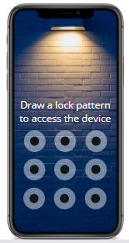
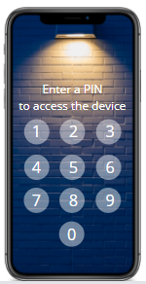
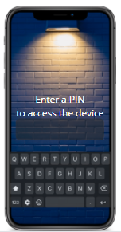
Unlock Method
I forgot password
I forgot password
I forgot password

Slide 8
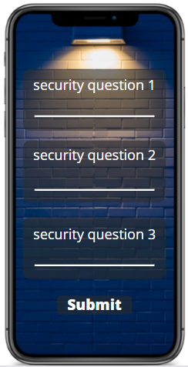
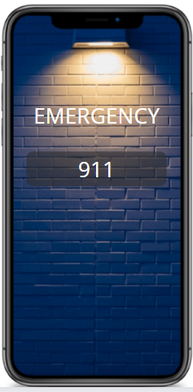
Forgot Password /Emergency

Slide 9
references
Anderson, Monica. “Many Smartphone Owners Don't Take Steps to Secure Device.” Pew Research Center, Pew Research Center, 25 Aug. 2020, https://www.pewresearch.org/fact-tank/2017/03/15/many-smartphone-owners-dont-take-steps-to-secure-their-devices/.
TheConsumerman. “Most Americans Don't Secure Their Smartphones.” CNBC, CNBC, 26 Apr. 2014, https://www.cnbc.com/2014/04/26/most-americans-dont-secure-their-smartphones.html.
Chandler, Simon. “Brits Boost Mobile Industry by Losing 98 Million Smartphones to Date.” Forbes, Forbes Magazine, 14 July 2020, https://www.forbes.com/sites/simonchandler/2020/07/14/brits-boost-mobile-industry-by-losing-98-million-smartphones-to-date/?sh=1c12f97755c9.
Notes:
앱이 가동되고 있으니까 핸드폰의 기능을 사용하기 위해서는 이 잠금장치를 먼저 해야하잖아.
전화가 수신시에 잠금잠치를 먼저 해제해야하는 번거로움이 생길 수 있기때문에
전화 수신시에는 앱이 가동되지 않는다 : 해결방안
틀렸을때는 날짜/시간 로그 기록해놓고 주인이 볼수있게
5번틀리면 그 이후로 틀릴때마다 1분
10 틀리면 그냥 폰이 잠김 ->초기화

