Slide 1
Lock Tomato
Jenny Min

Slide 2
Statement of Purpose
Purpose: secure and strengthen personnel data
Problem statement: Not securing data is considered one of the biggest vulnerabilities, which will cause a data exposure on a daily basis. It does not have to be sensitive information, but there might be unwanted files the device owner does not wants to share with other people.
Notes:
Smartphone or tablet does not look like laptop or desktop. However, smartphone or tablet is nothing more than a computer just in a small size. Only main difference is that major purpose we are carrying smartphone or tablet. Because it has high mobility. They are very easy to carry around which implies that there are more people using smartphone or tablet in public where strangers are all around us. In other word, people lost or get stolen their smartphone or tablet more than their laptop or desktop. Then what happens after that? Just from curiosity, people could go over the device and look into the device. To prevent this, I came up with the idea locking each app whatever user desires

Slide 3
Research & Background
Type of lock method
Necessity
Percentage
Notes:
Type of lock method: PIN, passcode, pattern, biometric, and so on
Let’s go into little bit more into background. Why is it necessary to secure our phones? There are several reasons we should secure our phones. The smartphone holds the device owner’s name, phone number, email address, images, credit or debit card information, and even payment methods. It is essentially important to lock the device these days to prevent and avoid the leak or the exposure of personnel data during the time when the device is physically not with its owner.
So when I researched about little more, Each year, more than seventy million smartphones get lost in the United States. We can imply that this can be interpreted that there will be increasing numbers of lost smartphones in the future and smartphone sales are increasing every second. Surprisingly, twenty-eight percent of smartphone owners do not secure their smartphone. Among these smartphone users, twenty-two percent of owners have installed software that can help them find the phone when it gets lost or stolen.

Slide 4
Project Requirements
Language
Software
Hardware
Target
Notes:
Language: Java
Software: Android Studio
Hardware: computer/laptop, Testing android device. Higher than version 5.0, cable for USB debugging
The target audience is whoever that Android mobile devices. A device user who desires to strengthen his or her device security should absolutely use it. It will be offered in English and Korean. So, any user who can comprehend English or Korean can use it. Most importantly, a device user who wants to protect sensitive information should definitely consider using the app.

Slide 5
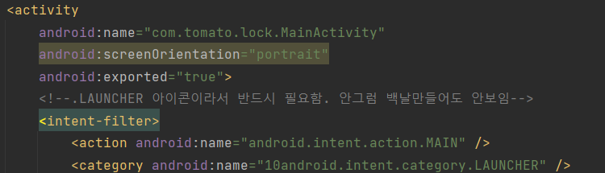
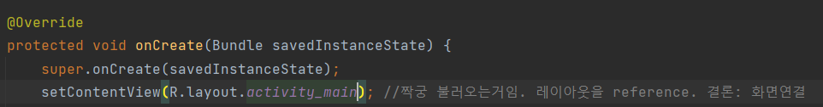
Manifest
Notes:
Manifest 파일자체는 개발자가 이러이러한 권한을 쓸거다라고 명시를하고 그 안에 permission()에서는 enduser에게 직접 권한을 동의받는 기능이 포함돼어있음
프로젝트 생성시 manifest파일이 자동으로 생성됌.
launcher가 있는데 이것은 쉽게 아이콘/앱 실행 버튼
코드를 읽어보면, 앱이 실행하면 .MainActivity class가 실행됌
그래서 java> .MainActivity class 파일로 가면 onCreate에 R.layout.activity_main이 연결돼어있음
onCreate: 액티비티의 라이프 사이클. 액티비티가 실행돼면 onResume->onCreate->onPause->onDestroyed 의 라이프 사이클의 형태를 띄고있음. 하나의 룰. 클래스가 호출됄때 실행돼는 함수. On create는 소프트웨어가 실행돼는 그때, 한번만 실행됌. 예를 들어 우리가 유트브를 보다가 문자메세지 앱으로 넘어가려고 밑으로 잠깐 내릴때 유트브는 on pause state로 갔다가 on resume으로 가는거임

Slide 6
Activity Life Cycle in Android
Activity Launched
onCreate( )
onStart( )
onResume( )
Activity Launched
Activity
running
onDestroy( )
onPause( )
https://developer.android.com/guide/components/activities/activity-lifecycle?hl=ko

Slide 7
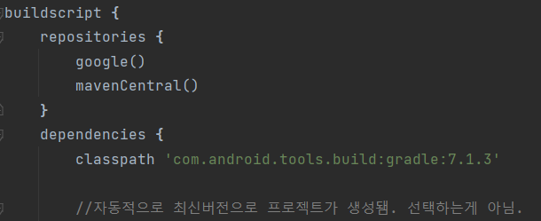
Build.gradle
Build.gradle(project)
Notes:
Not only Manifest file, build.gradle is as much as important to configure the app. Android uses gradle in order to build a software. Under gradle, there are two types. Project and Module. This is the picture of build.gradle(project) . It is about general setting that you can set an app version.

Slide 8
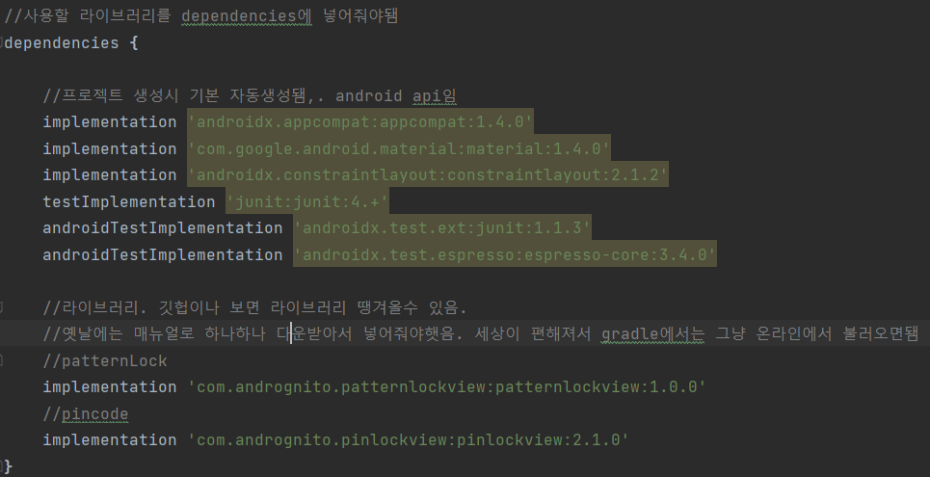
Build.gradle
Build.gradle(project)
Notes:
So is build.gradle(module). It is important.
In build.gradle(module), I can configure an app in depth.
Build.gradle(module)에서 제일 많이 쓰이는 부분은 라이브러리를 추가할 때이다
//안드로이드 어떤버전으로 컴파일하꺼냐. 중요함. 낮을수록 보안 취약. // ex.플레이 스토어에 등록할 때 굉장히 중요함. 왜냐하면 플레이스토어 쪽에서 룰을 바꿈. 정책이 바뀌면서 수시로 버전을 바꿔줘야할수있음 // 정책상으로 인해 버전을 바꿔야할 경우에는 grace period를 줌 //영향도가큼. 컴파일 안먹힐수 있음. 버전에 따라서 android api가 자동적으로 삭제돼거나 매뉴얼로 추가 해야할것들이 생길 수있음

Slide 9
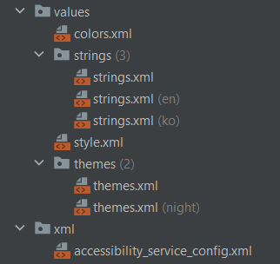
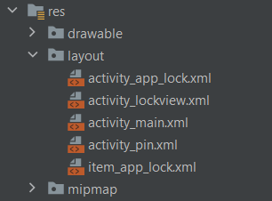
Resource
Notes:
효율적으로 관리하기 위해서 씀 : 하나하나 정의하는게 귀찮을 수 있지만 나중에 수정할 일이 생긴다면 반복적인 노동을 피할수 있기 때문에 시간낭비를 덜 할수 있다. 일일히 수정하는 일을 면할수 있고, 리소스에서 등록됀 값 한개만 바꿔주면됌. 처음에는 시간낭비라고 생각할수 있지만 나중에 수정할 일이 생긴다면 못보고 누락됄수 있는 실수가 생길수 있기때문에 해주는게 좋다.
Drawable: 앱에서 사용하는 모든 이미지 vault
Resource>layout> 오른쪽에 ‘design’버튼을 클릭.
Layout: enduser에게 보여지는 화면을 설계하는 곳
Mipmap: 아이콘 이미지를 무엇으로 쓸지 지정하는 곳
Values: color값 string값을 세팅해 놓는곳
Themes: 기본적으로 생성돼는거. 여기서 색깔 지정가능. 나이트모드
Xml: 앱특성상 다른 앱 의 화면을 가리기 때문에 권한설정을 위해서 쓰이는 파일

Slide 10
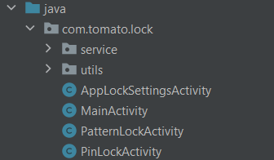
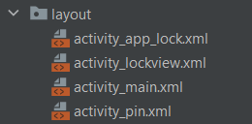
Activity Class
Notes:
이제 화면을 다 만들었으니까, 화면에 따른 기능을 추가 해줘야겠죠? 그거를 activity class에서 하는겁니다.

Slide 11
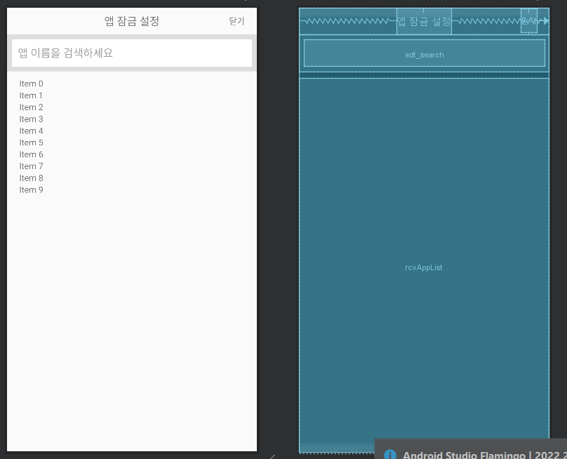
Java
Notes:
Java>AppLockSettingActivity : 디바이스에 설치됀 모든 앱 리스트를 가져와서(안드로이드 api인 package manage를 이용함) 이용자가 리스트 형태로 나열됀 화면이다. 검색창을 이용해서 앱이름을 검색할수 있는 기능이 있고 잠금을 원하는 앱을 결정할수 있는 기능을 갖고있다.
짝궁:activity_app_lock.xml

Slide 12
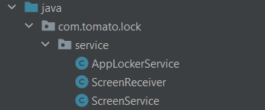
Java > Service
Notes:
Service>ScreenReceiver : 화면이 꺼지고 켜지고를 감지하여 켜질 때에 해당 잠금 화면(pattern/pin)을 띄워줌
Service>AppLockService: Screen Receiver는 화면이 꺼지고 켜지고를 감지하는 기능이라면, AppLockService는 디바이스에 모든 앱이 실행됄때를 감지하는 기능을 갖고있다. 실행돼는 앱의 패키지 명이 enduser가 락을 원한 앱 패키지명과 같다면 락스크린을 띄울수 있는 기능을 갖고있다.
Service>ScreenService: ‘상단바에 앱이 실행중이다’, ‘Receiver를 등록하는 함수’ ‘종료됄때 onDestroy라이프 사이클’ 기능이 들어있는 파일

Slide 13
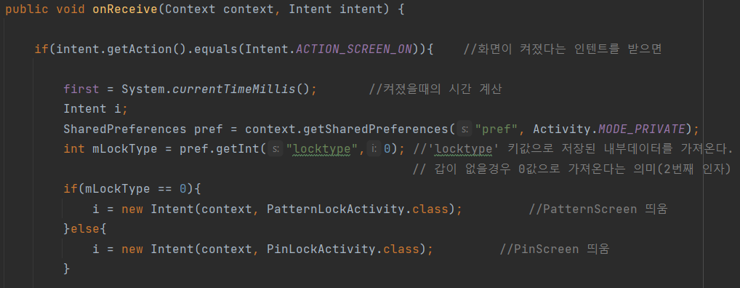
Java > Service
ScreenReceiver

Slide 14
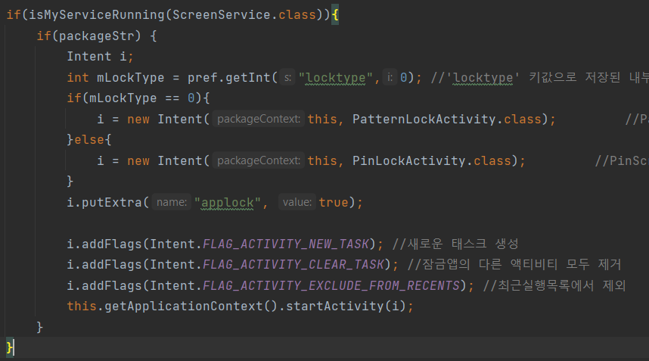
Java > Service
AppLockerService

Slide 15
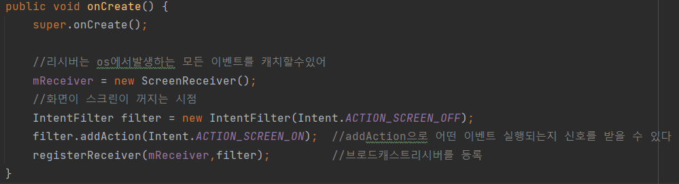
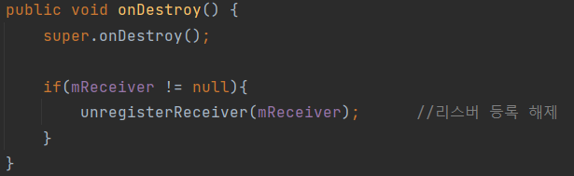
Java > Service
ScreenService

Slide 16
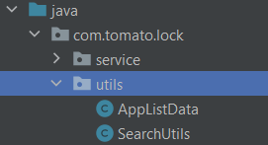
Java > Utils
Notes:
Utils>AppListData: 디바이스에 있는 앱들을 목록을 갖고 있는 데이터 모델이다
Utils>SearchUtils: AppListData에 저장돼어 있는 데이터를 바탕으로 유저가 specific한 앱을 검색 할수 있는 기능이 있음.

Slide 17
Test Plan / Result
Enable/ Disable function and work properly?
Accessibility permission?
Lock method choose and forget password?
Language change
Different language beside English or Korean?

Slide 18
Overcome Challenge
Constructing app screen
Android uses xml – options
Layout – not accurate
Cause –reusing view in Android list view
Service class
Activity class vs service class
Random detection
Notes:
Android app uses xml to create screen. There were many options that I could use so it was hard to choose which one I should use. I could build a screen by drag and drop components by using design tool, but when I used that tool, result I was getting was not as same as I wanted to be. The components were not in the spot where I wanted to be. So, it took more time than I thought to even create a screen even though it is a simple page.
Android has activity class and service class. Activity class is simply what user sees, service class is what user cannot see when they are using an app. To make this app, I had to use service class because I need a function that it detects if device screen is on and off. In Service, I had to use broadcast service to detect android system event and make app activates as soon as device detects whether the screen is on and off. However, service got terminated so randomly that sometime I see the screen and sometimes not which is abnormal behavior. The main reason I was struggle with this issue is because when service gets on destroy stage, it is no longer able to detect the event.

Slide 19
Overcome Challenge
Cause
Background service
Solution
Foreground service – letting user know that the certain service is currently running
Notes:
Foreground service – letting user know that the certain service is currently running
I searched and figured out there are two different service. Foreground service and background service. I was only tempted to use background service. The problem was that when app is being closed, it terminates background service as well. So I had to find a way to use foreground service in order to fix this issue. Foreground service causes an error ANR(Application Not Responding) when it doesn’t notify service is in being used within 5 seconds. Because of this I had to come up with a method to let user which service is being use to user. After changing to foreground service, I could confirm that the issue is not being occurred anymore.

Slide 20
Future Enhancement
Vulnerability issue – Shared password.
Take a picture automatically.
Color
Language options
Icon launcher image
Notes:
This app could be improved by fixing a vulnerability issue. It is not a problem if a user only locks the certain apps, however, if user decide to use this app to lock their device, he/she can be exposed in vulnerability because the app only uses one password that user would be sharing same password to unlock their device and unlock their certain apps. So, if stranger finds out the password, he/she can unlock phone and all other apps that is locked due to having shared password.
Also, this app could be improved by taking a picture if a user attempts certain amount of trial unlocking the app. And the picture automatically saves in the gallery so owner can know who was trying to get into his/her device. It really does not matter if owner reaches to the maximum attempts because owner knows that it is her/his picture.

