Slide 1

Mini Project Final PRESENTATION 2022-2023
JSS ACADEMY OF TECHNICAL EDUCATION
JSS Campus, Dr. Vishnuvardhan Road, Bangalore – 560060
DEPARTMENT OF ELECTRONICS AND COMMUNICATION ENGINEERING
Title: Intravenous Drip Monitoring and Control System Using IOT
Batch No. B11
NAME | USN | Mobile Number | Email id
Adarsh Ujjual | 1JS20EC002 | 9773612371 | ujjualadarsh@gmail.com
Sambhav Pathak | 1JS20EC075 | 7667081700 | sambhavpathak600@gmail.com
Sumit Kumar | 1JS20EC097 | 7783873885 | k.sumit.ec@gmail.com
Vikash Yadav | 1JS20EC106 | 8217511250 | vikash11153@gmil.com
Under the guidance of :
Guide Name: Mrs. Gouri S Katageri
Designation: Assistant Professor

Slide 2
Contents
Introduction
Literature survey
Problem statement and objectives
Methodology
Implementation
Testing & Results
Conclusion
References

Slide 3
Introduction
Internet of Things (IoT) has changed people’s lives in many areas, especially in healthcare sector. It has enabled devices which made remote monitoring in the healthcare sector possible. It has the potential to keep patients safe and healthy, and empowering doctors and nursing staff to deliver high quality care. One of them is Automated IV Drip System. Monitoring patients during IV therapy is still a challenging problem.
In our current medical care system, we manually do all this monitoring task. We need to alert the medical staff about the drip level in a saline bottle that is being injected through the patient’s vein and the patient condition on a real time. Intravenous therapy is treatment that infuses intravenous solutions, medications, blood samples directly into a vein. IV therapy is an effective and fast way to administers fluid and medications treatment in emergency situations, and for patients who are unable to take medications orally.
In order to reduce the workload of nursing staff and overcome critical situations like backflow of blood, we proposed a system called Automated IV Monitoring and Control System based on IoT technology. The proposed system can overcome a number of problems during the IV therapy, which implies less patient concern and greater efficiency of medical staff with less effort and greater satisfaction.

Slide 4
Literature survey
Sl. No | YEAR | RELATED WORK | Outcome & Limitations
1. | 2012 | Drip infusion monitoring system employing Bluetooth by Hikaru Amano: This system consists of several infusion monitoring devices and a central monitor. It consists a Bluetooth module can detect the drip infusion rate and an empty infusion solution bag. | These data are sent to the central monitor placed at the nurses’ station via the Bluetooth. This System was limit by one device and access limited by distance of Bluetooth range.
2. | 2016 | Intravenous drip meter & controller by Raghavendra B: IV drip usage and a solution is proposed to enable monitoring and control of IV drip based on sensing of drops falling through the drip chamber. | The device displays the flow rate and also has alarms which operate when the rate deviates from pre-set value. This require a power source to function, which can limit their portability. Specific devices may have limitations in terms of the types of fluids they can monitor, compatibility with certain IV setups, or the range of drip rates they can accurately measure

Slide 5
Literature survey
Sl. No | YEAR | RELATED WORK | Outcome & Limitations
3. | 2018 | Intravenous Drip Monitoring System by M. Anand: | The system can easily control the hardware by use the Arduino controller. This project provides the advantages for nurse/assists in healthcare system and control of notice board generally. Limitations are: Reliance on GSM Technology Lack of Real-Time Data and Feedback
4. | 2018 | Design and Development of IOT enabled IV infusion rate monitoring and control device for precision care and portability by Mohammed Irfan: Proposed a smart infusion pump with IoT capabilities to ensure accurate and controlled delivery of IV fluids. These studies demonstrate the growing interest in leveraging IoT technology for improving IV infusion processes. | The IoT-enabled platform allows doctors and nurses to monitor the IV infusion setup remotely and make necessary adjustments wirelessly. This real-time monitoring and control functionality can enhance the accuracy of drip rate settings, minimize the risk of human errors, and improve patient safety. Limitation: The device's compatibility with existing IV infusion setups and integration with healthcare systems should be thoroughly examined. Compatibility issues with different infusion pump models or communication protocols could limit the device's applicability in certain healthcare facilities

Slide 6
Problem Statement and Objectives
Problem Statement :
Intravenous Drip Monitoring and Control System
Objective :
Enhance Patient Safety
Improve Efficiency and Accuracy of IV Therapy

Slide 7
Methodology
b
Buzzer
Intravenous Bag
Load Cell
Load Cell Amplifier
Servo
Motor
ESP32
Blynk App

Slide 8
Components
COMPONENTS | SPECIFICATIONS
NodeMCU ESP32 | Xtensa dual-core (or single-core) 32-bit LX6 microprocessor, running at 160 or 240 MHz Memory: 520 KB SRAM 12-bit × 18 ADC channels and 2 × 8-bit DAC channels 10 × touch sensors (capacitive sensing GPIOs) Infrared remote controller (TX/RX, up to 8 channels) All security feature of IEEE 802.11 standard, like WFA, WPA/WPA2, and WAPI, secure boot, Flash encryption.
HX711 Load Cell Amplifier | Capacity : 5kg / 11 lbs Operation supply voltage range: 2.6 - 5.5V Maximum excitation voltage : 10V Differential input channels: 2 Data accuracy: 24 bit (24 bit A / D converter chip.) Operating current: <10 mA Simultaneous 50 and 60Hz supply rejection 16 pin SOP-16 package
Load Cell | Capacity : 5kg / 11 lbs, Maximum excitation voltage : 10V DC Rated o/p : 1.2 ± 0.1mV/V Overall Precision : 0.02%F.S Safety Overload : 120%
Servo Motor | Operating voltage : +5 V, Operating speed : 0. 17 s Stall Torque: 9.4kg/cm (4.8v); 11kg/cm (6v) Rotation angle: 180 degree
Buzzer | Rated Voltage: 5V, Operating Voltage: 4~8V Max Rated Current: <32 mA Min Sound Output at 10cm: 85 dB Resonant Frequency: 2300Hz ± 300Hz

Slide 9
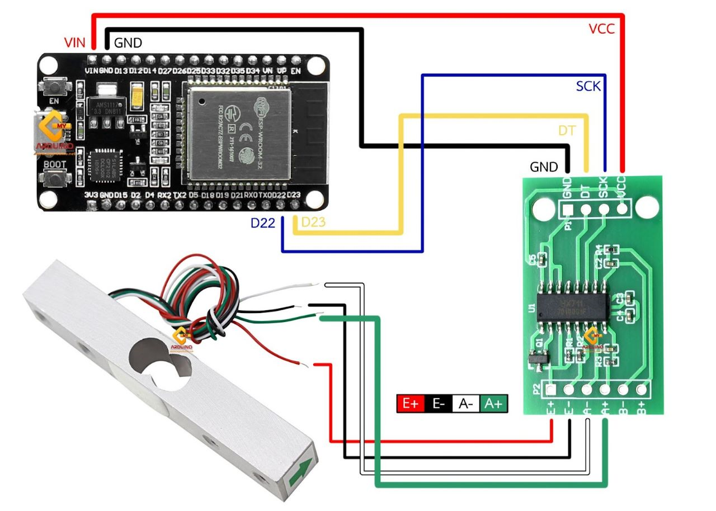
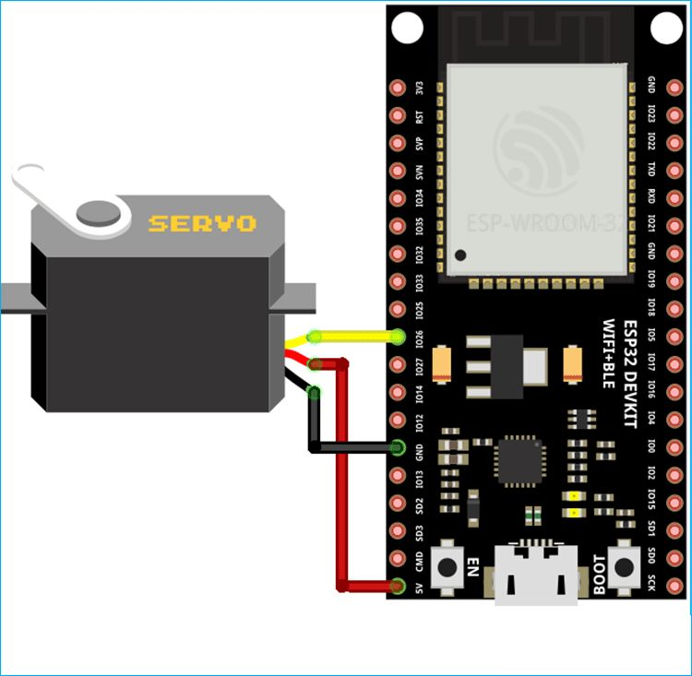
Implementation Circuits:

Slide 10
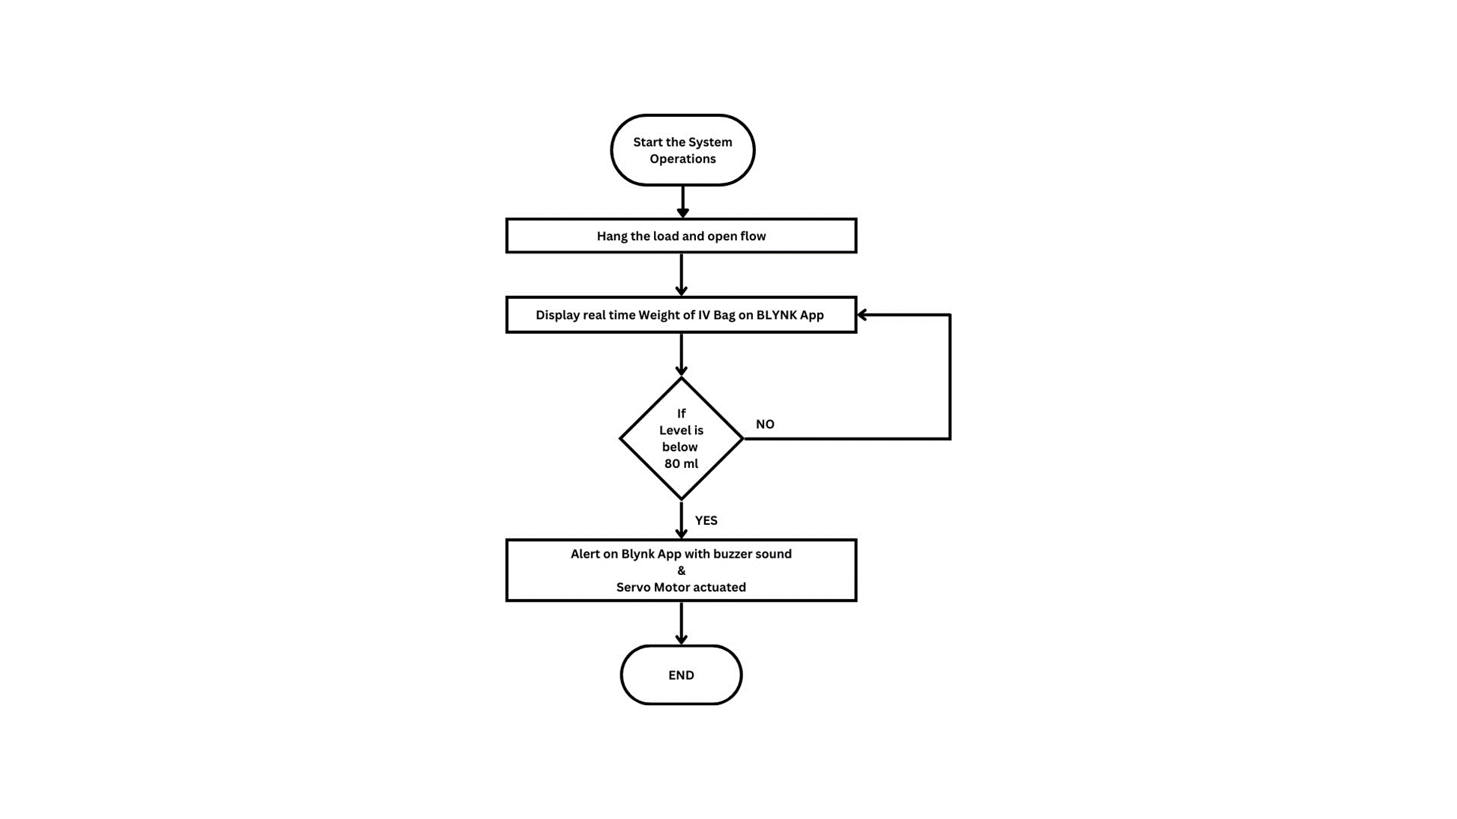
Flow Chart

Slide 11
The content of saline in a normal saline bottle is 500 gm. The saline bottle is replaced by another when the saline falls below 80 gm.
The critical level of saline is set to 80 gm which is between 50 to 100 gm so the nurse can change the saline bottle when the liquid reaches the critical point.
As soon as the saline bottle is hung on the stand and attached to the sensor via a hook, an initial weight reading of the bottle is recorded in the database designed by the esp32 module. The load cell in the IV bottle level sensor senses the weight at regular intervals. The same is updated in the database regularly.
As the read value of the load reaches 16% of its initial value recorded in the database, a notification is sent to the respective nursing staff on the blynk app.
The load cell keeps reading the real time weight of the bottle and displays the weight continuously on the Blynk App.
As the weight of the bottle further decreases to 16 percent of its initial weight(i.e. 80 ml) the servo motor is actuated, which disconnects the patient with the intravenous bag and Buzzer also starts to ring .
The servo motor stops the flow of the fluid and prevents the saline to get fully consumed without being disconnected thus it stops the backward flow of blood. The buzzer stops ringing when the bottle is removed.

Slide 12
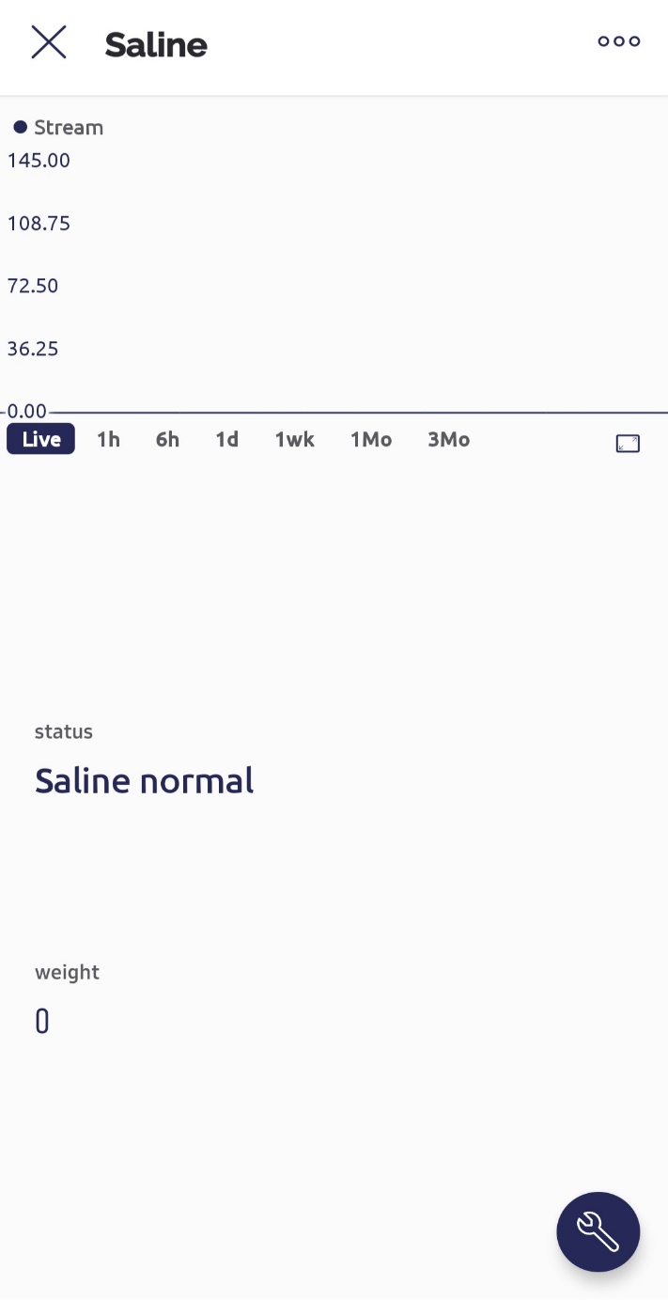
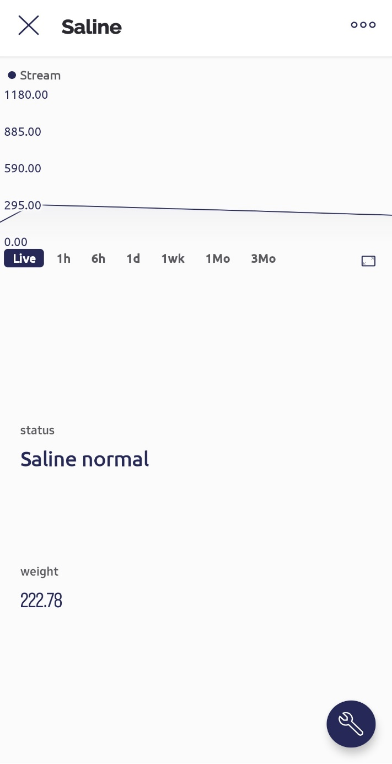
Testing & Results Obtained
Step 1: Initial Weight is 0
Step 2: Weight of the saline added

Slide 13

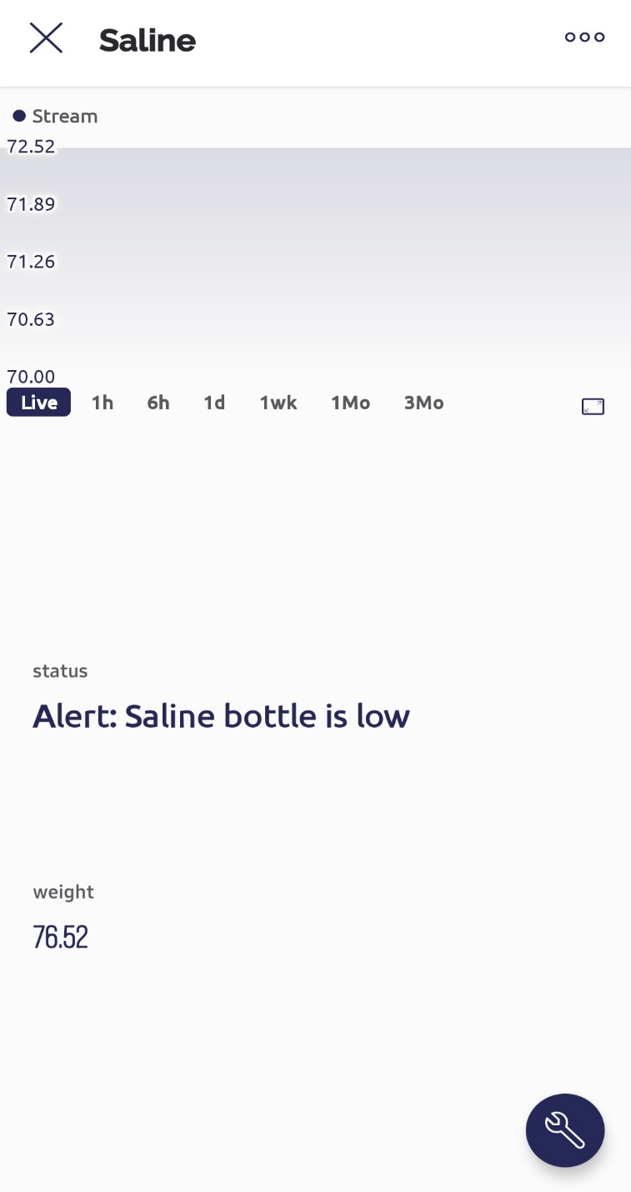
Step 3: Current weight after some time
Step 4: When the weight reaches below 80g

Slide 14
Conclusion
The IV Drip Monitoring and Controlling System is designed and tested successfully. The system includes NodeMCU ESP32 Controller, Load Cell, Servo Motor with clam, Saline Bottle, Buzzer, and Blynk App. The system is designed to capture the changes in the level of saline bottle and determine the level of saline bottle which is continuously being displayed oven the blynk application. When the determined level is less than predefined threshold weight, then the buzzer sounds to notify the nursing staff and the supply of the fluid through the pipe to the patient is stopped. A warning is also issued on the blynk application.

Slide 15
References
[1] C. Chiang and P. Tsai, "A CMOS liquid level to frequency converter with calibration circuits for detecting liquid level of intravenous drip," 2014 IEEE International Conference on Mechatronics and Automation, Tianjin, 2014, pp. 342-346.
[2] D. J. Kim et al., "Design a wireless capacitive sensor detection system with power line communication for liquid volume of intravenous drip measurement," Proceedings of 2013 IEEE-EMBS International Conference on Biomedical and Health Informatics, Hong Kong, 2013, pp. 269-272.
[3] A. Cataldo, G. Cannazza, N. Giaquinto, A. Trotta and G. Andria, "Development of a remote system for real-time control of intravenous drip infusions," 2014 IEEE International Symposium on Medical Measurements and Applications, Bari, 2014, pp. 234-237.
[4] J. Lin, C. Kuo, W. Huang and H. Lee, "Demo Abstract: A Sensor-Fusion Approach System for Detecting Early Extravasation of Infant Intravenous Infusion," 2019 18th ACM/IEEE International Conference on Information Processing in Sensor Networks (IPSN), Montreal, QC, Canada, 2019, pp. 344- 345.
[5] C. Huang and J. Lin, "A warning system based on the RFID technology for running-out of injection fluid," 2015 Annual International Conference of the IEEE Engineering in Medicine and Biology Society, Boston, MA, 2015.
[6] Raghavendra B, Vijayalakshmi K and M. Arora, "Intravenous drip meter & controller," 2016 8th International Conference on Communication Systems and Networks (COMSNETS), Bangalore, 2016, pp. 1-5, doi: 10.1109/COMSNETS.2016.7440024.

Slide 16
References
[7] F. Chen, J. Wang, S. Chen, S. Tu and K. Chen, "A Hang-and-Play Intravenous Infusion Monitoring System," 2015 3rd International Conference on Applied Computing and Information Technology/2nd International Conference on Computational Science and Intelligence, Okayama, 2015, pp. 278-281, doi: 10.1109/ACIT-CSI.2015.57.
[8] P. Mahajan, P. P. Kalkundri and A. Sultana Shaikh, "Precision Actuator Control for on/off Type Solenoid Valves using Pid Control Loop," 2019 IEEE 5th International Conference for Convergence in Technology (I2CT), Bombay, India, 2019, pp. 1-4, doi: 10.1109/I2CT45611.2019.9033834.
[9] D. L. Lavanya, S. J. Kanwar, A. K. Nanda, M. Ravikiran and P. L. Bora, "Design, Development and Performance Evaluation of Automated Relay Controller for Solenoid Valve Operation During Static Test of Rocket Motors," 2018 International Conference on Power, Energy, Control and Transmission Systems (ICPECTS), Chennai, 2018, pp. 275-280, doi: 10.1109/ICPECTS.2018.8521634.
[10] Mohammed Arfan, M Srinivasan, Adithya Gowda Barager, “Design and Development of IOT enabled IV infusion rate monitoring and control device for precision care and portability,” 2020 4th International Conference on Electronics, Communication and Aerospace Technology (ICECA), 2020. DOI: 10.1109/ICECA49313.2020.9297376.

