Slide 1



组会汇报
汇报人：郭庞
2021年10月13日

Slide 2
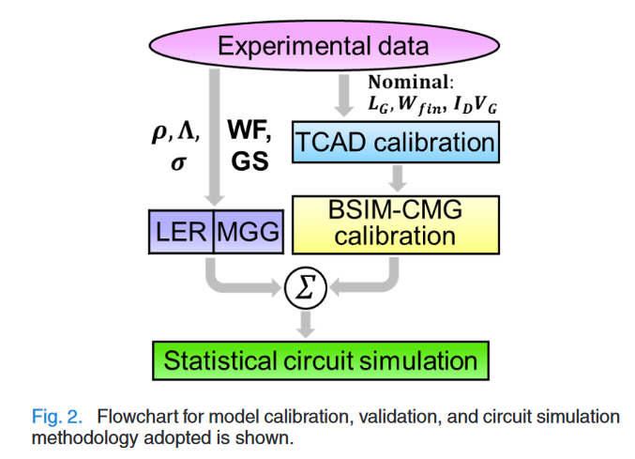
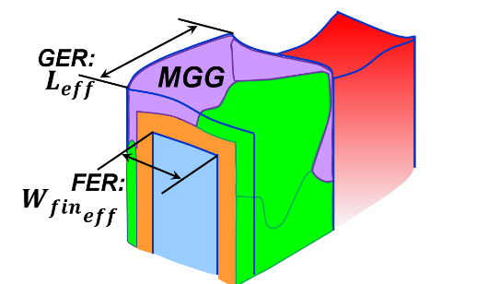
一、基于TCAD的DTCO方法
随着电路的缩放，加速了process-induced variability 的加剧，不期望的工艺上产生的变化会导致气质统计使器件间的变化从而产生电路级的变化。变化包括LEG、GER、RDD，如何将这些变化引入到紧凑模型中，并精确的反应电路的性能，是仿真的关键。

Slide 3
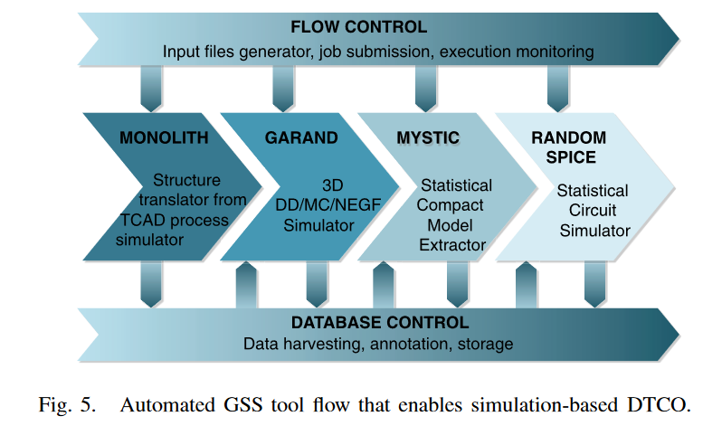
一、GSS tool flow

Slide 4
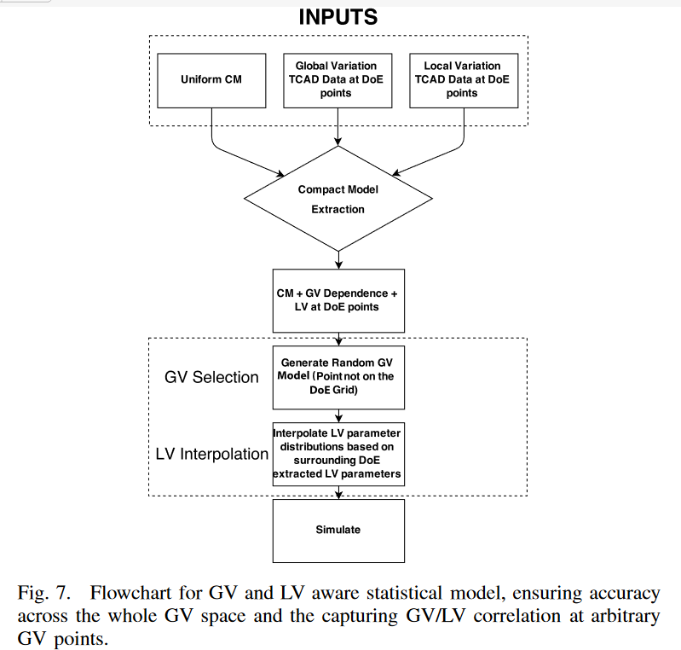
二、流程

Slide 5
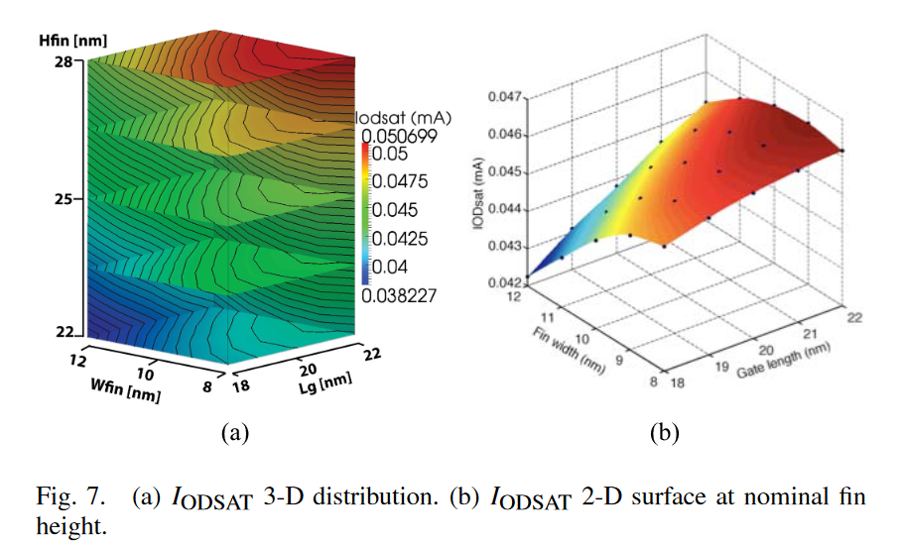
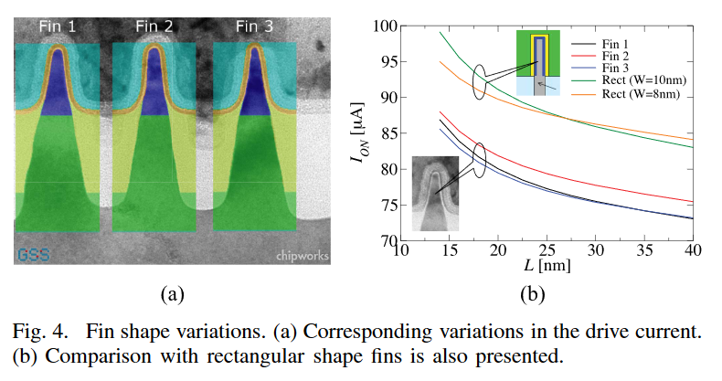
二、TCAD仿真

Slide 6
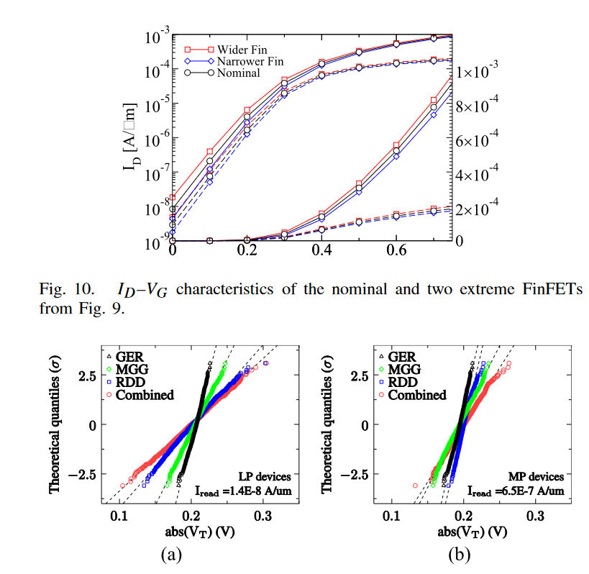
二、variations 仿真

Slide 7
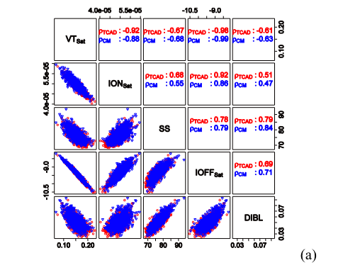
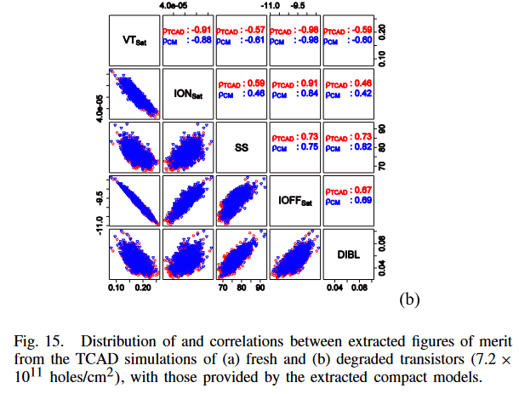
二、器件性能分析

Slide 8
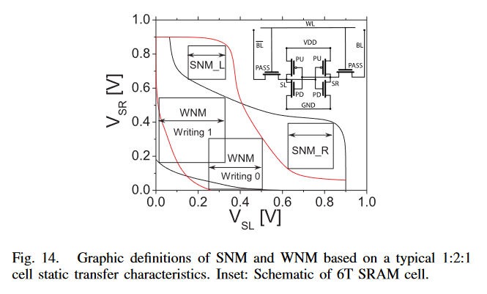
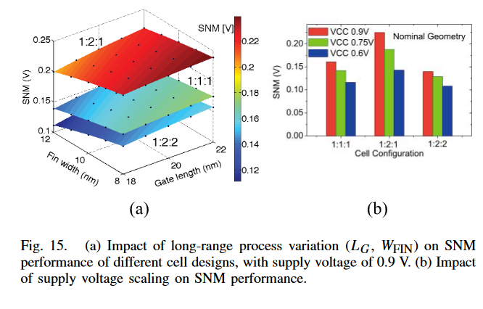
二、电路性能分析

Slide 9
参考文献
A. Asenov et al., "Variability Aware Simulation Based Design- Technology Cooptimization (DTCO) Flow in 14 nm FinFET/SRAM Cooptimization," in IEEE Transactions on Electron Devices, vol. 62, no. 6, pp. 1682-1690, June 2015, doi: 10.1109/TED.2014.2363117.
L. Gerrer et al., "Accurate Simulation of Transistor-Level Variability for the Purposes of TCAD-Based Device-Technology Cooptimization," in IEEE Transactions on Electron Devices, vol. 62, no. 6, pp. 1739-1745, June 2015, doi: 10.1109/TED.2015.2402440.
X. Wang et al., "FinFET Centric Variability-Aware Compact Model Extraction and Generation Technology Supporting DTCO," in IEEE Transactions on Electron Devices, vol. 62, no. 10, pp. 3139-3146, Oct. 2015, doi: 10.1109/TED.2015.2463073.
S. Patil, A. Rawat and U. Ganguly, "An Accurate Process-Induced Variability-Aware Compact Model-Based Circuit Performance Estimation for Design-Technology Co-Optimization," in IEEE Transactions on Electron Devices, vol. 69, no. 1, pp. 45-50, Jan. 2022, doi: 10.1109/TED.2021.3131966.

Slide 10

敬请批评指正！
地址：杭州市建设三路733号10号楼
网址：https://mne.zju.edu.cn/

