Slide 1

Software Trace Cache
汇报人：樊启元 汇报时间：2022/12/18

Slide 2

CONTENES
01
INTRODUCTION
02
RELATED WORK
THE STC ALGORITHM
03
SIMULATION SETUP
04
PERFORMANCE IMPACT
05
06
CONCLUSIONS

Slide 3
内存延迟
内存延迟
01
INTRODUCTION
memory latency
fetch width
branch prediction accuracy
Superscalar
processors

Slide 4
02
RELATED WORK
the layout of the basic blocks inside a routine
2) the splitting of a procedure into several different routines or traces
3) the layout of the resulting routines or traces in the address space
code layout
optimizations

Slide 5
RELATED WORK
Basic Block Chaining
Subroutine Splitting
Procedure Placement
1）greedy
Exec Threshold
Branch Threshold
2）the bottom-up algorithm
1）A coarse-grain splitting
2）A fine-grain splitting
1）map routines in popularity order
2）Conflict
Free Area (CFA)

Slide 6
03
THE STC ALGORITHM
Seed Selection
2) Trace Construction
3) Trace Mapping
Software
Trace Cache

Slide 7
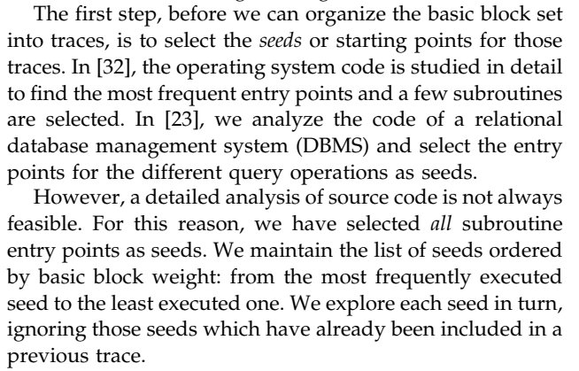
1. Seed Selection

Slide 8
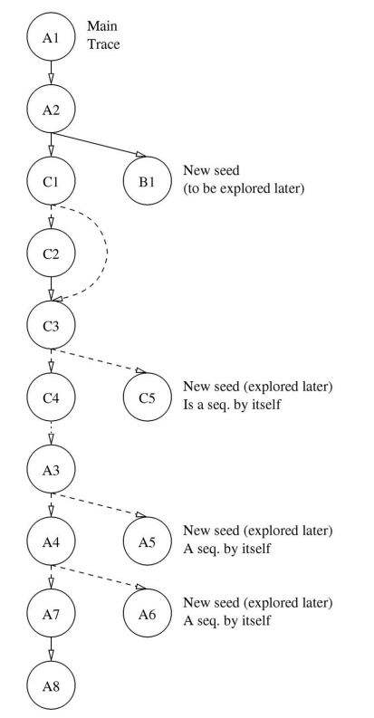
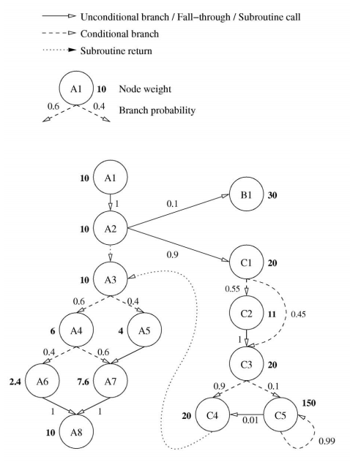
2. Trace Construction

Slide 9
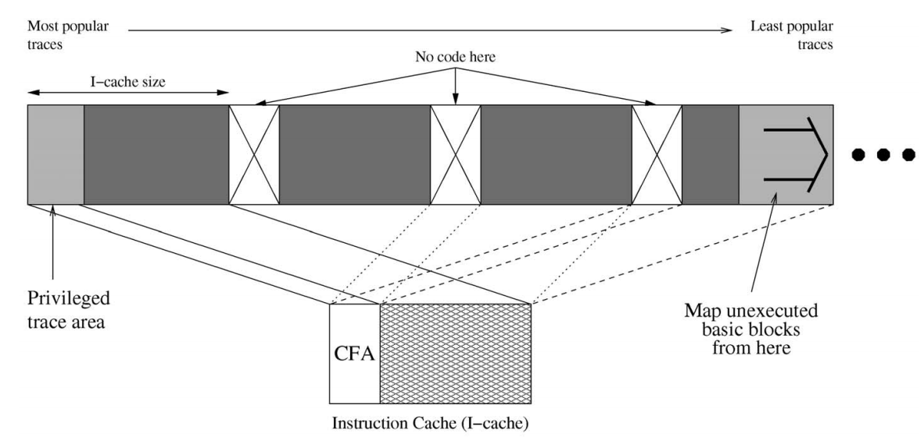
3. Trace Mapping

Slide 10
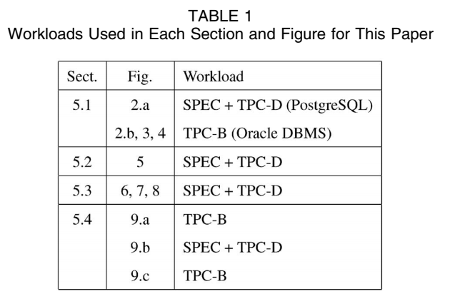
04
SIMULATION SETUP

Slide 11
05
PERFORMANCE IMPACT
Impact on the Instruction Cache
Impact on the Fetch Width
Impact on the Branch Predictor
Overall Performance Impact

Slide 12
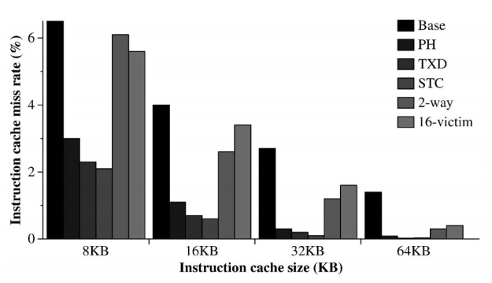
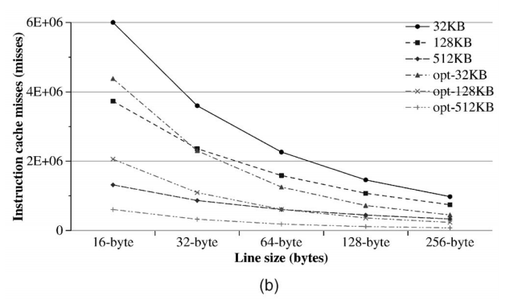
1. Impact on the Instruction Cache

Slide 13
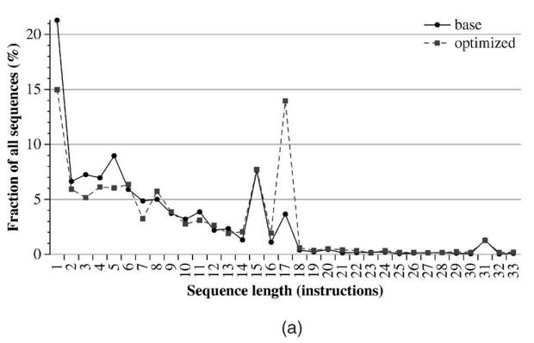
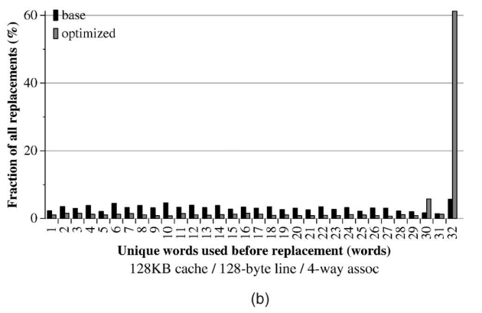
1.1 Spatial Locality

Slide 14
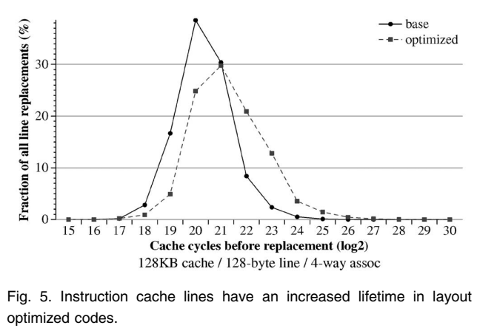
1.2 Temporal Locality

Slide 15
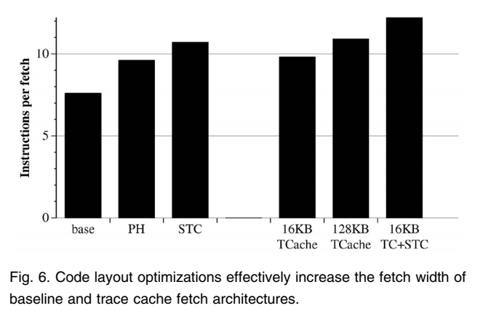
2. Impact on the Fetch Width

Slide 16
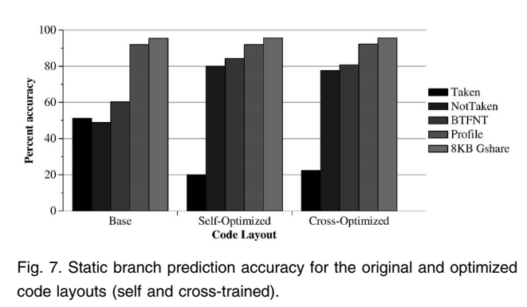
3. Impact on the Branch Predictor
Effect on Static Prediction

Slide 17
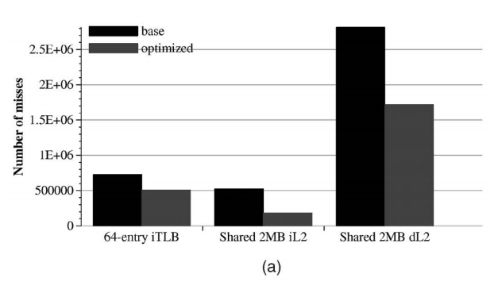
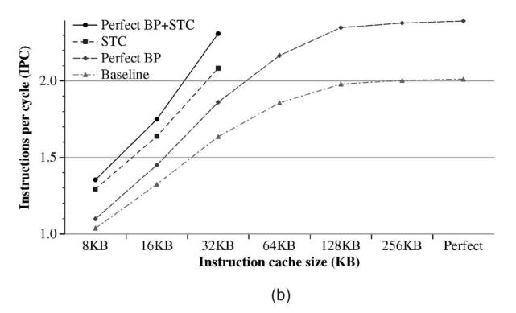
4. Overall Performance Impact

Slide 18
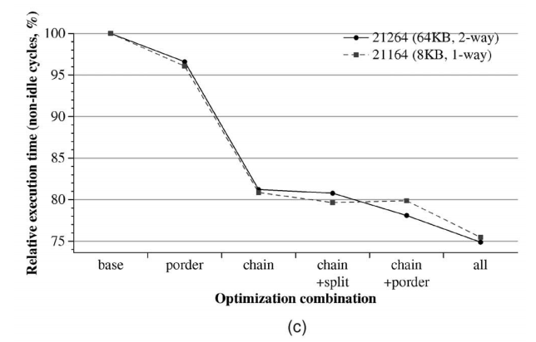
4. Overall Performance Impact

Slide 19
06
CONCLUSIONS
Our results show significant performance improvements by adapting the software to the characteristics of the underlying hardware.

Slide 20
Thanks!
汇报人：樊启元 汇报时间：2022/12/18

