Slide 1

Shine From Your Original Design
®
®
TEAMNAME TEAMNAME
01.23.2024
©2022 Parillume All rights reserved
Notes:
Set Up: Notebooks, Index Card, Pens, Chocolates, Buzzers, Lenses, Bag-o-Questions, MB Quiz
Put teams in Enneagram groups by alphabetical order
Welcome! Thank you!
One quirky hobby, passion, or behavior that the team doesn’t know about + bag-o-questions

Slide 2



Phase I:
The Foundation
Our proven, fully-integrated
people-development system
leverages your team’s unique
strengths, personalities, and perspectives
for superpowered growth.
The Shine From Your
Original Design Experience
®
Embrace Superpowers + recognize Kryptonite
GOAL
Superpowered
80% of the time
OWN
New hire assessment
and onboarding
Superpowered
Growth
Superpowered Growth
ACTIVATE
INTEGRATE
into hiring, onboarding and performance on your team
Harness Superpowers +
hack Kryptonite
Phase 3:
Cultural Integration
Phase 2:
People-Development
Customer Success
Team Workshop
©2022 Parillume All rights reserved
Notes:
Why are we here? Ultimately, so you and your team can be in your superpowers 80% of time, in alignment with annual and quarterly performance objectives for triple win.
What does superpowered growth look like for you now? Internally and externally?
What does superpowered growth look like for you?
4 ways this can go wrong
Leadership examples | Superpowers/Kryptonite
Individual mastery : SFOD sessions, “The One Sheet to Rule them All”: boxes as references for self, meetings, issues - example | Help the individuals that aren’t here – debrief
Inert Individuals/Weaponization: This is a growth tool – putting self or others in boxes = not what we’re here for | The PFP + Notebooks
Customize this work (Phase 2) – but the goal all the way through is that you have a common lens and language now to do this work yourself – today breakouts are for you to practice applying this on your team

Slide 3

®
Shine From Your Original Design
Activate Your Superpowers 2024
Customer Success
Team Workshop
©2023 Parillume All rights reserved
Notes:
Superpowers Tour - Activate Your Superpowers Worksheet
Fill out first box with your percentage from February
Eric - 70%
Tim - 50%
Lee - 50%
Tonya - 40-50%
Sam - 25%
First three boxes on column two of 2024 worksheet
Last quarter to this quarter %
PFPs & Impact - also review your team PFP chart from last year & include anything you worked on there

Slide 4
®
Shine From Your Original Design
Activate Your Superpowers 2024
85%
90%
Prepped workshops
in a more disciplined
way; documented our
3-phases workflow; increased automation
Instead of being anxious & stressed, I am more at peace & enjoying the increased workload & every workshop
Customer Success
Team Workshop
©2023 Parillume All rights reserved
Notes:
Superpowers Tour - Activate Your Superpowers Worksheet
Fill out first box with your percentage from February
Eric - 70%
Tim - 50%
Lee - 50%
Tonya - 40-50%
Sam - 25%
First three boxes on column two of 2024 worksheet
Last quarter to this quarter %
PFPs & Impact - also review your team PFP chart from last year & include anything you worked on there

Slide 5
©2016 Parillume All rights reserved
Myers-Briggs® is a registered trademark of Myers & Briggs Foundation in the United States and other countries.

Slide 6


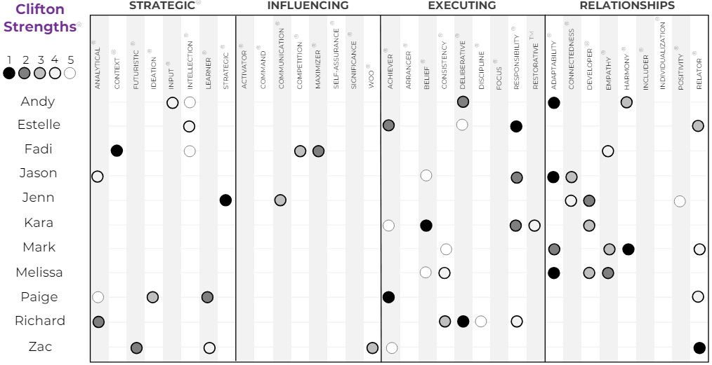
®
Shine From Your Original Design
Njevity Customer Success Team
Customer Success
Team Workshop
©2016 Parillume All rights reserved
This material contains trademarks of GALLUP®. The non-Gallup information you are receiving has not been approved and is not sanctioned or endorsed by Gallup in any way. Opinions, views and interpretations of CliftonStrengths® are solely the beliefs of Parillume.

Slide 7
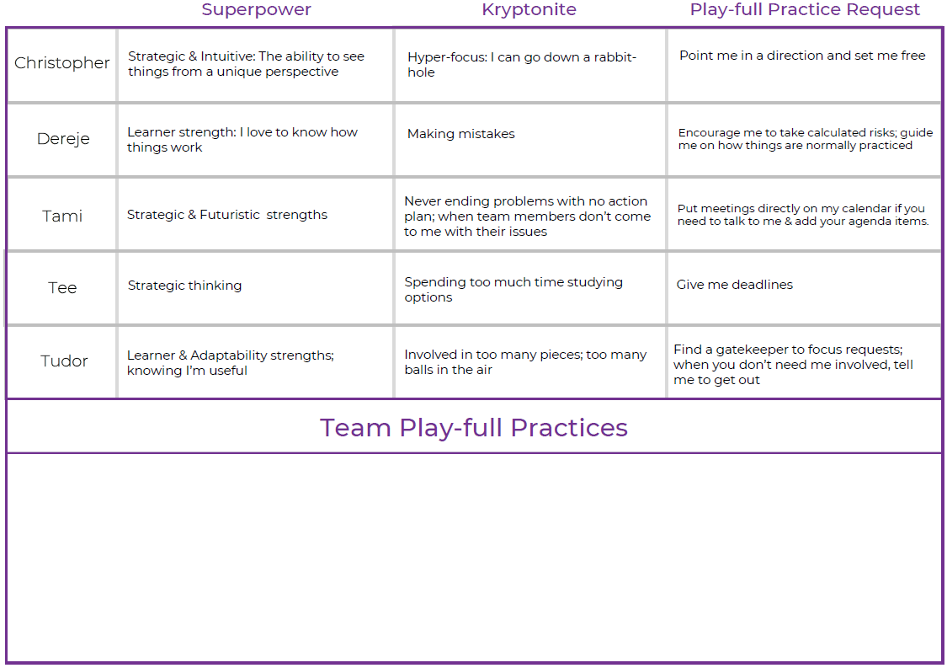
®
Shine From Your Original Design
Njevity Customer Success Team
Customer Success
Team Workshop
©2021 Parillume All rights reserved

Slide 8
Giving & Receiving Feedback
I give feedback so YOU can SHINE. I receive feedback so I can SHINE.
Know thyself Know the other person
Review the Enneagram kryptonite, hack, and communication styles
for yourself, and for the person you’ll be speaking with.
PREP
S
H
I
N
E
pecifics
Convey what happened – just the facts.
“I’ve noticed you’ve committed to three deadlines in the past several months but didn’t meet those deadlines and didn’t communicate that they would be missed.”
eart of the matter
Explain why this matters.
“I have my own deadlines to meet that require the information you are providing me. When I don’t hear from you, and I have no idea when I’ll get the data I need, my work and reputation suffer. I also find myself not trusting the deadlines you give me.”
nvitation to respond
Ask for their perspective.
“I know that’s not your intention, so I’m curious about what’s happening from your perspective and how we can collaborate better going forward.”
ext steps
Collaborate on a Play-full Practice.
“I’ll check my calendar before committing to a deadline and review my mantra ‘Under Promise & Over Deliver.’ If I know I can’t meet a deadline, I’ll communicate at least 48 hours ahead and recommit to a new deadline that I won’t miss.”
xpected outcome
Define measurable success.
“Going forward, we will get really clear with ourselves and each other about deadlines before we commit to them. I’ll explain to you ‘the why’ behind my deadline, and you will keep me up-to-date and provide alternatives if a deadline will be missed.”
Customer Success
Team Workshop
©2022 Parillume All rights reserved

Slide 9
Conflict to Collaboration Script
Initiator:
Once I’m in a zone of compassion and understanding for myself and the Listener, it is my opportunity/responsibility to communicate and “clean up” what happened:
Here is what happened from my perspective: Just the facts, without interpreting intent
Here is the story I made up about what happened: Take responsibility for your personal interpretation of the event(s)
Here is the impact on me based on the above, my superpowers, and my kryptonite: Explain why it was painful, challenging, etc.
Listener:
Your goal is to “get it” – all of it – and then create a new possibility with the Initiator.
What I heard you say was: Repeat back as closely as possibly what they said happened, the story that was created and the impact on them.
Did I get it? Only when the listener “gets it” will the initiator begin to relax.
Repeat the above until the answer to "Did I get it?" is "Yes."
Is there anything else? Be sure the Initiator gets everything off their chest along with any specific request they have for the future.
( If appropriate, Switch Roles )
Collaborate on a Solution:
Create a new intention or goal together and then activate superpowers and hack kryptonite to fulfill it!
Customer Success
Team Workshop
(c) 2022 Parillume All rights reserved
Notes:
Teach through the script with a concrete example - Renee performance conversation with Amy - Renee /Lisa script & solution “Is it pretty?”
Ground rules: No one is “wrong” & we seek to understand before being understood; no interrupting initiator of conversation. They need to be heard.
Being seen, heard & valued enough to be understood disappears complaints
Recreating Communication is in the script.
CONFLICT TO COLLABORATION EXERCISE
Bring one-sheets
No names & no judgment - own your experience
Purpose is to work through a real challenge
Decide who will be the Initiator first
Create a goal: Get clear on what would solve this for you with your partner. Create a PFP around this.
If, for some reason, the issue actually involves the 2 of you, create a common intention and activate superpowers to achieve it. This becomes your PFP together.
VOLUNTEERS TO COACH THROUGH
Who has more than one challenge you could workshop in this exercise?
Who wants to get extra practice on Active Listening?
I’m going to facilitate, so I will interrupt you so I can teach
Move throughout hotel
What if this feels too vulnerable? Emotional? Just follow the script. Do it anyway
DEBRIEF: What did you take away? What was easy? Hard? Where did it feel awkward?
Write out your PFP.

Slide 10
The Two Sides of Growth
Proactive Growth
Empowerment:
I can change the world.
Harnessing Superpowers
External Change
What is one way that I want
to proactively grow?
What Superpowers will I use
to reach my growth goal?
How will the world look different
due to my proactive growth?
Enneagram 3 Leadership: Weekly meetings with the team. Breaking the project down and tracking our progress each week. Being accountable to each other.
ENFJ Time Blocking: Cleared Monday & Tuesday for creative work & our team meeting.
Our 3-phase people-development system will be complete. We will have greater capacity to scale. Our brand will move forward. Our clients will have access to all of our tools and resources and how to use them, so they can continue integrating this work into their cultures by themselves.
My team and I create Parillume’s Phase 3 Dashboard for leaders, and I sell into it by Q4 2023 - instead of just talking about it like I did in 2022.
Customer Success
Team Workshop
©2022 Parillume All rights reserved
Notes:
The Two Sides of Growth - Slides
This is to teach you to evolve your understanding of your superpowers & kryptonite in a conscious way for more superpowered growth.
Walk through the worksheet as it relates to their leadership
Use my example
Have people keep their one-sheets in front of them
And fill out the page based on what they wrote on the index cards
Get examples from the group from both columns
Breakout Exercise
Share your answers with one another
See if there is any way you can support one another or come up with cross-functional PFPs
Debrief
Have each group share their takeaways and how they are going to support one another
Ask what they need from leadership

Slide 11
The Two Sides of Growth
Responsive Growth
Disempowerment:
The world changes me.
Hacking Kryptonite
Internal Change
What challenge am I currently facing?
What is my Kryptonite?
How will I hack my Kryptonite
with my Superpowers?
How will I be different
due to my responsive growth?
First drafts. Lack of time for creative flow. Insecurity & fear. Explaining my process in writing.
I am 100% responsible for writing and producing 18 videos, plus the lesson content to go along with each video. I am immobilized by the amount of work to do in the midst of a full client load. I have also put this work off until Q3.
I will be more confident in my ability to do hard things and crack the code on video projects. I will develop more discipline and understand how I can approach creative projects in the future.
Teleprompter approach. Hired professional videographers so couldn’t move the shoot dates. Time blocked 3 weeks in August. Used AI and collaborated closely with team member in script drafts.
Customer Success
Team Workshop
©2022 Parillume All rights reserved
Notes:
The Two Sides of Growth - Slides
This is to teach you to evolve your understanding of your superpowers & kryptonite in a conscious way for more superpowered growth.
Walk through the worksheet as it relates to their leadership
Use my example
Have people keep their one-sheets in front of them
And fill out the page based on what they wrote on the index cards
Get examples from the group from both columns
Breakout Exercise
Share your answers with one another
See if there is any way you can support one another or come up with cross-functional PFPs
Debrief
Have each group share their takeaways and how they are going to support one another
Ask what they need from leadership

Slide 12
®
Shine From Your Original Design
Activate Your Superpowers 2024
90%
Prepped workshops
in a more disciplined
way; documented our 3-phases workflow; increased automation
Instead of being anxious & stressed, I am more at peace & enjoying the increased workload & every workshop
Work with my accountant to level-up my understanding of business finance.
Customer Success
Team Workshop
©2023 Parillume All rights reserved
Notes:
Closing
Review the day & PFPs | Takeaways
Where do you go from here? How will you apply this?
How will you remember PFPs?
Where do you keep them?
How will you measure your growth as a leader?
Write your PFP on the bottom of your Activate Your Superpowers worksheet. We’ll review this together at our next workshop.

Slide 13
Parillume.com | lisa@parillume.com | 720.481.8505
©2022 Parillume All rights reserved
Notes:
Bag-o-questions + biggest takeaway or PFP

